Slide 1
4th SG13 Regional Workshop for Africa on “Future Networks for a better Africa: IMT-2020, Trust, Cloud Computing and Big Data” (Accra, Ghana, 14-15 March 2016)
IMT Vision Towards 2020 and Beyond Nicholas Muzhuzha Manager Networks & Standards
Postal & Telecommunications Regulatory Authority of Zimbabwe (POTRAZ)
Email: nick@potraz.gov.zw

Slide 2
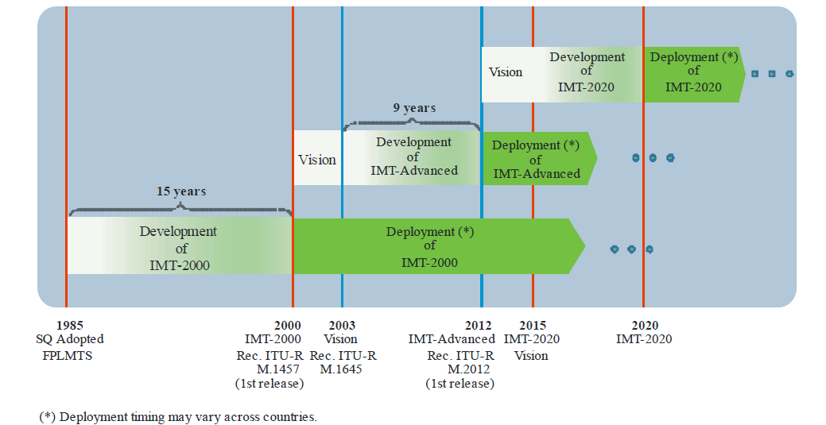
Overview of timeline for IMT development and deployment

Slide 3
Role of IMT for 2020 and beyond
Wireless infrastructure to connect the world
New ICT market
Bridging the Digital Divide
New ways of communication
New forms of education
Promote Energy Efficiency
Social changes
New art and culture

Slide 4
Usage scenarios for IMT for 2020 and beyond
Enhanced Mobile Broadband
Ultra-reliable and low latency communications
Massive machine type communications
Flexibility to adapt to new use cases with a wide range of requirements

Slide 5
Capabilities of IMT-2020
Peak data rate
Mobility
Connection density
Energy efficiency
Spectrum efficiency
Area traffic capacity

Slide 6
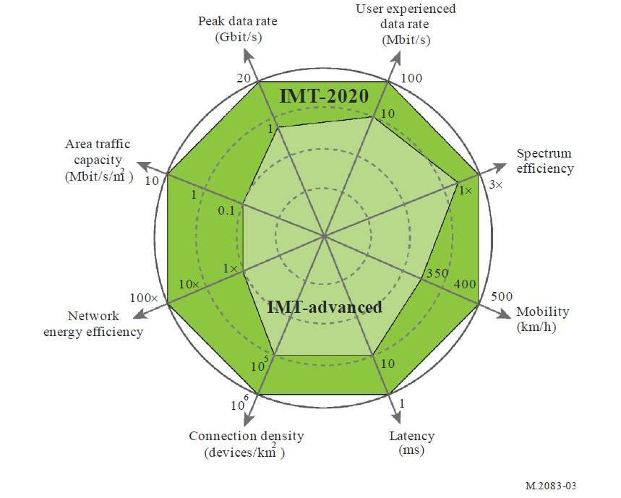
Enhancement of key capabilities from IMT-Advanced to IMT-2020

Slide 7
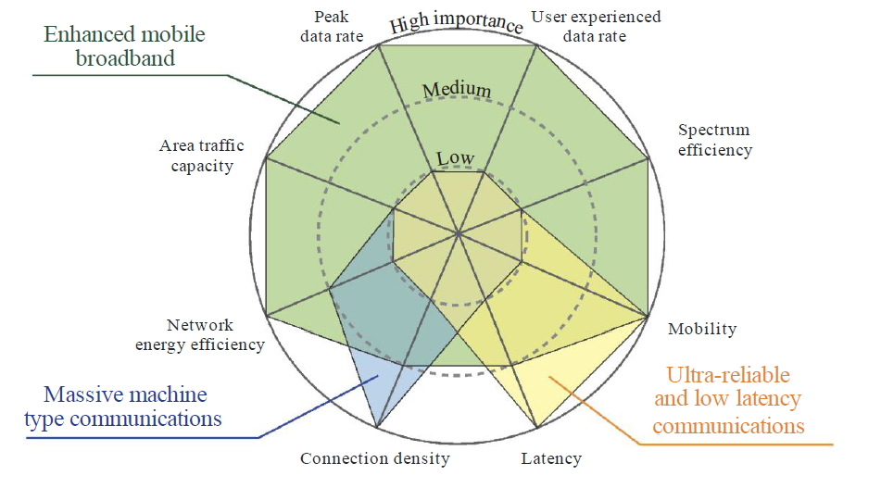
The importance of key capabilities in different usage scenarios

Slide 8
Other capabilities for IMT-2020
Spectrum and bandwidth flexibility
Reliability
Resilience
Security and privacy
Operational lifetime

Slide 10
Bibliography
Recommendation ITU-R M.2083-0: IMT Vision – Framework and overall objectives of the future development of IMT for 2020 and beyond
IMT Vision towards 2020 and Beyond IMT-2020（5G）Promotion Group February 2014

