Slide 1
4th SG13 Regional Workshop for Africa on
“Future Networks for a better Africa: IMT-2020, Trust, Cloud Computing and Big Data”
(Accra, Ghana, 14-15 March 2016)
Paving the Way to 5G
Ali Amer
Senior Expert/Consultant
Saudi Telecom Company
Email=aliamer@stc.com.sa

Slide 2
Overview
Global Mobile Market Overview
5G Drivers & Use cases
5G Expectations
5G Spectrum
5G standardization Activities
Conclusion & Takeaways
2

Slide 3



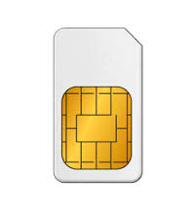

Global Mobile Market Growth
2014
Mobile Operator Revenues
Overview
Overview
3.6bn
4%
CAGR
2020
2014-2020
2014
59%
50%
$1.4tn
2020
CAGR
3.1%
2020
4.6bn
$1.15tn
2014
Penetration Rate
2014
2014-2020
3G/4G Connections
Data Traffic Growth
10 Times(2014-2020)
7.3bn
39%
5.4%
CAGR
2014
3G
4G
2020
69%
2020
5.9
bn
10bn
2.6
bn
SIM Connections
Smart Phone
3

Slide 4

Global Mobile Economy
Mobile Industry Contribution to GDP
Mobile ecosystem contribution
in the Public Funding
$465bn
US $3.9 tn
4.2% of GDP
2020
2020
$411bn
3.8% of GDP
2014
2014
US $3 tn
Jobs Directly Supported by Mobile Ecosystem
2020
+11.8M
Indirect Jobs
in 2014
15M JOBS
2014
13M JOBS
4

Slide 5
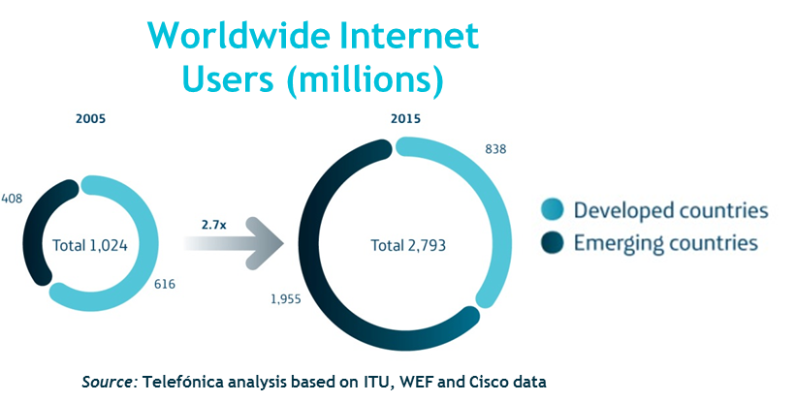
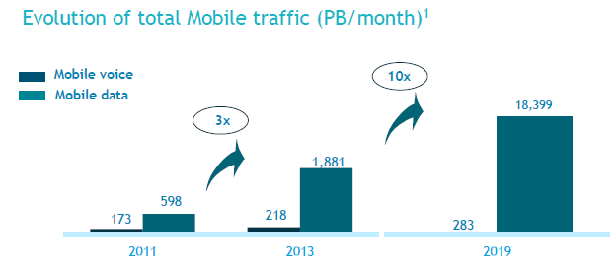
Mobile Traffic Growth
Rise of emerging markets (North vs. South)
A growing data-centric business
2013
2019E
600 MB
2,2 GB
Traffic per customer
Source: CISCO & GSMA Intelligence
Source: Ericsson mobility report Nov.2013
5
Notes:
3/11/20162011-10-19
5
Challenges: Fundamental difficulties that should be addressed

Slide 6
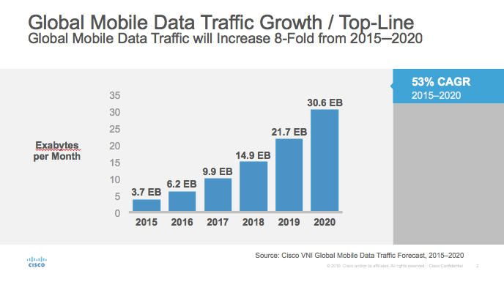
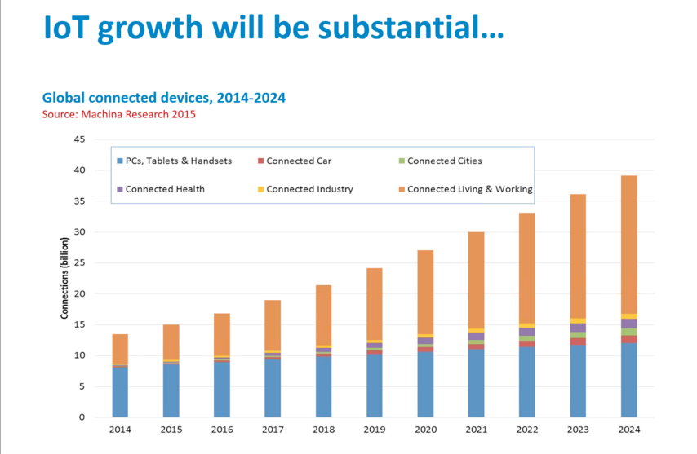
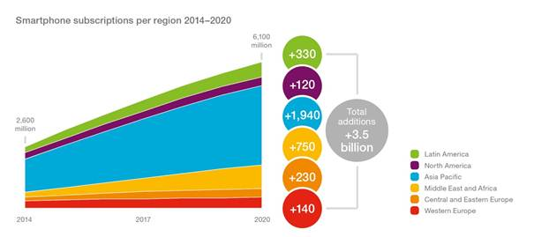
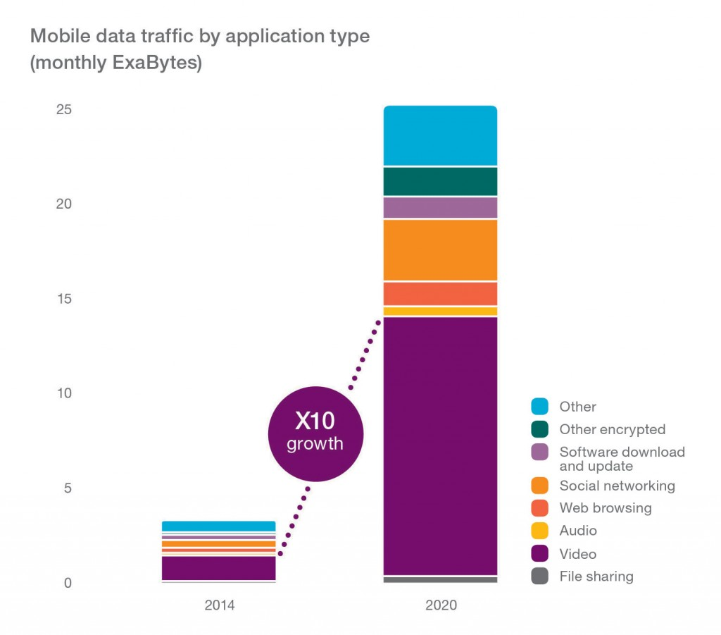
Global Data Traffic Growth
6

Slide 7
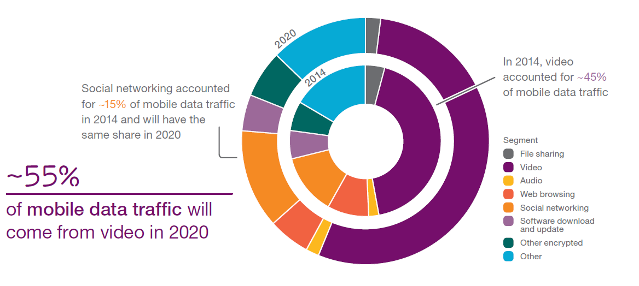
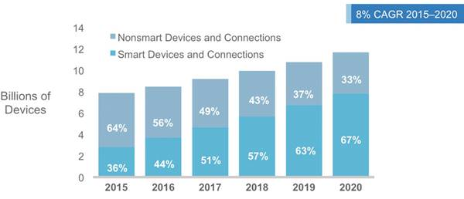
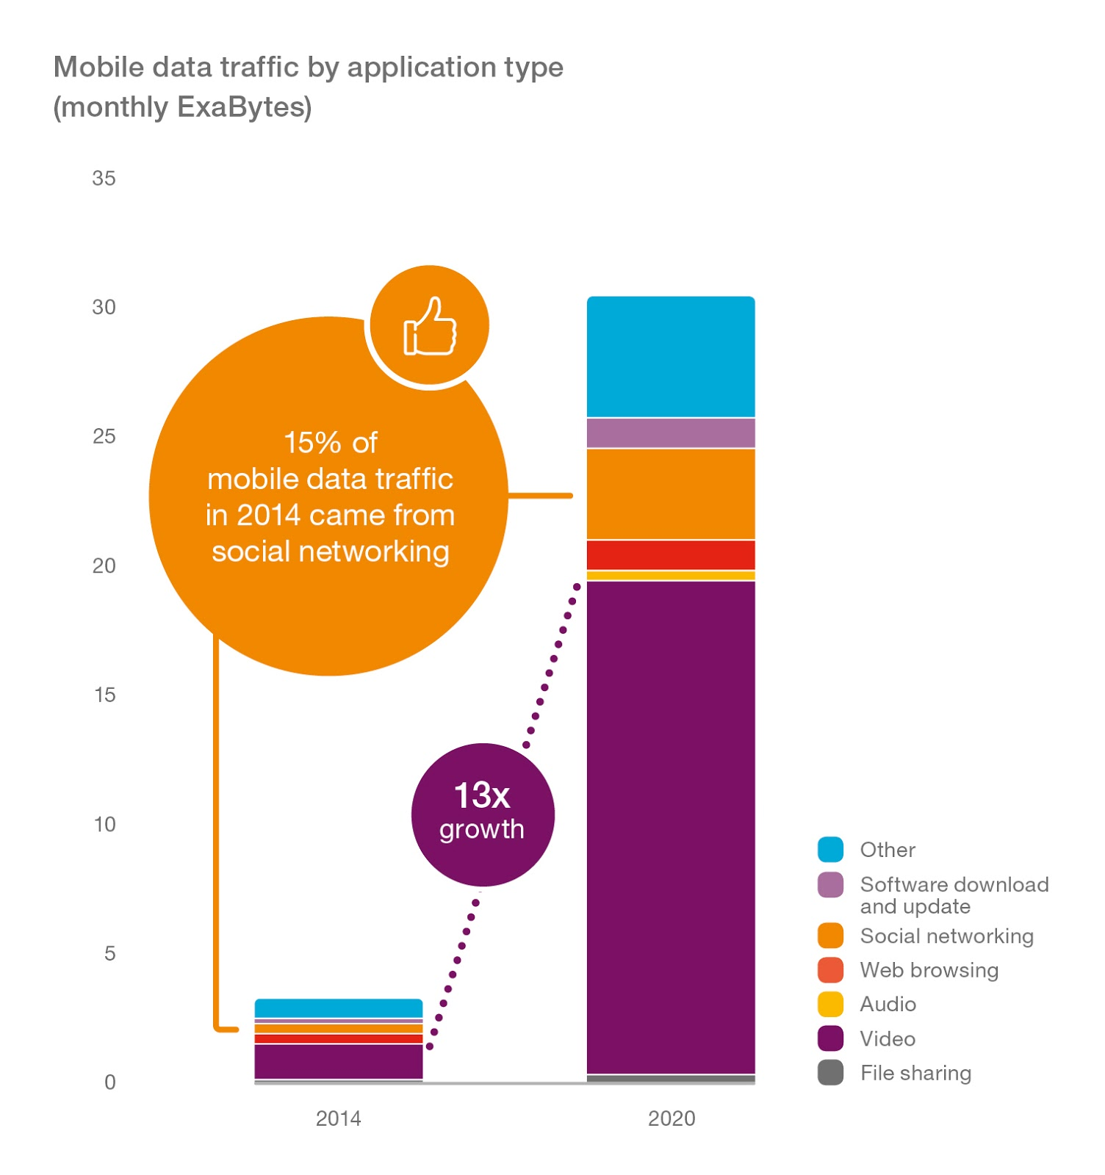
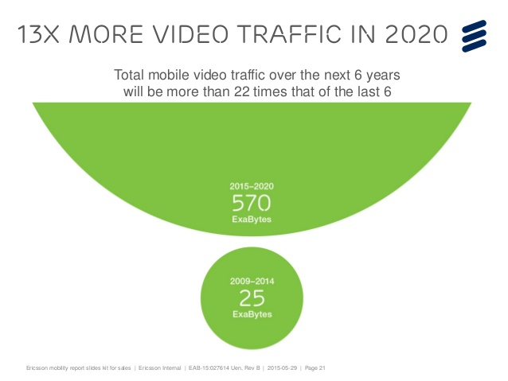
Driving factors for the Data Growth
7

Slide 8
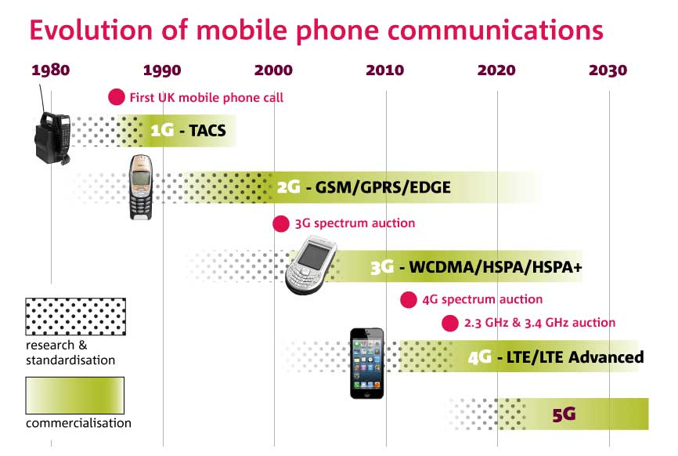
Mobile Networks Evolution- up to 5G
Yesterday
Now
Future
LTE
LTE-A
IMT2020
WCDMA
HSPA
HSPA+
GSM/EDGE
2G
3G
4G
5G
8

Slide 9
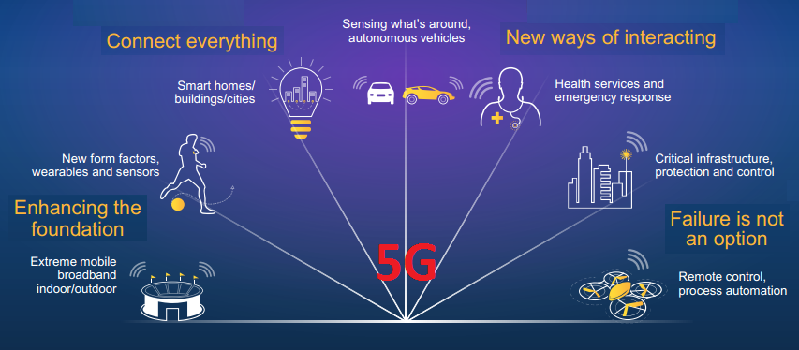

5G is an end-to-end ecosystem to enable a fully mobile and connected society
1000x
10x-100x
5x
Mobile Data
Volumes
Connected Devices
Lower Latency
10x-100x
End-user Data Rates
10x
3G
4G
5G
2G
Battery Life for Low Power Devices
Source: METIS
9

Slide 10
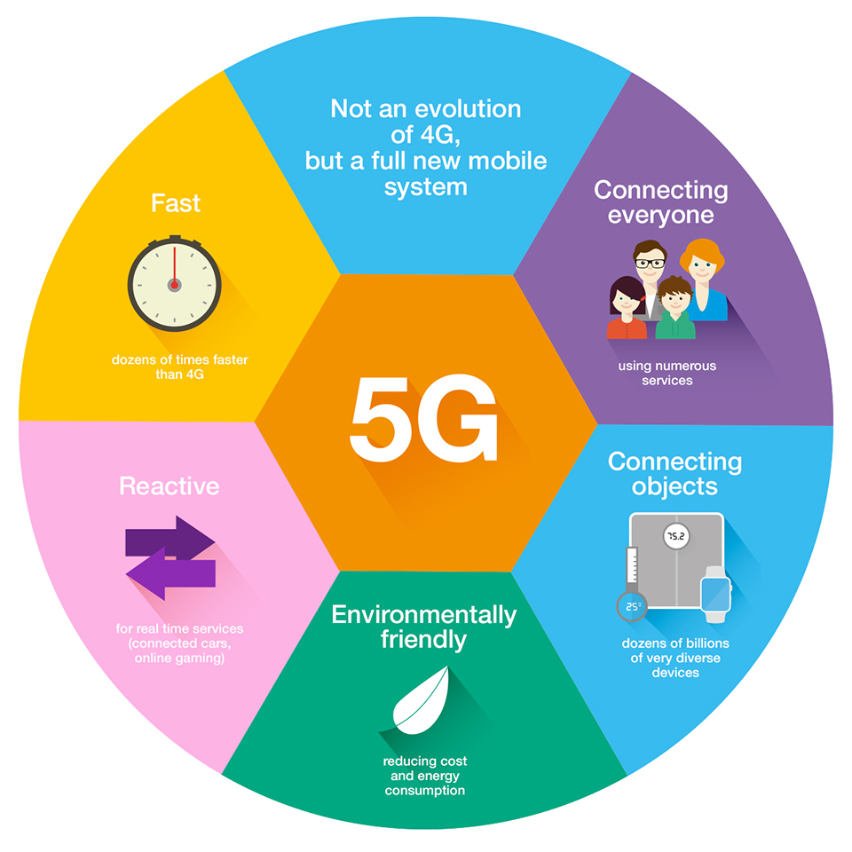
Expectations from 5G Networks
Flexibility
Robustness
Open
Scalable
Mobile
Secure
Programmable
Reliable
Agile
Standardized
Sustainable
10

Slide 11
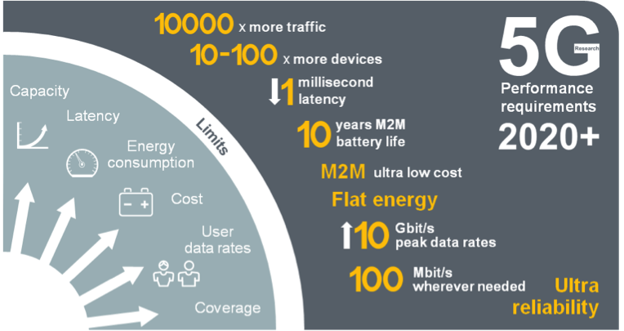
5G Mobile Network Expected Performance
Multi domain
performance
  Energy Performance
  Critical machine type
  of communications
  Global
  standard
11

Slide 12
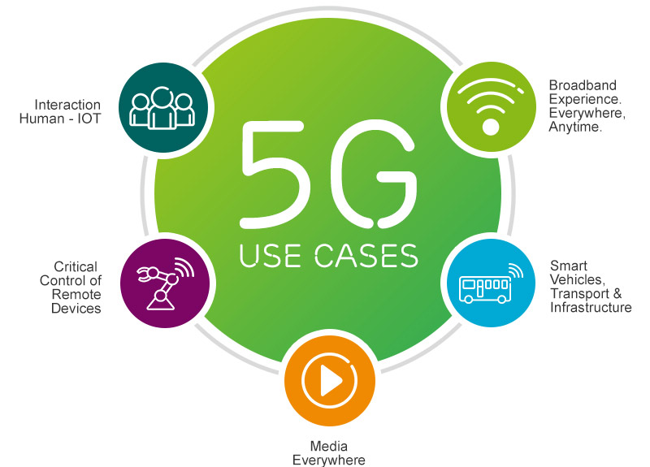

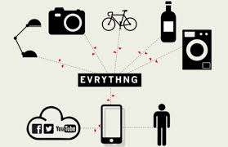
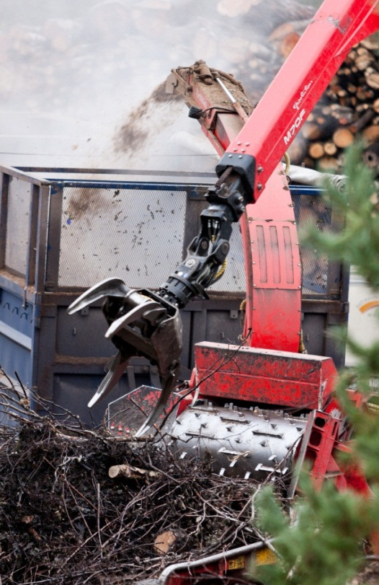


5G Top Use Cases
Broadband experience
everywhere anytime
Massive Machine
Type Communication
Critical Machine
Type Communication
Mass market
personalized TV

Slide 13
Spectrum remains a Challenge for 5G and for Wireless Industry
12

Slide 14
Three key frequency ranges are currently worthy of consideration for different 5G deployment scenarios
Sub-1 GHz
1-6 GHz
Above 6 GHz
Ideal coverage band could provide a very useful means of extending a superior 5G user experience into rural areas and deep inside buildings.
Could not support extremely wide bandwidths and therefore enable the fastest possible data rates
But Help prevent a new digital divide by ensuring the improved experience.
Reaches more people in both developed, and especially developing, markets.
There are numerous existing mobile bands between 1 GHz-2.6 GHz, and when 5G technology is ready to deploy there may be others between 2.6 GHz and 4 GHz.
Although these bands offer a reasonable mixture of coverage and capacity they are unlikely to be able to support the highest potential 5G data rates without carrier aggregation.
This spectrum could support very wide channel sizes and therefore extremely fast data rates, and massive additional mobile network capacity, making it fertile territory for 5G research.
However, heavy reliance on these bands without complimentary lower frequency spectrum may mean 5G services are limited to small urban areas and inside buildings as its radio propagation qualities would favor small cell sizes.
13

Slide 15
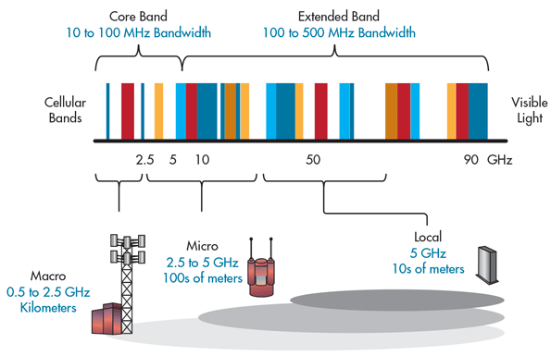
5G Bands and its impact on Cell size
14

Slide 16




Standardization activity is going on for a global 5G standard
CHINA
NGMN
ITU-R
3GPP
NORTH AMERICA
863, 5G promotion group
EUROPE
JAPAN
Europe
METIS
Horizon2020/5GPPP
ARIB, Testbed activities
4G Americas
University Research
KOREA
5G Forum, Govt push
15

Slide 17

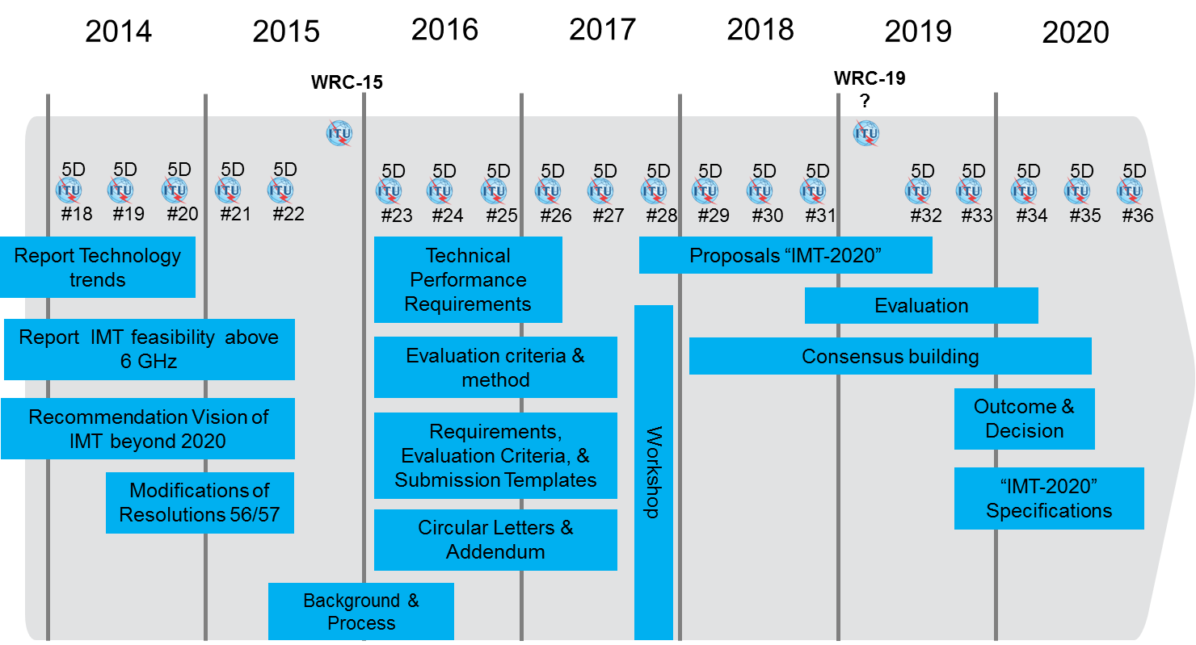
Several Global Initiatives from SDOs, Academia, Industry, and R&Ds working on 5G standardization
Exploratory research
Pre-standardization activities
Standardization activities
Commercialization
2012
2013
2014
2015
2016
2017
2018
2019
2020
WRC’12
WRC’15
WRC’18/19
15

Slide 18
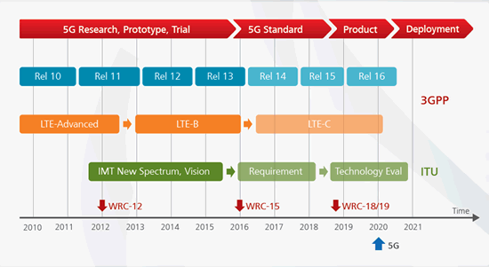
Standardization of 5G Time line (ITU & 3GPP)
16

Slide 19
Others working Groups Timeline and their Plans
for 5G Standardization Development
17

Slide 20
Conclusion & Takeaways
5G race is still going on, Commercial deployment of 5G systems is expected in years 2020+, Field trials planned from year 2018 onwards, not yet based on commercial products.
5G will provide at least a ten-fold improvement in user experience compared to 4G in terms of peak data rates and minimal latency
5G will deliver an ecosystem for sustainable technical and business innovation
5G will support multi tenancy and network resource slicing models, New architectures will be used (using Likely many of the generalized concepts –SDR, CR, SDN, NFV, … )
5G will be designed to be a sustainable and scalable technology
5G spectrum and Bands not yet finalized
18

Slide 21
Thank you
19

