Slide 1
4th SG13 Regional Workshop for Africa on “Future Networks for a better Africa: IMT-2020, Trust, Cloud Computing and Big Data” (Accra, Ghana, 14-15 March 2016)
Importance of Standardization
for the African Countries
Dr. Rim Belhassine-Cherif Products and Services Executive Director, Tunisie Telecom
SG13 Vice-chair & SG13 RG-AFR Vice-chair
Rim.belhassine-cherif@tunisietelecom.tn

Slide 2
Importance of Standards for the African
Countries
2. Importance of SG13’s Standardization Topics
PLAN
3. Involvement of African Countries in SG13
Activities
4. Conclusion & Recommendations

Slide 3
Importance of Standards for the African
Countries
2. Importance of SG13’s Standardization Topics
PLAN
3. Involvement of African Countries in SG13
Activities
4. Conclusion & Recommendations

Slide 4
Imagine a World without standards?
Manufacturers would be obliged to invent their own individual solutions to even the simplest needs
Customers would be restricted to one manufacturer or supplier
Products may not work as expected and may have inferior quality
Products may be incompatible with each others and may not even interconnect
Non-standardized products may be dangerous
Source: http://www.etsi.org
Standards are essential in all aspects of our daily life including ICT

Slide 5
Standards Advantages for Governments
1
Complement regulation and promote international trade
Reduce technical barriers to international trade and position the country’s industry to compete in the world economy
Regulate and monitor industry so as to prevent adverse business practices
Offer an alternative to regulation with less red tape and business costs, while still ensuring that products and services are safe and healthy
Help developing countries in building their infrastructure and encouraging economic development
Help make laws consistent
Reduce negative impacts on the environment
Encourage technology transfer from technology leaders to developing nations
Source: www.sabs.co.za

Slide 6
Standards Advantages for Business
2
Save costs by optimising operations and therefore improve the bottom line
Inspire added trust in companies business
Assist business to meet mandatory regulations
Improve quality and reliability
➔ enhance customer satisfaction and increase sales
Create a competitive advantage by improving the quality of products and services
Help access to new markets by preventing trade barriers and opening up global markets
Increase market share by increasing productivity and competitive advantage
Improve internal risk management and planning
Source: www.iso.org

Slide 7
Standards Advantages for Consumers
3
Ensure the protection of consumers from hazards to their health and safety
Promote and protect economic interests of consumers
Guarantee an easier access to and greater choice in products and services
Ensure improved quality and reliability
Ensure better operation and compatibility between products and services
Enhance purchasing power
Source: www.sabs.co.za

Slide 8
Standards Advantages for Innovation
4
Create a common framework for innovation that encourages the sharing of knowledge (by defining common vocabularies, establishing essential characteristics of a product or service, …)
Provide a framework for moving from the development bench into production
Minimize duplication during R&D
➔ increasing efficiency
Source: www.bsigroup.com
Maximize the ability of a product to be used in conjunction with others
Reduce unnecessary variance
With all these advantages, standards have the potential to facilitate the adoption of new ICT technologies and make countries worldwide benefit from their related opportunities

Slide 9
Importance of Standards for the African
Countries
2. Importance of SG13’s Standardization Topics
PLAN
3. Involvement of African Countries in SG13
Activities
4. Conclusion & Recommendations

Slide 10
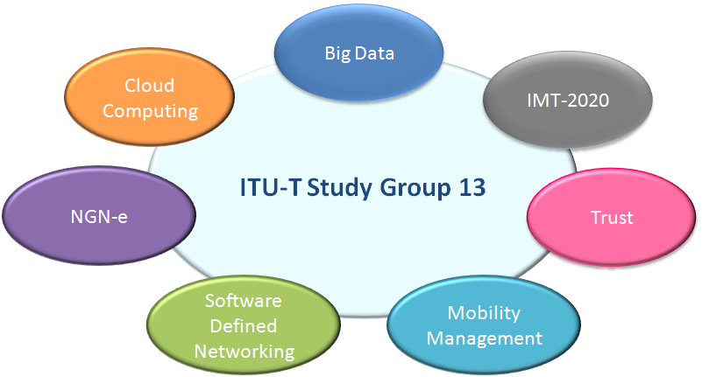
Main Standardization Topics Of ITU-T Study Group 13
Rich scope of standardization activities related to several new technologies and concepts, offering great opportunities at technical, economic and social levels

Slide 11
Opportunities of SG13 Topics for the African Countries: IMT-2020
1
Improved access to broadband services
Lower battery power consumption
Better coverage and higher data rates at the edge of cell
Source: Challenges & Evolution of Next Generation
in Mobile Communication Network, IJARCSSE, September 2014
Increased download and upload speeds providing users with enhanced experience and enabling advanced applications
Better security
Cheaper fees due to lower costs of deployment infrastructure
Better QoS
Higher system spectral efficiency
Better revenue for the service providers

Slide 12
Opportunities of SG13 Topics for the African Countries: Cloud Computing
2
GDP growth through the reduction in traditional ICT costs
Contribution to national economic growth
New jobs’ Creation
Development of beneficial applications in the fields of health care, education, agriculture, etc.
Reducing the digital divide
Enhancement of human resources qualifications and skills
Disaster Recovery
Increasing security via cloud storage
Enabling the export of knowledge and the attract ion of foreign investments
Respect of Environment

Slide 13
Opportunities of SG13 Topics for the African Countries: Big Data
3
Business Opportunities
Development Opportunities
Improve customer experience & efficiency of company's marketing activity
Meet pressing public policy objectives and save lives (for example by tracking earthquake victims, tracing flu epidemic, checking the pattern of diseases, etc.)
Smartly manage data for better quality of life and sustainability via smart services and cities, allowing pollution reduction + urban planning improvement + efficiency and agility increase of utility infrastructures (electricity grid, sanitation, transportation, …)
Improve company’s operational efficiency
Develop company’s Business Model
Provide improved services and enhanced convenience in daily life through targeted advertising, location information, better and informed decisions
Source 1: Impact et Applications du Big Data en Entreprise, Data-Business.fr, October 2014
Source2 : ITU Telecom Worlds 2013 Outcomes Report, November 2013

Slide 14
It will be advantageous for African Countries to get more involved in the standardization activities of SG13. This will allow them to better understand the new ICT technologies, reflect their priorities related to the studied topics and then facilitate and accelerate the adoption of these technologies
How are African countries currently contributing to SG13’s activities
What initiatives were taken in order to promote SG13’s activities in Africa and encourage active participation to the SG13’s work

Slide 15
Importance of Standards for the African
Countries
2. Importance of SG13’s Standardization Topics
PLAN
3. Involvement of African Countries in SG13
Activities
4. Conclusion & Recommendations

Slide 16
African Representatives in SG13 Study Period 2013-2016
3 Vice-chairman
Mr. Simon Bugaba, UCC, Uganda
Mr. Ahmed Raghy, NTRA, Egypt
Dr. RimBelhassine-Cherif, Tunisie Telecom, Tunisia
2 Rapporteurs
Mr. Brice Murara, RURA, Rwanda (Question 4/13)
Mr. Simon Bugaba, UCC, Uganda (Question 5/13)

Slide 17
African Participation to SG13 Meetings
Acceptable number of African participants to the last meetings of SG13
Important African participation to the meeting of November 2013 which was held in Uganda
SG13 Meetings | Nb. of Contributions | Nb. Of Participants
November 2015 | 6 | 19
April 2015 | 7 | 17
July 2014 | 5 | 24
November 2013 | 1 | 34
➔ Successful initiative to encourage African participation to SG13 activities
Growth in the number of contributions but this number is still insufficient
➔ Necessity to increase the number of contributions from Africa to the upcoming SG13 meetings: Objective of the training session planned for 17/03/2016

Slide 18
SG13 Regional Workshops for Africa
 | Theme | Place | Date | Host
1 | Standardization on IMT, M2M, IoT, Cloud Computing and SDN | Algiers, Algeria | 8 September 2013 | ARPT
2 | Future Networks: Cloud Computing, Energy Saving, Security & Virtualization | Tunis, Tunisia | 28 April 2014 | Tunisie Telecom
3 | ITU-T Standardization Challenges for Developing Countries Working for a Connected Africa | Livingstone, Zambia | 23-24 February 2015 | ZICTA
4 | Future Networks for a better Africa: IMT-2020, Trust, Cloud Computing and Big Data | Accra, Republic of Ghana | 14-15 March 2016 | NCA

Slide 19
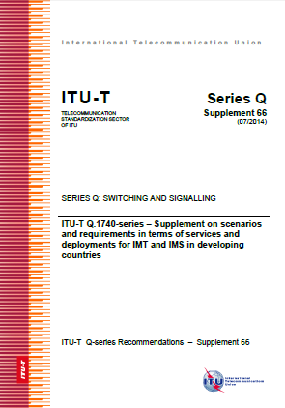
Elaboration of Reference Documents
1
ITU-T Q Suppl. 66 : ITU-T Q.1740-series - Supplement on scenarios and requirements in terms of services and deployments for IMT and IMS in developing countries
Date of approval: 2014-07-18
Base Text’s source: Q5/13 Rapporteur
Scope: Providing advisory information, especially to developing countries, on the requirements for migration to IMT and IMS, challenges to migration and some scenarios of migration to IMT and IMS drawn from feedback from developing countries

Slide 20
Elaboration of Reference Documents
2
Supplement/Handbook/guide on “Scenarios and Requirements in Terms of Services and Deployments for Cloud Computing in Developing Countries”
Base Text’s source: Tunisie Telecom, UCC & ZICTA
Scope:
present the situation of Cloud Computing adoption in the developing countries, the encountered obstacles and the best practices for Cloud Computing
highlight the current scenarios and the requirements of developing countries in terms of Cloud Computing services and deployments
Current Status: elaboration of 2 questionnaires (for CSP and CSC) for data collection – to be circulated in Q2/Q3 2016

Slide 21
SG13 Regional Group For Africa Objective and Mandate
1
Objective: Encourage national authorities and operators from countries in Africa to work together and better contribute to ITU-T SG 13 activities in general and to Cloud Computing in particular in line with SG 13 mandate
Main Tasks:
Encourage African countries to contribute to the development of new/revised ITU-T Recommendations on cloud computing and future networks
Encourage active participation of African administrations, regulators and operators in the work of ITU-T SG 13
Reflect the relevant priorities of the continent as per ITU-T SG 13 mandate
Encourage participation of African countries in workshops, Rapporteur meetings and other ITU-T SG13 events
Act as a liaison body between administrations, operators, regulators and ITU-T in matters relating to cloud computing and future networks

Slide 22
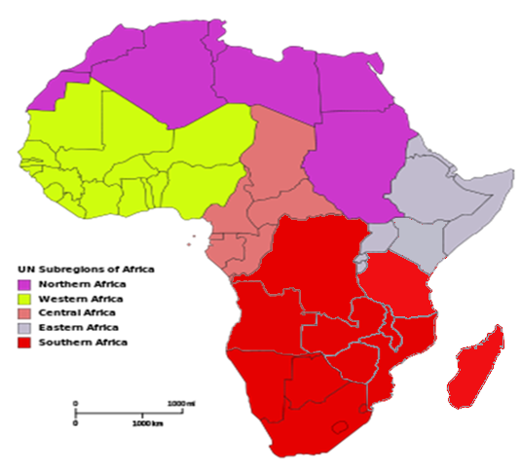
SG13 Regional Group For Africa Current Structure
2
3 main principles:
1
Maintaining the same number and topics of the SG13’s working parties
2
Relying on focal points for work coordination
3
Involving sub-region’s representatives in each working party
Africa Regions considering UN and SADC
partitioning

Slide 23
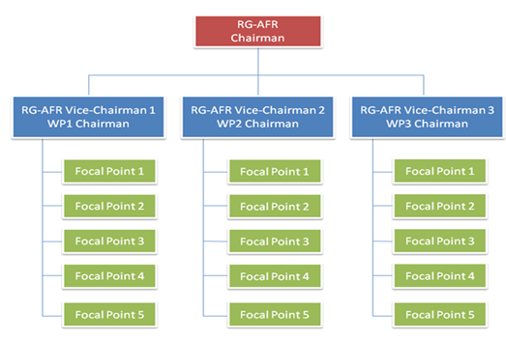
SG13 Regional Group For Africa Current Structure
3
1 Chairman
Management Team
3 Vice-Chairman responsible each of one of the working parties
A team of 5 Focal Points under each Working Party (every Focal Point represents one African region)

Slide 24
SG13 Regional Group For Africa Management Team
4
Chairman
Mr. Simon Bugaba
UCC Uganda
Vice-Chairman 1
WP1 Chairwoman
Dr. Rim Belhassine-Cherif
Tunisie Telecom, Tunisia
WP1 : NGN-e and IMT
Vice-Chairman 2
WP2 Chairwoman
Miss. Soumaya Benbartaoui
ARPT, Algeria
WP2 : Cloud Computing and Common Capabilities
Vice-Chairman 3
WP3 Chairman
Mr. Brice Murara
RURA, Rwanda
WP3 : SDN and Networks of Future

Slide 25
SG13 Regional Group For Africa ToR of a Focal Point
5
Mobilize African countries in Focal Points Region, for active participation of administrations, regulators, operators and experts, in the work of ITU-T SG13
Identify and ensure that there are experts working in each area of work (Questions) in SG13
Assist the submission of work (proposals, contributions etc) through the WP Vice-Chairman
Respond to the requests for information of the African region countries in Focal Points Regions
Encourage participation of African countries in workshops, Rapporteur meetings and other ITU-T SG13 events
Ensure the promotion of SG13-AFR issues within a focal point region

Slide 26
SG13 Regional Group For Africa Still Required Focal Points
6
Working Party | Still Required F.P. | Regions
WP 1 | 2 | Eastern Africa and Central Africa (one each)
WP 2 | 2 | Eastern Africa and Central Africa (one each)
WP 3 | 3 | Eastern Africa, Western Africa and Central Africa (one each)
Any Volunteers

Slide 27
SG13 Regional Group For Africa Advantages of the adopted Structure
7
Stimulating the participation of all sub-regions to SG13 activities
Encouraging active participation of regional stakeholders to the maximum of SG13 work items
Adequate workload division that makes the staff’s work more efficient, prosperous and precise
Decentralized and efficient coordination inside the group
Easier coordination and collaboration between each regional and parent working party
Creating a task force in the region including high skilled experts in the SG13’s topics
Efficient and easier interaction with sub-regions thanks to focal points

Slide 28
SG13 Regional Group For Africa Regional Meetings
8
4 Annual Regional meetings since 2013
In addition to some E-meetings and meeting’s sessions during SG13 meetings
Year | Venue | Host | Input Documents (*) | Nb. of Participants
2013 | Alger, Algeria | ARPT | 4 | 26
2014 | Tunis, Tunisia | Tunisie Telecom | 5 | 44
2015 | Livingstone, Zambia | ZICTA | 7 | 35
2016 | Accra, Ghana | NCA | - | -
(*): Input Documents = Contributions + Input Temporary Documents
The number of input documents is increasing but still low. So, African Countries are invited to intensify their contribution to the RG-AFR activities

Slide 29
Importance of Standards for the African
Countries
2. Importance of SG13’s Standardization Topics
PLAN
3. Involvement of African Countries in SG13
Activities
4. Conclusion & Recommendations

Slide 30
Conclusion
Standards are essential elements in our daily life and in the global infrastructure of ICTs which allow a large number of players to interoperate and innovate, leading to expand commercial business, accelerate technology progress and allow end users to enjoy wider choice range, richer functionalities and lower costs
ITU-T SG13 is concentrating its standardization activities on the cutting-edge topics in the ICT domain, such as Cloud Computing, Big data and IMT-2020, which are very beneficial to African countries at many levels and have positive socio-economic impacts
African Countries should get more involved in the standardization activities of SG13, by increasing their participation and the number of submitted contributions to its meetings
SG13 RG-AFR has the potential to guarantee a greater participation of African countries to its activities and to SG13 activities, and that by relying on focal points

Slide 31
Recommendations
1
1
2
Awareness regarding the importance of standards, especially for innovation, should be more an more raised in African countries in order to enhance their participation in the Standardization activities of international SDOs while setting mechanisms to encourage the participation of SME, start-ups and academia from these countries
Organizing training sessions on how to prepare and submit contributions to ITU-T groups may help increase the number of contributions from Africa to the next SG13 and RG-AFR meetings
3
Organizing one or two SG13 meetings per study period in African countries may help promote its activities in Africa and increase African participation and contributions
4
Using surveys at the end of Regional Workshops could be interesting in order to collect the feedback of participants and identify the standardization priorities for African Countries

Slide 32
4th SG13 Regional Workshop for Africa on “Future Networks for a better Africa: IMT-2020, Trust, Cloud Computing and Big Data” (Accra, Ghana, 14-15 March 2016)
Thank you for your Attention
Dr. Rim Belhassine-Cherif Products and Services Executive Director, Tunisie Telecom
SG13 Vice-chair & SG13 RG-AFR Vice-chair
Rim.belhassine-cherif@tunisietelecom.tn

