Slide 1
3rd SG13 Regional Workshop for Africa on “ITU-T Standardization Challenges for Developing Countries Working for a Connected Africa” (Livingstone, Zambia, 23-24 February 2015)
The Success Story of Ghana’s Standardization
“ Type Approval Management System”
Isaac Boateng
National Communications Authority, Ghana
VC, ITU-T SG11 & Rapporteur Q8/11 & Q11/11
isaac.boateng@nca.org.gh

Slide 2
Highlight
Introduction
Technical & Regulatory requirements
The Type Approval Management System
Challenges

Slide 3
Introduction
Type Approval is proof by a manufacturer or its Authorized agent of a product that specific essential minimum technical and regulatory requirements related to the product have been fulfilled.

Slide 4
Regulatory Requirements
Section 3 (n) of the NCA Act, Act 769 of 2008, sections 66 and 67 of the Electronic Communications Act, Act 775 are our Authority for Action
Manufacturers or their Authorized Agents require Type Approval Certificate (TAC) before producing or assembling, or selling/using any Electronic Communication Equipment (ECE) in Ghana.
Dealers are also required to deal in only type approved and genuine ECE.
Approved Equipment models come with NCA Type Approval Certificate (TAC) with unique identity
Importers must inform the NCA of any ICT equipment importation into the country for checks, TAC and final clearance

Slide 5
Regulatory Requirements
TAC must always be visible and displayed to the public
All communications equipment coming into the country must be inspected and passed by the NCA
Destination Inspectors go to the point of entries for inspection
Two levels of clearance
Customs Clearance
Regulatory Clearance
Market Surveillance shall soon be an integral part of the process.
Establishment of National ICT Task Force in collaboration with the security agencies and the Ghana Standard Authority through the GCAP.

Slide 6
Technical Requirements
The minimum essential technical requirements:
International, Regional and National Standards
Environmental, Health and Safety Standards
Proof of Genuineness
Electromagnetic Radiation and Emissions
Radio Frequency requirements
Network Compatibility/Interoperability

Slide 7
Who Can Apply for TAC?
Vendors and Assemblers;
Dealers of ICT equipment for marketing/commercial use;
Licensed Operators and Service Providers;
Individuals or Companies wishing to import ICT equipment even for their own use;

Slide 8
Type Approval Management System
Is a web tool developed with following main objectives;
To serve as an application portal for Type Approval Certificate and Dealership Licence
Secured and robust
As database and search tool for NCA approved Devices
Running on dedicated platform/infrastructure/servers
To reduce the time of introduction of devices to market

Slide 9
Type Approval Management System
APPPLICATION REQUIREMNTS
Fill an online application form in addition to submission of following:
Application Cover letter
Technical Documentation /Technical Construction File
A general description of the electronic communication equipment
Design information /results of design calculations made
A list of the adopted standards and/or other relevant technical specifications
The declaration of conformity;
Certificate of conformity from CAB;
Test reports issued by accredited testing laboratories
RF Test Report
EMC Test Report
Health and Safety Reports
Sample of electronic communication equipment where necessary

Slide 10
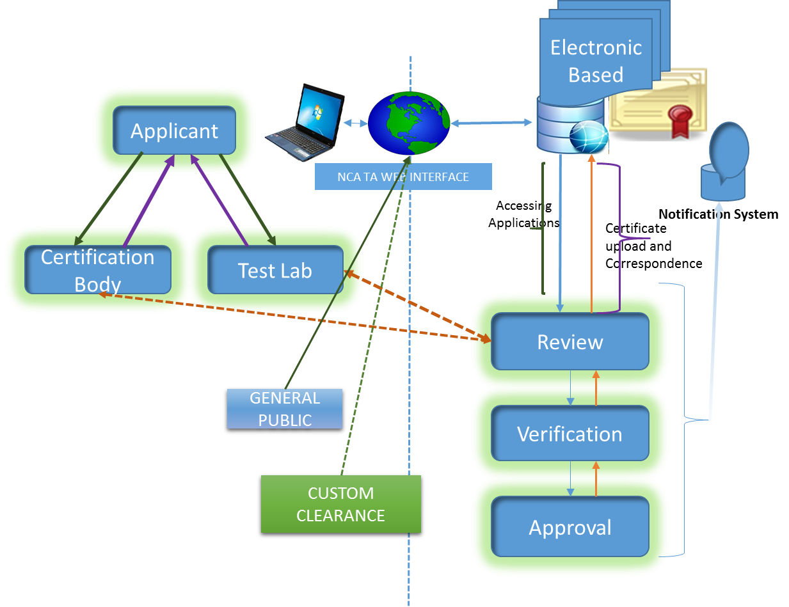
Type Approval Management System

Slide 11
Type Approval Management System
Three stages of evaluation;
Review Stage – Comprehensive analysis and verification of submitted document including lab reports
Verification Stage – verification of review process, check lists and recommendation for approval where necessary
Approval Stage
Provisional Approval
Final Approval
Rejected

Slide 12
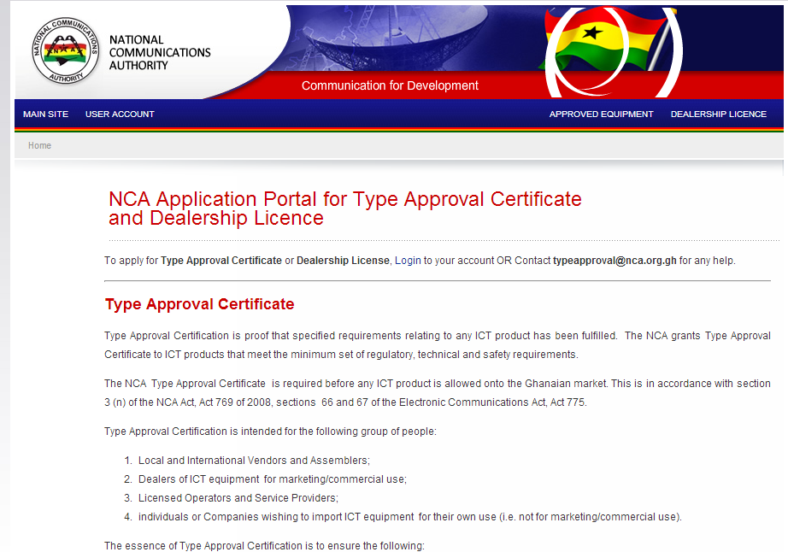
Snapshot of TA Application Web Portal

Slide 13
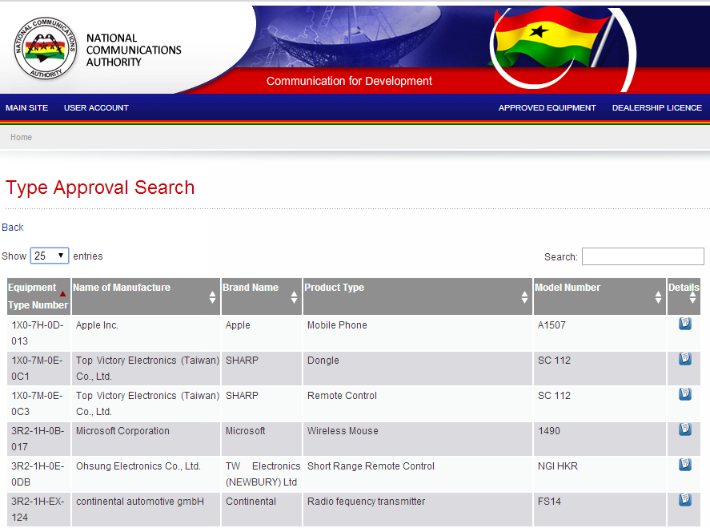
Snapshot of NCA Approved Equipment

Slide 14
TAC Unique Identifier
Type Approved Equipment models are now given unique identity marks on the Certificate
ECE CC TAT IY SN
“NCA APPROVED: XXX - XX- XX- XXX”
ECE CC : ECE COLOUR CODE
TAT : TYPE APPROVAL TYPE (modular or complete)
IY : ISSUE YEAR
SN : SEQUENCE NUMBER

Slide 15
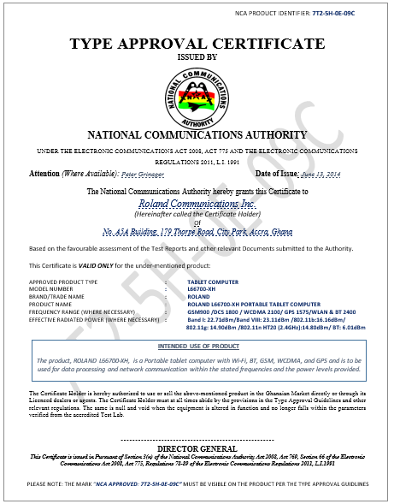
Front view of TAC

Slide 16
Why TAC Unique Identity?
To show that the Certificate is for specific equipment model/category/type
ECE meets essential requirements of the Authority
To provide public confidence
Manufacturer’s/Dealer’s own declaration that ECE is genuine
Manufacture/Dealer bears responsibility for any breach under which TAC was issued.
If equipment is found to be Fake/Counterfeit
If certain key functions (both software and hardware) of the ECE is altered

Slide 17
Challenges
Current process is based on test results from vendor or recognized/accredited 3rd party testing
Independent verification and market surveillance are required to provide assurance that the products category/model sold in the market have met the requirements of the Authority.
Lack of testing labs, market surveillance & enforcement make it a challenge.
Porous ports of entry and un-approved routes
Vendors/Dealers/Consumers are still un-aware of the type approval regime
Incomplete applications/ inadequate documentations

Slide 18
NCA Web Sources Related to Type Approvals
portal.nca.org.gh
www.nca.org.gh
Type Approval Guidelines
Contacts
typeapproval@nca.org.gh
isaac.boateng@nca.org.gh

