Slide 1
3rd SG13 Regional Workshop for Africa on “ITU-T Standardization Challenges for Developing Countries Working for a Connected Africa”
(Livingstone, Zambia, 23-24 February 2015)
HOMOLOGATION OF TELECOM EQUIPMENT IN ZAMBIA – PROCEDURE AND EXPERIENCE
Elliot N. Kabalo
Type Approval Engineer, ZICTA ekabalo@zicta.zm

Slide 2
Overview of the ICT Sector
TECHNOLOGY & SERVICE CARD
FACT SHEET CARD
POPULATION = 14.6 million
AREA = 75 million Hectare
GSM Coverage = 80% Geog, 74% pop
ICT Sector= Fully Liberalized in 2009
Sector Regulator = ZICTA, 2009
Licensing = Unified, Tech neutral
PSTN Penetration = < 1%
Mobile Subscription = 9.3 million-march 2014
Internet Subscriptions = 23,039 (Fixed) 2.8m (Mobile)
PSTN
2G, 2.5 G, 3G, 4G (LTE)
Optic Fibre national and Metropolitan
Microwave
GSM
ADSL
International Gateways = 3
SAT3, ESSY, SEACOM connections

Slide 3
ZICTA MANDATE
Regulating….
ICT ACT NO. 15 2009
Quality
Availability
POSTAL SERVICES ACT No. 22 2009
Cost
Investments
ECT ACT No. 21 2009
ICT Sector

Slide 4
Type Approval Scope
Regulation 4
Type Approval of EC apparatus
Regulation 5
Type Acceptance (No MRAs)
Regulation 8
Certification of ICT Equipment

Slide 5
Application Procedure
Regulation 6
App. Procedure for TA
Regulation 7
Grant of Type Approval
Regulation 9
List of approved equipment

Slide 6
Marketing ICT Equipment in Zambia
Regulation 12
Obligations of Importer and Distributors
Regulation 14
Marketing ICT Equipment in Zambia
Regulation 17
Facility installation clearance
Regulation 16
Complaint against Harmful apparatus

Slide 7
Type Approval Fees
TELECOMMUNICATION TERMINAL EQUIPMENT
xDSL,ADM,
DISTRIBUTION EQUIPMENT
PBX, ROUTERS
RADIO EQUIPMENT
Base stations, broadcasting Tx, VSATs, Mobile Phones
CORE NETWORK EQUIPMENT
MSC,

Slide 8
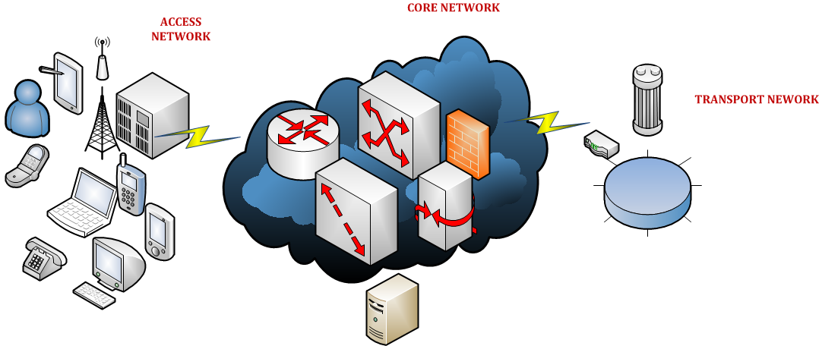


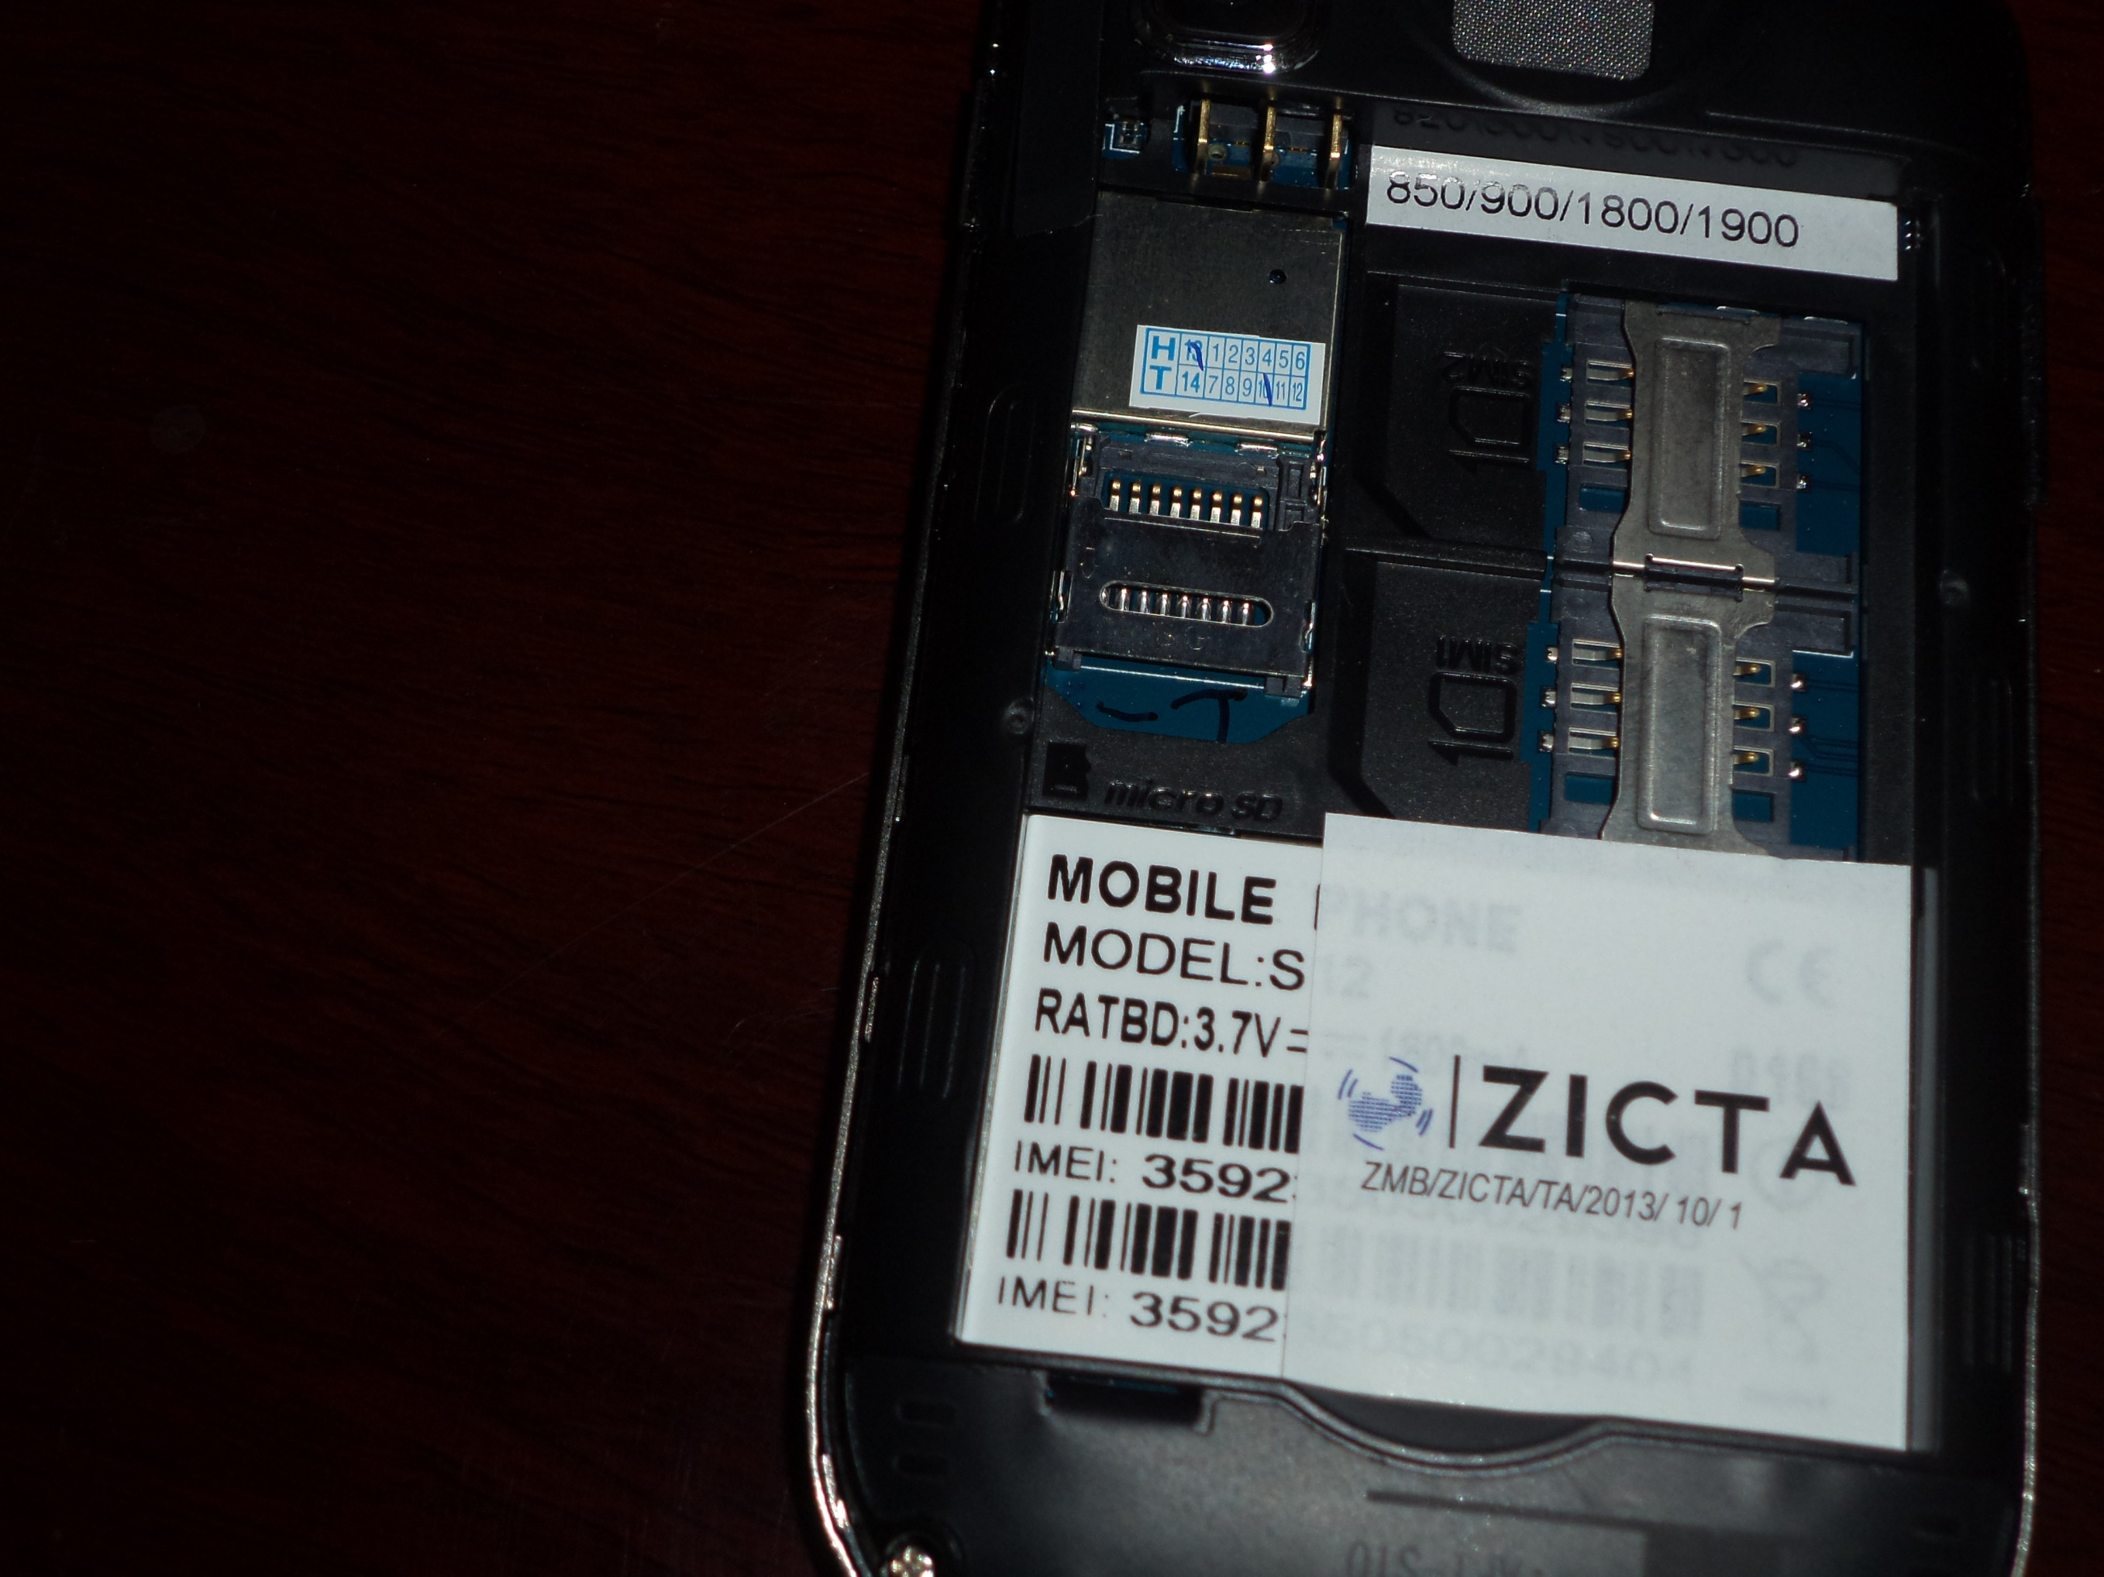
Type Approval Process
Rejection
ZICTA TYPE APPROVAL
Equipment before entering Zambian Market
Type Acceptance
Standard Type Approval
Equipment Allowed to enter Zambian Market
Certification and Marking

Slide 9
Challenges
ICT Equipment Supply LANDSCAPE
Conformity Assessment ?
Interoperability & QoS ??
Integration Testing ?
Accreditation ?
Type Approval ?
Fake Docs
Cheap
Fake Products
Regulatory Testing ?
ICT Equipment Market
Big Vendors= 3
Small Vendors = > ?
SDoC
Proprietary Standards
Lock-in
Limited knowledge transfer
Manufacturers = ?
No Accredited Test Labs
No MRAs
Low cost poor quality

Slide 10
ZICTA ZABS MoU
ICT Standardisation Steering Committee
ISC Secretariat (ZICTA/ZABS)
TC1 - ICT Safety & Protection
TC2 - Electromagnetic Compatibility & Immunity
TC3 - QoS & Interconnection
TC4 - Terminal & Human Factors
TC5 - Cyber security

Slide 11
Type Approval LAB Project
ZAMTEST LAB PROJECT
2012
2013
2014-2020
Business Case
RFPs & Tender Process
Feasibility & Business Planning
Procurement: Building & Equipment
COMMISSION 4 LABS
PROPOSED IMPLEMENTATION APPROACH
WIRELESS LAB
HUMAN EXPOSURE LAB
WIRELINE LAB
2015
CALIBRATION LAB
2016
2017
2018
2019
2020

Slide 12


Implementation Status
Procedures for establishing a Conformity Assessment regime, described in SADC C&I Assessment Study Report:
A. Query for new products to be homologated
B. Issuing and/or validating a Certificate of Conformity
C. Issue of the Homologation (or acceptance)
D. Import procedures for testing proposals
ZAMBIA IMPLEMENTATION STATUS
E. Reference Standards for conformity assessment
F. Recognized Laboratories and Test Reports
G. Marking
H. Monitoring, Enforcement, and Sanctions and Post-Market Surveillance

Slide 13
Adopted ITU-T Standards
No. | ZS Number | Title
1 | ZS ITU-T E.420 | Checking the quality of the international telephone service – General considerations
2 | ZS ITU-T E.422 | Observations on international outgoing telephone calls for quality of service
3 | ZS ITU-T E.425 | Internal automatic observations
4 | ZS ITU-T E.426 | General guide to the percentage of effective attempts which should be observed for international telephone calls
5 | ZS ITU-T E.431 | Service quality assessment for connection set-up and release delays
6 | ZS ITU-T E.543 | Grades of service in digital international telephone exchanges
7 | ZS ITU-T E.721 | Network grade of service parameters and target values for circuit-switched services in the evolving ISDN
8 | ZS ITU-T E.723 | Grade-of-service parameters for Signalling System No. 7 networks
9 | ZS ITU-T E.771 | Network grade of service parameters and target values for circuit-switched public land mobile services
10 | ZS ITU-T E.800 | Telephone network and ISDN QoS, Network Management & Traffic Engineering
11 | ZS ITU-T G.108 | Application of the E-model: A planning guide
12 | ZS ITU-T G.109 | Definition of categories of speech transmission quality
13 | ZS ITU-T G.114 | One-way transmission time
14 | ZS ITU-T G.175 | Transmission planning for private/public network interconnection of voice traffic
15 | ZS ITU-T Q.931 | ISDN user-network interface layer 3 specification for basic call control
16 | ZS ITU-T Y.1541 | Network performance objectives for IP-based services
17 | ZS T-REC-E.419-200602 | Business Oriented Key performance indicators for management of networks and services
18 | ZS T-REC-E.420-198811 | Checking the quality of the international telephone service – General considerations
19 | ZS T-REC-E.421-198811 | Service quality observations on a statistical basis
20 | ZS T-REC-E.423-198811 | Observations on traffic set up by operators
21 | ZS T-REC-E.427-198811 | Collection and statistical analysis of special quality of service observation data for measurements of customer difficulties in the international automatic service
22 | ZS T-REC-E.434-199206 | Subscriber-to-subscriber measurement of the public switched telephone network
23 | ZS T-REC-E.437-199905 | Comparative metrics for network performance management
24 | ZS T-REC-E.470-200502 | Operational considerations for QoS of voice over IP-based networks with PSTN-IP-PSTN architecture

Slide 14
Adopted ITU-T Standards
25 | ZS T-REC-E.490.1-200301 | Over view of recommendations on traffic engineering
26 | ZS T-REC-E.493-199602 | Telephone network and ISDN QoS, Network Management & Traffic Engineering
27 | ZS T-REC-E.500-199811 | Traffic intensity measurement principles
28 | ZS T-REC-E.501-199705 | Estimation of traffic offered in the network
29 | ZS T-REC-E.503-199206 | Traffic measurement data analysis
30 | ZS T-REC-E.504-198811 | Traffic measurement administration
31 | ZS T-REC-E.506-199206 | Forecasting international traffic
32 | ZS T-REC-E.507-198811 | Models for forecasting international traffic
33 | ZS T-REC-E.508-199210 | Forecasting new telecommunication services
34 | ZS T-REC-E.540-198811 | Overall grade of service of the international part of an international connection
35 | ZS T-REC-E.724-199602 | GOS Parameters and Target, Objectives for in-services
36 | ZS T-REC-E.733-199811 | Methods for dimensioning resources in Signalling System No. 7 networks
37 | ZS T-REC-E.750-200003 | Introduction to E.750 series of Recommendations on traffic engineering aspects of networks supporting personal communications services
38 | ZS T-REC-E.801-199610 | Framework for Service Quality Agreement
39 | ZS T-REC-E.802-200702 | Framework and methodologies for the determination and application of QoS parameters
40 | ZS T-REC-E.860-200206 | Framework of a service level agreement
41 | ZS T-REC-E.880-198811 | Field data collection & evaluation on the performance of equipment, networks and services
42 | ZS T-REC-G.1000-200111 | Communications QoS: a framework & definitions
43 | ZS T-REC-G.1010-200111 | End-user multimedia QoS categories
44 | ZS T-REC-Y.1540-200711 | Internet protocol data communication service - IP packet transfer & availability performance parameters
45 | ZS T-REC-Y.1541-200602 | Network performance objectives for IP-based services
46 | ZS T-TEC-E.731-199210 | Methods for dimensioning resources operating in circuit switched mode

Slide 15
Installation Standards
Started with installation for optical fibre
Intend to develop other standards for data centres installations and other infrastructure
To put in place guidelines that will enable issuance of installation permits and certification of installations

Slide 16
Way Forward on Application of Standards
Procurement-Specifications
Certification Programs
Regulations & Guidelines
Codes of Practice
Government and Private
Dealers & Eqp. Homologation
e.g. Qos Guidelines, Interconnection etc.
Professional bodies e.g. EIZ, IEEE etc.

Slide 17
END
HOMOLOGATION OF TELECOM EQUIPMENT IN ZAMBIA – PROCEDURE AND EXPERIENCE
Elliot N. Kabalo
Type Approval Engineer, ZICTA ekabalo@zicta.zm

