Slide 1
3rd SG13 Regional Workshop for Africa on “ITU-T Standardization Challenges for Developing Countries Working for a Connected Africa”
(Livingstone, Zambia, 23-24 February 2015)
Cloud Computing and Big Data :
current state and opportunities
Zièd Choukair,
Sup’Com Tunis
zied.choukair@supcom.tn

Slide 2
Cloud Computing

Slide 3





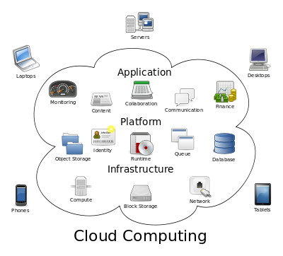






Cloud Computing
“Cloud computing: paradigm for enabling network access to a scalable and elastic pool of shareable physical or virtual resources with self-service provisioning and administration on-demand”
NOTE – Examples of resources include servers, operating systems, networks, software, applications, and storage equipment. [Source: ISO/IEC 17788 | Recommendation ITU-T Y.3500 “Information technology - Cloud computing - Overview and vocabulary”, 13 August 2014]
SaaS
PaaS
IaaS
Storage-as-a-service
Database-as-a-service
Information-as-a-service
Process-as-a-service
Application-as-a-service
Integration-as-a-service
Security-as-a-service
Mgt/Governance-as-a-service
Testing-as-a-service
Network-as-a-Service
Testing-as-a-Service
Notes:
A more granular classification on the basis of service provided

Slide 4
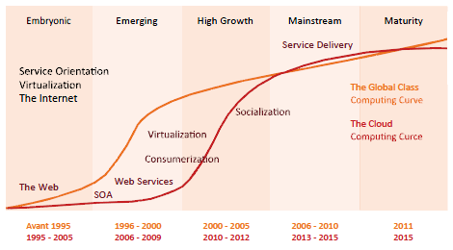
Cloud Computing evolution

Slide 5
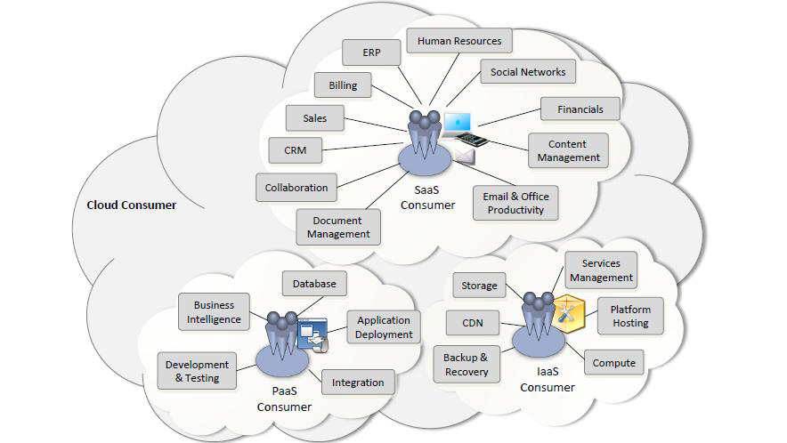
SaaS, PaaS and Iaas applications

Slide 6
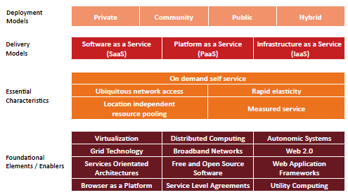
NIST Cloud Computing perspective

Slide 7
Cloud characteristics
Technology | Business | Social / Legal | Other
Elasticity / Scalability | Outsourcing | Security | Multi-tenancy
Virtualization | Pay per use | Provenance | Ease of Use
Agility & adaptability | Resource utilization | Privacy
Availability | Energy efficiency
Data Management | Cost efficiency
Reliability | Accounting
Programmability
K. Jeffery and B. Neidecker-Lutz: „Advances in Clouds – Research in Future Cloud Computing”. Expert Group Report, 2012.

Slide 8
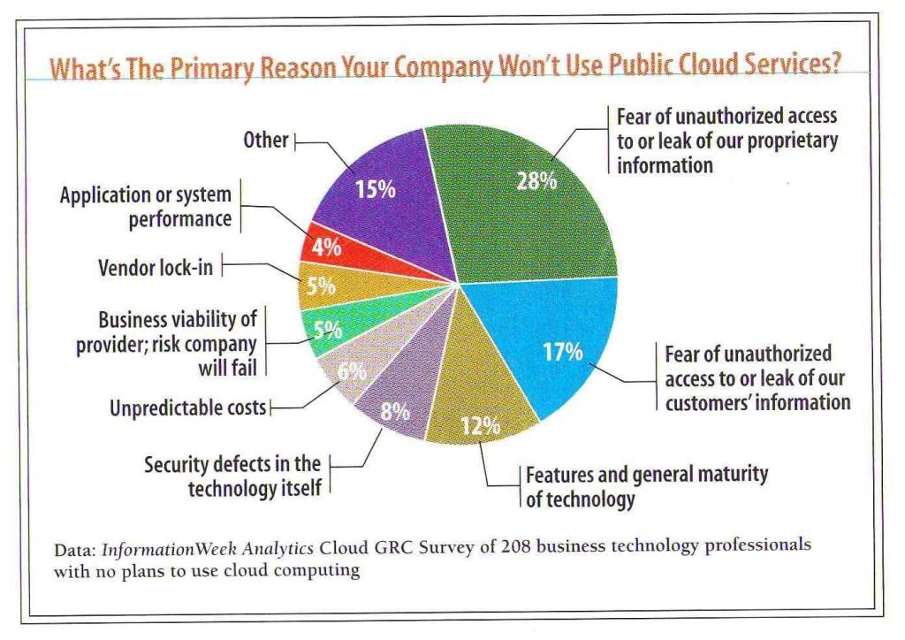
Identified risks

Slide 9
Challenges (1)
Cloud Computing Models, Architectures, and Platforms
  Resource management, provisioning, and migration
  Data/streams and associated retrieval/processing techniques
  Security architectures, policy enforcement
  Secrecy, privacy, authentication, and integrity
  Content delivery, transferring, and migration
  Service models
  User-oriented (community, private/public, ad-hoc clouds)
  Crowd collaborating models and associated platforms
  Green computing

Slide 10
Challenges (2)
Cloud-based Systems Engineering
  Innovative infrastructures, architectures, and middlewares
  Resource collaboration and management
  Monitoring solutions and evaluation techniques
  Testing tools and techniques
  Resource-effective quality of service and applications
  Protocol optimizations and specific resource scheduling
  Knowledge engineering and data mining techniques
  Virtualization of resources
  Bridging the gap between mobile access and cloud
Notes:
Modeling, analysis, design methods, and tools

Slide 11
Challenges (3)
Bridging the gap between mobile and cloud
  Embedded mobile platforms and technologies for mobile clouds
  Innovative mobile middleware, platforms and client technologies
  Smart sensor platforms and Urban (crowd) sensing
  Emergent barcode/RFID/NFC-based mobile technologies
  Mobile cloud data centers and storage/persistency technologies
  Mobile cloud networking, communication, and tunneling
  Energy-saving wireless communication technologies

Slide 12
Challenges (4)
Bridging the gap between mobile and cloud through Middleware
  Mobility identity & access mechanism
  Context- and location-aware middleware
  Agent technologies in ubiquitous, wearable, and mobile services
  Messaging, media streaming, and event management middleware for mobile devices
  Mobility API integration, brokerage, and management
  Mobile backend as a service (MBaaS) and mobile app platform
  Reliability, availability, serviceability, scalability, and disaster recovery for mobile services
  Knowledge acquisition, discovery, matching, composition, and analytics for mobile services

Slide 13
Challenges (5)
Disruptively Innovative Applications
  Next generation applications enabled by the cloud
  Innovative mobile, ubiquitous, and wearable applications
  Mobile social networking
  Ubiquitous collaborative & social services
  Mobile Web
  Services based on ad hoc and sensor networks
  Community based computing
  Personal-area services and applications
  Smart mobile SaaS on clouds
  Mobile virtual and physical interactions and mobile enabled virtual reality
  Mobile context-aware services and computing for clouds
  Cloud-based mobile commerce applications and systems
  Location-aware mobile applications on clouds
  Cloud-based mobile app stores and environments
  Human-centered applications based on wearable computing devices relating to Clouds

Slide 14
Big Data

Slide 15
Big Data
Big Data is for large data sets (volume, variety, velocity, variability, veracity, complexity) complex to analyze, capture, cure, search, share, store, transfer, visualize, and manage their privacy.
Big Data Is About Massive Data Volume
Big Data Means Unstructured Data
Big Data Is for Social Media & Sentiment Analysis
Log data collected from hundreds for distributed servers
Different file format (each CDN has its own format), variable arrival rate …
Different file sizes: from 20MB to few Bytes … (Akamai sends fixed size, Level3 sends us more than 80,000 small files / day, EdgeCast Verizon send variable file size …)
Big data uses inductive statistics and concepts from nonlinear system identification to infer laws (regressions, nonlinear relationships, and causal effects) from large sets of data to reveal relationships, dependencies and perform predictions.

Slide 16
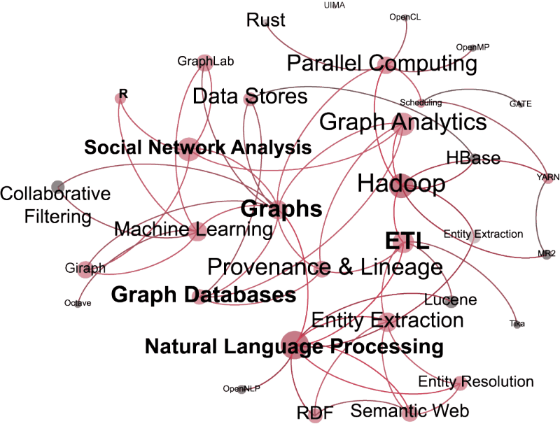
Big Data Landscape …

Slide 17
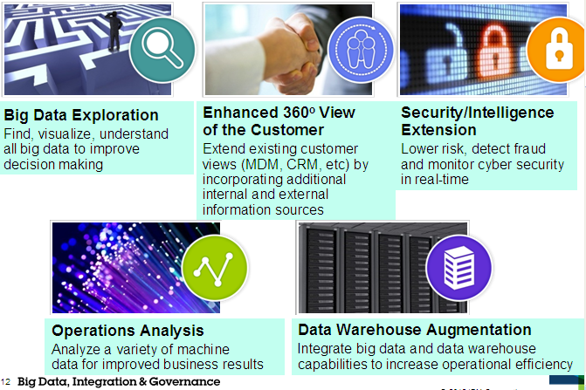
Big Data Use Cases (IBM)

Slide 18
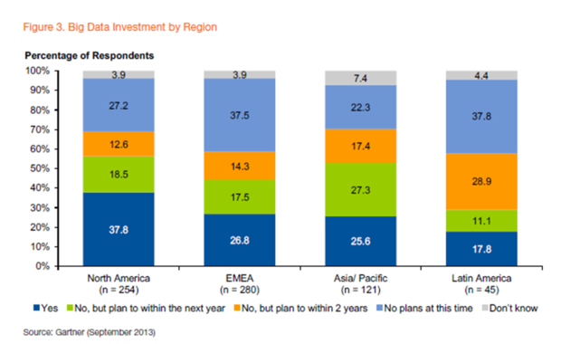
Big Data Adoption Today
(Source: Gartner Sept 2013)

Slide 19
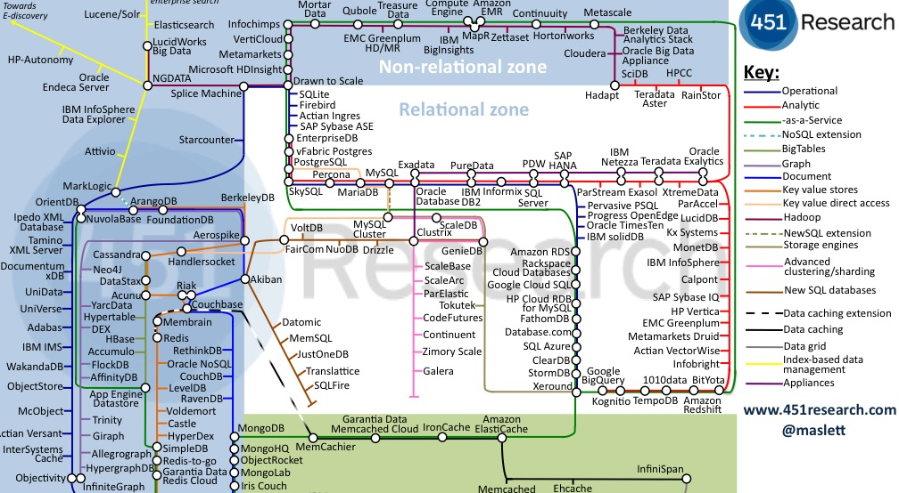
An Abundance of Technologies …

Slide 20
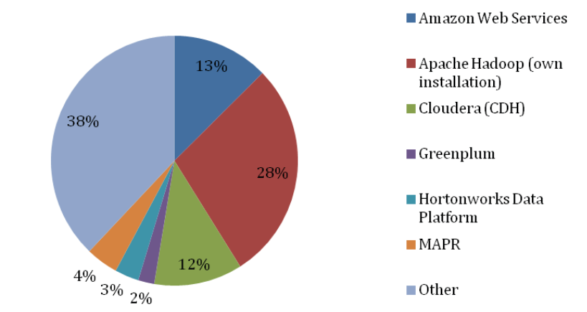
Big Data Technologies …

Slide 21
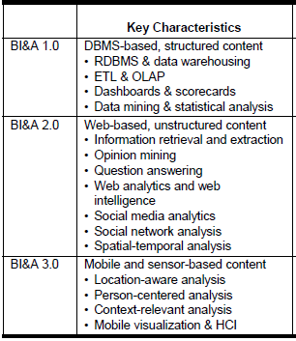
Big impact of Big Data
Business intelligence and analytics (BI&A)

Slide 22
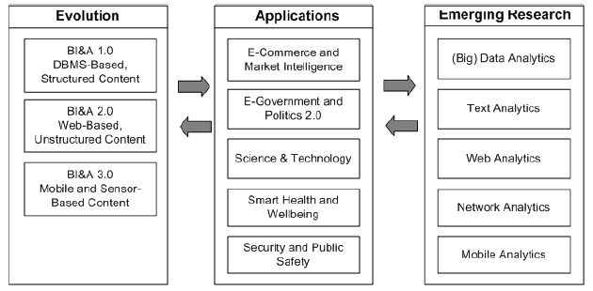
Big impact of Big Data

Slide 23
Challenges (1)
Big Data Models and Algorithms
  Foundational Models
  Algorithms and Programming Techniques
  Analytics and Metrics
  Representation Formats for Multimedia Big Data
  Big Data Architectures
  Big Data as a Service
  Cloud Computing Techniques for Big Data
  Big Data Open Platforms
  Big Data in Mobile and Pervasive Computing
Big Data Search and Mining
  Algorithms and Systems for Big Data Search
  Distributed, and Peer-to-peer Search
  Machine learning based on Big Data
  Visualization Analytics for Big Data

Slide 24
Challenges (2)
Big Data Management
  Big Data Persistence and Preservation
  Big Data Quality and Provenance Control
  Management Issues of Social Network Big Data
Big Data Protection, Integrity and Privacy
  Models and Languages for Big Data Protection
  Privacy Preserving Big Data Analytics
  Big Data Encryption
Security Applications of Big Data
  Anomaly Detection in Very Large Scale Systems
  Collaborative Threat Detection using Big Data Analytics

Slide 25
Challenges (3)
Big Data for Enterprise and Society
  Big Data Economics
  Value Creation through Big Data Analytics
  Big Data for Business Model Innovation
  Big Data in Business Performance Management
  SME-centric Big Data Analytics
  Big Data for Verticals
  Scientific Applications of Big Data
  Large-scale Social Media and Recommendation Systems
  Big Data in Enterprise Management Models and Practices
  Big Data in Government Management Models and Practices
  Big Data in Smart Planet Solutions
  Big Data for Enterprise Transformation

Slide 26
Cloud Computing and Big Data
  Convergent models and technologies
  The cloud as an enable for Big Data Analytics : AaaS
  A compelling compilation
  A symbiosis between Cloud Computing, Big Data, and Mobile
  Cloud, big data, and mobile computing are related, and benefit from each other : we should treat these three concepts as one
  Undeniable interdependence between cloud computing, big data and mobile and multiply as data growth and mobile use continue.

