Slide 1
3rd SG13 Regional Workshop for Africa on “ITU-T Standardization Challenges for Developing Countries Working for a Connected Africa”
(Livingstone, Zambia, 23-24 February 2015)
Challenges for Standardization on Cloud Computing and Big Data considering the Internet of Things
Gyu Myoung Lee,
Q11/13 & Q16/13 Rapporteur,
LJMU(KAIST), gmlee@kaist.ac.kr

Slide 2
Contents
Introduction of technology trends
  IoT, Cloud Computing and Big data
Integration of Clouds, Big data considering the IoT
  Various examples, related activities
Cloud-based Internet of Things
  Basic concepts
  Architectural views
Challenges for future standardization
Conclusion

Slide 3
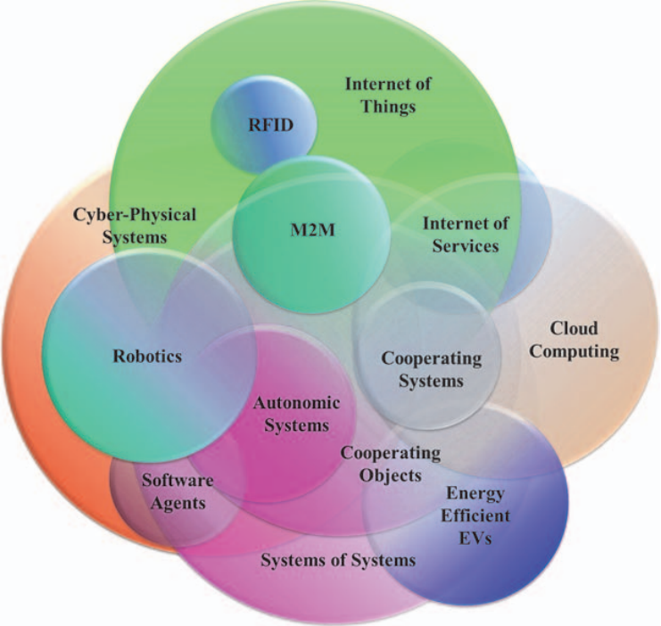
Technology Convergence
Source: Ovidiu Vermesan “Internet of Things – Converging technologies for smart environments and integrated ecosystems” Riverpublishers, 2013.

Slide 4
From stand alone PC to the Cloud-based IoT

Slide 5
Big Data
A category of technologies and services where the capabilities provided to collect, store, search, share, analyze and visualize data which have the characteristics of high-volume, high-velocity and high-variety.
Data Collection
Data Processing
Data Analysis
Data Execution

Slide 6
IoT & Big Data
Big Data is not just about volume
  Volume, Velocity, and Variety
  Geo-distribution from IoT
Technical aspects
  Data collected and stored continues to grow exponentially
  Data is increasingly everywhere and in many formats
  Traditional solutions are failing under new requirements
  ➔ Aggregate and process data from Things in the Cloud

Slide 7
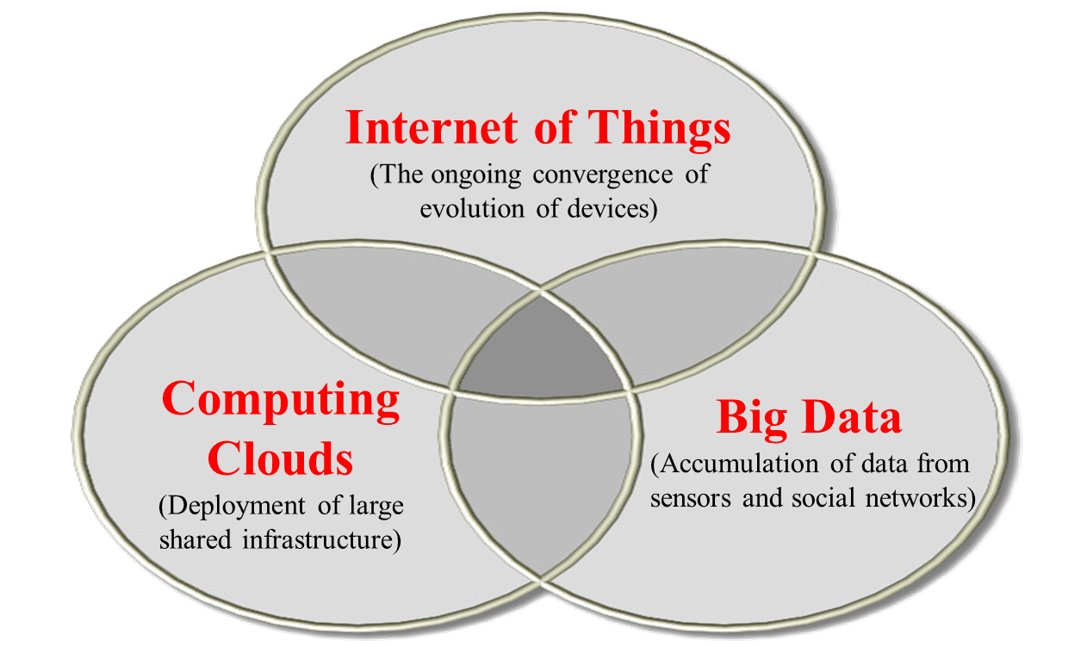
Exciting new challenges

Slide 8
Vision - Interdisciplinary fusion revolution
Ubiquitous connectivity
  Allowing for whenever, whoever, wherever, whatever types of communications
Pervasive reality
  For effective interface to provide connectable real world environments
Ambient intelligence
  Allowing for innovative communications and providing increased value creation.

Slide 9
Clouds, Big data considering the IoT
Data stored in the “Cloud”
Data follows you & your devices
Data accessible anywhere
Data can be shared with others
Convergence
Contents
Computing
Communication
Connectivity
5C+5Any
Any Time
Any Where
Any Service
Any Network
Any Object

Slide 10
Integration of Clouds and the IoT
Combining clouds and the IoT
  To support required resources to increasing heterogamous objects
  To meet the dynamic computational needs of environmental applications with existing sensor network technologies
Benefits
  The cloud can work on behalf of the object for increasing availability, maintaining performance and scalability.
  The cloud can support resource continuity so that objects move freely changing access technologies while using resources from the same cloud.

Slide 11
Key features of clouds to support the IoT
Several features available in clouds are requirements of resource-constrained objects
  Flexibility of resource allocation
  More intelligent applications
  Energy saving
  No on-site infrastructure
  Heterogeneity of the smart environment
  Scalability and agility
  Virtualization

Slide 12
A conceptual diagram for the cloud-based Internet of Things
Cloud
-
based Services of Things
Smart
Services
Cloud Computing
Service
Software
Platform
Infrastructure
Provisioning
(
SaaS
)
(
PaaS
)
(
IaaS
)
&
Management
(Security, OAM,
Virtual Resources
Self Management)
(Control, transport, computing & storage, access resources)
Ubiquitous Access/
Seamless Connectivity
Smart
Environment
Humans
with Attached Devices
Objects
(Remote Monitoring and
Information Devices, Contents)

Slide 13
The IoT using local distributed clouds
Public resource management, QoS management, Service invocation, Admission control
Location management, Service exposure, Billing, Identity management, Service
Support functions
Local resource management, Public cloud interaction
Resource exposure,
Resource Request

Slide 14
Challenges for future standardization
Technical consideration for standardization
  Object naming
  Virtualization
  Inter-clouds
  Distributed clouds (edge clouds)
  Security
  Geo-distribution
  Mobility considering mobile objects
  Resource provisioning for constraint objects
  Application-awareness
  Big Data considering dynamics of traffic pattern
  Connected objects and interdisciplinary fusion services

Slide 15
Conclusion
The cloud-based IoT service environment
  Combines the cloud computing, big data and the IoT
  Aims to efficiently support various services using cloud and analytics technologies from different kinds of objects (e.g., devices, machines, etc.).
Standardization
  The relevant standardization efforts for realization of the cloud-based IoT need to be accelerated with special consideration of their commercial viability.
  Q11/13: a new work item on “cloud-based IoT” (living list)

Slide 16
Q&A
Thank you for your attention

