Slide 1


3rd SG13 Regional Workshop for Africa on “ITU-T Standardization Challenges for Developing Countries Working for a Connected Africa”
(Livingstone, Zambia, 23-24 February 2015)
IDENTITY MANAGEMENT STANDARDIZATION IN THE CLOUD COMPUTING
MOUNIR FERJANI
Product Manager, Huawei Technologies
mounir.ferjani@huawei.com

Slide 2
AGENDA
Access Control
Identity paradigm
Cloud identity management Scenarios
Use Cases and Challenges for identity standardization
SCIM core Schema
SCIM Protocols
Shortcomings

Slide 3
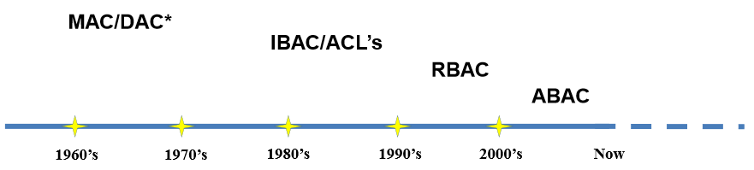
Access control
Access control is concerned with determining the allowed activities of legitimate users, mediating every attempt by a user to access a resource in the system.
NIST 7316

Slide 4


RBAC
Role-based policies require the identification of roles in the system. A role is a collection of permissions to use resources appropriate to a person's job function
Least privilege : ensure users have access to only the resources they need
automate access certification processes from start to finish to meet ongoing compliance requirements
  Policies : separation-of-duties
Help Desk
Representative
Developer
Budget
Manager
Director

Slide 5
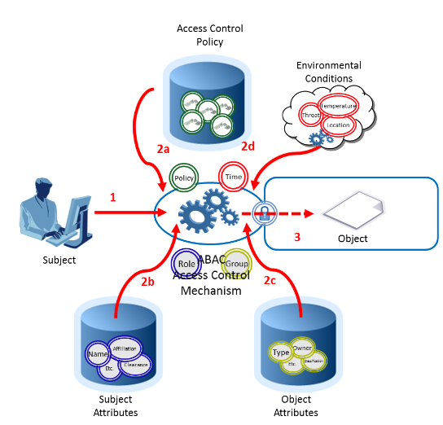
ABAC
NIST SP 800-162

Slide 6
Authorization and Access control create special challenges for identity management

Slide 7





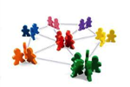
Identity
The first concept of identity is a set of
identifiers or attributes.
NIST sp800-103-draft
ID to request certificates
E-Commerce ID
ID for online
banking
ID for online magazines
Identifiers Unique Identity
(ID)
Attributes
Secret
ID to purchase flights
ID for social network

Slide 8
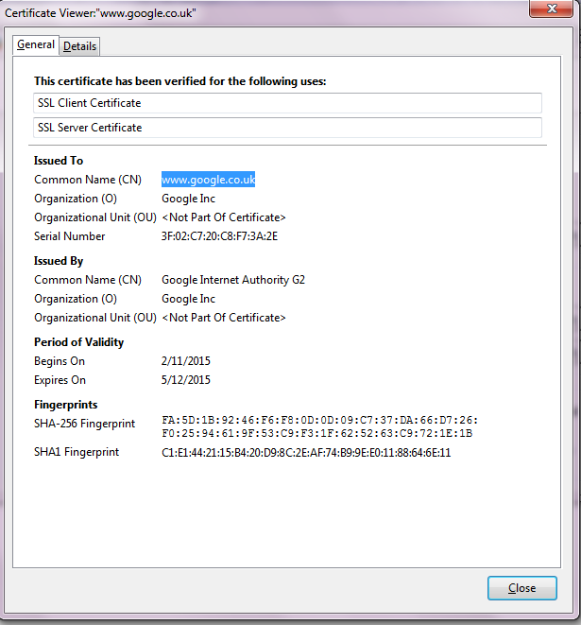
Certificates
Server SSL Certificates
VPN certificates
Digital signature
Encryption Certificates

Slide 9
Kerberos
AS
ID+Hash(password)
Client TGS/TGT
Client
TGS
TGT
Client-to-server Ticket
Client-to-server Ticket
Server
Ticket = Client ID, Client network address,
Validity Period, Client/Server Session Key

Slide 10
SAML Assertions
Assertion ID
Issue Instant
Issuer
Subject (user identity)
Authentication instant
Authentication mechanism
Not Before
Not After
Subject
Asserted Attributes
Digital Signature

Slide 11
Identity Management
Directory services :
  AD, LDAP, RADIUS
Identity providers
  PKI
  SAML : exchange ID via web XML
OpenID
  RP : Relying parties
WS security : SOAP extension
Oauth

Slide 12
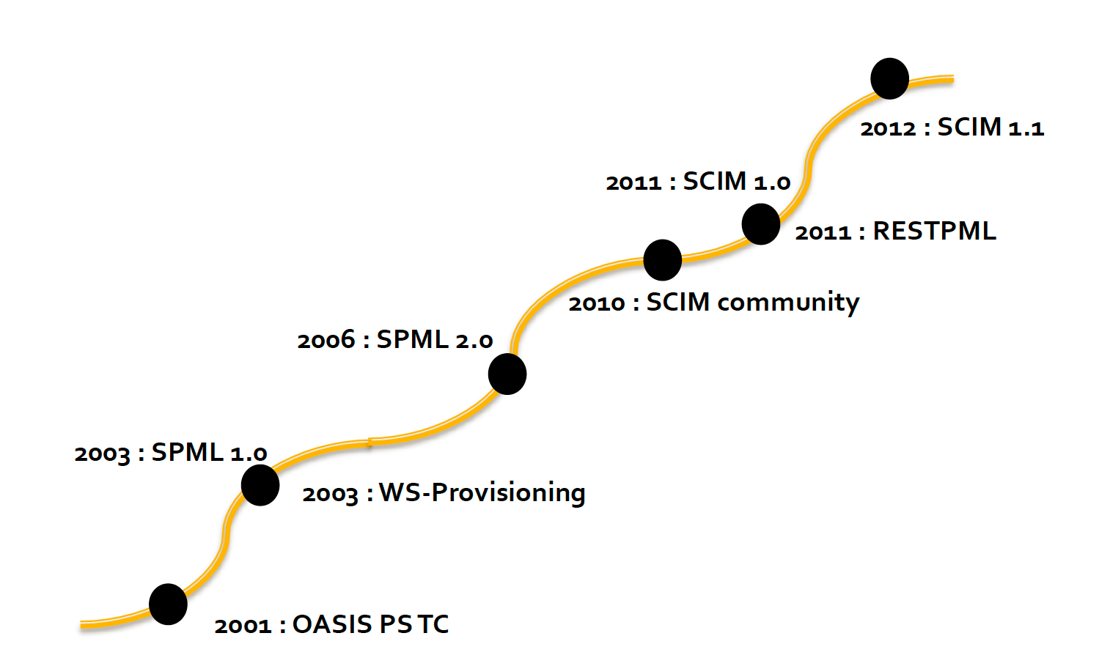
Identity Provisioning History

Slide 13
Cloud computing
Paradigm for enabling network access to a scalable and elastic pool of shareable physical or virtual resources with self-service provisioning and administration on-demand
  NOTE – Examples of resources include servers, operating systems, networks, software, applications, and storage equipment.
            ISO/IEC 17788 | Recommendation ITU-T Y.3500

Slide 14
Characteristics
On-demand self-service
Broad network access
Resource pooling
Rapid elasticity
Measured service

Slide 15
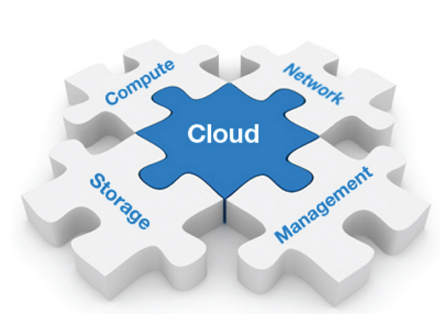


Cloud User Ownership change (1)
CSP has a multitenant cloud platform
User 1 and user 2 belong to enterprise
Enterprise is tenant
Enterprise is customer of CSP
User1 and user 2 are entitled with different identities to access subjects (files)
If user 1 leaves enterprise, enterprise will ask CSP to change identity ownership to user 2

Slide 16
Cloud User Ownership change (2)
Requirements :
  Secure communication protocols between tenant and CSPs
  CSP can enforce identity change
  Secure log of all identity change availabe for auditing

Slide 17
Migration of the identities
Enterprise is customer of CSP1 and has app 1 managing identity information.
Enterprise becomes customer of CSP2 and has app 2 managing identity information.
Applications and CSP providers support the same identity format& protocol standard
  Format of identity
  Protocol for managing identities

Slide 18
Identity federation between cloud providers
User has an account with application hosted by a CSP1.
User requests a service from an application running on CSP2 relying on user's authentication by CSP1 and using identity information provided by CSP1
Trust model establishment between CSPs :
  How to securely provide identity information (protocol)
  How to verify received identity information
  How to process the identity information received

Slide 19
Simple Cloud Identity Management
SCIM group : System for Cross-domain Identity Management
  Standardize methods for creating, reading, searching, modifying, and deleting user identities and identity-related objects across administrative domains, with the goal of simplifying common tasks related to user identity management in services and applications.
  SCIM 1.0.
  Protocol : draft-ietf-scim-api-15
  Schema : draft-ietf-scim-core-schema-15

Slide 20
Schema
SCIM schema provides a minimal core schema for representing users and groups (resources)
Resource is a collection of attributes identified by one or more schemas.
Minimally, an attribute consists of the attribute name and at least one simple or complex value either of which may be multi- valued.
For each attribute, SCIM schema defines the data type, plurality, mutability, and other distinguishing features of an attribute.

Slide 21
Resources
Resource Type
Schema Attribute
Common Attributes
Core Attributes
Extended Attributes

Slide 22
Resource Type
Resource
Resource Type
Name
Description
Endpoint
Schema
SchemaExtensions

Slide 23
Common Attributes
Resource
Common Attributes
ID
External ID
Meta
Created
Last modified
Location
Version

Slide 24
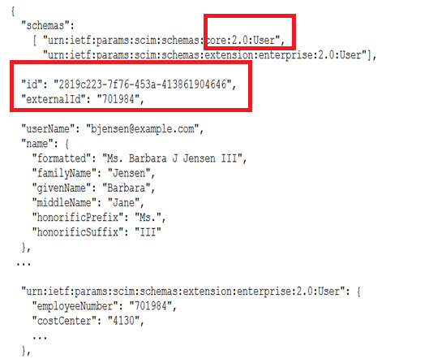
User resource schema
Single attributes :
  Username
  Name
  Display name
  Nick name
  Title
  Timezone
  Active
  Password

Slide 25
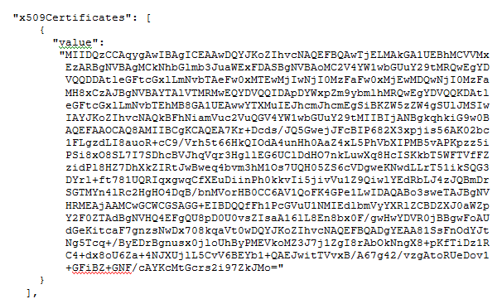
User & Group resource schema
User
  Multi-valued attributes
    Emails
    Phone numbers
    Addresses
    Photos
    Groups
    Entitlement
    Certificates (X509)
    Roles
Group
  Display name
  Members

Slide 26
Service Provider Schema
{ "schemas": [ "urn:ietf:params:scim:schemas:core:2.0:ServiceProviderConfig" ], "documentationUrl":"http://example.com/help/scim.html",
……
……
"authenticationSchemes": [ { "name": "OAuth Bearer Token", "description": "Authentication Scheme using the OAuth Bearer Token Standard", "specUrl": "http://tools.ietf.org/html/draft-ietf-oauth-v2-bearer-01", ……….
Single attributes
  documentationUrl
  changePassword
  authenticationSchemes

Slide 27
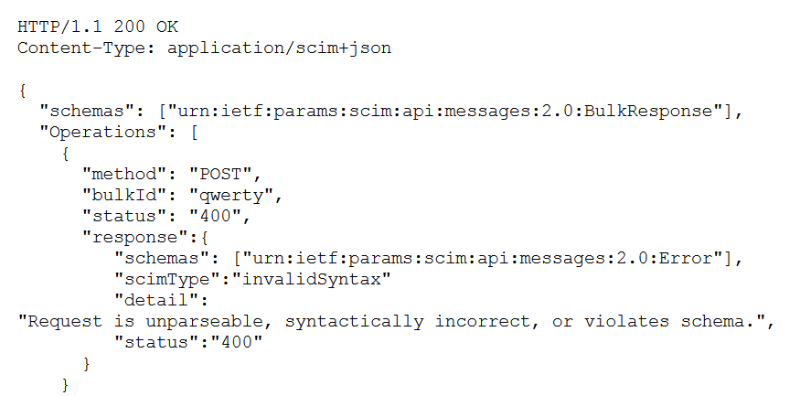
SCIM protocol API
REST API
  Create Resource
  Retrieving Resources
  Modifying Resources
  Deleting Resources

Slide 28
Identity synchronization
CSPs need to integrate with existing systems :
  Billing
  Accounting
  Contract Management
Identity formats
Format exchange protocol

Slide 29
Cloud Resources provisioning
Cloud service automatic provisioning
Workflows definition
  Automation layer manage provisioning engines
  Provisioning engines act on resources using APIs
The need to Protection Profile for Hypervisor APIs
  Identity of objects belonging to orchestration
  Protocol for exchange

Slide 30
Cloud Resources de-provisioning lifecycle
Automatic Cloud service de-provisioning
  User
  Due to contract stopping for postpaid modes
  Due to end of validity period
    Freeze and delete
    Internal : from orchestration linked to time servers
Auto de-provisioning request :
  Identity of time servers
  Identity of external systems (billing, …)
  Identity of objects inside de-provisioning engine

Slide 31
Summary
Need for :
  Open standards for identity and access management in the cloud
  Identity interoperability
  Identity orchestration
Shortcomings of SCIM :
  Do not specify identity for resource pools APIs : like Hypervisor APIs (vdisk APIs, storage APIs, VM provision APIs, SaaS APIs…)
  Do not define identity for Broker APIs
  Do not define authentication mechanisms : the choice of authentication mechanism will impact interoperability

Slide 32
Proposals to ITU
Define a digital identity framework for the cloud computing
  Format, Protocols, APIs, secure digital identity, interoperable digital identity
Define minimum security requirements for the cloud identity service (PKI, relying or third parties,…)

Slide 33
Thank You
Q&A

