Slide 1
3rd SG13 Regional Workshop for Africa on “ITU-T Standardization Challenges for Developing Countries Working for a Connected Africa”
(Livingstone, Zambia, 23-24 February 2015)
Where Are We In The Cloud? And How it is Helping You Really?
Africa High hopes
Can IT leaders deliver on the strategic potential of emerging IT?
Selma Turki,
Business Development Executive, IBM Europe
Selma.turki@be.ibm.com

Slide 2


Africa’s IT and business climate is changing rapidly – creating new opportunities and challenges
Africa’s booming technological and its 1 Billion potential consumer revolution is underway
$400B
650M
100M
The expected growth in Africa’s consumer-facing industries between now and 2020¹
Mobile subscribers
at the start of 2012, making the African mobile telephony market larger than EU or US²
African Facebook users as of September 2014
Technology will play a key role in driving this transformation…
Source:
¹ African Development Bank Group, The African Consumer Market, 2012.
² World Bank and African Development Bank (AfDB) joint report, eTransform Africa: The Transformational Use of Information and Communication Technologies in Africa, http://web.worldbank.org/WBSITE/EXTERNAL/TOPICS/EXTINFORMATIONANDCOMMUNICATIONANDTECHNOLOGIES/0,,contentMDK:23262578~pagePK:210058~piPK:210062~theSitePK:282823,00.html
³ Socialbakers.com, “Egypt Facebook Statistics”, http://www.punkinafrica.co.za/2013/07/11/african-facebook-users-infographic/

Slide 3
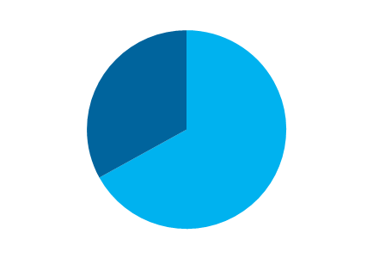
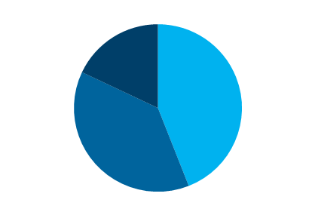
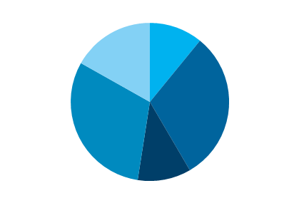
Are Africa’s IT leaders ready?
To find out, we surveyed 180 Africa-based IT decision makers
Respondent distribution
IT Spend
Countries
Number of Employees
17%
South Africa
11%
Egypt
18%
1K+
employees
33%
$50K or more
44%
50-249 employees
31%
Kenya
31%
Nigeria
38%
250-999 employees
67%
$10K to less than $50K
11%
Morocco
Source: Setting the pace in Africa, an IBM global study involving 180 Africa-based IT leaders

Slide 4
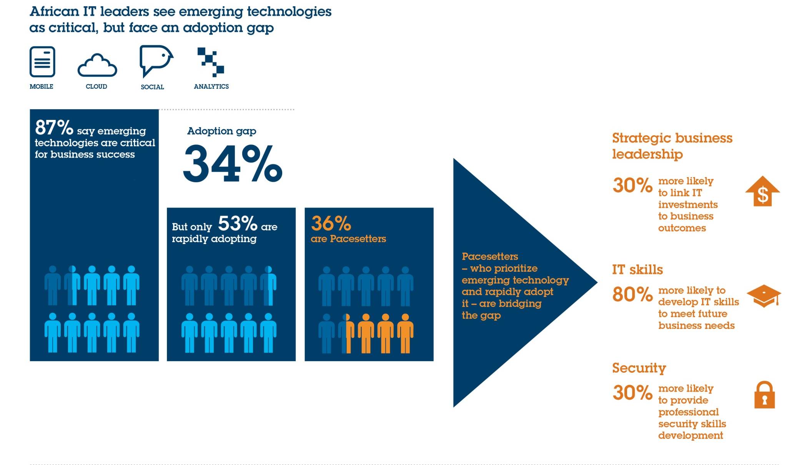
Our research revealed a technology adoption gap, but Pacesetters are bridging it
Source: Setting the pace in Africa, an IBM global study involving 180 Africa-based IT leaders

Slide 5
How can Africa-based IT leaders deliver on the strategic potential of emerging IT?
Questions to consider.
Assess strategic business leadership competencies | What is your vision of how IT will drive the business forward?
 | How do you link investments to business outcomes?
 | How often do you meet with your peers in the business, including the CEO and senior executives?
 | Which metrics and scorecards do you have in place?
Implement emerging technologies and promote skills development | Are you driving IT skills development to transform the organization, beyond meeting the basic needs of the business?
 | How do you proactively develop IT skills to meet future business needs?
 | Are you actively securing resources to pursue opportunities for technology-enabled business innovation?
Tackle security maturity and preparedness | How do you communicate and collaborate with your organization on security concerns?
 | How do you deliver professional security skills development?
 | What process is in place to incorporate new security technology?

Slide 6
Why Cloud?

Slide 7
Cloud is a competitive asset that expands economic potential, promoting agility, security, efficiency and cost control
Cloud holds 6 key benefits
Cloud’s essential characteristics
Speed, agility, and scalability
Cost optimized
Masked complexity
Broad Network Access
Rapid Elasticity
On-demand self service
Measured service
Improved efficiency
Secure and highly available
Ecosystem connectivity
Resource Pooling
Source: NIST, IBM IBV Power of cloud study
Notes:
7
Research.ppt
24/02/2015
7
7
7

Slide 8
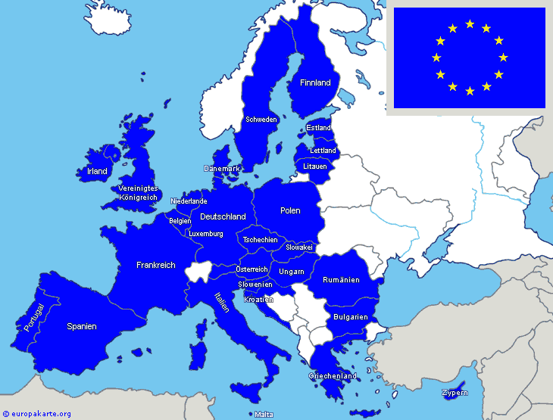
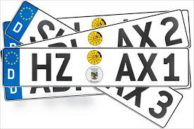



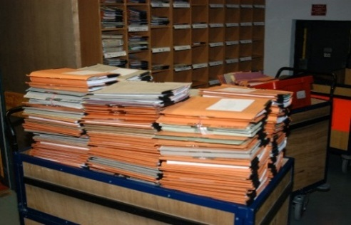
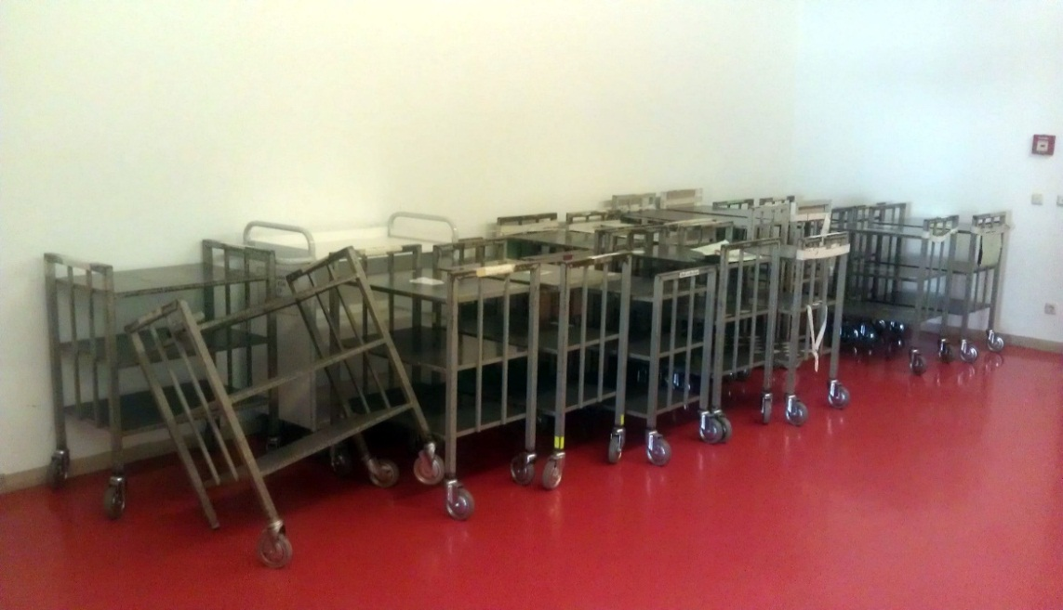

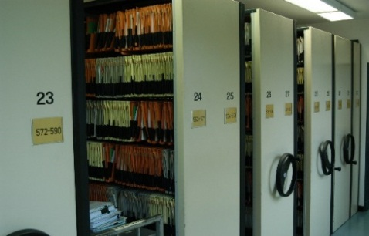
Examples of how cloud is used - by all sizes of companies and institutions – to gain significant benefits
Speed, agility, and scalability
Cost optimized
Masked complexity
Improved efficiency
Secure and highly available
Ecosystem connectivity
Notes:
8
Research.ppt
24/02/2015
8
8
8

Slide 9
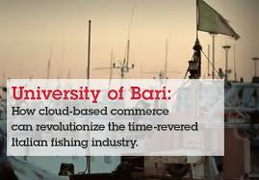

A cloud application brings smarter commerce processes to the local community
Speed, agility, and scalability
Cost optimized
Masked complexity
Improved efficiency
Secure and highly available
Ecosystem connectivity
Notes:
9
Research.ppt
24/02/2015
9
9
9

Slide 10


Municipal processes and eGovernment services provided as-a-Service in a hybrid cloud implementation with data residing in the municipal network
Speed, agility, and scalability
Cost optimized
Masked complexity
Improved efficiency
Secure and highly available
Ecosystem connectivity
Hybrid Cloud
Notes:
10
Research.ppt
24/02/2015
10
10
10

Slide 11




Patient data in the public cloud with end-to-end data encryption to comply with national security & privacy requirements
Speed, agility, and scalability
Cost optimized
Masked complexity
Improved efficiency
Secure and highly available
Ecosystem connectivity
Public Cloud
Notes:
11
Research.ppt
24/02/2015
11
11
11

Slide 12

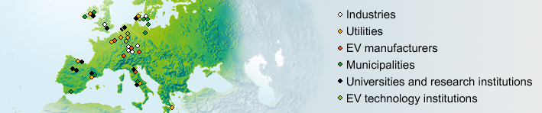

European consortium uses cloud and analytics to gain insight into demand of an interconnected electric vehicle services network
Speed, agility, and scalability
Cost optimized
Masked complexity
Improved efficiency
Secure and highly available
Ecosystem connectivity
Notes:
12
Research.ppt
24/02/2015
12
12
12

Slide 13



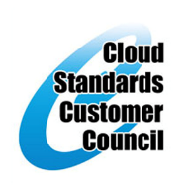
The optimal cloud model varies based on the unique needs and goals of an organization
Private Clouds
Hybrid
Public Clouds
Flexible business service delivery and consumption models
Evolve existing infrastructure to Cloud
Progressive implementation roadmaps using Cloud enablement components
Flexible deployment options through pattern-based approaches
Pre-integrated, simple to deploy Cloud platforms with built-in expertise
Immediate access to a managed platform with variable cost
Externally hosted Cloud services platform with enterprise QoS
Leverage Software as a Service (SaaS)
Access 60+ public cloud SaaS solutions
Common Cloud platform built an open standards reference model
Notes:
13
13
Flexibility in delivering , integrating and consuming cloud capabilities is enabled by open standards, delivered thur a common cloud platform.
This allows clients flexibility and choice in how they consume cloud technologies
With greater confidence that things will work together with a degree or portability….enabling a hybrid approach.

Slide 15

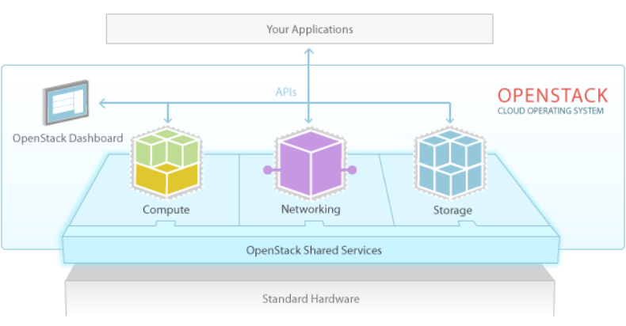

























Look for Open standards, no vendor lock-in; The OpenStack Foundation is Open for Business
OpenStack is a global collaboration of developers & cloud computing technologists working to produce an ubiquitous Infrastructure as a Service (IaaS) open source cloud computing platform for public & private clouds.
Platinum Sponsors
Gold Sponsors
Exponential growth in participation
APR
2012
JAN
2013
30 UGs
As of
As of
47 UGs
2600 Individuals
5600+ Individuals
OpenStack Compute (core)
Provision and manage large networks of virtual machines
OpenStack Image Service (shared service)
Catalog and manage massive libraries of server images
OpenStack Object Store (core)
Create petabytes of secure, reliable storage using standard HW
OpenStack Identity (shared service)
Unified authentication across all OpenStack projects and integrates with existing authentication systems.
OpenStack Dashboard (core)
Enables administrators and users to access & provision cloud-based resources through a self-service portal.
  Code available under Apache 2.0 license. Design tenets – scale & elasticity, share nothing & distribute everything
http://openstack.org
Notes:
15

Slide 16


