Slide 1
3rd SG13 Regional Workshop for Africa on “ITU-T Standardization Challenges for Developing Countries Working for a Connected Africa” (Livingstone, Zambia, 23-24 February 2015)
Standardization of IoT Applications for Energy Saving
Gyu Myoung Lee,
Q11/13 & Q16/13 Rapporteur,
LJMU(KAIST) & gmlee@kaist.ac.kr

Slide 2
Contents
Introduction
Key standardization results of IoT applications for energy saving
Y.2064: Energy saving using smart objects in home networks (01/2014)
Y.2070: Requirements and architecture of home energy management system and home network services (01/2015)
Y.sfem-WoO: Service Framework of Web of Objects for Energy Efficiency Management

Slide 3
Introduction
Q11/13 (Evolution of user-centric networking, services, and interworking with networks of the future including Software-Defined Networking)
Smart ubiquitous networks
Internet of Things and applications
Energy saving, micro energy grid, Web of Things(Objects), social device networking, etc.
Interworking

Slide 4
Y.2064: Energy saving using smart objects in home networks
This Recommendation covers the following:
General overview of energy saving using smart objects in home networks;
Requirements and capabilities for energy saving using smart objects in home networks;
Functional architecture for energy saving using smart objects in home networks.
Considers fixed home environment like residential homes/buildings and mobile home environment like networked electric vehicles (EVs) which support ubiquitous networking among smart objects.

Slide 5
A conceptual diagram for energy saving using smart objects in home networks

Slide 6
Requirements for energy saving using smart objects
Home networks are required to
support networking using various communication protocols and interfaces
deliver on-demand consumption and other information for customers
store most recent readings on energy consumption
provide periodic energy monitoring information on request by authorized market participant(s)
support remote energy management (e.g., meter status, activation/de-activation capability, error messaging, fraud detection)
support of remote changes of tariff through the interaction with utility company

Slide 7
Physical configuration of home networks with outdoor networks

Slide 8
Functional architecture for home network functions to support energy saving

Slide 9
Energy saving through building energy management
Dynamic pricing and metering information transfer: To enhance the efficiency of electrical power usage and provide detailed energy usage in building, BEMS monitors and manages electric usage for building operation and maintenance based on the input dynamic pricing information and the provided usage information.
Demand response message transfer: After receiving the message to reduce demand by consumer with reaching to peak demand, BEMS is able to control electricity usage in the building based on BEMS energy management algorithm and policy.
EV information transfer and EV’s electric charge and discharge: Based on the information of EV’s state such as storage state, operating schedule, BEMS is able to control EV’s electric charge and discharge in order to optimize energy usage by EV.

Slide 10
Y.2070: Home energy management system (HEMS)
This Recommendation covers the followings.
Overview of the HN service architecture for the HEMS and the other HN services;
Requirements for the device, the home gateway (HGW) and the management platform (PF) in the HN service architecture as well as for the security required for the architecture;
Reference Architecture with four ways to connect to the devices from the HGW according to the device types; the basic device (IP based and non-IP based) and the non-basic device (connecting to the HGW directly and through the adapter);
Functional architecture with the entities; the device, the HGW, the management PF and the application;
Functional relationship with three functional categories in the functional architecture; the device operation, the application execution and the management;
Security model and functions for the HN services with mainly describing the HEMS.

Slide 11
Home Network Service Architecture

Slide 12
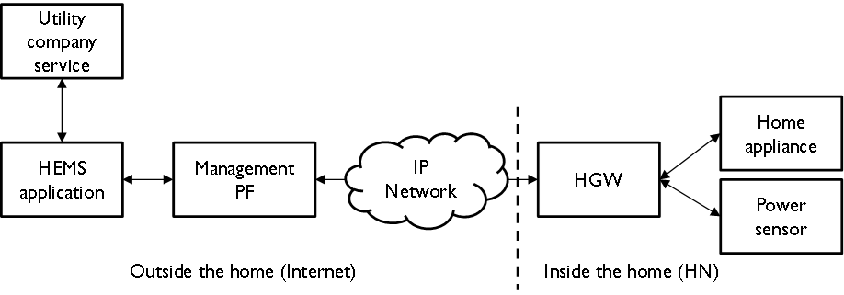
HEMS Examples
(1) Visualization of energy consumption with IHD (In Home Display)
(2) Energy consumption control with DR

Slide 13
Reference architecture

Slide 14
Functional architecture for IP based basic device

Slide 15
Y.sfem-WoO: Web of Objects for Energy Efficiency Management
This draft Recommendation identifies the service framework of WoO service to support the following objectives.
promotion of quality of the response in energy/power consumption monitoring and measurement
provision of intelligent energy efficiency management model
enhancement of a manageability in energy efficiency management of building, home and factory

Slide 16
Creation of composite virtual object (CVO) for WoO based services

Slide 17
Architecture model of WoO based Energy Efficiency Management (WEEM)

Slide 18
Example of WBEEMS Architecture

Slide 19
Conclusion
Key standardization results
Y.2064, Y.2070 and Y.sfem-WoO
Other standardization activities on energy
Y.meg (Framework of micro energy grid)
Y.energy-platform (Framework of energy sharing and trading platform)
NOTE – Q16/13 developed Y.3022 (Measuring energy in networks)

Slide 20
Q&A
Thank you for your attention

