Slide 1

3rd SG13 Regional Workshop for Africa on “ITU-T Standardization Challenges for Developing Countries Working for a Connected Africa”
(Livingstone, Zambia, 23-24 February 2015)
e-Health Applications
& Standardization in Africa
Dr. Rim Belhassine-Cherif
Products and Services Executive Director, Tunisie Telecom
SG13 Vice-chair, SG13 RG-AFR Vice-chair, FG Innovation Vice-chair
rim.belhassine-cherif@tunisietelecom.tn

Slide 2
Why do African Countries need
e-Health services?
2. Examples of e-Health services
& applications in African countries
Agenda
3. e-Health standardization
4. Tunisie Telecom Experience
in e-Health
5. Conclusion & Recommendations

Slide 3
Why do African Countries need
e-Health services?
2. Examples of e-Health services
& applications in African countries
Agenda
3. e-Health standardization
4. Tunisie Telecom Experience
in e-Health
5. Conclusion & Recommendations

Slide 4
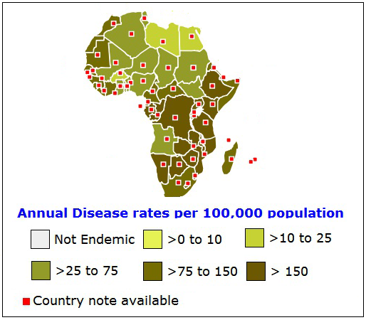
Health Care Issues in
African Countries
High child and maternal mortality Rates
Lack of access to safe water supply and insufficient sanitation facilities
Infectious Diseases spread (HIV/AIDS, Tuberculosis,…)
Critical occupational health and environmental pollution
Strained national Finances, vulnerable administrative abilities and inadequate systems
Lack of personnel, institutions and medications in public health and medical systems
Difficult access to health care institutions
…
Tuberculosis Distribution Map 2013
(source: GEDEON Informatics)
e-Health services can help African Countries find solutions to these health care issues
Source : Introduction The Issues of Public Health and Medical Systems in Developing Countries

Slide 5

e-Health Advantages for health care stakeholders
1
e-Health services have positive impacts
on many health care stakeholders
Individuals
Healthcare Providers and suppliers
Governments
NGOs/IGOs
Enhanced personal health and life quality
Improved access to healthcare services/providers
Less waiting time
More autonomy in health management
…
Source : The Socio-Economic Impact of Mobile Health, April 2012

Slide 6

e-Health Advantages for health care stakeholders
2
Individuals
Healthcare Providers and suppliers
Governments
NGOs/IGOs
Better service providing quality
Improved health care efficiency and accuracy
Reduced need for Health care workforce
Updated data and knowledge sharing
Reduced costs per patient
…
Source : The Socio-Economic Impact of Mobile Health, April 2012

Slide 7



e-Health Advantages for health care stakeholders
3
Individuals
Healthcare Providers and suppliers
Governments
NGOs/IGOs
Help to reach MDG
Ensure regional equity in healthcare services providing
Reduce health care cost per capita
Reduce pollution and energy consumption (minimize patient transport,…)
Healthier workforce ➔ increase productivity
Citizens satisfaction …
Source : The Socio-Economic Impact of Mobile Health, April 2012

Slide 8



e-Health Advantages for health care stakeholders
4
Individuals
Healthcare Providers and suppliers
Governments
NGOs/IGOs
Provide healthcare institutions with necessary infrastructure
Increase the reach of Health care services
Enhance data collection and sharing
Make healthcare more affordable
Better promote own health agenda/targets
…
Source : The Socio-Economic Impact of Mobile Health, April 2012

Slide 9
Why do African Countries need
e-Health services?
2. Examples of e-Health services
& applications in African countries
Agenda
3. e-Health standardization
4. Tunisie Telecom Experience
in e-Health
5. Conclusion & Recommendations

Slide 10
Why do African Countries need
e-Health services?
2. Examples of e-Health services
& applications in African countries
Agenda
3. e-Health standardization
4. Tunisie Telecom Experience
in e-Health
5. Conclusion & Recommendations

Slide 11
e-health systems categories
E-Health Systems
Electronic health record
Pharmacy information
Patient registration or scheduling
Monitoring, evaluation and patient tracking
Clinical decision support
Patient reminder
Research/data collection
Laboratory information management
Telemedicine
Source : Evaluations of the Impact of e-Health Technologies in Developing Countries: A Systematic Review, July 2008

Slide 12
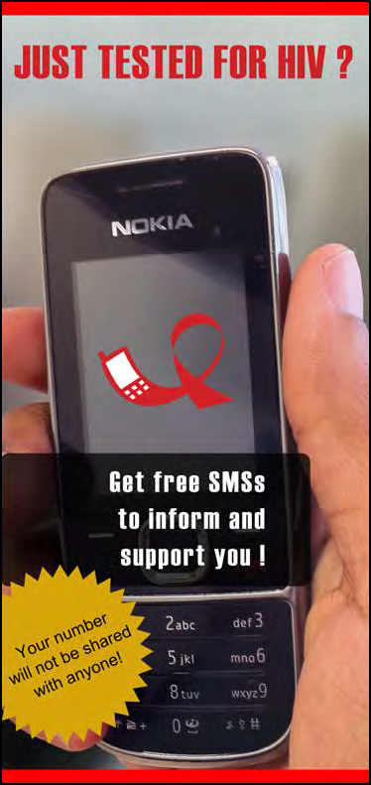
Examples of e-Health Services
& Applications in Africa
JustTested (South Africa, May 2012)
1
Objective: Giving support and information to people who has just tested (regardless of whether they test HIV positive or negative)
The service sends 39 messages over the course of three months on the topics of healthy living and addressing HIV and AIDS related issues
Source : m-HEALTH COMPENDIUM, VOL(2), Technical report, Mai 2012

Slide 13
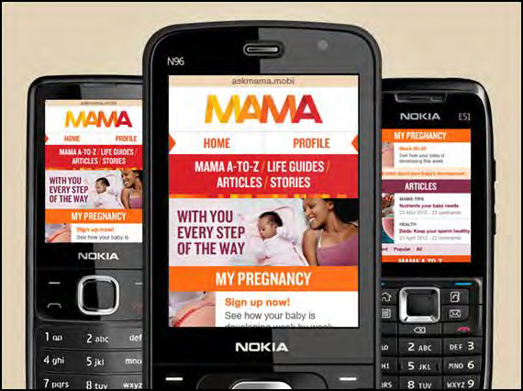
Examples of e-Health Services
& Applications in Africa
MAMA (South Africa, May 2013)
2
Objective: providing support and information to pregnant women and new mothers through 4 channels
  Channel1: SMS text messaging twice a week (with further information for HIV+ mothers)
  Channel2: Mobile web-based community portal (askmama.mobi)
  Channel3: USSD interactive quizzes twice a week
  Channel4: educational portal through the MXit social networking platform
Results: 641,771 users in November 2014
Source : http://www.mobilemamaalliance.org

Slide 14
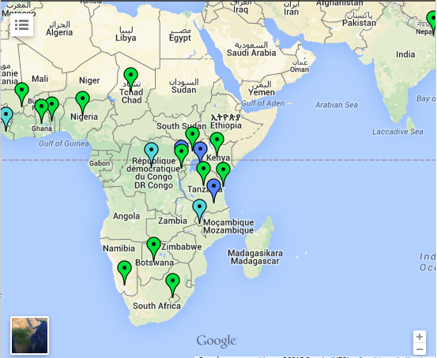
Examples of e-Health Services
& Applications in Africa iHRIS (Uganda, 2007)
3
Objective: managing health workforce information
iHRIS Mobile Reference Dictionary was developed in 2012 to protect patients from individuals posing as health professionals
Results
  Currently, 19 countries are using iHRIS with one more in the pipeline
  More than worldwide 900,000 health worker records are supported
Derivative: mHero (Mobile Health Worker Ebola Response and Outreach) which allowed to instantly send critical information to health workers’ mobile phones during the outbreak in Liberia
iHRS global implementation
Source : http://www.ihris.org/

Slide 15
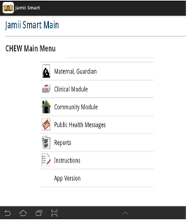
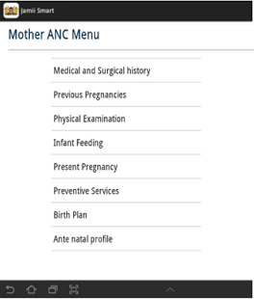
Examples of e-Health Innovative
Applications in the D.C.
Jamii Smart (Kenya)
4
Scope:
  collecting maternal and child health data on an android application
  aggregating the data on the government’s cloud-based Information Systems
  sending alerts, reminders and tips to mothers and community health workers
  Phase 2: “Linda Jamii”
  a medical micro-insurance product by Safaricom and partners, and mVouchers to facilitate transportation to health facilities
Source : Analysing Progress on Commitments to the Global Strategy for Women’s and Children’s Health

Slide 16
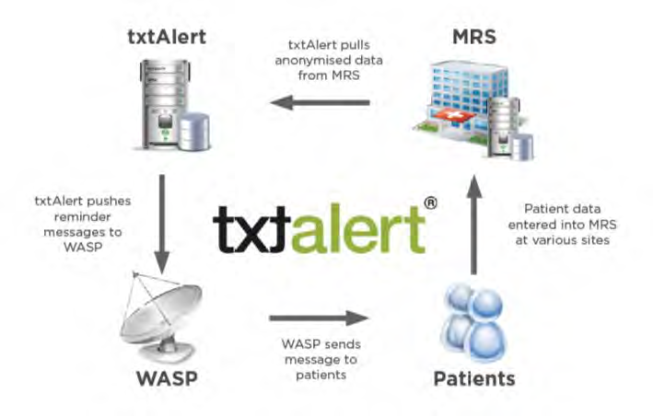
Examples of e-Health Services
& Applications in Africa
TXTALERT (South Africa, 2007)
5
Scope:
  appointment reminder
  facility for patients to reschedule or confirm an appointment (with no additional cost)
  4 different variants : for simple patient, for HIV patient, for pregnant women and for TB patients
Encouraging results: (example of Theba Lethu clinic)
  Missed appointments decrease: 30% to 4%
  loss to follow decrease: 27% to 4%
Source : m-HEALTH COMPENDIUM, Vol(2), Technical report, May 2012

Slide 17
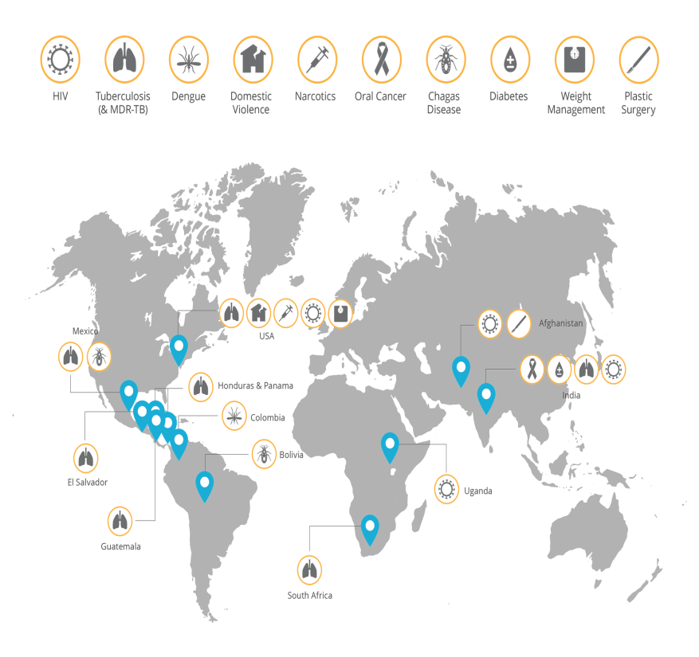
Examples of e-Health Services
& Applications in Africa eMOCHA (Uganda, 2009)
6
eMOCHA: electronic Mobile Open-source Comprehensive Health Application
  A smartphone app designed to assist health programs in resource-limited settings and improve provider communication and education, as well as patient care
  First version aimed to deliver multi-media training to healthcare workers in rural Uganda combating HIV
  Used Technologies: video, audio, touch screen quizzes, GPS and SMS to collect and analyse large amounts of health-related data
Source : http://main.ccghe.net/content/emocha

Slide 18
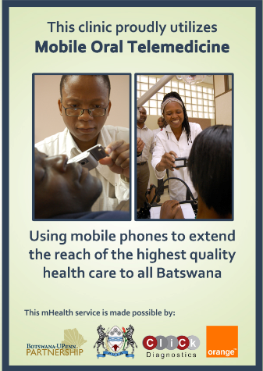
Examples of e-Health Services
& Applications in Africa
Mobile Telemedicine (Botswana, 2010)
7
Scope:
Access to Specialists (store and forward)
  Mobile Oral Telemedicine
  Mobile Cervical Cancer Screening
  Mobile Teledermatology
  Mobile Teleradiology
Access to Medical Resources
  National Treatment Guidelines SMS Query System
  Mobile Telementoring
Source : Mobile Telemedicine in Botswana

Slide 19
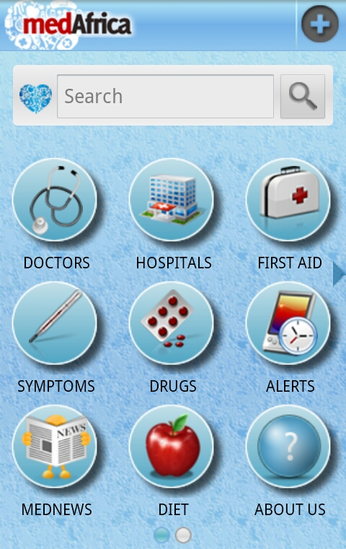
Examples of e-Health Services
& Applications in Africa medAfrica (Kenya, 2011)
8
Objective: improve community health by increasing access to healthcare information directly though the MedAfrica app
Accessibility: via Java, Nokia phones, Android, mobile web and USSD for the low end phones
Results: 25,000 downloads after nearly a month from its launch with 60% of active users
Source : m-HEALTH COMPENDIUM, Vol(2), Technical report, May 2012

Slide 20
Why do African Countries need
e-Health services?
2. Examples of e-Health services
& applications in African countries
Agenda
3. e-Health standardization
4. Tunisie Telecom Experience
in e-Health
5. Conclusion & Recommendations

Slide 21
Why do African Countries need
e-Health services?
2. Examples of e-Health services
& applications in African countries
Agenda
3. e-Health standardization
4. Tunisie Telecom Experience
in e-Health
5. Conclusion & Recommendations

Slide 22

e-Health Standardization
Standardization Benefits
Ensure interoperability among healthcare systems
  facilitate information exchange
  avoid single vendor lock-in
Decrease the risks related to new technologies development
Minimize costs by stimulating market competition and eliminating expensive and personalized solutions
Widen the spread of solutions’ adoption
Address specific concerns about e-Health issues (privacy, security, patient recognition,...)
Source: Standards and eHealth ITU-T Technology Watch Report -January 2011

Slide 23

e-Health Standardization
Main Challenges
Many stakeholders (Patients, Hospitals, Pharmacies, primary care physicians, administrative entities…)
Different technologies, information systems, and medical devices often based on proprietary specifications
Difficulty of technical integration
Privacy protections, quality assurance, and security of information
Very strict national regulations
Reluctance of health practitioners to adopt the new technologies
Source: Standards and eHealth ITU-T Technology Watch Report -January 2011

Slide 24
e-Health Standardization
Standards Areas
Source: Standards and eHealth ITU-T Technology Watch Report -January 2011
e-Health standards focus on 3 main areas
Area1: e-Health Information
Area2: e-Health Software Systems
Area 3: e-Health Infrastructure
Patient Data
Information Systems
Mobile Systems
Aggregate Medical Data
DBMS
Remote Diagnostics
Security Systems
Diagnostic Images
Diagnostic Systems
Identification, Authentication
Medical Research
Process Management
Systems Management
Medical Informatics
Mobile Apps

Slide 25





e-Health Standardization
Standardization Initiatives
Some standardization initiatives were launched, among which:
Source : E-health Standards and Interoperability ITU-T Technology Watch Report - April 2012
epSOS (European Patients Smart Open Services)
A pilot initiative that focuses on creating an interoperable electronic health record system across Europe
DICOM (Digital Imaging and Communications in Medicine)
A set of specifications dedicated to the standardization of medical images under the responsibility of the U.S. National Electrical Manufacturers Association
Global Observatory for e-Health (World Health Organization)
An initiative dedicated to the study of e-Health, its evolution and impact on health
Medical /Health Device Communication Standards (ISO/IEEE 11073)
A set of joint ISO, IEEE, and CEN standards for medical device interoperability

Slide 26




e-Health Standardization
Standardization Institutions
Many institutions are currently active in e-Health standardization field, among which:
Source : E-health Standards and Interoperability ITU-T Technology Watch Report - April 2012
Continua Health Alliance
A non-profit organization seeking to promote interoperability among personal e-health devices and systems
HL7 (Health Level Seven International)
A standards organization specifically devoted to the practice of developing standards related to the exchange, storage, and use of electronic health information
CEN/TC 251
The Health Informatics Technical Committee of the European Committee for Standardization (CEN)
ISO/TC 215
ISO Technical Committee 215: “Health Informatics”
GS1
Healthcare
A global non-profit standards association that focuses on the supply chain and care delivery

Slide 27

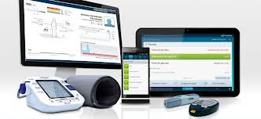
ITU-T Standardization
Activities on e-Health
1
e-Health standardization from the perspective
of general ICT infrastructure
  SG16–Q28 : Multimedia framework for e-Health Applications
  SG13–Q2 : Requirements for NGN evolution and its capabilities including support of IoT and use of software-defined networking
  SG17–Q9 : Telebiometrics
  e-Health Standardization Coordination Group
  FG M2M : Requirements and specifications for a common M2M Service Layer with the initial priority on e-Health
  IPTV and mobile application for e-health (Application Challenge on IPTV Apps for e-health, September 2012)
Further Activities
Source: ITU-T Work on Standardizing e-Health

Slide 28

ITU-T Standardization
Activities on e-Health
2
SG16 – Q28: Multimedia Framework for e-Health Applications
Main Study Items
Identification of user requirements
Multimedia framework, Generic architecture and Specific system characteristics for e-health applications
Roadmap for e-health standards
Databases and knowledge-bases for e-Health (information, expertise, technologies, consultants, specialists, potential customers …)
Creation of glossary of e-health
Methods for inputting, transmitting and processing data for e-health
Personal terminals for e-health

Slide 29

ITU-T Standardization
Activities on e-Health
3
SG13–Q2 : Requirements for NGN evolution and its capabilities including support of IoT and use of software-defined networking
  Work item under study
  Y.EHM-cap-framework: Capability framework for e-health monitoring services
  Recommendations
  Y.2065: “Service and capability requirements for e-health monitoring services”
  Some IoT Related Recommendations
  Y.2061: Requirements for the support of machine-oriented communication applications in the next generation network environment
  Y.2213: NGN service requirements and capabilities for network aspects of applications and services using tag-based identification
  Y.2221: Requirements for support of ubiquitous sensor network (USN) applications and services in the NGN environment

Slide 30


ITU-T Standardization
Activities on e-Health
4
Some Publications
  ITU-T Rec. X.108x series on telebiometrics, including security, authentication, interfaces, API and protocols
  Y.2065 “Service and capability requirements for e-health monitoring services”
  HSTP.EHMSI (draft) “Multimedia Service and Interfaces for e-health ”
  ITU-T Technology Watch Report - January 2011 “Standards and eHealth”
  ITU-T Technology Watch Report – April 2012 “E-health Standards and Interoperability”
Source: ITU-T Work on Standardizing e-Health

Slide 31

Factors Affecting the Adoption of e-Health Standards in Africa
Large number of standards developed by various SDOs
Several areas of technology related to e-Health
Existence of conflicting and overlapping standards
Difficulty of combining standards from different SDOs
High cost of converting to new standard-based solutions
Limited participation in standards development process
Lack of involvement of diverse users of standards in the development process
Lack of understanding of the importance of standards at national level
Lack of foundational infrastructure
Lack of human resource capacity for standards development
Lack of implementation guidelines
Source: Barriers and Challenges to the Adoption of E-Health Standards in Africa, CSIR Meraka Institute

Slide 32
Why do African Countries need
e-Health services?
2. Examples of e-Health services
& applications in African countries
Agenda
3. e-Health standardization
4. Tunisie Telecom Experience
in e-Health
5. Conclusion & Recommendations

Slide 33
Why do African Countries need
e-Health services?
2. Examples of e-Health services
& applications in African countries
Agenda
3. e-Health standardization
4. Tunisie Telecom Experience
in e-Health
5. Conclusion & Recommendations

Slide 34
TT Approach
1
Aware of the importance of e-Health services, Tunisie Telecom has participated in the implementation of telemedicine projects since 1996
  1996
  Children Hospital of Tunis & LATIMONE Hospital (Marseille)
  2000
  Interconnexion of 4 sites
  2008 (January)
  Positioning System for Ambulances «GPS Tracking »
  1998
  Salah Azaiez Tunis Institute & Lacassagne Hospital (Nice)
  2004
  Charles Nicolle Tunis Hospital & Cardinelli Hospital (Naples)
  2008 (September)
  Pilot project (4 sites): Optical Fiber, MPLS, VoIP, Videoconferencing

Slide 35

TT Approach
Mega e-Health project for the Ministry of Health
2
  Objective: Upgrade of the National Health Network, 263 medical institutions (280 sites)
  Negotiations and the technical studies have started since 2008
  Project is performed on phases according to sites’ criticality
  The installation is ongoing: More than 90% of sites are installed
All the sites will be connected to TT Next generation MPLS : High speed up to 100 Mbps, security, QoS aware network, High availability
Legacy Telephony is migrating to Voice over IP, with a unique dial plan, and a local survivability for more than 28 000 users
Provided Services
Wi-Fi and audio conference are provided in many sites
Infrastructure is ready to host more Value Added Services

Slide 36
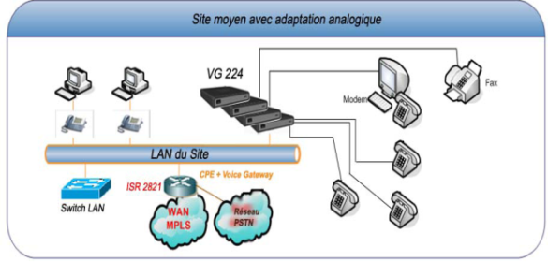


Unified Data & VoIP Infrastructure
Redundant Call Manger Hosted in TT Data Center
PSTN/
PLMN
7609-S
Optical Fiber up to100 Mbps
Backbone IP/MPLS
7609-S
166 small sites : FULL IP Solution
7609-S
ADSL Backup
Copper 2 Mbps
13 critical sites
101 importants sites

Slide 37

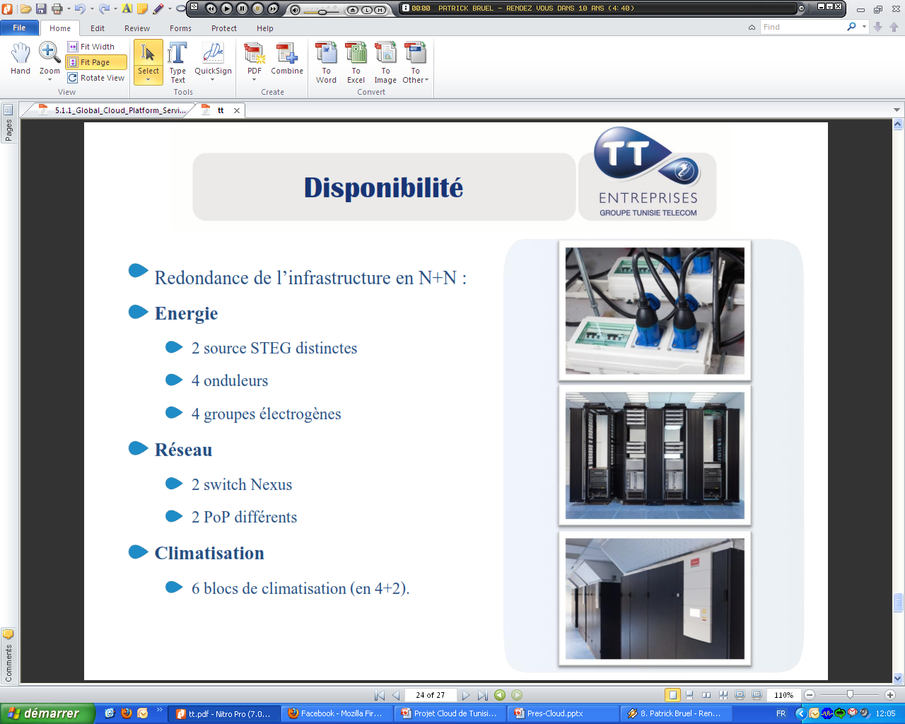
TT Data Centers
Tunisie Telecom has focused on the preparation of data centers to host many TT and customers’ platforms, according to TIA-942 Standard
  Kasbah Data Center (First TT DC )
  Area: 280 m², 92 42U Racks
  Redundant power and redundant air conditioning
  Hosts TT SaaS platform and Cloud Platform (nearly)
  Used for Corporate Housing TT offers
  Carthage Data Center
  A second Data Center (For load balancing) : Ready since October 2013
  Kairouan Data Center
  Data Center for «Disaster Recovery»
  Installation is ongoing

Slide 38

Services Evolution
Many services are provided within the present solution
  Voice supplementary services
  Directory
  Virtual mobility
e-health solution is scalable and able to support more VAS
  One unified number
  Telepresence
  Webex for healthcare
  Audio and video Conference
  WiFi - RFID
  Wi-Fi
  Audioconference
  etc.
  Collaboration services
  Presence
  Document sharing
  Instant messaging

Slide 39



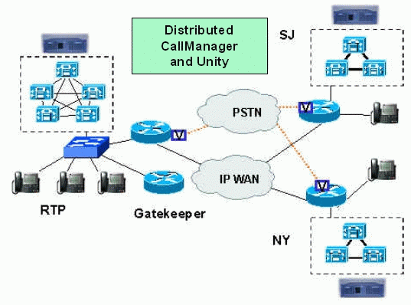

eHealth Mobility
Unified Number
One Number to dial
Gives users the ability to receive calls from any selected device, such as desktop, cellular phones, etc.
Users can also transition active calls between desktop and mobile phone without interruption
Doctors are more available and emergency is better processed
The doctor is not in his office now. 7003 : 70000003
70000003
Call Manager
98000005
7003
The doctor answers on his mobile
7003 : 98000005
The nurse called the doctor unified number: 7003 without knowing his location

Slide 40
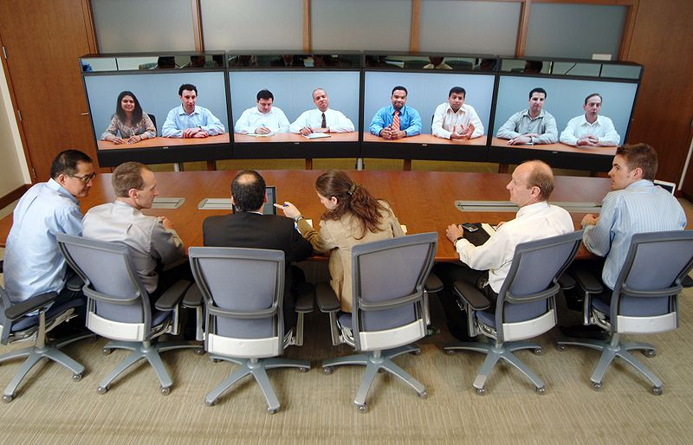
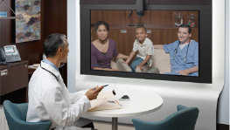
e-Health Telepresence
Provides patients and care providers with opportunities to consult and collaborate with specialists no matter the location
Make clinical decisions faster, improving patient care and outcomes
Reduce travel costs and time for patients, doctors and specialists
The infrastructure is ready, the service needs arrangement of rooms
We highly recommend Hospitals to subscribe to telepresence service for their benefit

Slide 41

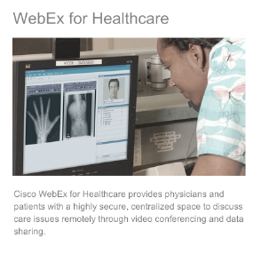
e-Health Webex
TT offers Webex service since 2012, Hospitals need only subscription
Provides physicians and patients with a highly secure, centralized space to discuss care issues remotely through video conferencing and data sharing
Advantages:
  Increased physician to physician and physician to patient collaboration
  Higher physician productivity through less travel
  Lower costs
  Possibility to invite specialists to discussion session
Tunis Hospital
Gabes Hospital

Slide 42
Why do African Countries need
e-Health services?
2. Examples of e-Health services
& applications in African countries
Agenda
3. e-Health standardization
4. Tunisie Telecom Experience
in e-Health
5. Conclusion & Recommendations

Slide 43
Why do African Countries need
e-Health services?
2. Examples of e-Health services
& applications in African countries
Agenda
3. e-Health standardization
4. Tunisie Telecom Experience
in e-Health
5. Conclusion & Recommendations

Slide 44

Conclusion
The use of ICT in health care brings many advantages especially to individuals, health care providers and governments, allowing higher quality, safer, more equitable and more efficient health care system and helping African countries find solutions to their health care issues (high child and maternal mortality, wide spread of diseases, difficult access to health care institutions,…)

Slide 45
Conclusion
The critical health care situation in African Countries urges national and international organizations and governments to intervene and invest in the development of innovative services and applications that aims to solve, even partially, the main health issues in these countries

Slide 46

Conclusion
In order to ensure more interoperability among Health care systems and reduce technology costs, many international organization have paid an important attention to e-Health standardization and launched some initiatives
Among these organizations, ITU is accomplishing several activities in the e-Health field, and that, mainly through its Study Groups and Focus Groups

Slide 47
Conclusion
Tunisie Telecom, as an incumbent operator, is concerned with proposing services for social purposes and it is providing currently, through its mega e-Health project for the Ministry of Health, a high available, secured and reliable infrastructure platform enabling many e-Health services such as: teleconsultation, telediagnosis, telepathology, teleradiology, Videoconferencing, telepresence, etc.

Slide 48

Recommendations
African countries should take advantage from the mobile telecommunications potential and focus more on the development of mobile health care applications since they are more accessible
Government in African countries should plan efficient strategies to promote e-Health and encourage industrials, service providers and suppliers to invest in the development of this field

Slide 49
Recommendations
Telecom Operators should catch the opportunities of innovative services offered in the e-Health field and find the most effective and convenient business models for e-Health services providing
In order to make the standardization initiatives more effective, a collaborative work between national and international organizations, local authorities and regulators should be established in addition to a strong willing from the health practitioners to adopt the new e-Health technologies

Slide 50

Thank you for your Attention
3rd SG13 Regional Workshop for Africa on “ITU-T Standardization Challenges for Developing Countries Working for a Connected Africa”
(Livingstone, Zambia, 23-24 February 2015)
Dr. Rim Belhassine-Cherif
Products and Services Executive Director, Tunisie Telecom
SG13 Vice-chair, SG13 RG-AFR Vice-chair, FG Innovation Vice-chair
rim.belhassine-cherif@tunisietelecom.tn

