Slide 1
3rd SG13 Regional Workshop for Africa on “ITU-T Standardization Challenges for Developing Countries Working for a Connected Africa”
(Livingstone, Zambia, 23-24 February 2015)
ICT standardization including Cloud Computing in Zambia
Mwenya Mutale,
Manager Standards and Type Approval, ZICTA, mmwenya@zicta.zm

Slide 2
Situational Analysis
Policy Environment
Economic
ICT Policy of 2006
Slowing Global economy
National Quality Policy of 2010
Unbalanced global trade
ICT Act No. 15 of 2009
ZABS Act of 1994
ICTs contribute < 2% GDP growing@6 %av.
ICT Standardization Policy 2011
Social/Cultural
Technological
Information Society, WSIS
Big Data
Cloud Computing
Social Media
Internet of Things
Increasing Digital awareness
NGN & DTT Migration ??
Broadband ?
Convergence

Slide 3
Challenges
Limited industry participation
lack of full access to international standards
inadequate R&D Capacity in Zambia
Lack of human resources
No standards education
Low industrialization

Slide 4
Opportunities
Participation in ITU activities such as SGs, World Telecom Standardization Assembly,
improved specifications for procuring network systems
ICT Standardization Scoping Study

Slide 5
ICT Standards Policy 2011
VISION: An efficient and advanced ICT sector offering quality and affordable services and products that are safe, environmental friendly and inter-operable.
STAKEHOLDERS: Engineers, Suppliers, Consumers, Operators etc.

Slide 6
ICT Standards Policy 2011
Objectives
Improve the effective functioning of ICT sector through adoption of high-quality and interoperable standards for ICT infrastructures in order to increase the efficiency of service delivery.
Increase access to ICT standards so as to boost innovation, economic competitiveness, and global trade.
Increase Global Access to Knowledge through interoperability standards enabling new forms of knowledge exchange such as digital education, medical and health diagnostic information, and to participate more actively in cultural and political life.

Slide 7
Institutional Framework
Sets long term Standards Roadmap.
ISC Conference
Secretariat
Executive wing of the ISC. Day to day implementatation of Policy & RoadMap
ICT Steering Committee
Approve the output of the TCs as well as set standards agenda. Recommend standards for gazette
Technical Committees
Assigned Topics of Study by ISC. May form subcommittees. Prepares standards for adoption

Slide 8
Implementation Plan of Zambia Standards
Procurement-Specifications
Certification Programs
Regulations & Guidelines
Codes of Practice
Government +Private
Dealers & Type Approval
e.g. Qos Guidelines, Interconnection etc.

Slide 9
Standards Developed
Over 160 developed/Adapted/Adopted
ETSI TS 102 250-1 | Part 1: Identification of QoS aspects | ZS ETSI TS 102 250-1
ETSI TS 102 250-2 | Part 2: Definition of QoS parameters and their computation | ZS ETSI TS 102 250-2
ETSI TS 102 250-3 | Part 3: Typical Procedures for QoS measurement equipment | ZS ETSI TS 102 250-3
ETSI TS 102 250-4 | Part 4: Requirement for QoS measurement equipment | ZS ETSI TS 102 250-4
ETSI TS 102 250-5 | Part 5: Definition of typical measurement profiles | ZS ETSI TS 102 250-5
ETSI TS 102 250-6 | Part 6: Post processing and statistical methods | ZS ETSI TS 102 250-6

Slide 10
TC5 and Cloud Computing
Technical Committee 5 is the lead TC for Cybersecurity
It looks at security issues for ICT sector
Intends to develop security standards for cloud computing
Held a cloud computing forum with stakeholders

Slide 11
Cloud Computing Forum
Objectives
To discuss matters pertaining to cloud services such as security, data protection and standardization of the sector and to develop recommendations for further action.
To explore the potential of cloud based services for the Zambian ICT sector.
Explore the risks and subsequently enhance on development of mitigation measures for security in the cloud.
To develop a strategy for educating the public on the usage of cloud services.

Slide 12
Cloud Services in Zambia
Service Providers:
NetOne,
Complete Enterprise Solutions (CES) and
MTN Business Zambia

Slide 13
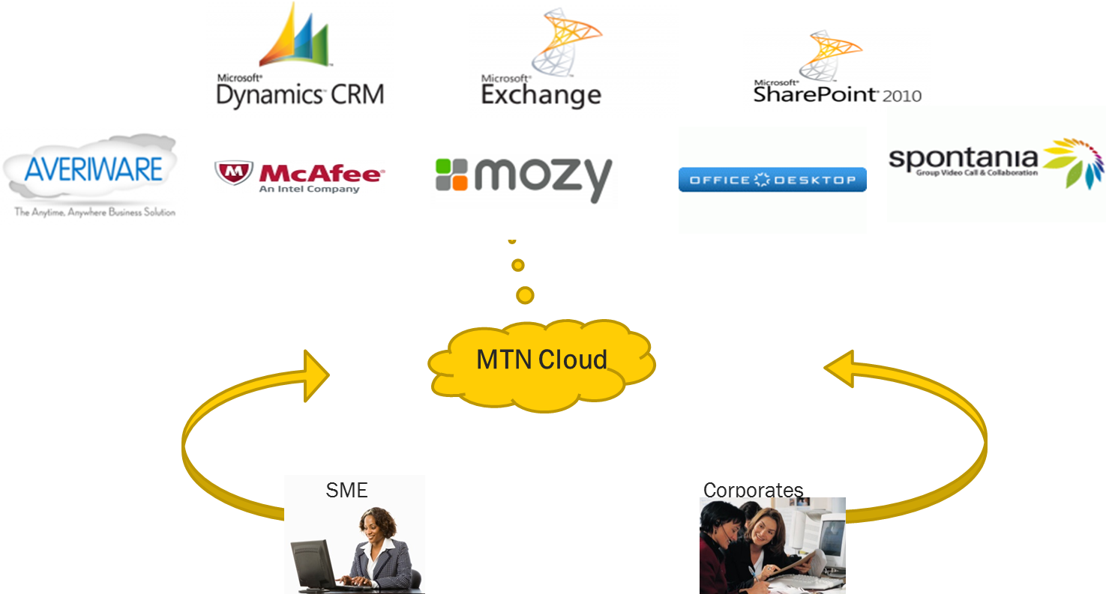
MTN Cloud Ecosystem

Slide 14











CES Cloud Service Range
Management
Virtual Applications
Virtualization
Compute
Network
EMC Storage
EMC Powered Backup
RSA Security

Slide 15

NetOne Cloud Service Portfolio
Pay as you GoService Offerings
NetBackup –Online backup and recovery
Mail Archiving –Email backup and archiving
EndPoint Protection –Antivirus & Anitspam
Firewall – Intrusion protection

Slide 16

NetOne Cloud Service Portfolio
MS Windows Server 2012 – Full Server 2012 capabilities including Data Center Edition
MS Exchange 2013 – Hosted Email services with full exchange capabilities
MS Office 2013 – Office Online
MS Lync - Voice Collaboration
MS SharePoint – Document and workflow sharing
CRM – Customer management and relationship

Slide 17


NetOne Cloud Service Portfolio
Sage HR
Hosted Payroll and Human Resource Management Offerings
Premier Payroll
Human Resource Management
Employee Self Service

Slide 18
Stakeholder Concerns
Security and Privacy
Connectivity
Certification
Data Storage

Slide 19
Security and Privacy
This has been the most significant concern and users tend to be sceptical about handing over their data to a third party. Among things sited are confidentiality of company information, handling of data and what happens to the data after one has migrated to another provider or when the contract comes to end.

Slide 20
Connectivity
There has been a general concern from the Cloud Service Providers (CSPs) and consumers about the unreliable and low speed internet connection over which cloud services are provided. Lack of Internet exchange points (IXP) has also resulted in users paying high international bandwidth prices thereby negatively affecting cloud service provision.

Slide 21
Certification
The CSPs are not being certified for the level, quality and standard of service provision.

Slide 22
Data Storage
The geographical location of the data centres has raised a lot of speculation on how that data will be handled when providers house their data centres overseas. The local Authorities may not have jurisdiction over this information and users are concerned on how they will be protected in such instances or indeed what the country’s strategy is in this regard.

Slide 23
Forum Recommendations
Build human capacity in Standards Development, Regulation, Auditing, Management and application development
Scoping study of the viability of cloud services in Zamia
Adopt, adapt and develop standards to be used for regulation and infrastructure installation
Licensing of Cloud Service Providers
Hold awareness campaigns so as to instill confidence in consumers of cloud services

Slide 24
In Conclusion….
More effort required by Africa in standards development
Standards to have relevance to the Africa’s needs
Sensitization required to encourage uptake of emerging services, need for quality etc
Synergies with SDOs should be established

