Slide 1
3rd SG13 Regional Workshop for Africa on “ITU-T Standardization Challenges for Developing Countries Working for a Connected Africa” (Livingstone, Zambia, 23-24 February 2015)
Why do African Countries need Standardization? Example of Cloud Computing Standardization
Dr. Rim Belhassine-Cherif
Products and Services Executive Director, Tunisie Telecom
SG13 Vice-chair, SG13 RG-AFR Vice-chair, FG Innovation Vice-chair

Slide 2
Cloud Computing & its opportunities
for African Countries
2. Importance of Cloud Computing
Standardization for African Countries
Agenda
3. Tunisie Telecom Experience
in Cloud Computing
4. Conclusion & Recommendations

Slide 3
Cloud Computing & its opportunities
for African Countries
2. Importance of Cloud Computing
Standardization for African Countries
Agenda
3. Tunisie Telecom Experience
in Cloud Computing
4. Conclusion & Recommendations

Slide 4
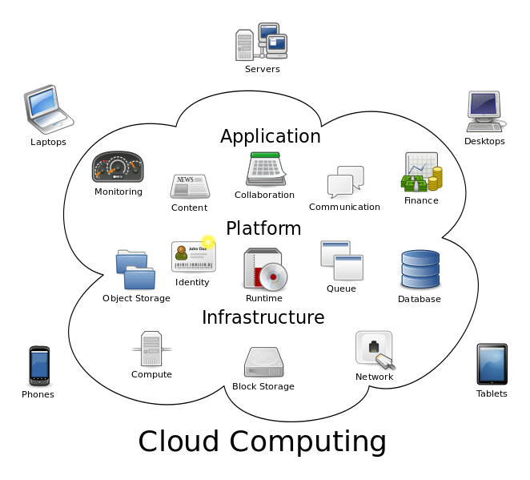
What is Cloud Computing ?
1
Cloud computing: “Paradigm for enabling network access to a scalable and elastic pool of shareable physical or virtual resources with self-service provisioning and administration on-demand”
Examples of resources include servers, operating systems, networks, software, applications, and storage equipment
Source: ISO/IEC 17788 | Recommendation ITU-T Y.3500 “Information technology - Cloud computing - Overview and vocabulary”

Slide 5
What is Cloud Computing ? Main Characteristics
2
Measured Service
Broad network access
Multi-tenacy
Source: ISO/IEC 17788 | Recommendation ITU-T Y.3500 “Information technology - Cloud computing - Overview and vocabulary”
On-demand self-service
Rapid Elasticity & Scalability
resource pooling

Slide 6
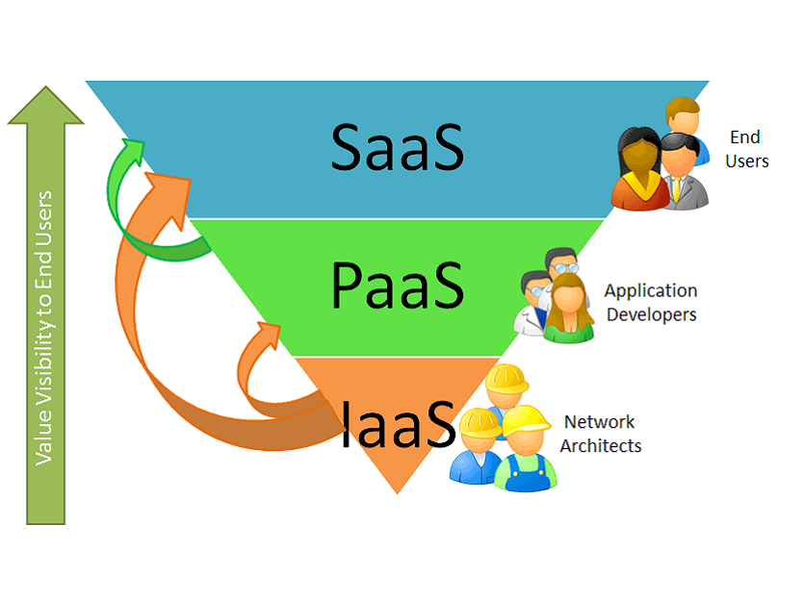
What is Cloud Computing ? Service Models
3
SaaS
Use provider’s applications over a network
PaaS
Deploy customer-created applications to a cloud
IaaS:
Rent processing, storage, network capacity, and other fundamental computing resources

Slide 7
CC Opportunities For African Countries
1
Cloud
Computing
Competitiveness
Collaboration
New jobs
Creation
Environment
Respect
Security
Mobility
Mobiles
Applications
Flexibility
Cost
Optimisation
DATA
Recovery
Opportunities for business that have socio-economic impact on African Countries

Slide 8
CC Opportunities For African Countries
2
"On Demand": You pay only for the service you consume
Significant cost savings through the pooling of technical resources
Less energy consumption
Cost
Optimisation
Discharge of ICT Budget with around 30% [Microsoft, 2012]
More financial resources for value added processes + innovation
Less investments for new entrants (SME)
Contribution to national economic growth
Exemple
The turnover of online storage services in South Africa in 2017 can reach 245 M$ (versus 72 M$ in 2011) [Pyramid Research, 2013]

Slide 9
CC Opportunities For African Countries
2
"On Demand": You pay only for the service you consume
Significant cost savings through the pooling of technical resources
Less energy consumption
Cost
Optimisation
Discharge of ICT Budget with around 30% [Microsoft, 2012]
More financial resources for value added processes + innovation
Less investments for new entrants (SME)
Contribution to national economic growth
Estimation
Revenues resulting from innovations in Cloud Computing can reach
1.1 B$ per year by 2015 [IDC, 2012]

Slide 10
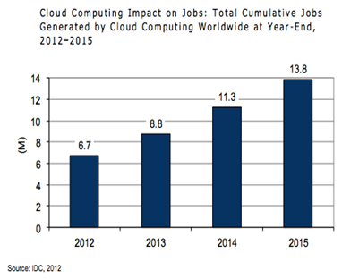
CC Opportunities For African Countries
3
13.8 M new jobs based on Cloud Computing will be created by 2015 [IDC, 2012]
New Jobs
Creation
The share of South Africa will be around 145K new jobs by 2015 (will double 7 times % 2012)
The share of Egypt will be around 112K new jobs by 2015

Slide 11
CC Opportunities For African Countries
4
Efficient tool for socio-economic development
➔ Development of beneficial applications in the fields of health care, education, agriculture, etc.
Mobile Cloud
Potential
Main Drivers:
Mobile phone users number in Africa (>600M) exceeds the number of Internet users (>140M) [World Bank, 2012]
Launch of many initiatives for applications development for Africa (ex: Apps4Africa)
Popular Applications:
iCow (Tanzania, since 2010)
medAfrica mobile health platform (Kenya, 2011)
M-PESA (Kenya, since 2007)

Slide 12
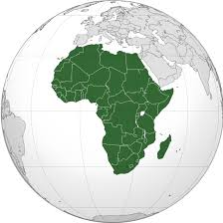
CC Opportunities For African Countries
5
Flexibility
Competitiveness
Ability to rapidly respond to enterprises’ requirements
Increase the potential of companies in competitiveness ➔ reduce the prices of end-users services
Data
Recovery
Mobility
In case of natural disaster or breakdown
Positive impact on the balance between private life and professional life of employees and on companies’ productivity

Slide 13
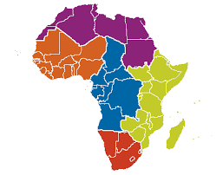
CC Opportunities For African Countries
6
Increased
Collaboration
Innovation
Access to cutting edge technologies used by multinational companies
Synchronisation of actions + share of documents and applications ➔ more efficiency
Respect of Environnement
Security
Data storage in the Cloud = guaranty against security problem in some countries
Reduction of IT wastes (the use of one virtual server reduces 4 tons of CO₂ [Vmware])

Slide 14
CC In Africa Some Key Figures
In 2013, 50% of medium and large enterprises in South Africa use CC, 48% in Kenya and 36% in Nigeria
In 2013, private Cloud is the most widespread with 25% of questioned organisations, 13% opt for hybrid Cloud and 7% for public Cloud
Source: Cloud in Africa: Reality Check 2013 research study, World Wide Worx & Cisco, November 2013
44% of Nigerian enterprises migrated to the Cloud in 2014 versus 24% in Kenya and only 16% in South Africa
In 2017, Africa and middle East will have the most important growth rates of Cloud traffic (57 % CAGR), followed by Asia pacific (43 % CAGR) and Central and Eastern Europe (36% CAGR)
The most used cloud service is storage (28% of questioned enterprises) followed by SaaS (10% of questioned enterprises)
CAGR : Compound Annual Growth Rate

Slide 15
CC In Africa Main Challenges
Lack of basic infrastructure in rural communities (roads, telecommunications, electricity, water, etc.)
Lack of PC for Internet access (predominance of Mobile Internet)
Poor Internet coverage (penetration rate of 20% in 2014)
Insufficiency of qualified human ressources
Data security issues (serious efforts are required in the field of security and the fight against data piracy and computer attacks)
Source: Developing Economies and Cloud Security: A Study of Africa, Journal of Emerging Trends in Computing and Information Sciences, August 2012
Need for a coherent regulatory framework that ensures transparency, protection and integrity respect of data
Importance of standardization to overcome such issues

Slide 16
Cloud Computing & its opportunities
for African Countries
2. Importance of Cloud Computing
Standardization for African Countries
Agenda
3. Tunisie Telecom Experience
in Cloud Computing
4. Conclusion & Recommendations

Slide 17
Cloud Computing & its opportunities
for African Countries
2. Importance of Cloud Computing
Standardization for African Countries
Agenda
3. Tunisie Telecom Experience
in Cloud Computing
4. Conclusion & Recommendations

Slide 18
Imagine a World without standards?
Manufacturers would be obliged to invent their own individual solutions to even the simplest needs
Customers would be restricted to one manufacturer or supplier
Products may not work as expected and may have inferior quality
Products may be incompatible with each others and may not even interconnect
Non-standardized products may be dangerous
Source: http://www.etsi.org
Standards are essential in all aspects of our daily lives including ICT

Slide 19
Standards Advantages for Governments
1
Complement regulation and promote international trade
Reduce technical barriers to international trade and position the country’s industry to compete in the world economy
Regulate and monitor industry so as to prevent adverse business practices
Offer an alternative to regulation with less red tape and business costs, while still ensuring that products and services are safe and healthy
Help developing countries in building their infrastructure and encouraging economic development
Help make laws consistent
Source: www.sabs.co.za
Reduce negative impacts on the environment
Encourage technology transfer from technology leaders to developing nations

Slide 20
Standards Advantages for Business
2
Save costs by optimising operations and therefore improve the bottom line
Inspire added trust in companies business
Assist business to meet mandatory regulations
Improve quality and reliability ➔ enhance customer satisfaction and increase sales
Create a competitive advantage by improving the quality of products and services
Help access to new markets by preventing trade barriers and opening up global markets
Increase market share by increasing productivity and competitive advantage
Improve internal risk management and planning
Source: www.iso.org

Slide 21
Standards Advantages for Consumers
3
Ensure the protection of consumers from hazards to their health and safety
Promote and protect economic interests of consumers
Guarantee an easier access to and greater choice in products and services
Ensure improved quality and reliability
Ensure better operation and compatibility between products and services
Enhance purchasing power
Source: www.sabs.co.za

Slide 22
Standards Advantages for Innovation
4
Source: www.bsigroup.com
Create a common framework for innovation that encourages the sharing of knowledge (by defining common vocabularies, establishing essential characteristics of a product or service, providing a means to disseminate results of R&D)
Provide a framework for moving from the development bench into production (defining essential parameters, safety considerations, testing, prototyping and scale-up)
Minimize duplication during R&D ➔ increasing efficiency
Maximize the ability of a product to be used in conjunction with others
Reduce unnecessary variance

Slide 23
CC Standardization Main Challenges
Efficiency of Service Provisioning
Information Security
Interoperability
Portability Between Providers
Transparency of Service Delivery & Billing
Source: Standardizing the Cloud, A Call to Action, Booz & Company 2012
Ensuring Fair Competition in the Market
Effectiveness of Service Usage & Control
Compliance with Regulatory Requirements
Data Privacy

Slide 24
Active Organizations in cloud standards
Source: Standardizing the Cloud, A Call to Action, Booz & Company 2012

Slide 25
ITU-T Work on CC Study Group 13
1
ITU-T SG13: Future networks including cloud computing, mobile and next-generation networks
3 questions on CC under the scope of WP 2/13 : Cloud Computing and Common Capabilities
Q17/13
Q18/13
Q19/13
Cloud computing ecosystem, general requirements, and capabilities
Cloud functional architecture, infrastructure and networking
End-to-end Cloud computing service and resource management
Common task: Providing necessary collaboration with external SDOs, consortia and forums working on CC

Slide 26
ITU-T Work on CC Joint Coordination Activity for Cloud Computing (JCA-Cloud)
2
Established after the TSAG agreement in January 2012 meeting with SG13 as parent group (Cf. TSB Circular 261)
Scope :
coordination of the ITU-T cloud computing standardization work within ITU-T
For example: SG2 on telecommunication management, SG5 on ICT and climate change, SG11 on protocols and interoperability, SG12 on QoS and SG17 on security
coordination of the communication with standards development organizations and forums working on Cloud Computing protocols and standards

Slide 27
ITU-T Work on CC Focus Group on Aviation Applications of Cloud Computing for Flight Data Monitoring (FG AC)
3
Established after the TSAG agreement in June 2014
This FG should work in close collaboration with the International Civil Aviation Organization and other international organizations, relevant ITU-T study groups, ISO/IEC JTC 1, ISO TC 20, key stakeholders (ICT solution providers, aircraft manufacturers, airlines)…
Objective :
Identify the requirements for telecommunication standards for an aviation cloud for real-time monitoring of flight data (protection and security, data ownership and access to flight data,…)

Slide 28
ITU-T Work on CC Examples of Past Workshops
4
ITU Workshop on "Cloud Computing Standards - Today and the Future”, Geneva, Switzerland, 14 November 2014
2nd SG13 Regional Workshop for Africa on "Future Networks: Cloud Computing, Energy Saving, Security & Virtualization”, Tunis, Tunisia, 28 April 2014
ITU Workshop on “Standardization on IMT, M2M, IoT, Cloud Computing and SDN​”, Algiers, Algeria, 8 September 2013
ITU Workshop on Cloud Computing, Tunis, Tunisia, 18-19 June 2012

Slide 29
Cloud Computing & its opportunities
for African Countries
2. Importance of Cloud Computing
Standardization for African Countries
Agenda
3. Tunisie Telecom Experience
in Cloud Computing
4. Conclusion & Recommendations

Slide 30
Cloud Computing & its opportunities
for African Countries
2. Importance of Cloud Computing
Standardization for African Countries
Agenda
3. Tunisie Telecom Experience
in Cloud Computing
4. Conclusion & Recommendations

Slide 31
TT Sectors
Fixed Telephony for mass market and Business
Mobile Telephony for mass market and Business
Interconnexion services : for Hole sale et international
Data : ADSL, Internet 3G,
Managed Services : Housing, Business Continuity, Business Applications, Unified Communication
Wide fiber optic network + 16 000 km of fiber optic installed in urban and interurban, covering a large part of Tunisia
More than 200 business areas served by fiber optics (Metro Ethernet) throughout the country
GSM coverage rate: > 99%
Mobile Data coverage rate (Edge / 3G ) : 82%

Slide 32
TT Strategy for Cloud Solutions
Offer innovative services and match the market trends
Enrich its service portfolio
Maintain its position as an “incumbent Operator" and be a leader in the local market
Reduce Opex and Capex

Slide 33
Existing TT Cloud Computing Offers
Corporate Housing
DaaS « Desktop as a Service»
Housing service provides Corporate Customers with space, power, cooling, and physical security for their server, storage, and networking equipment in TT Data Center
DaaS: A thin Client is provided to customer while the back-end of a virtual desktop infrastructure (VDI) is hosted by TT cloud
SaaS « Software as a Service »
Hosted Conferencing Solutions
Microsoft MCS2010 platform based Solution. The following services are provided:
Exchange
Link
Sharepoint
Audio conference
Video conference
Web Meeting

Slide 34
Future TT Cloud Computing services
1
Tunisie Telecom is implementing a Cloud Computing platform being secured, scalable and efficient
In the first phase, the following services will be provided:
IaaS: Infrastructure as a Service (DS, VPS, Storage)
BaaS: Backup as a Service
Web Hosting
Firewalling as a Service
Load Balancing as a Service

Slide 35
Future TT Cloud Computing services
2
The platform is characterized by the following features:
High availability
Flexibility and scalability
High security
end-to-end physical and logical security
Fully automatic service provisioning
➔ reduce activation time

Slide 36
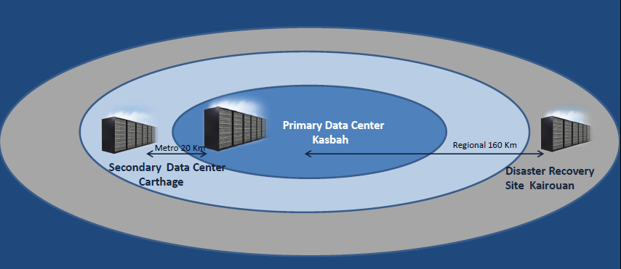
TT DATA Centers
1
Primary DC: Kasbah
Secondary DC: Carthage : 20 Km far from the primary DC
Disaster Recovery DC: Kairouan: 160 Km far from the primary DC

Slide 37
TT DATA Centers
2
TIA-942 Standard
Kasbah Data Center (First TT DC )
Area: 280 m², 92 42U Racks
Redundant power and redundant air conditioning
Hosts TT SaaS platform and Cloud Platform (nearly)
Used for Corporate Housing TT offers
Carthage Data Center
A second Data Center: Hosts new platforms and can be used for load balancing. This DC is ready since October 2013
Kairouan Data Center
Data Center for «Disaster Recovery»
Installation is ongoing

Slide 38
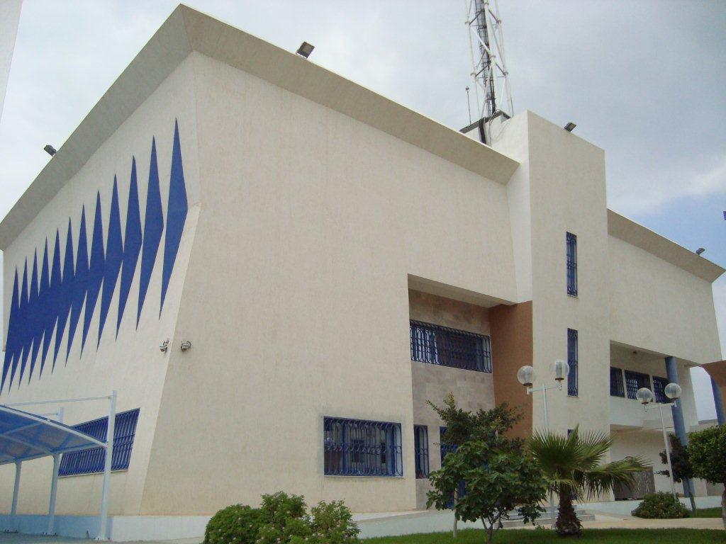
New TT DATA Centers Carthage Data Center
1
Tier III and ISO 27001 certification:
Process ongoing

Slide 39
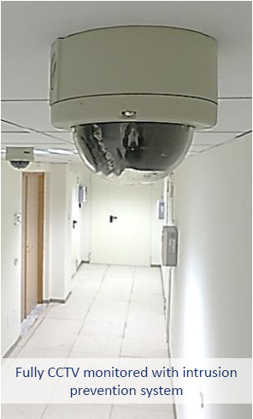
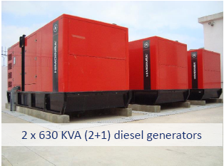
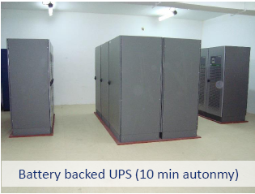
New TT DATA Centers Carthage Data Center
2
Cloud Ready Data Center

Slide 40
TT Preparations for the Cloud
Qualification and certification of TT Team in many technical fields (Networks, Security, Infrastructure, virtualization, storage…)
Network and Data Center Monitoring centers (24 x 7)
Processes for services , conform to international standards (ITIL or eTOM)
Assisting the companies as a long-term partner for telecom and IT services

Slide 41
Cloud Computing & its opportunities
for African Countries
2. Importance of Cloud Computing
Standardization for African Countries
Agenda
3. Tunisie Telecom Experience
in Cloud Computing
4. Conclusion & Recommendations

Slide 42
Cloud Computing & its opportunities
for African Countries
2. Importance of Cloud Computing
Standardization for African Countries
Agenda
3. Tunisie Telecom Experience
in Cloud Computing
4. Conclusion & Recommendations

Slide 43
Conclusion
1
Standards are essential elements in our daily live and in the global infrastructure of ICTs which allow a large number of players to interoperate and innovate, leading to expand commercial business, accelerate technology progress and allow end users to enjoy wider choice range, richer functionalities and lower costs
In the field of Cloud Computing, which offer several opportunities for African countries and stimulate economic and social development, standards can help these countries rapidly adopt CC services and technologies, benefit from their multiple advantages, and overcome related challenges
ITU-T, as other worldwide SDOs, was interested in the Cloud Computing concept, and that, since 2010 and it is continuing its work on Cloud Computing under the lead of its Study Group 13

Slide 44
Conclusion
2
SG13 is deploying serious efforts in developing standards that encloses many Cloud Computing-related aspect (definition, ecosystem, general requirements, Reference Architecture, Infrastructure, Resource Management, DaaS,...) and that, in collaboration with other study groups through the JCA-Cloud
Tunisie Telecom is aware of the emergence of cloud computing and it is investing in Cloud computing infrastructure in the objective of offering high quality cloud services and ensuring customer satisfaction. Tunisie Telecom is also conscious about the importance of standards in the field of Cloud Computing; for this reason it focused on building its Data Centers in accordance with international standards

Slide 45
Recommendations
1
Awareness regarding the importance of standards, especially for innovation, should be more an more raised in African countries in order to enhance their participation in the Standardization activities of international SDOs while setting mechanisms to encourage the participation of SME, start-ups and academia from these countries
Cloud Computing standards should follow the accelerating rhythm of Cloud Computing growth and evolution and that, in order to make it reach its full potential, become universally accepted and implemented and avoid service provider lock-in
Cloud computing standardization should be managed to support both innovation and competition, maximize contribution in the standardization process and minimize incompatibility of competing cloud services
Cloud Computing standardization stakeholders should further collaborate and work together in order to avoid standards fragmentation

Slide 46
Recommendations
2
Standardization should focus on the most important challenges of Cloud Computing (efficiency of service provisioning, effectiveness of service usage and control, information security, data privacy, interoperability, portability between providers, …) which are slowing down the adoption of Cloud Computing in markets around the world
The creation of datacenters respecting the international standards offers guarantees of service continuity, rapid accessibility and secure data backup, and helps provide technological requirements services to the business activities on time and at the right price
Governments need to promulgate legal and regulatory standards to ensure the consistent regulatory environment to concentrate on specific CC issues such as privacy

Slide 47
3rd SG13 Regional Workshop for Africa on “ITU-T Standardization Challenges for Developing Countries Working for a Connected Africa” (Livingstone, Zambia, 23-24 February 2015)
Thank You For Your Attention
Dr. Rim Belhassine-Cherif
rim.belhassine-cherif@tunisietelecom.tn

