Slide 1
3rd SG13 Regional Workshop for Africa on “ITU-T Standardization Challenges for Developing Countries Working for a Connected Africa” (Livingstone, Zambia, 23-24 February 2015)
AN OVERVIEW PRESENTATION OF Q.SUP66
BUGABA SIMON
Head/Regional Operations-UCC
stripleb@ucc.co.ug

Slide 2
Agenda;
Background
The study work
Justification for IMT & IMS
Considerations for implementation of IMT & IMS
Review of IMT & IMS in African states
Findings
Recommendations
After thoughts
Conclusions

Slide 3
Background
Developing Countries’ request to WTSA-08 ITU-T to study implementation of IMT and IMS in mobile networks
Work was assigned to SG 13, ( Qstn. 15 then Qstn.5)
Created relations with ITU-D, ITU-R, 3GPPP

Slide 4
The study work
Articulated and defined the scope of requirements
Solicited for contributions
Sent out an ITU-T Circular on subject
Collected current statistics and trends in IMT and IMS
Collaborated with other studies under ITU-D, ITU-R and 3 GPPP
Held workshops

Slide 5
Justification-IMT & IMS
Economical solutions for rural ICT needs;
Billing accuracy;
Improved QoE & QoS;
Improved security;
Spectrum efficiency for wireless technologies;
Increasing revenue streams from mobile operations.

Slide 6
Justification-IMT & IMS….
Addressing convergence between mobile and fixed services;
Backward compatibility with existing networks;
Support modern applications
Efficient utilization of electricity;
Support of modern services (data and multimedia) while maintaining voice services;

Slide 7
Considerations for implementing IMT & IMS
State of existing networks;
Availability of IMT spectrum;
Capital.
Expansion requirements for the network to underserved areas;
QoS & QoE.

Slide 8
Review of IMT & IMS in African states
Low rate of implementation : Reasons;
Insufficient information on the benefits of the new technologies and systems;
Lack of required capital;
Inability to pursue network owners to implement the technology;
Lack of infrastructure;
Expensive spectrum;
Unavailability of required spectrum;

Slide 9
Review of IMT & IMS in African states..
Different appreciation of (ITU) standardization among operators, regulators and users. E.g;
Regulators want the use of standards but do not know much about them and do not own the mobile networks
Operators know about standards but are reluctant to invest
Users want to use new applications but are “powerless”

Slide 10
FINDINGS: Awareness of the work of SG 13 on future networks

Slide 11
FINDINGS :Awareness of the work of SG 13 on IMT and IMS

Slide 12
FINDINGS :Deployment of mobile networks in 53 African countries (2014)

Slide 13
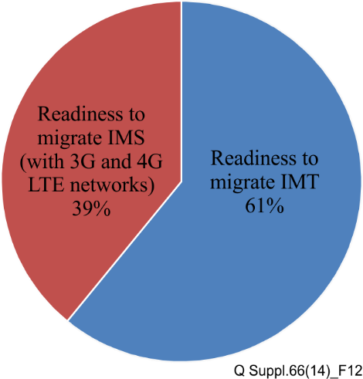
FINDINGS :3G and 4G LTE mobile networks with IMT capabilities

Slide 14
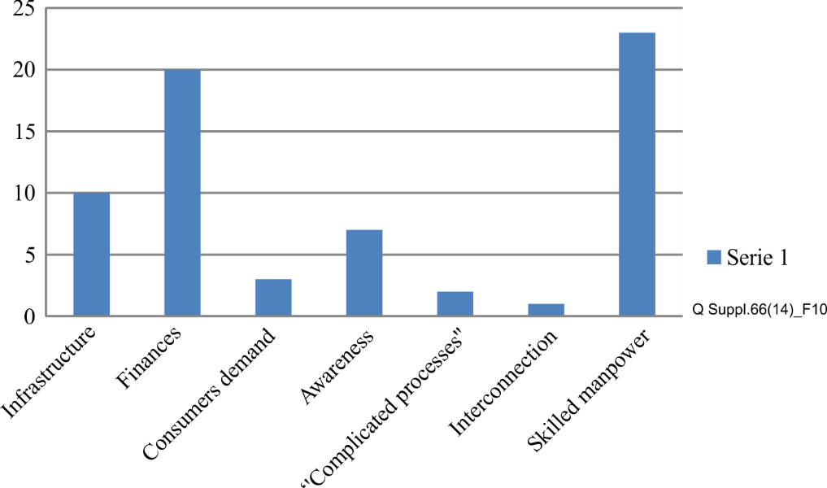
FINDINGS :Challenges to implementing IMT and IMS

Slide 15
General recommendations on implementing IMT and IMS
IMT & IMS are stable therefore recommendable
IMT and IMS both make implementation sense.
IMT networks are more cost effective
Offer better QoS and QoE
New services and choice

Slide 16
Conclusions
For IMT & IMS to thrive, developing countries need to;
Develop & Adopt new products, standards & Application
Govt, Regulators, operators and consumers to cooperate
Manpower issues & capacity to be addressed
Increase participation of developing countries in standardization work of ITU

Slide 17
After thoughts
IMT & IMS are for yesterday, how are developing countries prepared to adopt and adapt to new standards products, applications for the benefit of all?

Slide 18
END
THANK YOU FOR YOUR ATTENTION

