Slide 1
Smart utility connectivity
ITU Workshop
“Smart Sustainable Cities in Latin America ”
(Sao Paulo, Brazil, 30 July 2013)
Cesar Fuzeto,
IP Solution Director, Huawei cesar.fuzeto@huawei.com

Slide 2
Challenges
GOVERNMENTS & REGULATORY
NEAR-SHORT-TERM
RENEWABLES &
INNOVATION
SUSTAINABLE
BUSINESS
ENVIRONMENT

Slide 3
SUSTAINABLE BUSINESS ENVIRONMENT
NEAR-SHORT
-TERM
SMART METERING
M2M
INTERNET DRIVEN (RE)EVOLUTION
TSO & DSO DRIVEN EVOLUTION
MICROGRID
ENHANCED SERVICES AND
APPLICATIONS
SUSTAINABLE
BUSINESS
ENVIRONMENT
NEW BUSINESS MODELS
MORE DISTRIBUTED RENEWABLE
ENERGY
OPTIMIZING NEW POWER INVESTMENTS

Slide 4
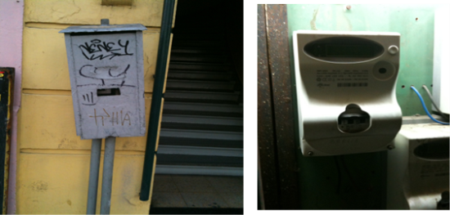
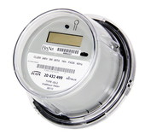
Next 5-10 Years
Source: Funkschau
M2M
Interconnecting Wind-Farms
Meter Evolution from Electricity-Water-Gas-Heating
Grid synchronization/
synchrophasors
Demand and Response
Islanding/micro grids
2013
2014
2015
2016
2017

Slide 5
AMI Requirements are not aligned
Date Collection Platform
Head-end-System
MDMS(Meter Data Management System)
Metering
Consumer
Network Management
IT Infrastructure
Fiber
Cloud
Firewall
Database Server
Authentication Server (AAA)
VPN Server
GE
Cellular
Microwave
Data Collection
Unit (DCU)
2G/3G, LTE/CDMA 450
Etc.
Substation 1..n
DLMS
BPL…….n
DLMS
Home Gateway
PLC
Integrated Security Module
RTU
ZigBee
MV PLC
DLMS
meter
meter
In-house home
Display
RS485/FE/GE/DI/USB
Electricity
Gas
Water

Slide 6
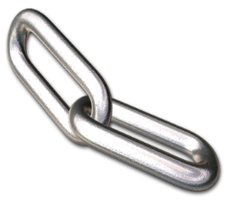
Technology Innovation for Smart Grid
Reliability
Availability
Efficiency
Cyber security
Integration/
Plug and play
Grid components
Communication
(ubquitous connectivity
and high bandwidth)
Developing a base for Advanced machine learning in the grid

Slide 7
Smart grid success components for consumers
Smart
Metering
Efficient
payment
Customer Benefit
Green gird
Economic
Pricing
Home
Automation
Smart
Appliances

Slide 8
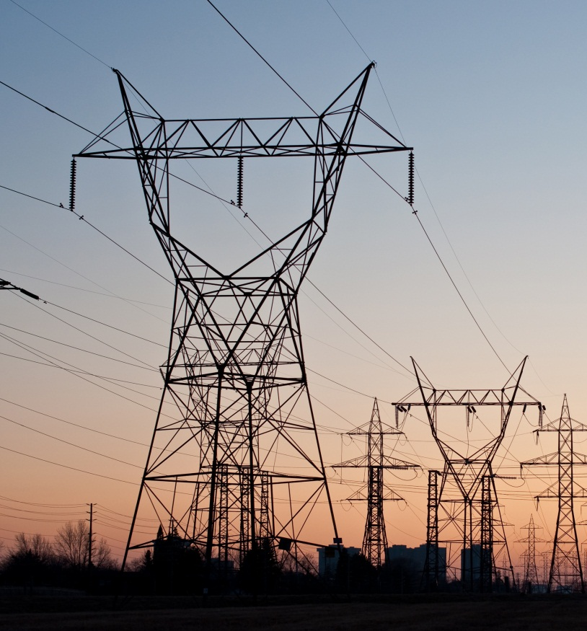
Smart Grid and it‘s Role in energy Networks
Present and Future
Challenges
Network Reliability
Intelligent Asset Management
Renewable and Distribution Energy Generation
Improving Utility Operations
Increased Cost transparency
Enhanced Customer Satisfaction

Slide 9
Communication Networks become Multi-X capable
Multi-Services
Measure
Control
Voice
Video
Messaging
Machine-Type
Multi Stakeholder
Producer
Transportation
Distribution
Consumer
Service Provider
Content Provider
Cloud Infrastructure
Applications
Backbone
Multi-Utility
Electricity
Gas
Oil
Water
Communication
Multi-Processes
Business Processes
Market & Trading
Operation
Access Networks
Terminals
Advanced Infrastructure & Services Offerings Requires:
Service Oriented IT Architecture & Cloud Infrastructure (XaaS)
Advanced QoS handling in Communication Networks
100% security and integrity of private data in shared medium

Slide 10
Machine Type Communication New Challenges Require New ICT Solutions
Public | Private | Sensor Networks (Telemetering)
 |  | Ultra Low Power Consumption (battery) or remote powered nodes
 |  | Ultra-Low Traffic: Bits (instead of Gigabits) per second
 |  | Long Latency accepted: Message delivery within hours
Public | Private | Control Networks (Telecontrol)
 |  | Ultra-Reliable (100%) physically redundant communication (e.g. via public backup)
 |  | Ultra-low latency in Milliseconds (e.g. line protection)
Designed to requirements
Private
(Utility Band, PLC, Fiber, ...)
Sensors,
Meters,
RTU, IED
Public
(Mobile, DSL)
Central Systems
Regulation Barriers
Operator SLA required
Private Communication Infrastructure Designed to Specific Customer Requirements
Can Outperform Public Infrastructure specially for Control Networks

Slide 11
Comparison of Downlink Communication
No. | Spec. Name | PLC（S-FSK） | PLC（OFDM） (G3 & PRIME) | RF/ZigBee | RS-485
1 | Applied Scene | High density | All | Disperse, but not too far | Centralized
2 | Transmission rate | 2.4kbps | 33.4kbps(G3) 128.6kbps(PRIME) | 9.6～250Kbps | 1200-9600bps, theoretically up to 10Mbps
3 | Transmission distance | 500m | 8km（MV） 220m（LV）* | 200m ~ 600m, open field up to 1000m | ≤1200m
4 | Success rate of one collection | About 70-85% | 95% | ≥85% | 100%
5 | Success rate of cycle collection | ≥95%(period of 1 day) | 99%(period of 1 day) | ≥95%(period of 1 day) | 100%(period of 1 day)
6 | Cost | Low | Medium | Medium | High
Notes:
1、对于OFDM的传输距离，未找到可靠的测试报告，G3的宣传口径一直是10km，但是是在中压线路的测试，低压线路目前能找到的是一份SAGEM的报告，测试距离为220m

Slide 12
Comparison of Uplink Communication
Technology | xPON | Public Network 2G/3G
Advantage | High capacity Far transmission distance Low latency Strong privacy | No network deployment and maintenance Good coverage Mature industry chain
Disadvantage | Difficult or unable deployment Long deployment cycle High one-time investment | Resource sharing with public Poor privacy Low reliability and security Low bandwidth Incapable for Service Development Subject to 2G/3G telecom operator
Notes:
MV PLC的优势查清楚

Slide 13
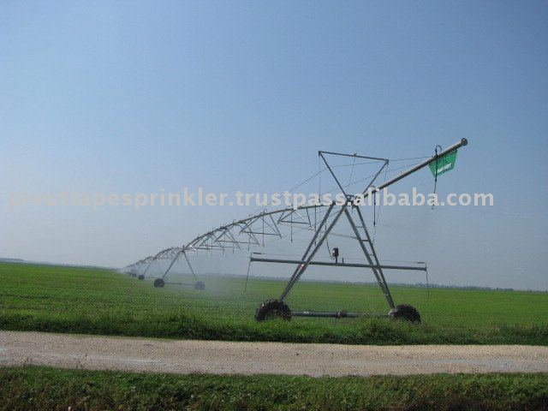
SMART
SMART
SMART
SMART
SMART
SMART
GRID
SMART
SMART
SMART
City
WATER

Slide 14
SMART WATER
The Telco Opportunity in Enabling the Smart Utilities including: Connectivity, Technology Platform and Consumer Service, Roberto Gavazzi, Telecom Italia ITU Workshop on “ICT as an Enabler for Smart Water Management” Luxor, Egypt, 14-15 April 2013

Slide 15
SMART……..
The Telco Opportunity in Enabling the Smart Utilities including: Connectivity, Technology Platform and Consumer Service, Roberto Gavazzi, Telecom Italia ITU Workshop on “ICT as an Enabler for Smart Water Management” Luxor, Egypt, 14-15 April 2013

Slide 16
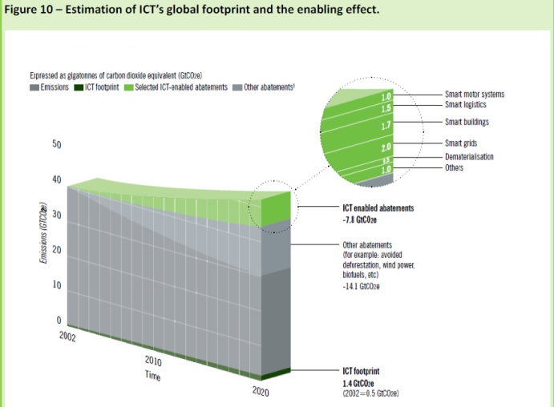
Energy efficiency needs to be sure about the benefits
ICT deployment in support of smart grids forces to reconsider energy-awareness of ICT devices, especially where large numbers of devices are involved (access network, inside home, AMI) .
an increased smartness on the part of the electrical grid allows greater flexibility in the energy aware resource allocation for the ICT sector; for example, in:
the choice of ”green” data centres (e.g., those utilizing renewable power sources;
o the introduction of faster dynamics in the energy price range (e.g., energy-price-aware (routing).

Slide 17
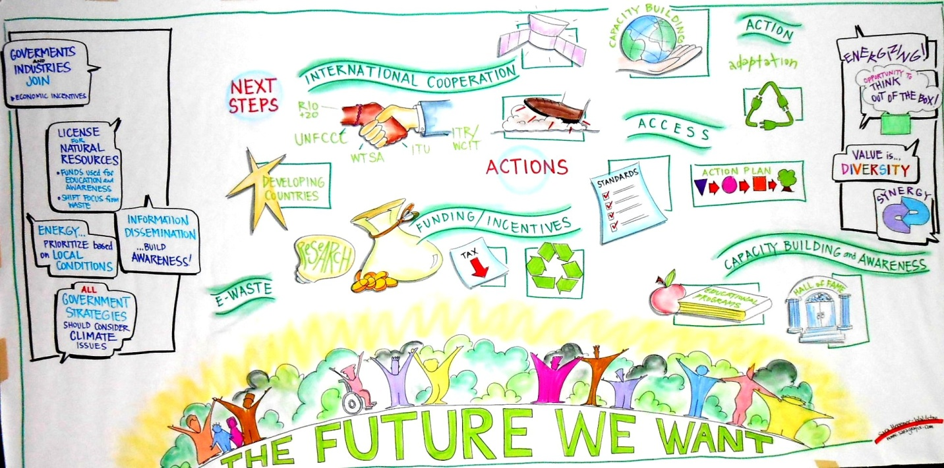
Thank you very much for your attention and think about the future …..
Image: Sara Heppner-Waldston
World Café @ ITU Seventh ITU Symposium on ICTs, the Environment and Climate Change
29 May 2012, Montreal, Canada

