Slide 1

ITU-T Standardization on Countering Spam
ITU Workshop on
“Countering and Combating Spam”
(Durban, South Africa, 8 July 2013)
Hongwei Luo
Rapporteur of ITU-T Q.5/17
luohongwei@catr.cn

Slide 2
Outline
Introduction to ITU-T Question 5/17
Introduction to spam
ITU-T standardization roadmap
Standards on countering spam
Practices of ITU-T standards
Future works

Slide 3
SG17 mandate established by World Telecommunication Standardization Assembly (WTSA-12)
WTSA-12 decided the following for Study Group 17:
Title: Security
  Responsible for building confidence and security in the use of information and communication technologies (ICTs). This includes studies relating to cybersecurity, security management, countering spam and identity management. It also includes security architecture and framework, protection of personally identifiable information, and security of applications and services for the Internet of things, smart grid, smartphone, IPTV, web services, social network, cloud computing, mobile financial system and telebiometrics. Also responsible for the application of open system communications including directory and object identifiers, and for technical languages, the method for their usage and other issues related to the software aspects of telecommunication systems, and for conformance testing to improve quality of Recommendations.
Lead Study Group for:
  Security
  Identity management
  Languages and description techniques
Responsible for specific E, F, X and Z series Recommendations
Responsible for 12 Questions

Slide 4
Study Group 17 Overview
Primary focus is to build confidence and security in the use of Information and Communication Technologies (ICTs)
Meets twice a year. Last meeting had 170 participants from 28 Member States, 19 Sector Members and 6 Associates.
As of 26 April 2013, SG17 is responsible for 312 approved Recommendations, 18 approved Supplements and 3 approved Implementer’s Guides in the E, F, X and Z series.
Large program of work:
  9 new work items added to work program in 2013
  April 2013 meeting: approved 3 Recommendations, 1 Amendment, and 3 Supplements; 2 Recommendations in TAP and 15 in AAP
  101 new or revised Recommendations and other texts are under development for approval in September 2013 or later
Work organized into 5 Working Parties with 12 Questions
8 Correspondence groups operating,
4 interim Rapporteur groups met.
See SG17 web page for more information
http://itu.int/ITU-T/studygroups/com17

Slide 5
SG17, Security
Study Group 17
WP 1/17
Fundamental security
WP 2/17
Network and information security
WP 3/17
IdM + Cloud Computing Security
WP 4/17
Application security
WP 5/17
Formal languages
Q.1/17
Telecom./ICT security coordination
Q.4/17
Cybersecurity
Q.8/17
Cloud Computing Security
Q.6/17
Ubiquitous
services
Q.11/17
Directory,
PKI, PMI, ODP, ASN.1, OID, OSI
Q.2/17
Security architecture and framework
Q.5/17
Countering spam
Q.10/17
IdM
Q.7/17
Applications
Q.12/17
Languages and Testing
Q.3/17
ISM
Q.9/17
Telebiometrics

Slide 6
1. Introduction to Question 5/17
Name: Countering spam by technical means
Establishment: 2005
Role: Act as the lead group in ITU-T on countering spam by technical means according to WTSA-12 Resolution 52 (Countering and combating spam)
  Achievement: 7 existing Recommendations and 2 ongoing work items from Q.5/17 in the ITU-T X.1230~X.1249 series Recommendations, 4 supplements exclusive

Slide 7
1. Introduction to Q.5/17
Objectives:
  Establish effective cooperation with the IETF, the relevant ITU study groups and appropriate consortia and fora, including private sector entities for this area.
  Identify and examine the telecommunication network security risks (at the edges and in the core network) introduced by the constantly changing nature of spam.
  Develop a comprehensive and up-to-date resource list of the existing technical measures for countering spam in a telecommunication network that are in use or under development.
  Determine whether new Recommendations or enhancements to existing Recommendations, including methods to combat delivery of spyware, worm, phishing, and other malicious contents via spam and combat compromised networked equipment including botnet delivering spam, would benefit efforts to effectively counter spam as it relates to the stability and robustness of the telecommunication network.
  Provide regular updates to the Telecommunication Standardization Advisory Group and to the Director of the Telecommunication Standardization Bureau to include in the annual report to Council.
  Maintain awareness of international cooperation measures on countering spam.

Slide 8
2. Introduction to spam
Understanding of Spam (defined in Rec. ITU-T X.1231):
  Spam is electronic information delivered from senders to receivers by terminals such as computers, mobile phones, telephones, etc., which is usually unsolicited, unwanted and harmful for receivers.
  administrations considers inappropriate in alignment to national laws and policies (out of scope)
  annoy or give bad influences on recipients, which sent without the recipients’ permission
Bulk
Repetitive
Unsolicited
Characteristics
of Spam
Illegal
collection and
use of addresses
Hard
to block

Slide 9
2. Introduction to spam
Common options
E-mail
Mobile messaging service
IP-based Multimedia
Phone call
VoIP
Any information technologies
Spammer utilize various technologies, services and applications to spread spam.

Slide 10
2. Introduction to spam
reducing users’
Satisfaction
Bad influences of
Spam
bringing other
bad influences
Merits
wasting network
resources
low price
excellent flexibility
easy usage
increasing
the social instability

Slide 11
2. Introduction to spam
Toolkits for countering spam
Regulation
Enforcement
Industry driven initiatives
Technical solutions
Education and awareness
Co-operative partnerships
ITU-T Q.5/17

Slide 12




2. Introduction to spam
1. Viruses for spam spreading
Q.4/17
4. Information protection
Q.7/17
Q.10/17
Q.5
5. Other relationships
2. PII protection
Etc.
3. Terminal security against spam
Q.6/17

Slide 13
3. ITU-T Standardization Roadmap
Principals on countering spam
Avoid the legal issues
Minimize changes to user interface
Increase the satisfaction of users
Implement easily with good interoperability
Minimize changes to the existing network system

Slide 14
3. ITU-T Standardization Roadmap
Technical strategies
Specific guideline
Specific framework and technologies
General technologies and protocols
Relative activities and policies

Slide 15
4. Standards on countering spam
ITU-T X.1231 (2008) :Technical strategies for countering spam
Summary:
  This Recommendation
  emphasizes technical strategies for countering spam
  includes general characteristics of spam and main objectives for countering spam.
  provides a checklist to evaluate promising tools for countering spam.

Slide 16
4. Standards on countering spam
ITU-T X.1231 (2008) :Technical strategies for countering spam
Filtering Strategies
Feedback Strategies
Service Strategies
Equipment
Strategies
Network Strategies

Slide 17
4. Standards on countering spam
ITU-T X.1231 (2008) :Technical strategies for countering spam
System evaluation
False positive
False negative
Cost
Conformance
Interoperability

Slide 18
4. Standards on countering spam
ITU-T X.1240 (2008): Technologies involved in countering e-mail spam
Summary
  This Recommendation
  specifies basic concepts, characteristics and effects of e-mail spam, and technologies involved in countering e-mail spam.
  introduces the current technical solutions and related activities from various standards development organizations and relevant organizations on countering e-mail spam
  provides guidelines and information to users who want to develop technical solutions on countering e-mail spam.

Slide 19
4. Standards on countering spam
ITU-T X.1241 (2008): Technical framework for countering email spam
Summary
  This Recommendation
  provides a technical framework for countering email spam, which describes one recommended structure of an anti-spam processing domain and defined function of major modules in it.

Slide 20
4. Standards on countering spam
ITU-T X.1241 (2008): Technical framework for countering email spam
Anti-spam processing entity
IC: SMTP
messages
IA: FTP and HTTP
Complaint reports and rules
Anti-spam processing sub-entity
Anti-spam processing sub-entity
IB: FTP and HTTP
Complaint reports and rules
IE: Web online, phone, email and client Software
Complaints
Email Server
Email Server
ID: POP3, IMAP4
Emails
Email Client
Email Client

Slide 21
4. Standards on countering spam
ITU-T X.1242 (2009): Short message service (SMS) spam filtering system based on user-specified rules
Summary
  This Recommendation
  describes the realization of the SMS spam filtering system based on user-specified rules.
  defines the structure of SMS spam filtering system, SMS spam filtering functions, users' service management, communication protocols and basic functional requirements of terminals with SMS functions.

Slide 22


4. Standards on countering spam
ITU-T X.1242 (2009): Short message service (SMS) spam filtering system based on user-specified rules
Messaging Service Center
Filtering
module
Filtering rules database
Filtered messages database
Web/MS/SS Management Platform

Slide 23
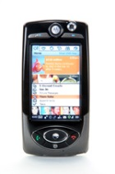

4. Standards on countering spam
ITU-T X.1242 (2009): Short message service (SMS) spam filtering system based on user-specified rules
Database for blocked SM
Filtering Center
Failed: Blocking and Saving
Filtering request
SM to B
SMSC
Filtering Module
Sender A
No
Yes
Yes/No response
Configuration Module
Passed: Deliver SM
User B
Filtering (Blocking) Process

Slide 24
4. Standards on countering spam
ITU-T X.1242 (2009): Short message service (SMS) spam filtering system based on user-specified rules
User-specified rules database (URD)
Filtered messages database (FMD)
User service management module (USMM)
SMS spam filtering module (SSFM)
Service control module (SCM)
Short Message Service Centre (SMSC)

Slide 25
4. Standards on countering spam
ITU-T X.1242 (2009): Short message service (SMS) spam filtering system based on user-specified rules

Slide 26
4. Standards on countering spam
ITU-T X.1242 (2009): Short message service (SMS) spam filtering system based on user-specified rules

Slide 27
4. Standards on countering spam
ITU-T X.1243 (2010): Interactive gateway system for countering spam
Summary
  This Recommendation
  specifies the interactive gateway system for countering spam as a technical means for countering inter-domain spam.
  enables spam notification among different domains
  prevents spam traffic from passing from one domain to another.
  describes basic entities, protocols and functions of the gateway system
  provides mechanisms for spam detection, information sharing and specific actions in the gateway system for countering spam.

Slide 28
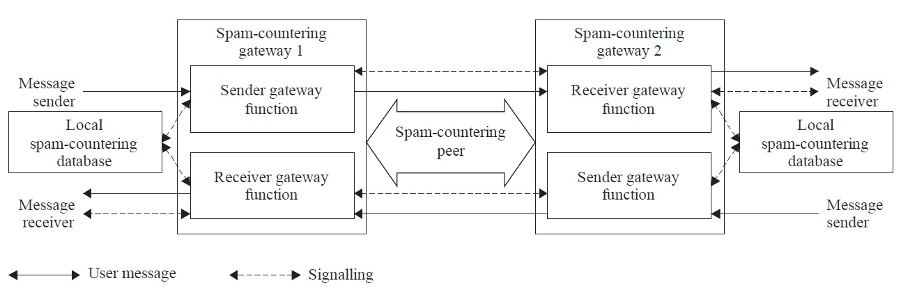
4. Standards on countering spam
ITU-T X.1243 (2010): Interactive gateway system for countering spam

Slide 29
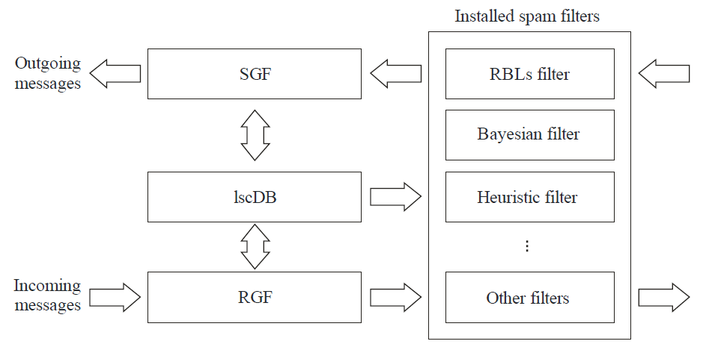
4. Standards on countering spam
ITU-T X.1243 (2010): Interactive gateway system for countering spam

Slide 30
4. Standards on countering spam
ITU-T X.1244 (2008): Overall aspects of countering spam in IP-based multimedia applications
Summary
  This Recommendation
  specifies the basic concepts, characteristics, and technical issues related to countering spam in IP multimedia applications
  describes various spam security threats that can cause IP multimedia application spam
  Introduce techniques which can be used in countering IP multimedia application spam
  analyses the conventional spam countering mechanisms and discusses their applicability to countering IP multimedia application spam.

Slide 31
4. Standards on countering spam
ITU-T X.1244 (2008): Overall aspects of countering spam in IP-based multimedia applications
Typical types of IP multimedia spam
typical types of IP multimedia spam
VoIP spam
IP multimedia message spam
Instant messaging spam
Chat spam
Multimodal spam
Website spam

Slide 32
4. Standards on countering spam
ITU-T X.1244 (2008): Overall aspects of countering spam in IP-based multimedia applications
Classification of IP multimedia spam
 | Text | Voice | Video
Real-time | • Instant messaging spam • Chat spam | • VoIP spam • Instant messaging spam | • Instant messaging spam
Non Real-time | • Text/multimedia message spam • Text spam over P2P file sharing service • Website text spam | •Voice/multimedia message spam • Voice spam over P2P file sharing service • Website voice spam | •Video/multimedia message spam • Video spam over P2P file sharing service • Website video spam

Slide 33
4. Standards on countering spam
ITU-T X.1244 (2008): Overall aspects of countering spam in IP-based multimedia applications
Technical issue for countering IP multimedia spam
Creation and delivery of spam
Collection of target list
Creation and delivery of spam
Detection and filtering of spam
Real-time communications
Difficulty of contents analysis of voice and video
Action for the received spam
add spammer's identifier to a blacklist
give a bad score to the spammer
Difficulty of spammer authentication
report illegal spam to punish spammers

Slide 34
4. Standards on countering spam
ITU-T X.1244 (2008): Overall aspects of countering spam in IP-based multimedia applications
Spam security threats
Attack techniques | Spam security threats
Malicious code/remote control | Spam Bot
Session hijacking | Session hijacking
SQL injection | SQL injection
Sniffing | Registration information sniffing
Spoofing | Sender spoofing, cache poisoning, routing control
Others | Identifier collection, vulnerable management system

Slide 35
4. Standards on countering spam
ITU-T X.1244 (2008): Overall aspects of countering spam in IP-based multimedia applications
Relationship between countermeasure and security threats
Countermeasures Threats | Authentication | Authorization | Security management
Identifier collection |  |  | X
Sender spoofing | X
Registration information sniffing | X
Session hijacking | X
SQL injection |  | X | X
Spam Bot |  |  | X
Cache poisoning | X
Routing control | X
Vulnerable management system |  | X | X

Slide 36
4. Standards on countering spam
ITU-T X.1244 (2008): Overall aspects of countering spam in IP-based multimedia applications
well-known mechanisms
Identification filtering
Address masking
Human interactive proof
Authentication by key exchange
Network-based spam filtering
Online stamp
Authorization-based spam filtering
Legal action and regulations

Slide 37
4. Standards on countering spam
ITU-T X.1244 (2008): Overall aspects of countering spam in IP-based multimedia applications
Considerations in countering IP multimedia application spam
Considerations
service subscriber
Service provider
Network operator
Public organization
Other considerations

Slide 38
4. Standards on countering spam
ITU-T X.1245 (2010): Framework for countering spam in IP-based multimedia applications
Summary
This Recommendation
  provides the general framework for countering spam in IP-based multimedia, which consists of four anti-spam functions
  describes the functionalities and the interfaces of each function for countering IP multimedia spam

Slide 39
4. Standards on countering spam
ITU-T X.1245 (2010): Framework for countering spam in IP-based multimedia applications
Technical methods
Source analysis method
Blacklist
Whitelist
Characteristics analysis method
Reputation system
Bulk analysis
Interactivity test
Spam labelling

Slide 40
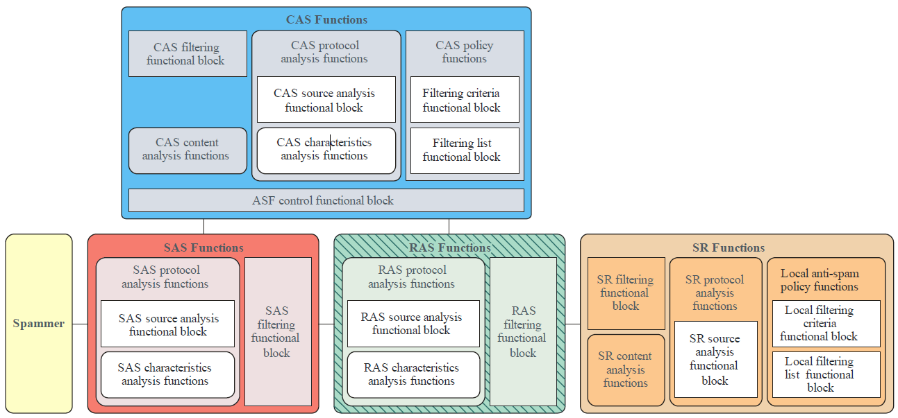
4. Standards on countering spam
ITU-T X.1245 (2010): Framework for countering spam in IP-based multimedia applications

Slide 41
4. Standards on countering spam
Supplement 6 to ITU-T X-series Recommendations (2009): Supplement on countering spam and associated threats
Summary
This Supplement
  states that in order to deal effectively with spam, governments need to employ a variety of approaches, including effective laws, technological tools, and consumer and business education.
  reviews the international forums where the issue of spam is being addressed.
  provides some information about the way the U.S. and Japan have approached the spam problem.

Slide 42
4. Standards on countering spam
Supplement 6 to ITU-T X-series Recommendations (2009): Supplement on countering spam and associated threats
London Action Plan
International(multilateral) countering spam initiative
OECD Spam Toolkit and Council Recommendation on spam Enforcement Cooperation
Supplement and associated threats
APEC TEL Symposium on spam
网络空间安全
United States
Case study of some activities to counter spam
Japan

Slide 43
4. Standards on countering spam
Supplement 11 to ITU-T X-series Recommendations (2011): Supplement on framework based on real-time blocking lists for countering VoIP spam
Summary
This Supplement
  provides a technical framework based on a real-time blocking list (RBL) for countering voice over Internet protocol (VoIP) spam
  specifies the functionalities, procedures, and interfaces of each functional entity for countering VoIP spam.

Slide 44
4. Standards on countering spam
Supplement 11 to ITU-T X-series Recommendations (2011): Supplement on framework based on real-time blocking lists for countering VoIP spam
Outbound Domain
inbound Domain
User-reputation system (URS)
User-reputation system (URS)
Global RBL
Local RBL
RBL central system for VoIP spam prevention
(VSP-RBL)
VoIP spam prevention policy server (VSPPS)
VoIP spam prevention policy server (VSPPS)
Local RBL
VoIP spam prevention system (VSPS)
VoIP spam prevention system (VSPS)
Sender
Recipient

Slide 45
4. Standards on countering spam
Supplement 12 to ITU-T X-series Recommendations (2012): Supplement on overall aspects of countering mobile messaging spam
Summary
This Supplement
  describes the basic concept and characteristics of mobile messaging spam. It also introduces and analyses current technologies on countering mobile messaging spam.
  proposes a general implementation framework for countering mobile messaging spam

Slide 46
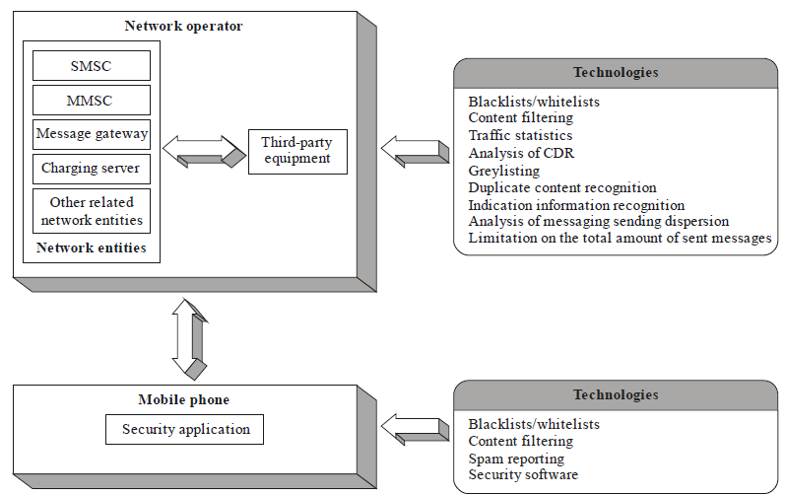
4. Standards on countering spam
Supplement 12 to ITU-T X-series Recommendations (2012): Supplement on overall aspects of countering mobile messaging spam

Slide 47
4. Standards on countering spam
Supplement 14 to ITU-T X-series Recommendations (2012): Supplement on a practical reference model for countering e-mail spam using botnet information
Summary
This Supplement
  provides a reference model. In this reference model, spam-countering gateways can share botnet-related information with each other.
  focuses on countering e-mail spam sent by a botnet.

Slide 48
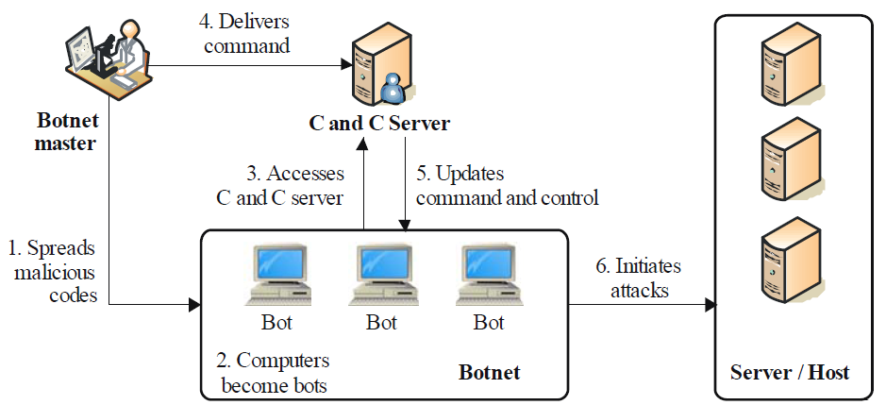
4. Standards on countering spam
Supplement 14 to ITU-T X-series Recommendations (2012): Supplement on a practical reference model for countering e-mail spam using botnet information

Slide 49
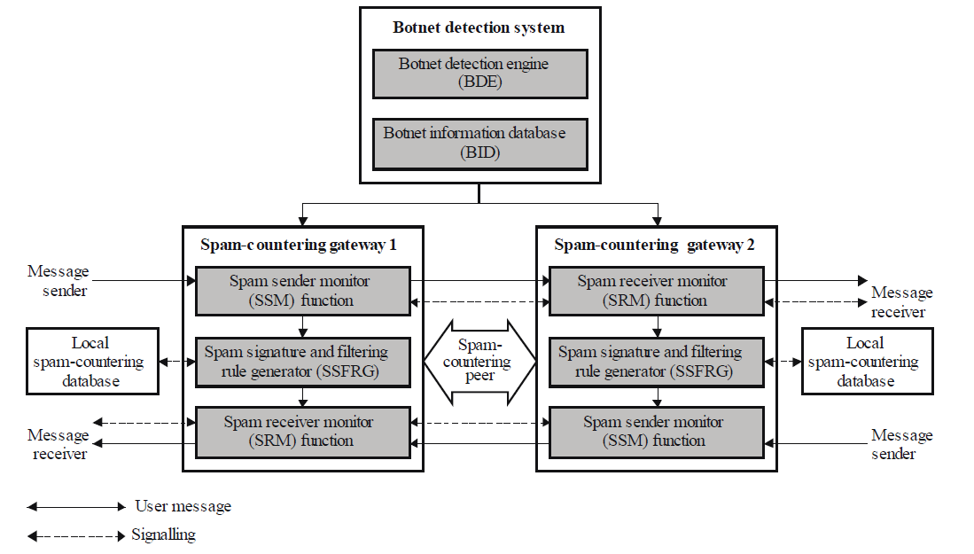
4. Standards on countering spam
Supplement 14 to ITU-T X-series Recommendations (2012): Supplement on a practical reference model for countering e-mail spam using botnet information

Slide 50

5. Practices of ITU-T standards
Implementation of ITU-T X.1242
mobile phone
Group SMS sending device
SP
SP
CMPP/SGIP/SMGP
SMPP
SMSC
SP
ISMG
Internet
Mobile networks

Slide 51
5. Practices of ITU-T standards
Implementation of ITU-T X.1242
Service Providers
Manufactories
1. Decreasing volume of the users’ complaints
2. Increasing the profits by charging the filtering service
3. Accelerating the development of messaging service
4. Satisfying administration

Slide 52
6. Future works
Technical strategies
E-mail
Spam
Guideline
Framework
technologies
IP-based Multimedia spam
Guideline
Framework
technologies
Mobile messaging
spam
Guideline
Framework
technologies
Web
Spam
Guideline
Framework
technologies
Other
Spam
Guideline
Framework
technologies
  Functions and interfaces for countering email spam sent by botnet (X.ics)
  Interactive gateway system for countering spam (X.1245)
  Technical means for countering VoIP spam (X.tcs-2)
  Personal information protection
  Other general technologies
  Supplements and best practices

Slide 53

Thank You !
Q/A
Hongwei Luo
Rapporteur of ITU-T Q.5/17
luohongwei@catr.cn

