Slide 1
E-waste in emerging markets: an opportunity
ITU Workshop on
“Environmentally Sound Management of E-waste”
(Durban, South Africa, 9 July 2013)
Ruben Janse van Rensburg,
Environmental Manager Africa, HP ruben.janse-van-rensburg@hp.com

Slide 2
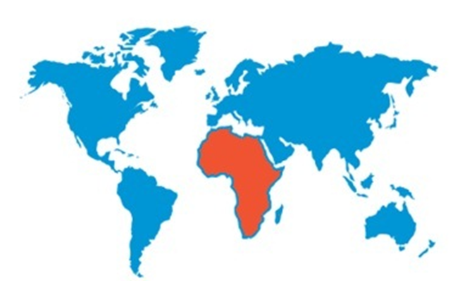
Africa : about growth ….
3.6 B population by 2050
EEE consumption growth rates very high (new & 2nd hand)
Domestically generated E-waste may exceed EU’s by 2018
2

Slide 3
Very few African countries have e-waste regs
African countries
Original “WEEE” countries
Nigeria
Cameroon
Ghana
Kenya
Ethiopia
Uganda
Tanzania
Rwanda
South Africa
Zambia
Egypt
160m
20m
25m
43m
91m
34m
47m
12m
50m
14m
84m
580m
United Kingdom | 63m
Germany | 81m
France | 66m
Austria | 8m
Belgium | 10m
Denmark | 6m
Finland | 5m
Greece | 11m
Ireland | 4m
Italy | 61m
Luxembourg | 1m
Netherlands | 17m
Portugal | 11m
Spain | 47m
Sweden | 9m
Norway | 5m
Switzerland | 8m
413m

Slide 4
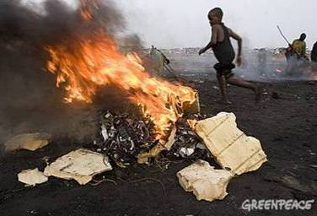
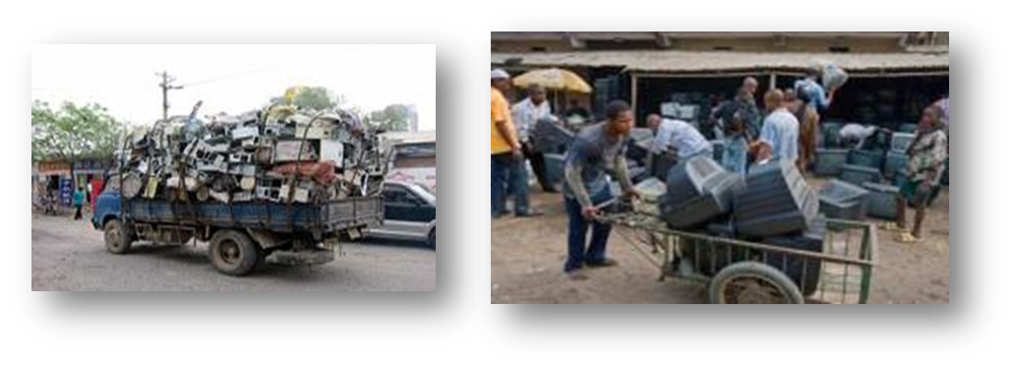
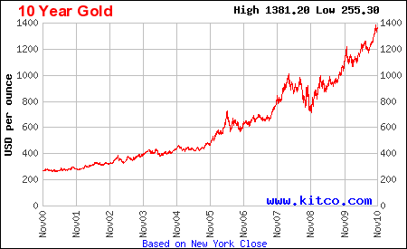
E-waste “basics”
Rudimentary recycling is the issue
Collection is NOT a
problem
E-waste has value → can be collected & treated as a profitable business

Slide 5
E-waste : current state…
behaviour
Non-Valuable Fractions
Local Dumping/ Burning
End User
Informal Collectors
“Recyclers”
Limited Material Markets
rudimentary
‘cherry’ picking
Producers
NO connection between “Producers” and the material flows
Informal collectors NOT connected to a formal recycling structure

Slide 6
With Extended Producer Responsibility
behaviour based system
local and global markets
recycling
standards
End User
Informal Collectors
Local and Global Material Markets
Recyclers
safety net for “problematic fractions”
activate local markets – waste beneficiation
Producers
E-Waste Control Body
Producer Registration & Obligation
Fair & enforced regulation is paramount to stimulate investments by recyclers
Regional approaches are critical to effective solutions deployment

Slide 7
Deployment in Kenya, a role model
Treatment Center & Trading Platform operating under strict recycling standards
$$
Collectors
$$
Collectors
Collectors
Collectors
Collectors
Collection centres X 50
Scope : all e-waste, including ‘problematic fractions’
Goal : self sustaining business model, supporting “EAC”
Enabled by draft regulation
Creating THOUSANDS of green jobs in Kenya
20 scavengers for each collection point
7

Slide 8
”E-waste solutions Alliance for Africa”
Reclaimed Appliances (UK) Ltd
Leading, not following
Working with and supported by
8

Slide 9
Where does the Alliance act together?
Ghana
Ethiopia
Kenya
Tanzania
Uganda
Nigeria
RSA
9

Slide 10
Where are the Recyclers?
Kenya
RSA
10

Slide 11
Partnerships are essential !
Government agencies and NGOs
Academia and research groups
OEMs and Recyclers
University of Ibadan
Reclaimed Appliances (UK) Ltd
Leading, not following
11

Slide 12
Thank you

