Slide 1
ITU Workshop on Environmentally Sound Management of E-Waste Durban, South Africa, 9 July 2013
THE COMPLEXITY OF THE E-WASTE PROBLEM
Phosa Mashangoane
General Manager Consumer Affairs
INDEPENDENT COMMUNICATIONS AUTHORITY OF SOUTH AFRICA
E-mail: pmashangoane@icasa.org.za
Durban, South Africa, 9 July 2013

Slide 2
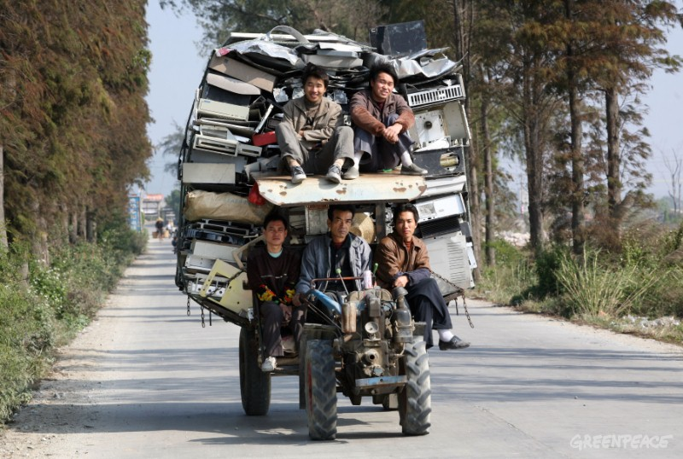
THE COMPLEXITY OF THE E-WASTE PROBLEM
ABOUT E-WASTE
Electronic waste, or e-waste, includes garbage of electronic goods such as phones, televisions, stereos, computers, printers and other electronic and electrical appliances
E-waste is world's fastest growing form of garbage
Durban, South Africa, 9 July 2013
2

Slide 3
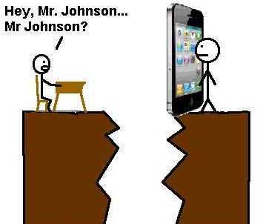
THE COMPLEXITY OF THE E-WASTE PROBLEM
BRIDGING THE DIGITAL DIVIDE
Digital divide is an economic inequality between individuals or groups that is construed, in terms of access to or the use of ICTs
Some of the major disadvantages that come from bridging the digital divide are the negative environmental and health effects, which are associated with e-waste
Durban, South Africa, 9 July 2013
3

Slide 4
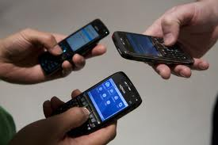
THE COMPLEXITY OF THE E-WASTE PROBLEM
TECHNOLOGY AND THE USERS
The electronics industry has revolutionized the world
Electrical and electronic products have become global universal technologies
Many people receive electronic equipment and dispose their old one
Durban, South Africa, 9 July 2013

Slide 5
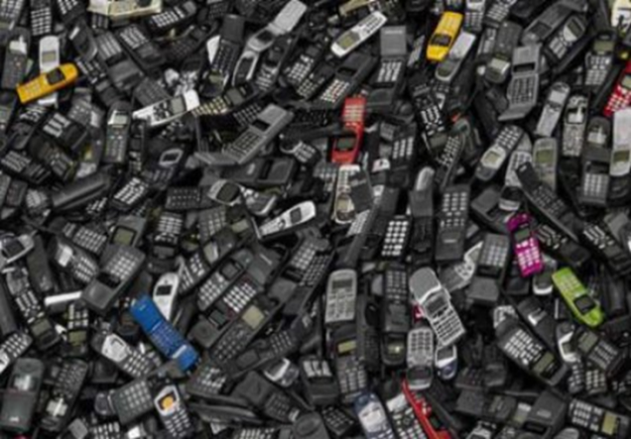
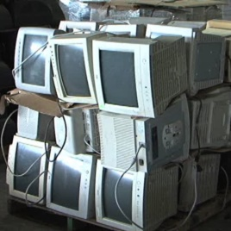
THE COMPLEXITY OF THE E-WASTE PROBLEM
OBSOLETE TECHNOLOGY
Obsolete technology is known as e-waste
E-waste contains a combination of reusable and toxic materials
These raw materials have value and can be reused to manufacture new products
E-waste is usually shipped away from industrialized countries and dumped in less developed countries
Durban, South Africa, 9 July 2013
5

Slide 6
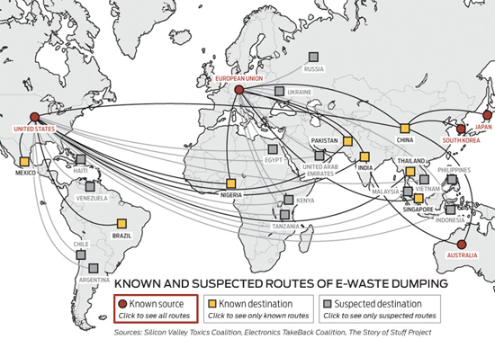
THE COMPLEXITY OF THE E-WASTE PROBLEM
Durban, South Africa, 9 July 2013
6

Slide 7
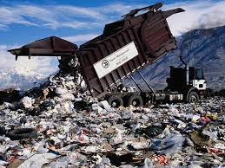
THE COMPLEXITY OF THE E-WASTE PROBLEM
E-WASTE DUMPING
From the dumps, chemicals contained in electronic devices emit vapours or seep into ground water
A single gram of evaporated mercury can pollute more than 11 million square feet of air
Chemicals and heavy metals from e-waste enter the food chain through water, flora and fauna
These toxic elements make their way to humans, causing serious health effects
Durban, South Africa, 9 July 2013
7

Slide 8
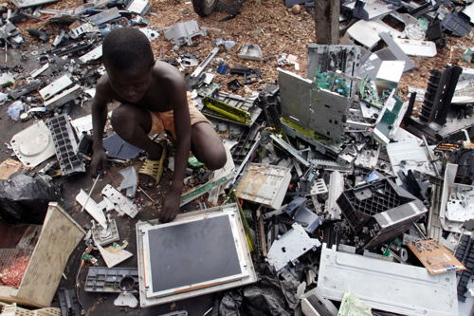
THE COMPLEXITY OF THE E-WASTE PROBLEM
EXPOSURE TO TOXIC MATERIALS
E-waste dumping is a great global concern
Children searching e-waste scraps are the most vulnerable to the toxic effects of e-waste
It is well known that children are more vulnerable to any poison, contaminant or toxin compared to adults because of their rapidly developing organs
Durban, South Africa, 9 July 2013

Slide 9
THE COMPLEXITY OF THE E-WASTE PROBLEM
HARMFUL EFFECTS OF E-WASTE TOXIC MATERIALS
E-waste contains toxic heavy metals such as lead, mercury, cadmium, nickel amongst others
These materials are harmful and can cause brain tumour, paralysis, infertility and even nervous system disorders
They can also have severe negative effect on the development of foetuses and the nursing of infants
Durban, South Africa, 9 July 2013
9

Slide 10
THE COMPLEXITY OF THE E-WASTE PROBLEM
ICASA’S POSITION ON E-WASTE
ICASA recognises the importance of having ICT regulations on e-waste
It encourages suppliers to ensure that obsolete equipment are safely disposed and recycled
It encourages the suppliers to take responsibility of providing consumers with information on safe disposal of their obsolete equipment
It encourages suppliers to provide consumers with incentives when returning their obsolete and unused equipment for disposal
It supports the South Africa’s Waste Act 59 of 2008
Durban, South Africa, 9 July 2013 10

Slide 11
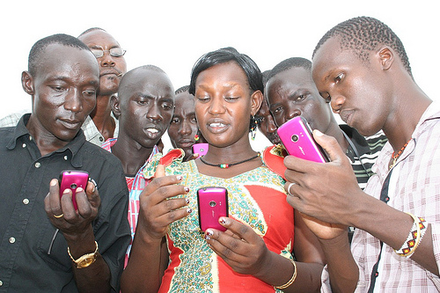
THE COMPLEXITY OF THE E-WASTE PROBLEM
CONSUMERS AND E-WASTE
Consumers play two roles in the life cycle of e-waste, that of a customer and e-waste holder
Consumers continue to ‘digitise’ their lives by purchasing and discarding larger volumes of electronics
Consumers ‘digitisation’ results in a growing waste stream of broken, obsolete and unwanted electronic equipment
Consumers of electronic products have a responsibility to buy smart, use right, manage well and dispose well
Consumers should be aware of the 3Rs of e-waste management, i.e. Reduce, Reuse and Recycle
Durban, South Africa, 9 July 2013

Slide 12
THE COMPLEXITY OF THE E-WASTE PROBLEM
GLOBAL INTERVENTIONS ON E-WASTE
Declaration of the United Nations Conference on the Human Environment
Cairo Guidelines and Principles for the Environmentally Sound Management of Hazardous Wastes
Recommendations of the United Nations Committee of Experts on the Transport of Dangerous Goods
Brussels Convention on the Control of Transboundary Movements of Hazardous Wastes and their Disposal
Lome IV Convention relating to the international movement of hazardous wastes and radioactive wastes
Basel Convention on the Control of Transboundary Movements of Hazardous Wastes and their Disposal
Bamako Convention on the ban of the Import into Africa and the Control of Transboundary Movement and Management of Hazardous Wastes within Africa
Durban, South Africa, 9 July 2013
12

Slide 13
THE COMPLEXITY OF THE E-WASTE PROBLEM
E-WASTE SOLUTIONS
INTERNATIONAL LEVEL
ITRs
ITU members were lobbied at WCIT 2012 in Dubai about the inclusion of the following in the ITRs:
Member States should promote access for persons with disabilities to international services, taking into account the relevant ITU-T recommendations
Member States are encouraged to adopt energy efficiency and e-waste best practices taking into account the relevant ITU-T Recommendations
Durban, South Africa, 9 July 2013

Slide 14
THE COMPLEXITY OF THE E-WASTE PROBLEM
E-WASTE SOLUTIONS CONT.
NATIONAL LEVEL
E-Waste laws
E-Waste regulations
Establishment of a national agency to regulate e-waste matters
Effective public education and awareness regarding the dangers of toxic metals in e-waste
Durban, South Africa, 9 July 2013
13

Slide 15
THE COMPLEXITY OF THE E-WASTE PROBLEM
E-WASTE SOLUTIONS CONT.
INDIVIDUAL LEVEL
Reduce the amount of toxic materials that would otherwise end up in our landfills
Reuse the products by selling them or donating them to others as that may keep them out of the waste stream
Recycle the unwanted electronics with an environmentally responsible recycler
Durban, South Africa, 9 July 2013
15

Slide 16
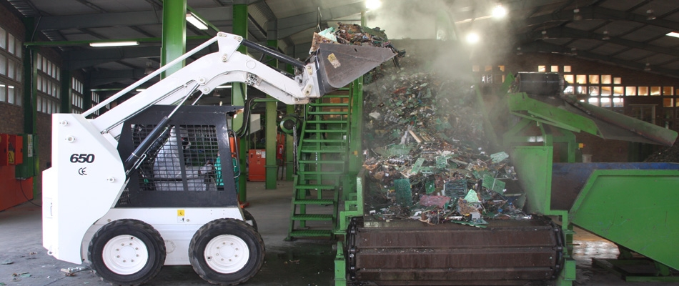
THE COMPLEXITY OF THE E-WASTE PROBLEM
E-WASTE RECYCLING
E- waste are collected for recycling from businesses, individuals and community collection points
E-waste is processed and separated into various raw materials such as plastic, glass, steel, copper, and aluminium
Using advanced technology, the toxic materials present in e-waste are recovered and kept out of our landfills
These materials become commodities that are used in the manufacturing of new products
Durban, South Africa, 9 July 2013
16

Slide 17
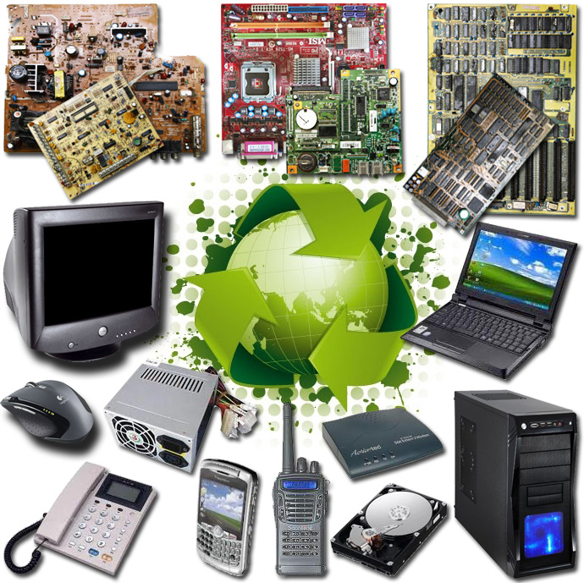
THE COMPLEXITY OF THE E-WASTE PROBLEM
RECYCLED E-WASTE PRODUCTS
Durban, South Africa, 9 July 2013
17

Slide 18
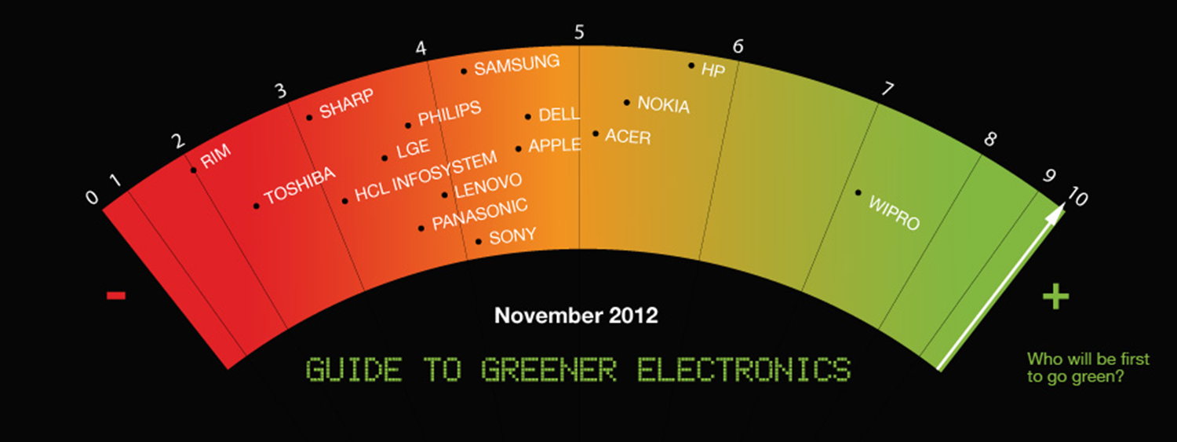
THE COMPLEXITY OF THE E-WASTE PROBLEM
GREENPECE INTERNATIONAL
Greener Electronics
Durban, South Africa, 9 July 2013
18

Slide 19
THE COMPLEXITY OF THE E-WASTE PROBLEM
CONCLUSION
People are generally aware of e-waste, but not many know about the problems it causes
Experts believe that consumers need to know more about what to do with e-waste
Everyone has the right to live in a world free from toxic pollution and environmental degradation
The key to success in terms of environmental effectiveness in e-waste is community awareness
RECOMMENDATIONS
People must understand that e-waste produces toxic materials that could lead to adverse health effects
Consumers, businesses, and authorities should take the responsibility for implementing e-waste policies
Consumer values, attitudes, and behavior need to support responsible handling of end-of-life electronic equipment
Durban, South Africa, 9 July 2013

Slide 20
THE COMPLEXITY OF THE E-WASTE PROBLEM
THANK
YOU
Durban, South Africa, 9 July 2013

