Slide 1
ITU Workshop on “Environmentally Sound Management of E-waste” (Durban, South Africa, 9 July 2013)
The Complexity of the E-waste Problem: Botswana Situation
Tebogo Ruth Mangadi
Acting Director Postal Services: Botswana Communications Regulatory Authority
mangadi@bocra.org.bw

Slide 2
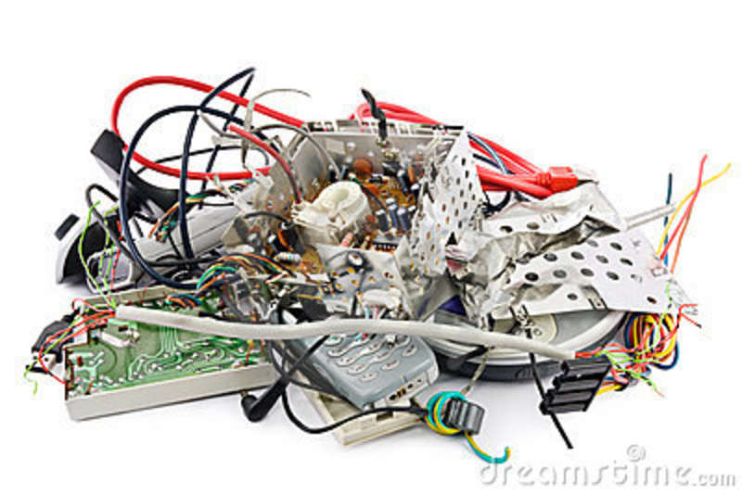
Statements of Fact:
“E-waste is one of the fastest growing segments of the waste stream.”
“Botswana has no E-waste Policy.”

Slide 3
Background:
Botswana is the signatory to the Basel Convention only as far as the control of transfer boundary movement of hazardous waste and their disposal. The ratification was done in 1989.

Slide 4
Demographics:
0-14 years: 33.5% (male 358,254/female 345,115) 15-24 years: 21.9% (male 227,527/female 232,004) 25-54 years: 36.4% (male 399,506/female 364,381) 55-64 years: 4.2% (male 39,161/female 49,499)
65 years and over: 3.9% (male 33,200/female 49,371) (2012 est.)

Slide 5
Challenges:
Lack of a specific policy or structured framework for managing WEEE in Botswana.
Lack of national database on the amount of e-waste generated and a clear cut definition for this waste category.
The current system of gathering information in which second hand, used and waste products are by and large invisible on the national statistics on sale and trade in goods.

Slide 6
Challenges continued…..
Lack of the necessary formal recycling and recovery infrastructure.
Lack of technical capacity to dismantle and retrieve usable / valuable components.
Lack of the general awareness on both the hazardous and resource potential of e-waste

Slide 7
Challenges continued…..
Lack of knowledge as well as the perceived lack of market compared to paper, metal scrap, cans and bottles.
Policy decision by government of replacing in the government offices, the electronic devices after every three years.
Similarly, the life span of the equipment due to rapid advancement of technology and proliferation into every aspect of business, many electronic products become obsolete in a very short time, creating a large surplus of unwanted and unusable products.

Slide 8
Short Falls continued….
Botswana has no plant that manufactures e-products thus it is a nation of gross importation of the equipment to meet its consumption demand.
There is no company that operates any form of electronic waste recycling in Botswana the nearest thing to recycling being practices in Gaborone (capital city) where e-waste is sent to RSA and Zimbabwe.
In extreme cases some individuals are observed practising uncommon disposal methods by taking their weee to the repair shops and never to fetch them back.

Slide 9
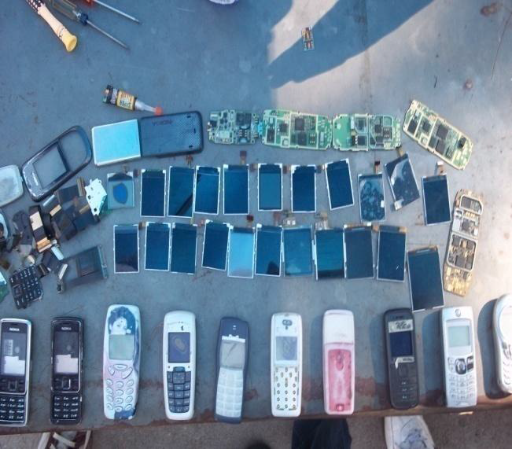
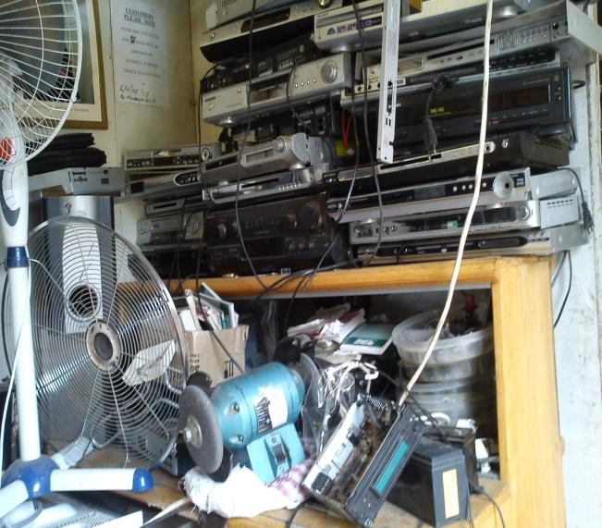
Cell phone repair shop-Gaborone (left) indoor electronic repair shop (right) courtesy: Kanda ad taye 2011
Cell phone repair shop-Gaborone (left) indoor electronic repair shop (right) courtesy: Kanda ad Taye 2011
Notes:
Cell phone repair shop-Gaborone (left) indoor electronic repair shop (right) courtesy: Kanda ad taye 2011

Slide 10
Conclusion:
Being a party to the Basel Convention and the availability of the local regulations on hazardous waste should serve as a stepping stone to delve into policy formulation on WEEE.
Exporting e-waste especially by government can pose security risk as the end of life equipment often contain sensitive information that if not properly deleted could leave opportunity for security bridge and fraud.

Slide 11
By exporting obsolete equipment to other countries we are exporting jobs.
There is need to Botswana to do research on the amount of e-waste we have as a country for proper planning and execution.
Indeed, e-waste is a complex subject matter that needs to be driven by relevant Policies, Regulations and treaties whilst educating and creating public awareness on e-waste issue.

Slide 12
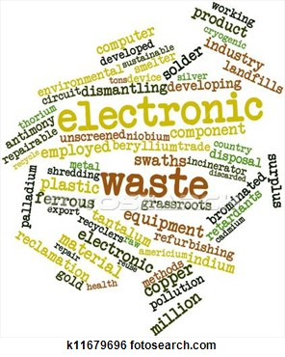
Thank you

