Slide 1
Overview of ITU Activities on E-Waste
Paolo Gemma
Chairman of Working Party 3 of ITU-T Study Group 5

Slide 2
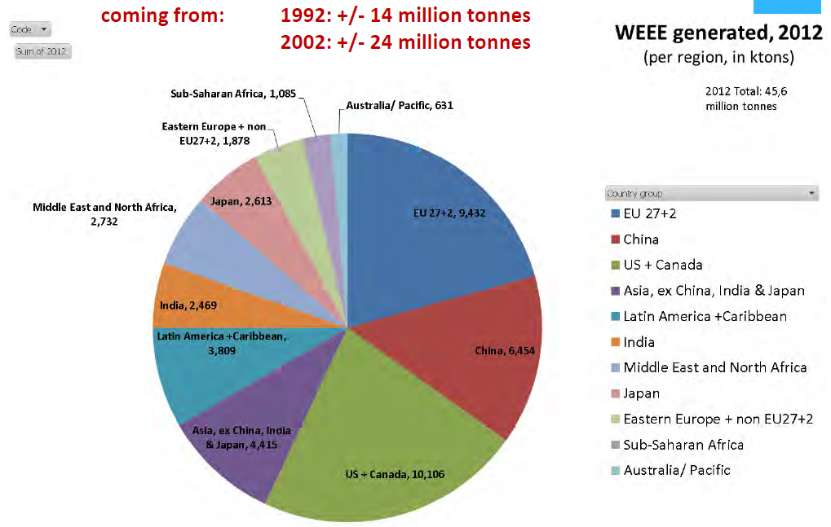
E-waste is the fastest growing waste stream
2012 total:
~45 mln tonnes
Source: Huisman 2012
Notes:
In particular, many developing countries face the specter of hazardous e-waste mountains with serious consequences for the environment and public health.

Slide 3
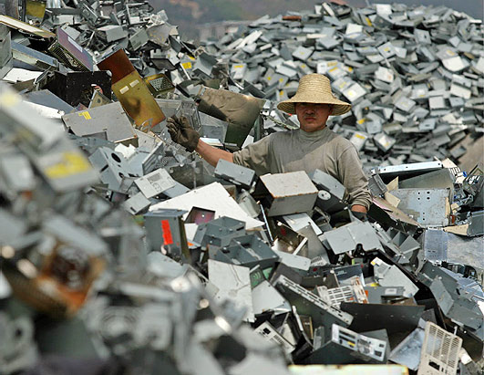
The best way to deal with e-waste is …
… avoid (or at least minimize) it!
From the manufacturing phase through:
Designing for easy disassembly and recycling
Avoid use of heavy pollutants
Minimization on the use of resources
Regulations and standards
During the life of equipment:
Prolonging its lifetime
Designing for reuse/multiple use
At end of life:
E-Waste Conscious management

Slide 4
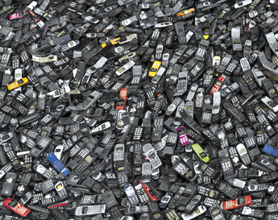
Avoid/minimize through standardization
Environmentally conscious companies have e-waste minimization programmes in place but:
Such programmes are difficult to set up and manage
The extra cost can discourage them
As individual companies they can have little impact
Need to create critical mass and act soon
Regulation is complex and takes long time
Standardization can fill the gap
and lead the market

Slide 5
ITU-T Activities

Slide 6
Structure of ITU-T Study Group 5
ITU-T SG5
“Environment and climate change”
Q 12 Terminology
WP1/5
Damage prevention and safety
WP2/5
Electromagnetic fields: emission, immunity and human exposure
WP3/5
ICT and climate change
5 Questions
6 Questions
7 Questions
Notes:
Terms of Reference of SG5
Study Group 5 is responsible for studies:
on ICT environmental aspects of electromagnetic phenomena and climate change;
related to electromagnetic compatibility (EMC), to safety and to health effects connected with electromagnetic fields produced by telecommunication installations and devices, including cellular phones.
Study Group 5 is lead SG for:
Environment and climate change
Electromagnetic compatibility and electromagnetic effects

Slide 7
Working Party 3/5 “ICT and climate change”
WP3/5 is responsible for studies relating to ICT, environment and climate change, development of methodologies for evaluating the ICT effects on climate change and publishing guidelines for using ICTs in an eco-friendly way.
Work areas:
Q13/5 - Environmental impact reduction including e-waste
Q14/5 - Setting up a low cost sustainable telecommunication infrastructure for rural communications in developing countries
Q15/5 - ICTs and adaptation to the effects of climate change
Q16/5 - Leveraging and enhancing the ICT Environmental sustainability
Q17/5 - Energy efficiency for the ICT sector and harmonization of environmental standards
Q18/5 - Methodologies for the assessment of environmental impact of ICT
Q19/5 - Power feeding systems

Slide 8
Question 13/5 Environmental impact reduction including e-waste
Brief Description
Main Tasks
Study the safety and environmental performance associated with ICTs, including the avoidance of hazardous materials and final disposal
Ensure that ICTs cause minimum environmental and health impact
Minimize and mitigate the effect of e-waste
Motivate ITU members to share experiences and spread knowledge related to environmental sustainability aspects
Determine processes to minimize the environmental impact
Study solutions to mitigate e-waste. UCS/CPS, rare metals, battery, conflict material……

Slide 9
Highlights on Deliverables of WP3/5
Important green ICT standards have been developed by SG5 WP3. These are namely:
Recommendation ITU-T L.1000: Universal power adapter and charger solution for mobile terminals and other hand-held ICT devices
Recommendation ITU-T L.1001: External universal power adapter solutions for stationary information and communication technology devices
Recommendation ITU-T L.1100: A method to provide recycling information of rare metals in ICT products
Recommendation ITU-T L.1200 : Direct current power feeding interface up to 400V at the input to telecommunications and ICT equipment
Recommendation ITU-T L.1300: Best practices for green data centres
Recommendation ITU-T L.1310: Energy efficiency metrics and measurement for telecommunication equipment
Recommendation ITU-T L.1400 : Overview and general principles of methodologies for assessing the environmental impact of information and communication technologies
Recommendation ITU-T L.1410 : Methodology for environmental impacts of Information and Communication Technologies (ICT) goods, networks and services
Recommendation ITU-T L.1420 : Methodology for environmental impacts of Information and Communication Technologies (ICT) in organizations
Recommendation ITU-T L. 1430 : Methodology for assessment of the environmental impact of information and communication technology greenhouse gas and energy projects (consented)
Notes:
Rec. L.1000 provides high level requirements for a universal power adapter and charger solution that will reduce the number of power adapters and chargers produced and recycled by widening their application to more devices and increasing their lifetime. The solution also aims to reduce energy consumption. The longer life cycle and possibility of avoiding device duplication reduces the demand on raw materials and waste. The universal power adapter and charger solution is designed to serve the vast majority of mobile terminals and other ICT devices.
Rec. L.1001 provides requirements for a universal power adapter solution (UPA) for stationary ICT devices that will reduce the number of produced power adapters by widening their application to more devices, enabling their reuse and increasing their lifetime. The solution also aims to reduce energy consumption. The longer life cycle and possibility of avoiding device duplication reduces the demand on raw materials and production of huge e-waste amount. The universal power adapter solution for ICT equipment for stationary use is designed to serve the vast majority of ICT devices.
Rec. L.1100 provides information on the recycling procedures of rare metals in information and communication technology (ICT) goods. It also defines a communication format for providing recycling information of rare metals contained in ICT goods.
Rec. L.1200 specifies the direct current (DC) interface between the power feeding system and ICT equipment connected to it. It also describes normal and abnormal voltage ranges, and immunity test levels for ICT equipment to maintain the stability of telecommunication and data communication services. The specified interface is operated from a DC power source of up to 400 V to allow increased power consumption and equipment power density, in order to obtain higher energy efficiency and reliability with less material usage than using a lower voltage such as -48 VDC or AC UPS power feeding solutions.
Rec. L.1300 describes best practices aimed at reducing the negative impact of data centres on the climate. It is commonly recognized that data centres will have an ever-increasing impact on the environment in the future. The application of the best practices defined in this Recommendation can help owners and managers to build future data centres, or improve existing ones, to operate in an environmentally responsible manner. Such considerations will strongly contribute to a reduction in the impact of the information and communication technology (ICT) sector on climate change.
Rec. L.1310 contains the definition of energy efficiency metrics test procedures, methodologies and measurement profiles required to assess the energy efficiency of telecommunication equipment.
Metrics and measurement methods are defined for telecommunication network equipment and small networking equipment.
These metrics allow for comparisons of equipments within the same class e.g. equipments using the same technologies.
Comparisons of equipments in different classes are out of the scope of this Recommendation.
Rec. L.1400 presents the general principles on assessing the environmental impact of information and communication technologies (ICT) and outlines the different methodologies that are being developed:
• Assessment of the environmental impact of ICT goods, networks, and services
• Assessment of the environmental impact of ICT projects
• Assessment of the environmental impact of ICT in organizations
• Assessment of the environmental impact of ICT in cities
• Assessment of the environmental impact of ICT in countries or group of countries.
This Recommendation also provides some examples of opportunities to reduce the environmental load due to ICT.
Rec. L.1410 deals with the assessment of the environmental impact of information and communication technology (ICT) goods, networks and services. It is organized in two parts:
Part I (clause 5) – ICT life cycle assessment: framework and guidance.
Part II (clause 6) – Comparative analysis between ICT and a reference product system (baseline scenario); framework and guidance.
Part I deals with the life cycle assessment (LCA) methodology applied to ICT goods, networks and services (ICT GNS). Part II deals with comparative analysis based on LCA results of an ICT GNS product system and a referenced product system.
This Recommendation provides specific guidance on energy and greenhouse gas (GHG) impacts.
Rec. L.1420 presents the methodology to be followed if an organization intends to claim compliance with this Recommendation when assessing its information and communication technology (ICT) related energy consumption and/or greenhouse gas (GHG) emissions.
This Recommendation can be used to assess energy consumption and GHG emissions generated over a defined period of time for the following purposes: for assessment of related impact from ICT organizations or for assessment of impact from ICT related activities within non-ICT organizations.
Rec. L.1430 is intended as a complement to ISO standard ISO 14064-2 and the Project Protocol of the Greenhouse Gas Protocol (GHG Protocol).
This Recommendation provides guidance for the application of a specific methodology to assess the environmental impact of information and communication technology (ICT) greenhouse gas (GHG) projects and ICT energy projects. The proposed methodology is specifically directed at the quantifying and reporting of GHG emission reductions and/or removal enhancements, energy consumption reductions, and the enhancement of energy generation and energy storage in ICT GHG projects and ICT energy projects.
An ICT GHG project uses mainly ICT goods, networks and services and is designed to reduce GHG emissions or increase GHG removals. These GHG reductions are quantified by comparison between the environmental impact of a project activity and a corresponding baseline scenario.
An ICT energy project uses mainly ICT goods, networks and services to reduce energy consumption and improve energy efficiency in project activity scenarios.
From the ICT perspective, this Recommendation takes into account considerations based on existing project quantification guidelines, and aims at covering ICT GHG and/or ICT energy project activities within both the ICT and the non-ICT sectors.
This Recommendation recognizes the importance of project validation and verification for the credibility of project results but does not enforce the validation and verification procedures to be applied. It is expected that such procedures be determined by the selected GHG programme, national regulation, internal policy of the project proponent, or the request of intended users.
ISO 14064-2 (2006): Greenhouse gases -- Part 2: Specification with guidance at the project level for quantification, monitoring and reporting of greenhouse gas emission reductions or removal enhancements.
The GHG Protocol Initiative was jointly convened in 1998 by the World Business Council for Sustainable Development (WBCSD) and the World Resources Institute (WRI): http://pdf.wri.org/ghg_project_accounting.pdf

Slide 10
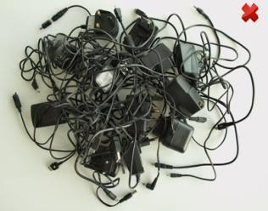
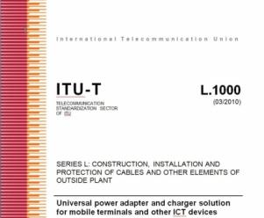
Tackling E-waste with Global ICT Standards
“Universal power adapter and charger solution for mobile terminals and other ICT hand held devices” (Recommendation ITU-T L.1000)
Saves 82,000 tons of e-waste per year
Saves at least 13.6 million tonnes of CO2 emissions annually
Notes:
Recommendation ITU-T L.1000 provides high level requirements for a universal power adapter and charger solution that will reduce the number of power adapters and chargers produced and recycled by widening their application to more devices and increasing their lifetime. The solution also aims to reduce energy consumption. The longer life cycle and possibility of avoiding device duplication reduces the demand on raw materials and waste. The universal power adapter and charger solution is designed to serve the vast majority of mobile terminals and other ICT devices.

Slide 11
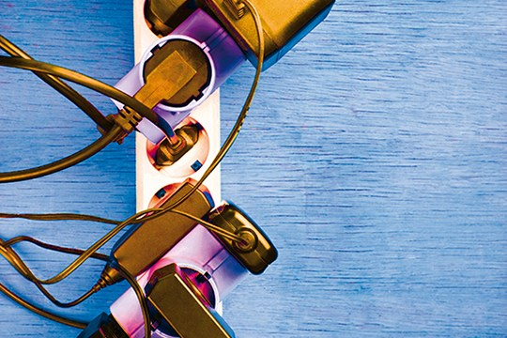
Waste Management with Smart ICT Standard
The step after L.1000…
NEW - “External universal power adapter solutions for ICT equipment for stationary use” (Recommendation ITU-T L.1001)
Saves 300,000 tonnes of e-waste annually
Reduces the energy consumption and greenhouse gas (GHG) emissions of external power supplies by between 25% and 50%
Approved!
Contributions are needed to develop Universal Power Adapter for portable devices (Phase 2)
Notes:
Recommendation ITU-T L.1001 provides requirements for a universal power adapter solution (UPA) for stationary ICT devices that will reduce the number of produced power adapters by widening their application to more devices, enabling their reuse and increasing their lifetime. The solution also aims to reduce energy consumption. The longer life cycle and possibility of avoiding device duplication reduces the demand on raw materials and production of huge e-waste amount. The universal power adapter solution for ICT equipment for stationary use is designed to serve the vast majority of ICT devices.

Slide 12
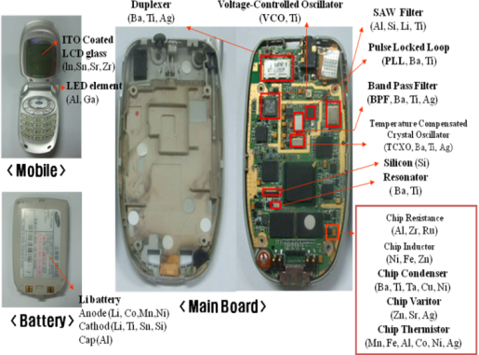
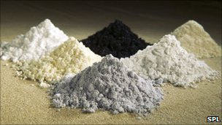
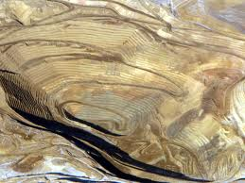
Recycling Rare Metals in ICT Products
ITU-T L.1100 Recommendation on Rare Metals outlines key considerations in all phases of the recycling process, and provides guidelines as to how organisations may fairly and transparently report on rare metal recycling.
Notes:
Rec. L.1100 provides information on the recycling procedures of rare metals in information and communication technology (ICT) goods. It also defines a communication format for providing recycling information of rare metals contained in ICT goods.

Slide 13
Research and Development

Slide 14
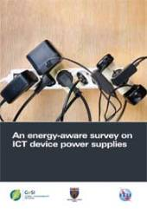
An Energy-Aware Survey on ICT Device Power Supplies
This survey reports the results of a wide analysis performed on a large set of commercially available external power supplies (more than 300 devices verified and more than 200 electrically measured) to assist the standardization activities within ITU-T Study Group 5 (SG5) (Recommendation ITU-T L.1001). Mechanical, electrical and environmental characteristics have been evaluated; correlation and statistics have also been developed.
Notes:
An Energy-aware Survey on ICT Device Power Supplies. Specifically, this document reports the results of a wide analysis performed on a large set of commercially available external power supplies (more than 300 devices verified and more than 200 electrically measured) to assist the standardization activities within ITU-T Study Group 5 (SG5) (Recommendation ITU-T L.1000, phase 2). Mechanical, electrical and environmental characteristics have been evaluated; correlation and statistics have also been developed.
The report is organized in two main parts. The first part (Sections 2 and 3) considers nameplate (e.g., voltage, current, efficiency class, etc.) and physical characteristics (e.g., weight, volumes, mains and DC voltage connector type). The second part (Sections 4 and 5) of the report shows the measured electrical features of the adapters, in terms of energy efficiency, DC voltage and Cos φ, with variable loads, together with no load measurements.

Slide 15
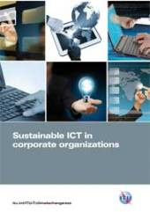
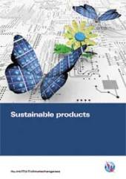
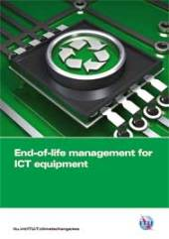
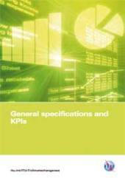
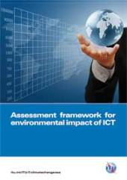
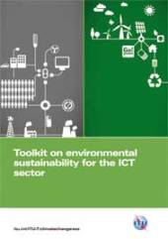
ITU Toolkit on Environmental Sustainability for the ICT Sector
Notes:
The Toolkit on Environmental Sustainability for the ICT sector is an ITU-T initiative which provides plenty of detailed support on how ICT companies can build sustainability into the operations and management of their organizations, through the practical application of international standards and guidelines.
This toolkit provides a set of agreed upon sustainability requirements for ICT companies that allows for a more objective reporting of how sustainability is practiced in the ICT sector in these key areas: sustainable buildings, sustainable ICT in corporate organizations, sustainable products, end of life management, general specifications and KPIs, and an assessment framework for environmental impacts of the ICT sector.

Slide 16
Purpose of the toolkit
Detailed practical support on how ICT companies can build sustainability into their operations and management
Practical
support
Ongoing contribution to ITU-T Study Group 5 which has the goal of developing global standards in this arena
Checklist
Standards
Support
Standardized checklist of sustainability requirements specific to the ICT sector
Notes:
The Toolkit on Environmental Sustainability for the ICT sector is an ITU-T initiative which provides plenty of detailed support on how ICT companies can build sustainability into the operations and management of their organizations, through the practical application of international standards and guidelines.
This toolkit provides a set of agreed upon sustainability requirements for ICT companies that allows for a more objective reporting of how sustainability is practiced in the ICT sector in these key areas: sustainable buildings, sustainable ICT in corporate organizations, sustainable products, end of life management, general specifications and KPIs, and an assessment framework for environmental impacts of the ICT sector.

Slide 17
Toolkit content
Document | Summary
Introduction to toolkit | A business-led perspective on the use of sustainability in ICT organizations
Sustainable ICT in corporate organizations | Sustainability issues with the use of ICT products and services
Sustainable products | Sustainability-led design principles and practice for ICT products
Sustainable buildings | Sustainability management of the construction, use and decommissioning of ICT buildings
End-of-life management | Support in dealing with the various end-of-life stages of ICT equipment
General specifications and KPIs | Environmental KPIs that can be used to manage and evaluate sustainability performance
Assessment framework | Mapping the standards and guidelines applying to the ICT industry

Slide 18
Collaboration with over 50 partners
3p Institute for Sustainable Management
Alcatel Lucent
BBC
BIO Intelligence Service
BT
CEDARE
Climate Associates
ClimateCHECK
Cogeco Cable
DATEC Technologies
Dell
Ernst & Young
ETRI
ETNO
ETSI
European Broadcasting Union
France Telecom/Orange
Fronesys
Fujitsu
GHG Management Institute (GHGMI)
Hewlett-Packard
Hitachi
Huawei
IBI Group
Imperial College
Infosys
International Telecommunication Union (ITU)
Mandat International
MicroPro Computers
Microsoft
MJRD Assessment Inc.
National Inter-University Consortium for Telecommunications
Nokia Siemens Networks
NEC Empowered by Innovation
NTT
Panasonic
PE INTERNATIONAL AG
Research In Motion
Scuola Superiore Sant’Anna of Pisa
Step Initiative
Telecom Italia
Telecommunications Networks and Telematics Laboratory
Telecommunication Technology Committee
Telefónica
Thomson Reuters
Toshiba
United Nations Environmental Programme
United Nations Environmental Programme Basel convention
United Nations University
University of Genova
University of Zagreb
Verizon
Vodafone Ghana

Slide 19
Raising Awareness

Slide 20
Upcoming Workshop and Events
ITU Workshop on Building a Sustainable Future Through Green ICT Standards 15-16 July 2013 (morning only), Ouagadougou, Burkina Faso
ITU Workshop on Smart Sustainable Cities in Latin America 30 July 2013, São Paulo, Brazil
ITU Workshop on E-Waste 13 August 2013, Quito, Ecuador
ITU Workshop on Human Exposure to Electromagnetic Fields (EMFs) 14 August 2013, Quito, Ecuador
Greening the Future: Bridging the Standardization Gap on Environmental Sustainability 3-4 October 2013, Colombo, Sri Lanka

Slide 21
3rd ITU Green Standards Week
To bring together leading specialists in the field, from top policy-makers to engineers, designers, planners, government officials, regulators, standards experts and others.
To raise awareness of the importance and opportunities of using ICT standards to build a green economy.
Programme:
16/09: ITU, UNEP, UNU, CEDARE Workshop on E-waste
17/09 (morning): Forum on Greening Mobile Devices: Building Eco-Rating Schemes
17/09 (afternoon): Meeting of the Focus Group on Smart Sustainable Cities
18/09: High Level Segment on Smart Sustainable Cities
19-20/09: 3rd Workshop on Submarine Communications Networks For Climate Monitoring and Disaster Warning
20/09: Meeting of the ITU/WMO/UNESCO -IOC Joint Task Force on Submarine Communications Networks For Climate Monitoring and Disaster Warning
SEE YOU IN MADRID, on 16-20 September 2013

Slide 22
E-Waste … the solution!
Key Actions:
Raise awareness on the dangers of e-waste;
Encourage the consideration of e-waste management in the design of ICT policy;
Adopt strategic policies, international standards and regulatory approaches that are sensitive to local context;
Encourage concerted cooperation in handling e-waste at the national, regional and international level.
Need of an integrated waste management approach to generate decent employment, curb health problems, cut greenhouse gas emissions and recover a wide range of valuable metals including silver, gold, palladium, copper and indium – by turning an e-challenge into an e-opportunity.

Slide 23
Links & Additional Information
ITU-T/SG5 “Environment & Climate Change”
http://www.itu.int/ITU-T/studygroups/com05/index.asp
ITU-T and Climate Change http://www.itu.int/ITU-T/climatechange
ITU Symposia & Events on ICTs and Climate Change http://www.itu.int/ITU-T/worksem/climatechange

Slide 24
Thank YOU cristina.bueti@itu.int paolo.gemma@huawei.com

