Slide 2
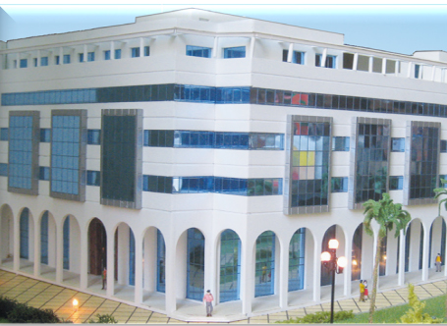
Medtech: Regional Center of Excellence in English language Engineering Education

Slide 3
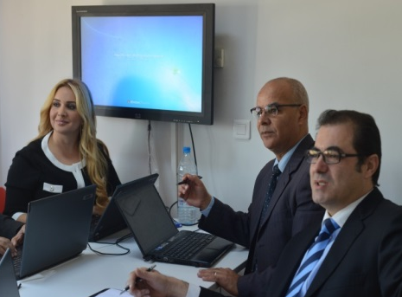
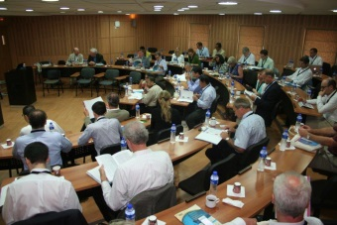
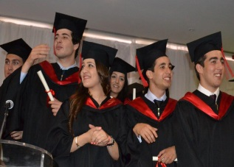
Student Life

Slide 4
MedTech and MSB
MedTech is sister Institution of MSB
MSB is first English Language Business School in Tunisia
AMBA Accredited
Cited by the Financial Times as a model to follow in Africa
MedTech Leverages Synergies with MSB
Unique blend of Engineering education and entrepreneurship training
MedTech/MSB Targeting a Regional Hub of Excellence
Accreditation
Certification

Slide 5
MedTech pillars of distinction
MedTech
World class
Faculty
Model Pedagogy &
Curricula
Fully English programs & focus on soft skills
Diverse set of
Partnerships
Real-world
Training
Modern
Facilities
- Graduates of world class universities
- Strong research and teaching track record
- Curricula and processes
targeting accreditation
- Modern Eng. pedagogy
- Learn by doing
- Creative workspaces
- Measured workload
- State of the art
Labs & Equipment
- Synergies with MSB
(Entrepreneurship)
- Standards Education
- Engineering Ethics
- Fully English courses
- Effective comm. skills
- Local and international partners
(ITU, Rice U, San Jose State U, Aalborg U, ...)

Slide 6
MedTech Startup Programs
Engineering programs
Computer Engineering
Software Engineering
Information and Communication Technologies
Renewable Energies
Master in Innovative Mobile Technologies
In partnership with Aalborg University, Denmark
Programs Approved by Ministry of Higher Education
Official Launch: June 13, 2014
First cohorts welcomed: Fall 2014

Slide 7
Engineering Programs
Engineering Common core
Computer Engineering Core
Systems & Networks
Hardware & Embedded Systems
Software Engineering
ICT
Renewable Energies
Software Eng. Specialization
ICT
Specialization
RE Specialization
Final Project
Final Project
Final Project
Final Project
Final Project
Final Project
Robotics & Control
4 sem.
3 sem.
1 sem.
2 sem.

Slide 8
Broad Common Core (first 2 years)
Maths
Calculus
Sciences
Eng Basics
Digital Systems
Linear Algebra
Probability & Stats
Discrete Maths
ODEs
Physics
Chemistry
Linear Circuits
Technical Seminar
Eff. Communication
English
Technical Writing
Presentation skills
Humanities & Soc. Sciences
History / Philosophy
Computer Architecture
Networks
Intro to Programming
OO Programming
Macroeconomics
Technical Electives
Fluid mechanics
Thermodynamics
Art / Literature

Slide 9
World class Engineering Education
Programs targeting accreditation (ABET)
Curricula covering all important knowledge areas
Aligned with ACM and IEEE recommendations
Benefiting from best practices of leading NA Universities
Focus on processes for quality assurance
Integrate feedback from leading institutions and experts
Leading technology companies
Major international organisations in the field (ITU)
Local and international industrial partners
Rich network of experts and professors

Slide 10
Business & Entrepreneurship Training
Programs prepare engineers to start/lead innovative ventures
Serious Entrepreneurship Training for all Eng. Programs
A total of 7 courses related to Business mgmt & Entrepreneurship
3 courses on economics
Two courses on Fundamentals: Macroeconomics & Microeconoimcs
One applied course: System Engineering Economics
3 courses on the principal areas of business management
Marketing
Finance
Operations management
One course on Entrepreneurship

Slide 11
Master in Innovative Mobile Technologies
Mastery of engineering concepts and techniques
Signal processing and communication electronics
Digital /wireless communications
Design and management of secure wireless networks
Mobile Services and platforms, content management for mobile networks
Internet technologies and service architectures
Courses on Entrepreneurship and the management of innovation
Managerial economics
Entrepreneurship
Intellectual property and technology transfer
Training in the key area of standards and regulation
Current and emerging issues in regulation
« Regulations, Standards, and governance of ICT infrastructures »

Slide 12
MoU MedTech-CTiF

Slide 13
MoU MedTech-Sunlife Holding

Slide 14
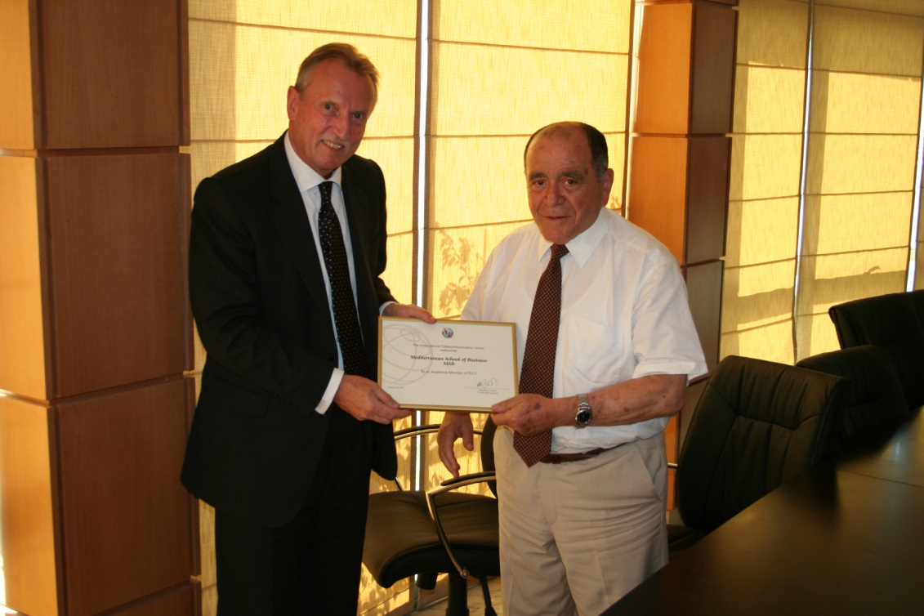
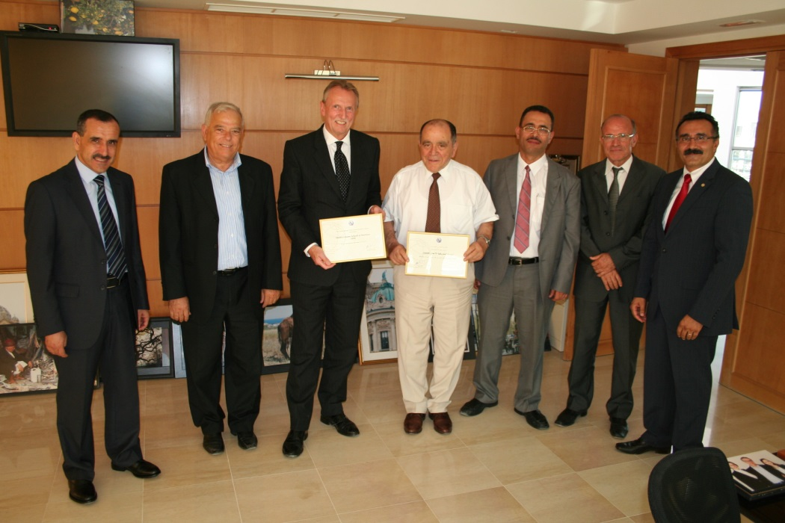
MedTech is an ITU
Academia Member
Signing ceremony, June 26, 2012

Slide 15
Merci / Thank you
Mediterranean Institute of Technology Les jardins du Lac II, 1053 Tunis – Tunisie For more info: Tel. +216 71 194 444 | +216 28 434 328 info@medtech.tn www.medtech.tn

