Slide 1
Tunisie Telecom Experience in Cloud Computing
Second Study Group 13 Regional Workshop for Africa on
"Future Networks: Cloud Computing, Energy Saving, Security and Virtualization"
(Tunis, Tunisia, 28 April 2014)
Nizar Bouguila
CTO, Tunisie Telecom
nizar.bouguila@tunisietelecom.tn

Slide 2
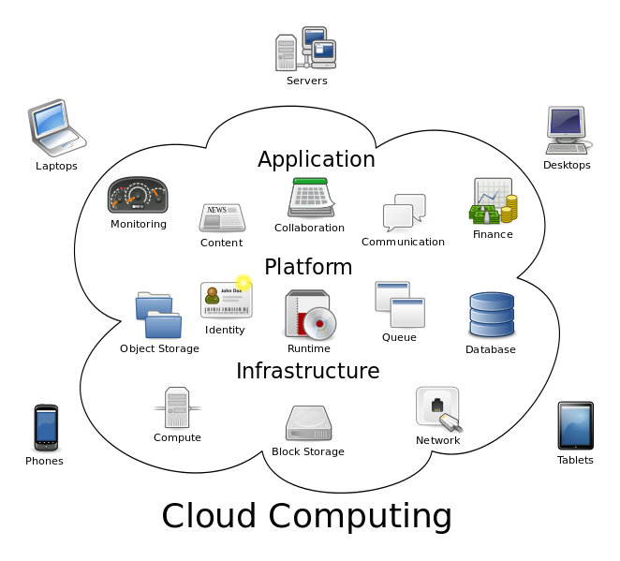
What is Cloud Computing ?
1
ITU-T Focus Group Cloud Definition *
“Cloud Computing is an emerging IT development, deployment and delivery model, enabling service users to have ubiquitous, convenient and on-demand network access to a shared pool of configurable computing resources (networks, servers, storage, applications, and services) that can be rapidly provisioned and released with minimal management effort or service-provider interaction.”
* Partially based on NIST cloud definition

Slide 3
What is Cloud Computing ? Main Characteristics
2
On-demand self-service
Ubiquitous network access
Location independent resource pooling
Rapid elasticity
Pay per use

Slide 4
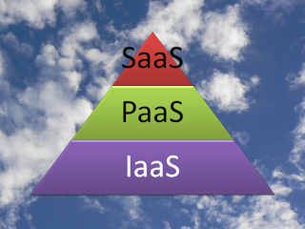
What is Cloud Computing ? Service Models
3
SaaS
Use provider’s applications over a network
PaaS
Deploy customer-created applications to a cloud
IaaS:
Rent processing, storage, network capacity, and other fundamental computing resources

Slide 5
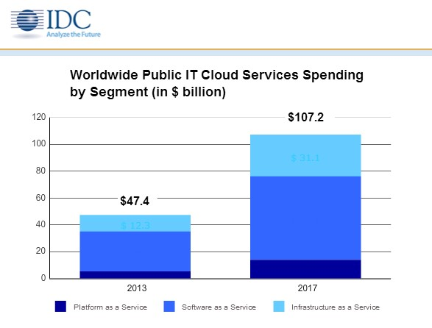
Which cloud delivery model
generates the highest revenues?
In September 2013, IDC predicts public IT cloud services will reach $47.4B and is expected to be more than $107B in 2017
Source IDC 2013 : http://www.idc.com/getdoc.jsp?containerId=prUS24298013

Slide 6
Key strengths of the
Cloud for entreprises
IT as a Service is a revolutionary model providing a value that is directly measured in terms of "Business" for your activity
Cost optimization (TCO)
"On Demand": You pay only for the service you consume
Significant cost savings through the pooling of technical resources
Security
The High availability of the cloud increases the availability of your applications.
Backups and replication facilitate the restoration of your data
Efficiency
Cloud adapts to the needs of your activity and the market
Outsourcing allows you to refocus on innovation and your core of business

Slide 7
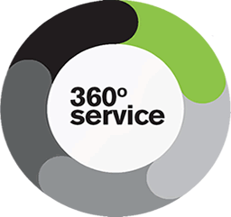
Key strengths of the
Cloud for entreprises
Agility
Each customer chooses the Cloud services offer that suites the most his needs and expectations
Instant deployment of new resources (servers, applications, desktops)
Included Services
Industrialized and complete management of your computing platforms
Multi-skills experts at your service all the day 24h/24

Slide 8
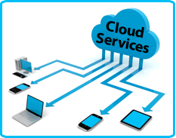
Why Telcos as CSP?
1
1- Quality of service:
Ability to fully control quality of service at every point in their networks,
Augment cloud offerings with wide-area network optimization and variable, tailored quality of service.
2- Connectivity:
Connected to just about every business, and thus have a unique selling proposition at the connectivity layer.
Can use that connectivity to refine and enhance a variety of cloud offerings.

Slide 9
Why Telcos as CSP?
2
3- Aggregation :
Telecom companies are uniquely positioned to group and structure a wide variety of trusted and tested cloud services for all their customers,
Ability to provide flexible combinations of private and public-cloud elements, depending on customers’ needs.
4- Delivery :
Their strengths in the connectivity layer allow them to offer a wide range of cloud based services.
They can fully integrate a variety of services including network quality of service, data centers, billing, aggregated application delivery, and e-commerce front ends into a single, powerful “end-to-end” experience.

Slide 10
Why Telcos as CSP?
3
5- Mobility solutions :
Work with mobility development teams to create integrated solutions in the cloud with mobile and non mobile applications
6- Sales channels :
Their existing sales channels, including telesales and portals, give telecom operators built-in direct access to large numbers of consumer, SMB, and enterprise customers
Telecom operators must extend their strengths to new areas while making use of the powerful assets and control
points they already have

Slide 11
How to be a successful CSP
Offer a rich and profitable cloud service portfolio to its Enterprises Customers
Recruiting the right Cloud Partners
Negotiating for the right partnership deals
Forming a Win-Win cloud partner ecosystem

Slide 12
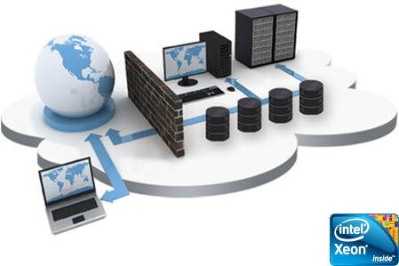
TT Strategy for Cloud Solutions
Offer innovative services and match the market trends
Enrich its service portfolio
Maintain its position as an "Historical Operator" and be a leader in the local market
Reduce Opex and Capex

Slide 13
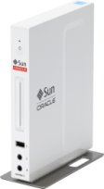
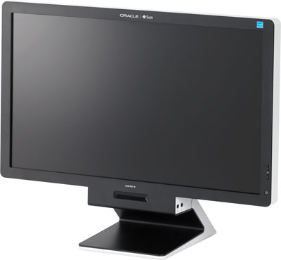
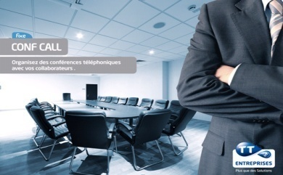
Existing TT Cloud Computing Offers
Corporate Housing
DaaS « Desktop as a Service»
Housing service provides Corporate Customers with space, power, cooling, and physical security for their server, storage, and networking equipment in TT Data Center
DaaS: A thin Client is provided to customer while the back-end of a virtual desktop infrastructure (VDI) is hosted by TT cloud.
SaaS « Software as a Service »
Hosted Conferencing Solutions
Microsoft MCS2010 platform based Solution. The following services are provided:
- Exchange
- Link
- Sharepoint
Audio conference
Video conference
Web Meeting

Slide 14
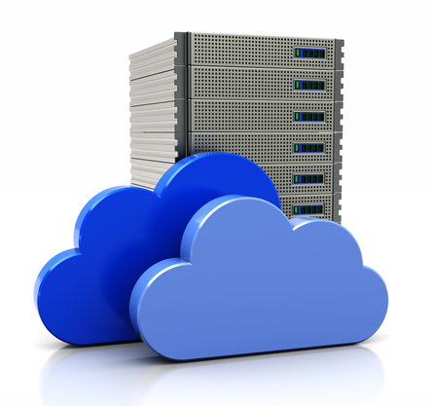
Future TT Cloud Computing services
1
Tunisie Telecom is implementing a Cloud Computing platform being secured, scalable and efficient
In the first phase, the following services will be provided:
IaaS : Infrastructure as a Service (DS, VPS, Storage)
BaaS : Backup as a Service
Web Hosting
Firewalling as a Service
Load Balancing as a Service

Slide 15
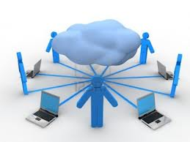
Future TT Cloud Computing services
2
The platform is characterized by the following features:
High availability
Flexibility and scalability
High security
end-to-end physical and logical security
Fully automatic service provisioning
➔ reduce activation time

Slide 16
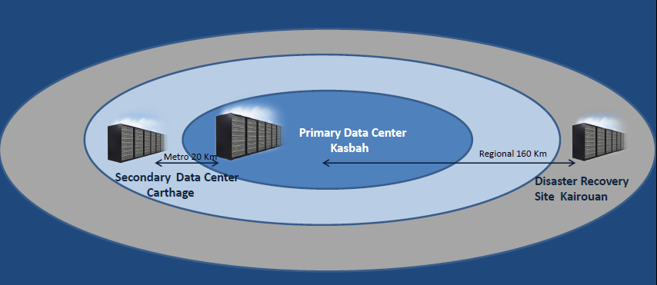
TT DATA Centers
1
Primary DC : Kasbah
Secondary DC: Carthage : 20 Km far from the primary DC
Disaster Recovery DC: Kairouan: 160 Km far from the primary DC

Slide 17
TT DATA Centers
2
TIA-942 Standard
Kasbah Data Center (First TT DC )
Area: 280 m², 92 42U Racks
Redundant power and redundant air conditioning
Hosts TT SaaS platform and Cloud Platform (nearly)
Used for Corporate Housing TT offers
Carthage Data Center
A second Data Center : Hosting new platforms and can be used for load balancing. This DC is ready since October 2013
Kairouan Data Center
Data Center for «Disaster Recovery»
Installation is in going

Slide 18
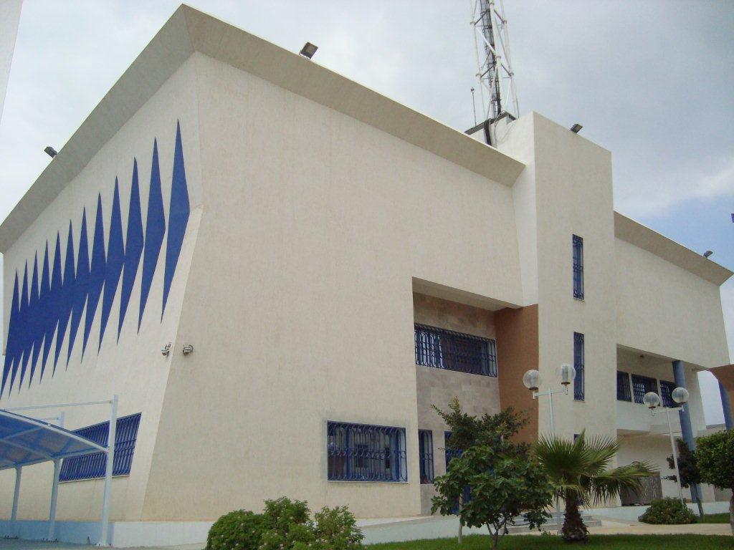
New TT DATA Centers
Carthage Data Center
1
Tier III and ISO 27001 certification:
Process ongoing

Slide 19
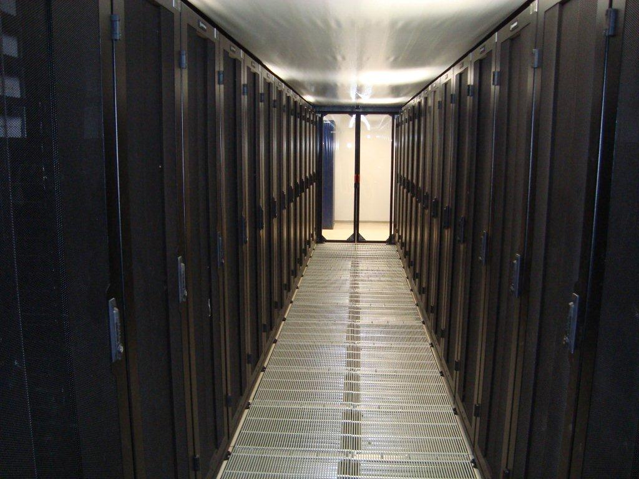
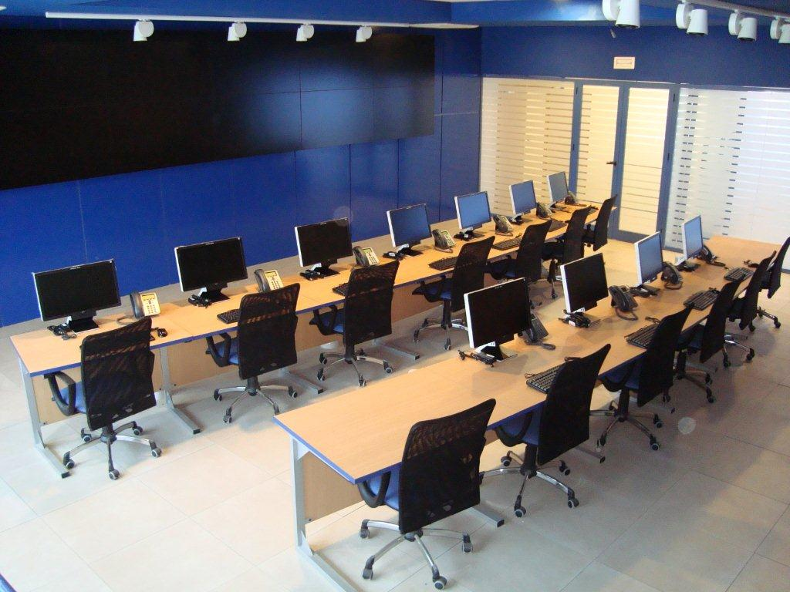
New TT DATA Centers
Carthage Data Center
2
Cloud Ready Data Center

Slide 20
TT Preparations for the Cloud
Qualification and certification of TT Team in many technical fields (Networks, Security, Infrastructure, virtualization, storage…)
Network and Data Center Monitoring centers
(24 x 7)
Processes for services , conform to international standards (ITIL or eTOM)
Assisting the companies as a long-term partner for telecom and IT services

Slide 21
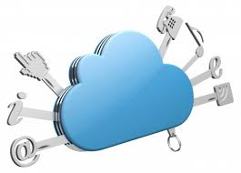
Conclusion
Tunisie Telecom is aware of the emergence of cloud computing
Exciting Revolution in Computer Infrastructure
TT has focused since 2010 on Cloud Computing offers : "SaaS", "DaaS“,…
TT is still investing in Cloud computing infrastructure for cloud services to host more enhanced services: Storage as a service, Firewall as a service, Load balancing service, …
TT capitalizes on its teams: training, certifications …
The main aim is to offer cloud services supporting quality of service, in order to ensure customer satisfaction

Slide 22
Recommendations
1
Cloud computing standardization should be managed to support both innovation and competition, maximize contribution in the standardization process and minimize incompatibility of competing cloud services,
A regulatory environment that meets international requirements and standards in terms of protection of personal data and data exchange security,
The creation of datacenters respecting the international standards offering guarantees of continuity of service, rapid accessibility and secure data backup, being able to provide technological requirements services to the business activities, on time and at the right price.
The setting of training programs and institutional strengthening in is needed.

Slide 23
Recommendations
2
Creation of strategic partnerships:
Technology partners
Telcos need to build a broader cloud ecosystem with industry
and technology partners to be able to provide end-to-end service.
Customers as partners
with customers to gain unique insights into the development of services that can be industry specific and provide the opportunity for shared revenue models.
Professional services firms as Partners
Telcos will need to recruit professional service firms for selling, demand creating, identifying and implementing complex Cloud solutions.

Slide 24
Thank you for your Attention
Second Study Group 13 Regional Workshop for Africa on
"Future Networks: Cloud Computing, Energy Saving, Security and Virtualization"
(Tunis, Tunisia, 28 April 2014)
Nizar Bouguila
CTO, Tunisie Telecom
nizar.bouguila@tunisietelecom.tn

