Slide 1

INFORMATION ECONOMY REPORT 2013
The Cloud Economy and Developing Countries
Torbjörn Fredriksson
(torbjorn.fredriksson@unctad.org)
Chief, ICT Analysis Section, UNCTAD
28 April 2014, Tunis,
Second SG13 Regional ITU Workshop for Africa on "Future Networks: Cloud Computing, Energy Saving, Security, and Virtualization“

Slide 2
Introduction to UNCTAD
United Nations Conference on Trade and Development
Founded in 1964
Overall aim: to promote the development-friendly integration of developing countries into the world economy.
Focus areas:
  International trade and commodities
  Investment and enterprise development
  Commodities
  Technology and logistics
  Africa and the least developed countries
ICTs

Slide 3




UNCTAD and ICT
Collaboration with ITU and other UN agencies
UN Group on the Information Society (UNGIS)
  Chairs and vice chairs: ITU, UNCTAD, UNESCO, UNDP and UNDESA
  30 members
Co-organizer of the annual WSIS Forum/WSIS+10 HL Event
  Lead facilitator of Action Line C7 on E-business
  High Level Event: 10-13 June 2014
Secretariat of the CSTD
  Follow-up to the WSIS – next session 12-16 May 2014
Partnership on Measuring ICT for Development
  Member of its Steering Committee
  13 members

Slide 4
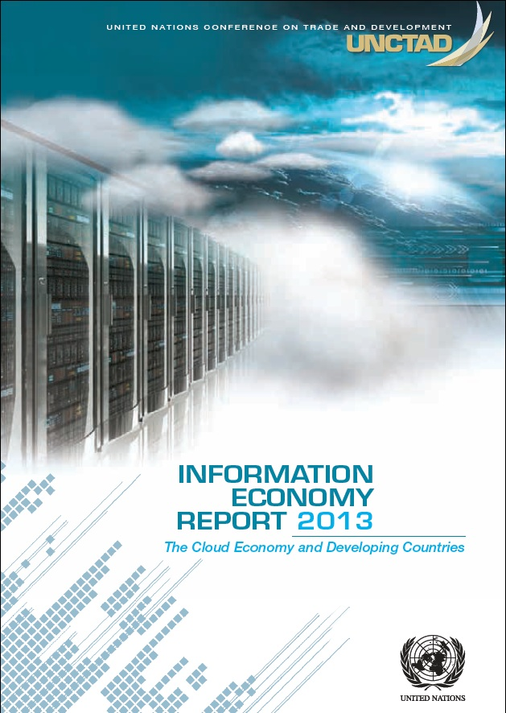
IER2013
The Cloud Economy and Developing Countries
Early stage but of growing relevance
Need for objective analysis
Lack of evidence
Valuable input from ITU Study Group, Jamil Chawki
First cloud analysis by UN secretariat

Slide 5
What is Cloud Computing?
A way of delivering applications, services or content remotely, rather than requiring users to hold them on their own servers, computers or other devices.
  Cloud computing is a model for enabling ubiquitous, convenient, on-demand network access to a shared pool of configurable computing resources (e.g., networks, servers, storage, applications, and services) that can be rapidly provisioned and released with minimal management effort or service provider interaction. (NIST, 2011)
Webmail, online social networks and file-sharing among the most popular applications on the Internet, also in the developing world.
Metaphor of the "cloud" misleading – cloud is enabled by physical hardware, networks, storage, services and interfaces

Slide 6
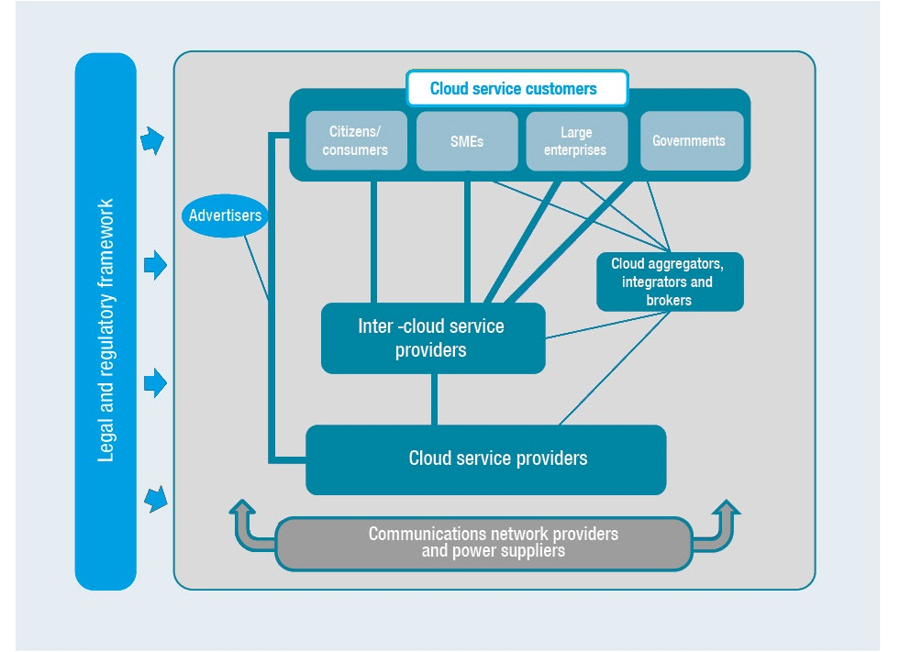
The Cloud Economy – a Framework
Key stakeholders and market relationships
Source: UNCTAD.

Slide 7
What has enabled the Cloud?
Processing power
  Intel’s current 22 nanometre CPU is 4,000 times faster, uses 0.02 per cent of the energy and costs 1/50,000 of its first CPU released in 1971
Digital storage
  The first IBM PC (1981) cost $3,000; accepted diskettes of 160kb
  By 2010, a hard disk for $600 could store all music ever recorded
Transmission speed
  Dial-up connection in 1993: 56kbps
  As of 2013, some consumer broadband packages 2Gbps – some 36,000 times faster

Slide 8
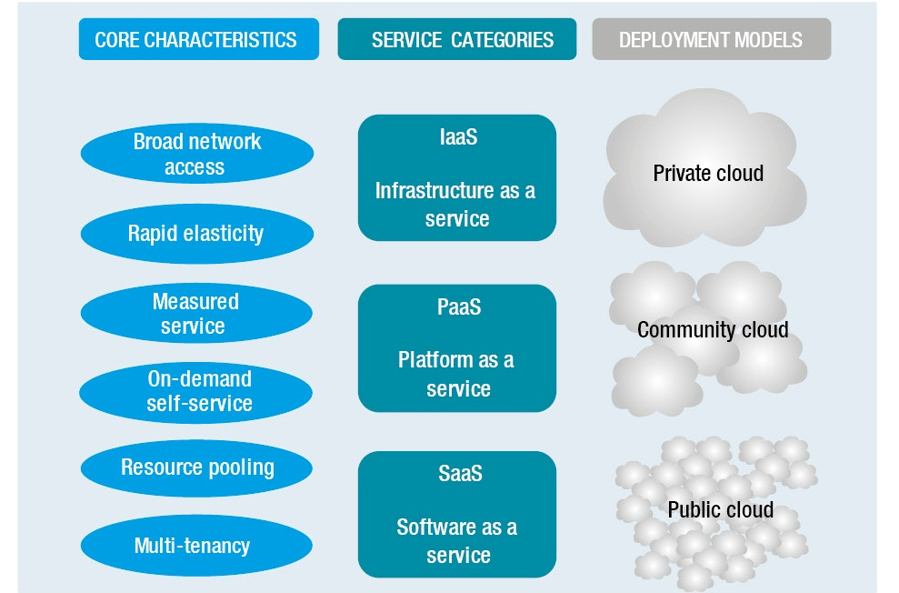
Cloud computing characteristics and models
Source: UNCTAD, adapted from NIST 2011.

Slide 9
Cloud revenue estimates and forecasts vary
2010 and 2015, $ billions
 | 2010 |  |  |  | 2015
Forecast by: | SaaS | Paas | Iaas | Total | SaaS | Paas | Iaas | Total
Gartner | 10.0 (70.9%) | 1.3 (9.2%) | 2.8 (19.9%) | 14.1 (100.0%) | 21.3 (49.2%) | 2.4 (5.5%) | 19.6 (45.3%) | 43.3 (100.0%)
Forrester | 13.4 (91.1%) | 0.3 (2.2%) | 1.0 (6.7%) | 14.7 (100.0%) | 78.4 (83.5%) | 9.8 (10.4%) | 5.8 (6.1%) | 94.1 (100.0%)
These numbers do not include advertising revenue!
Source: Berry and Reisman, 2012: 6.

Slide 10
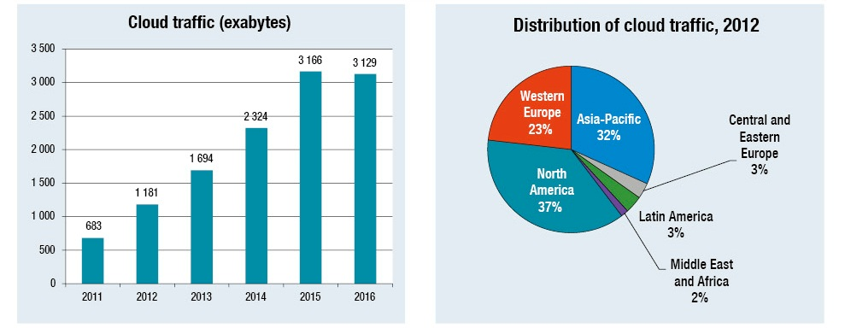
Cloud-related traffic on the Internet
Mainly in developed countries but growing fast
Source: Cisco Analysis.

Slide 11
Top Global Cloud Companies by estimated number of servers 2012
Company | Home country | Estimated number of servers
Google | United States | 900,000
Microsoft | United States | 300,000
Amazon Web Services | United States | 250,000
Facebook | United States | 180,000
Akamai | United States | 127,000
OVH | France | 120,000
Softlayer | United States | 100,000
Rackspace (2011) | United States | 79,805
Intel | United States | 75,000
1&1 | United States | 70,000
Source: UNCTAD, based on information from company reports and other sources.

Slide 12
Pros and cons with the Cloud
Potential advantages | Potential disadvantages
Reduced costs for rented IT hardware and software than for in-house equipment. | Increased costs of communications (to telecom operators/ISPs)
Reduced cost of in-house IT management | Increased costs for migration and integration
Enhanced elasticity of storage/processing capacity | Reduced control over data and applications
Greater flexibility and mobility of access to data and services | Data security and privacy concerns
Immediate and cost-free upgrading of software | Unreliable services, e.g. due to inadequate ICT or power infrastructure
Enhanced reliability/security of data and services | Risk of vendor lock-in (limited interoperability and data portability) with providers
Source: UNCTAD.

Slide 13
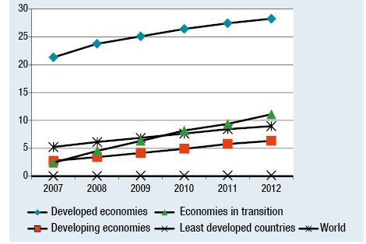
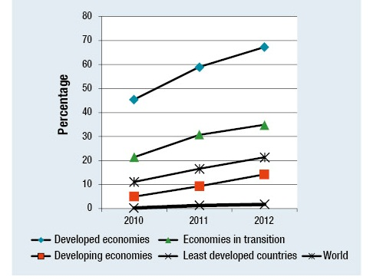
The Broadband Challenge
Gap to LDCs keep widening
Fixed broadband subscriptions per 100 people, 2007-2012
Active mobile broadband subscriptions per 100 people, 2010-2012
Africa (2012): 1
Africa (2012): 6
Source: ITU.

Slide 14
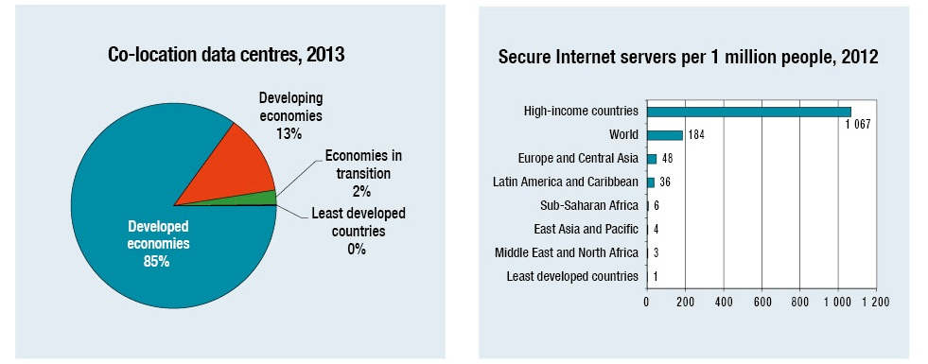
The Data Centre and Server Divides
Source: DataCentreMap and World Bank.

Slide 15
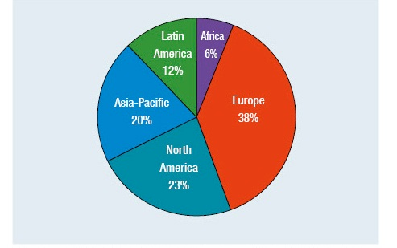
The Internet Exchange Point (IXP) Divide
Distribution (%) of IXPs by region, June 2013
Issue recognized by African Union Commission through the African Internet Exchange System project, funded by the EU-Africa Infrastructure Trust Fund and the Government of Luxembourg.
Studies of IXPs in Kenya and Nigeria show significant reduction in latency
Source: Packet Clearing House.

Slide 16
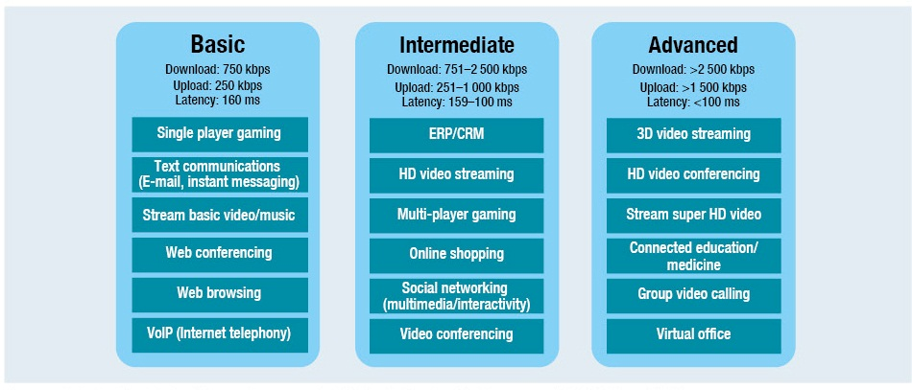
“Quality of Service” requirements vary
Latency and upload speeds main bottlenecks for developing countries.
Source: Cisco Analysis.

Slide 17
Broadband Quality of Service – Africa
Meet minimum requirements for advanced cloud services | Meet minimum requirements for basic cloud services | Do not yet meet requirements for basic cloud services
 | Egypt Ghana Kenya Morocco South Africa Tunisia | Algeria Angola Côte d'Ivoire Mauritius Mozambique Namibia Nigeria Senegal Sudan Uganda United Republic of Tanzania Zambia Zimbabwe
Source: UNCTAD, based on Cisco Analysis 2012.

Slide 18

Regulatory issues
Cloud data can become subject to multiple jurisdictions
The transfer of data out of the user’s jurisdiction may raise issues of control, effective oversight and audit.
For some regulated sectors, such as financial services, cloud-related transfers and storage outside the jurisdiction may breach national rules.
Key legal areas to address:
  Data protection
  Privacy
  Cybercrime
Source: UNCTAD.

Slide 19
Standardization issues
Cloud computing new and evolving area
Cloud service providers offer different approaches, based on different business models, capabilities and customer profiles
Standards critical to achieve interoperability, spur competition and enable effective use of multiple providers
Standard-setting activities on cloud mainly in and by developed countries – risk that specific needs and requirements of developing countries are not adequately addressed
Source: UNCTAD.

Slide 20
Policy recommendations
Welcome the cloud economy but tread carefully
Assess “cloud readiness“, define national strategy with relevant partners
Consider all cloud relevant configurations
Enhance access to reliable, affordable broadband
Address relevant laws and regulations
Recognize supply side opportunities of the cloud economy
Consider Government's own use of the cloud
Engage in standardisation forums
Seek support from Development Partners

Slide 21
Supply-side cloud opportunities in developing countries
Data centre services
  Local and foreign providers
  Government-owned centres
Provision of cloud services for local customers
  Infrastructure as a Service (IaaS) –first step in low-income countries
  Platform as a Service (PaaS)
  Software as a Service (SaaS)
Cloud aggregation, system integration, brokerage and related services
  Leverage experience with national business, legal and communications environment.

Slide 22
Data centre developments in Africa some examples
Communications providers
  Galaxy Backbone and Globacom (Nigeria)
  Safaricom (Kenya)
Government projects
  Kenya: data centre capacity for its own use as well as for public access to reduce costs for businesses and organizations that need to host data in-country.
  Ghana: three data centres that will host data from all government ministries, departments and agencies.

Slide 23
Cloud services in Africa – some examples
MTN (South Africa) launched cloud service business packages for SMEs in Ghana and Nigeria in December 2012
Vodacom, a South African telecommunication operator has partnered with Novell, an IT provider, to offer cloud services
Pamoja Cloud Services, owned by SEACOM (South Africa) targets demand for IT-as-a-Service from SMEs in Africa
Cloud aggregation services companies in Nigeria: Computer Warehouse, Resourcery, City Business Computers and Computer Information System
Mothers-2-mothers (M2M), a South African NGO, combines the cloud with database technology and mobile services to reduce the incidence of HIV/AIDS transmission from mothers to children

Slide 24
Policy recommendations
Welcome the cloud economy but tread carefully
Assess “cloud readiness“ and define national cloud strategy with relevant stakeholders
Consider all cloud configurations: public/private/hybrid clouds implemented nationally, regionally or globally
Enhance access to reliable, affordable broadband
Address laws and regulations concerning privacy, data protection and cybercrime
Recognize supply side opportunities of the cloud economy
Consider Government's own use of the cloud
Seek support from Development Partners

Slide 25

THE INFORMATION ECONOMY REPORT 2013
can be downloaded free of charge at
unctad.org/ier

Slide 26
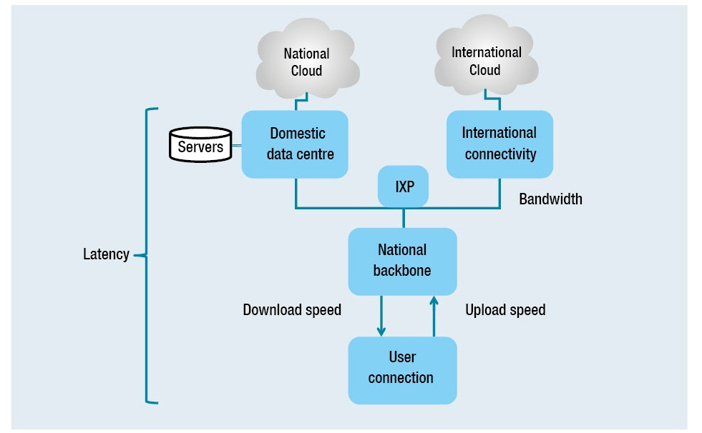
Getting to the cloud
Source: UNCTAD.

Slide 27
Areas and bodies for cloud computing standardisation
Source: Standardisation activities for cloud computing, NTT

