Slide 1
Introduction to ITU: Global solutions by consensus
Tatiana Kurakova,
Counsellor, ITU-T Study Group 13
1

Slide 2
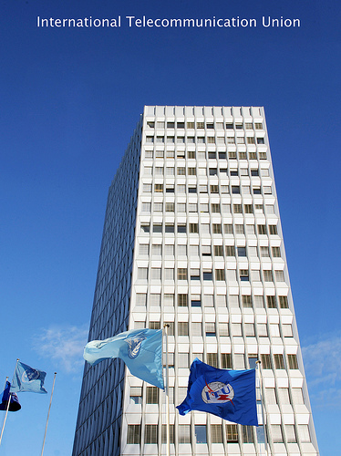
About ITU
The United Nations Specialized Agency for Information and Communication Technologies (ICTs)
Founded in Paris in 1865 as the International Telegraph Union
2015 will mark 150 years of experience and innovation
2
Notes:
ITU was founded in Paris in 1865 as the International Telegraph Union.
It took its present name in 1932, and in 1947 became a specialized agency of the United Nations.
Although its first area of expertise was the telegraph, the work of ITU now covers the whole ICT sector, from digital broadcasting to the Internet, and from mobile technologies to 3D TV

Slide 3
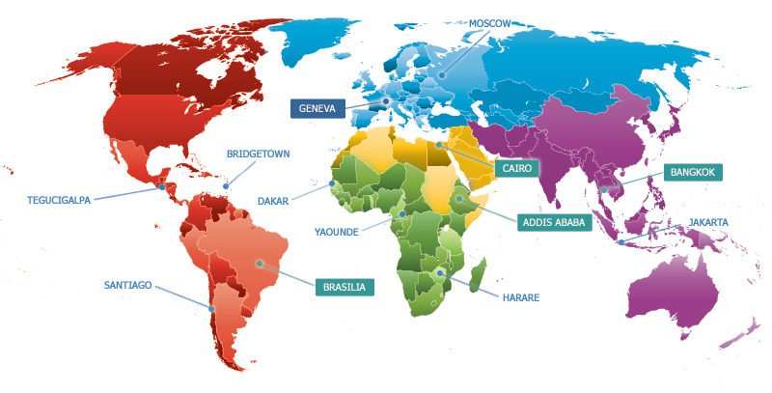
ITU’s Regional Offices
3
Notes:
Headquarters in Geneva with Liaison Office in New York
Regional offices in Addis Ababa, Bangkok, Brasilia, Cairo
Area offices in Bridgetown, Dakar, Harare, Jakarta, Moscow, Santiago, Tegucigalpa, Yaoundé
As a UN specialized Agency, ITU works in 6 languages Arabic, Chinese, English, French, Russian, Spanish
ITU has 747 Staff from 106 Countries ! (numbers from HR on 23/10/2013)

Slide 4

ITU’s Membership
193 Member States and Regulatory Bodies
750 Companies, Business Associations, NGOs
66 Universities & Research Establishments
4

Slide 5

ITU’s Structure
Radiocommunication
ITU-R
Coordinates global wireless communication
Standardization
ITU-T
Produces interoperable technical ICT standards
Development
ITU-D
Provides assistance to the un-connected
The General Secretariat provides coordination
for the whole organization
5
Notes:
ITU-T: production of standards covering all fields of telecommunications on a worldwide basis, as well as defining tariff and accounting principles for international telecommunication services
ITU-R: management of the radio-frequency spectrum and satellite orbits
ITU-D: improve telecommunication infrastructure in the developing world, Mobilizing resources and partners for project implementation, capacity building
The General Secretariat provides intersectoral coordination for the whole organization

Slide 6
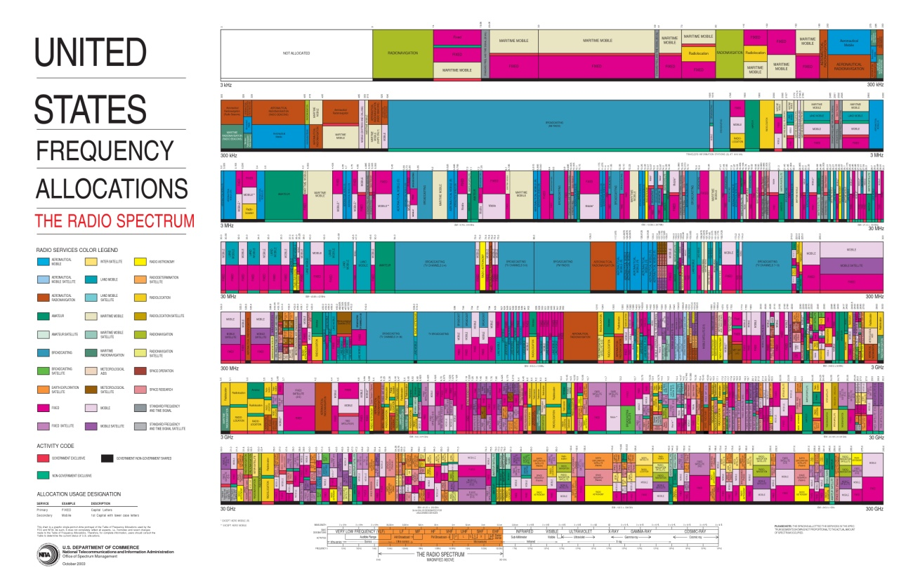

ITU-R: Radiocommunication Sector
Manages the radio-frequency spectrum and satellite orbits
6
Notes:
ITU-R
- Develop global regulations for spectrum and satellite orbit resources
- Establish harmonized, global standards for wireless systems
- Assist membership develop advanced radio-com systems
ITU-R Study Groups deal with themes such as: spectrum management, radiowave propagation, satellite services, terrestrial services, broadcasting, science services (systems for space operation, space research, Earth exploration and meteorology).

Slide 7
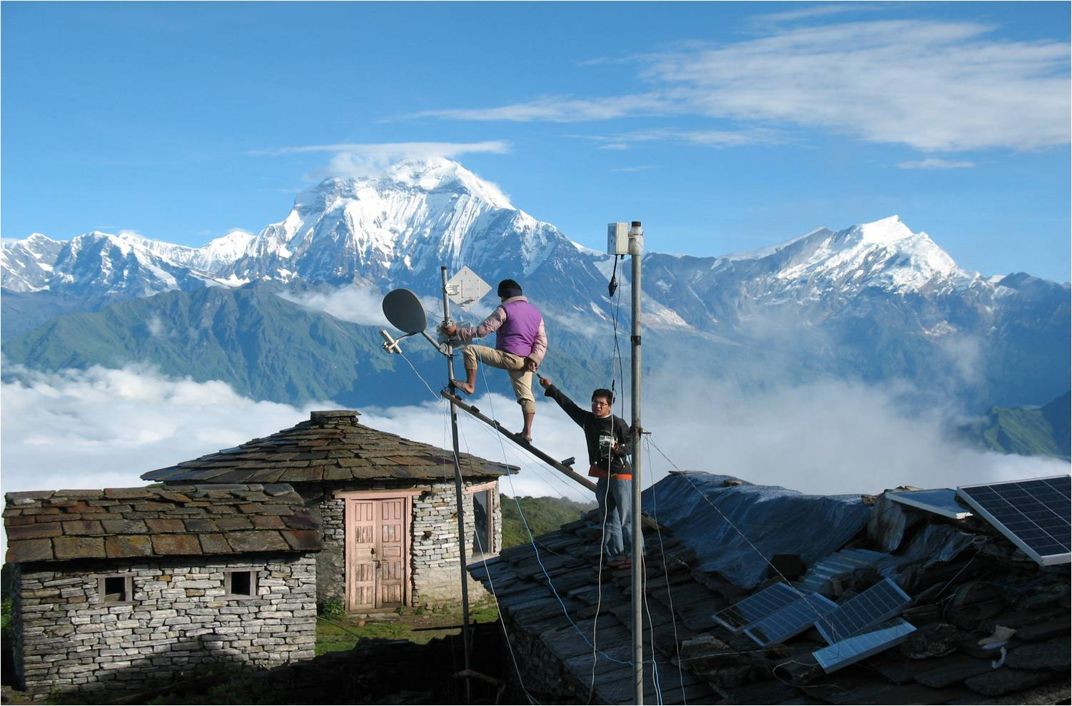
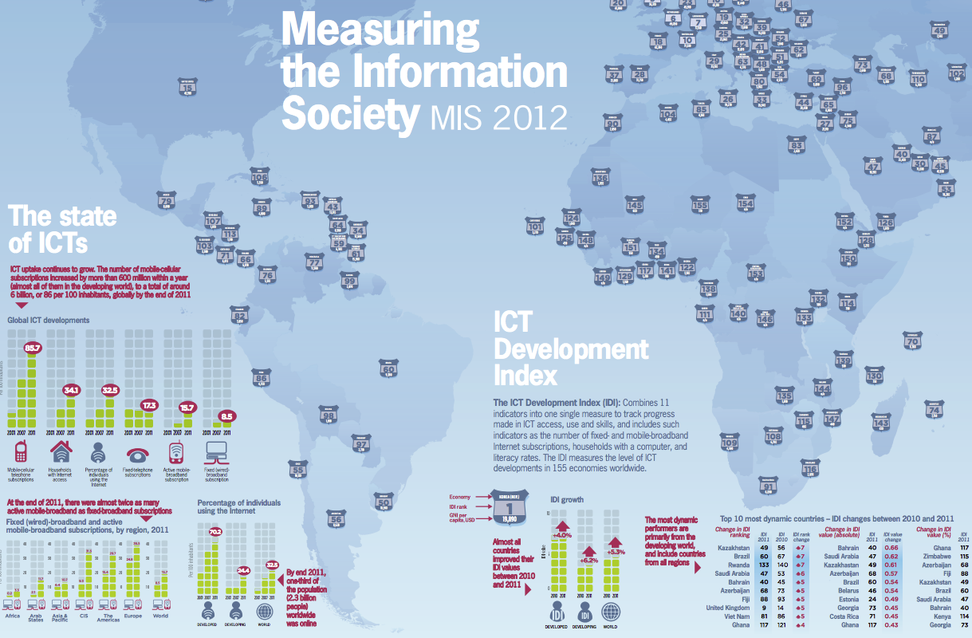
ITU-D: Development Sector
Assists the development of ICTs in the developing world
7
Notes:
ITU-D: assists the development of ICTs
- Neutral broker for multi-stakeholder partnerships, resource mobilization
- Executing agency for project implementation
Building capacity among members: technical assistance, advice on policy-regulatory frameworks for investment
Statistics and policy/regulatory trends
Membership Benefits:
- Support your CSR agenda. Build profile and relationships in new markets.
ITU-D Study groups looking at issues such as policy and regulatory reforms needed to stimulate ICT investment. Public-private partnership models for infrastructure roll-out, such as infrastructure sharing. Tax incentives. Licensing. How to expand rural connectivity.
ITU-D publishes its very much acclaimed annual report “Measuring the Information Society”. The report, which has been published annually since 2009, features two benchmarking tools to measure the information society: the ICT Development Index (IDI) and the ICT Price Basket (IPB). The 2012 IDI captures the level of ICT developments in 157 economies worldwide and compares progress made during the last year. The 2012 IPB combines the consumer prices for (fixed and mobile) telephone and Internet broadband services for 161 economies into one measure and compares these across countries, and over time. The 5th edition of the ITU Measuring the Information Society (MIS) report was launched on 7 October 2013, at ITU headquarters, Geneva, Switzerland

Slide 8


ITU-T: Standardization Sector
Produces standards covering all fields of telecommunications on a worldwide basis
and defines tariff and accounting principles for international telecommunication services
8
Notes:
ITU-T
- Develop interoperable, international standards (ITU-T Recommendations)
- Bridge standardization gap
- Cooperation among standardization bodies
ITU-T study groups look at issues such as: multimedia, security, environment and climate change, network and transport, broadband access, quality of service and experience, next generation networks, cloud computing, intelligent transport systems, numbering and addressing, tariff, security.
Some examples:
Internet Access through ITU standards
95% of all international traffic runs over fibre = ITU standards
Access:
ADSL: ITU-T G.992
Powerline Transmission:
ITU-T G.9960 (G.hn)
FTTX (Fibre to the <x>):
GPON (Gigabit Passive Optical Networks) ITU-T G.984
Bendable fibers: ITU-T G.657
Multimedia
Advanced video coding:
ITU-T H.264
Used to compress billions of clips
on YouTube, high-definition content
on Blu-ray Discs
New work H.265:
Joint Collaborative Team (ITU-T, ISO/IEC) to reduce data rate by 50%

Slide 9
Introducing ITU-T
The ITU Telecommunication Standardization Sector (ITU-T) is a platform for governments and the private sector to coordinate development of the telecommunication networks and services that connect the world.

Slide 10
Importance of global standards
Manufacturers, network operators and consumers all benefit:
International communication and trade
Competitiveness
Efficiency and innovation
Lower prices and increased availability

Slide 11
Vision:
Committed to Connecting the World
ITU-T is driven to remain the pre-eminent worldwide telecommunication standards body:
Developing interoperable,
non-discriminatory international standards
Bridging the Standardization Gap
Extending international cooperation

Slide 12

ITU-T Study Groups
Current Study Groups are:
SG2 - Operational aspects
SG3 - Economic and policy issues
SG5 - Environment and climate change
SG9 - Broadband cable and TV
SG11 - Protocols and test specifications​
SG12 - Performance, QoS and QoE
SG13 - Future networks
SG15​ - Transport, Access and Home
SG16 - Multimedia
SG17 - Security
12

Slide 13

Study Group 2
Operational aspects
  Service definition, numbering and routing
  Telecommunication for disaster relief/early warning
  Telecommunication management
Notes:
Misuse
Significant issue for some MS
Attempt to find practical solutions
National efforts vs international efforts
Resource constraints
WTSA Res 61
Consider mechanism to allow regulators to request carriers to release routing information
Collaborate and share information
Enhance ITU role and give effect to ITU-T Recommendations
Guidelines
Further studies in SG2
SG3 to study economic effects of call blocking
Cell Broadcasting
Technology that allows alerts to be sent to all mobile handsets connected to a given base station
SG2 studying, in liaison with other involved groups, possible harmonization of certain codes
A draft document is being progressed

Slide 14
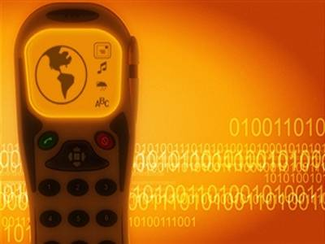
Study Group 3
Economic policy issues
  Tariff and accounting matters for international telecommunication services
  Telecommunication economic, accounting and policy issues
Photo by
Notes:
International Internet Connectivity:
This topic has been under study for many years
In April 2011, SG3 agreed a Supplement to D.50, on options for measuring international Internet traffic flows
the supplement focuses on how IP traffic flows can be measured at different points, including at Border Gateway Protocol (BGP) interconnect points
International Mobile Roaming
Responses to an SG3 Questionnaire confirm other studies: the large IMR price variations are not consistent with competitive markets
SG3 intends to develop a Recommendation, Supplement, or guidelines regarding IMR prices
There are proposals relating to the taxation provision of ITRs and IMR
Tariff and Accounting
Key ITU points:
-harmonization of global interconnection rates, also addressing VoIP, IP-based next-generation networks
-survey of international mobile termination rates
A key task of ITU is the complicated job of recommending some principles for the harmonization of global interconnection rates. Interconnection rates are the costs between telecommunication service providers when linking networks for the exchange of traffic. This work has become increasingly complex with the more widespread use of VoIP, and the move to IP-based or next-generation networks.
More recently ITU has surveyed international mobile termination rates, with a view to determining whether there are differences by region and, if possible, what might be causing those differences.

Slide 15

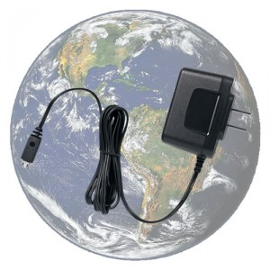

Study Group 5
Environment and Climate Change
Electromagnetic compatibility and electromagnetic effects
ICTs and climate change

Slide 16
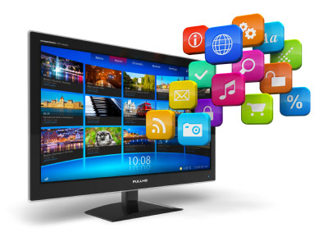
Study Group 9
Broadband and cable TV
Integrated broadband cable and television networks
16

Slide 17


Study Group 11
Protocols and test specifications
Signaling and protocols
Test specifications
M2M
17

Slide 18
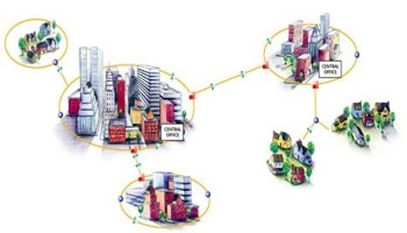
Study Group 12
Performance, QoS and QoE
Quality of Service (QoS) and Quality of Experience (QoE)
18

Slide 19


Future networks including cloud computing, big data, SDN, mobile and next-generation networks
Study Group 13
Future networks

Slide 20
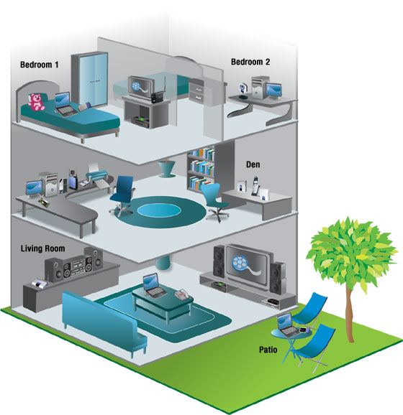
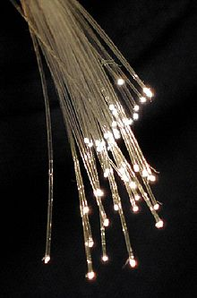
Study Group 15
Transport, access and home
Networks, technologies and infrastructures for transport, access and home
Smart Grid
Optical fiber
Notes:
Fiber cable can be very flexible, but traditional fiber's loss increases greatly if the fiber is bent with a radius smaller than around 30 mm. This creates a problem when the cable is bent around corners or wound around a spool, making FTTX installations more complicated. "Bendable fibers", targeted towards easier installation in home environments, have been standardized as ITU-T G.657.

Slide 21

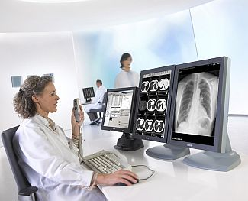
Study Group 16
Multimedia
Multimedia coding, systems and applications
Ubiquitous and Internet of Things applications
Telecommunication/ICT accessibility for persons with disabilities
e-Health
IPTV, Smart Cable Television
Study Group of Grammy award winning Recommendation H.264
21

Slide 22


Study Group 17
Security
Telecommunication security
Identity management (IdM)
Languages and description techniques
22

Slide 23
Membership
Member States
Governments and regulatory bodies
Sector Members
Private sector and regional/international organizations
Associates
Private sector (focus on one study group)
Academia
Universities and research establishments

Slide 24
Structure and organization (1/3)
General Secretariat
ITU-R
(radiocommunication)
ITU Council
ITU-D
(development)
WRC&RA
WTDC
Plenipotentiary Conference
ITU-T
(standardization)
WTSA

Slide 25
Structure and organization (2/3)
Study Group y
Study Groups …
Working Party 2/x
Working Party 1/x
Working Party 3/x
Working Parties …
Working Party 1/y
Question 1/1
Question 1/2
Question 1/3
Question 1/1
WTSA
Study Group x
TSAG & Review Committee

Slide 26
Process for Rec. creation
Usually, several meetings are necessary to produce one Recommendation.
Sessions and meetings for finalizing the document are important.
SG
meeting
SG
meeting
SG
meeting
SG
meeting
In case of TAP process
Determination
Decision
In case of AAP process
Consent
Approval

Slide 27
Approval and agreement
Traditional approval process (TAP)
Used for international standards (Recommendations) with regulatory or policy implications
Alternative approval process (AAP)
Used for technical Recommendations
Agreement
Used for non-normative texts (handbooks, guides, supplements, etc.)

Slide 28
Guiding texts
Basic Texts
Constitution, Convention, General Rules, etc.
Resolutions – Principles and instructions for:
Finance
Working methods
Work programme
External cooperation
Other strategic and technical matters
A-series Recommendations
Describe organization of ITU-T’s work

Slide 29
Thank you for your attention!
If interested please contribute to this work!
Contact:
tatiana.kurakova@itu.int

Slide 30
Backup slides

Slide 31
Newcomers – Essential information
Before the meeting (or as early as possible):
TIES account: Access to meeting documents and resources.
Web site: Useful information and contact details.
Collective letter: Describes meeting arrangements.
Registration: Done electronically via study group home page.
During the meeting:
Meeting room allocation: Shown on monitors.
Wifi network:ITUwifi SSID – How to Log In
Step 1: Connect - Choose ITUwifi SSID
Step 2: Key – (Mandatory) itu@GVA1211
Loan laptops: Available on request to the counsellor.
Extra support available.

Slide 32
Before the meeting
Register your participation on-line before the meeting.
Receive your authorized badge at the entrance of ITU Montbrillant building.
Without your authorized badge, you are not allowed to enter ITU building.
The badge helps you for your nice lunches.

Slide 33
Regional Groups
ITU-T SG2: Operational aspects
- Regional Group for the Arab Region (SG2RG-ARB)
ITU-T SG3: Economic policy issues
- Regional Group for Africa (SG2RG-ARB)
- Regional Group for the Arab Region (SG3 RG-ARB)
ITU-T SG5: Environment and Climate Change
- Regional Group for the Arab Region (SG5 RG-ARB)
ITU-T SG12: Performance, QoS and QoE
- Regional Group on QoS for the Africa Region (SG12RG AFR)
ITU-T SG13: Future networks
- Regional Group for Africa (SG13RG-AFR)
33

Slide 34
Structure and organization – other than SG groups
Other groups
Focus groups
Joint Coordination Activities (JCA)
Global Standardization Initiatives (GSIs)
Workshops
Regional groups
Special projects

Slide 35
Study group roles
Study group chairmen (and vice-chairmen)
Working party chairmen (and vice-chairmen)
Rapporteurs
Liaison rapporteurs
Editors
Delegates
Counsellor/advisor/engineer
Assistant

Slide 36
Coordination activities
All ITU-T work relies on coordination
Cooperation with other organizations
(Recommendations ITU-T A.4, A.5 and A.6)
Joint Coordination Activities (JCAs)
Global Standardization Initiatives (GSIs)
Special projects
Lead study groups
Management team
(Leadership team and editors: Chairmen, rapporteurs, liaison rapporteurs, editors, counsellors/advisors/engineers)

Slide 37
Secretariat services
Key role: facilitate standards development
Administrative support and technical knowledge
Manage meeting logistics
Document processing
Ensure quality of output standards
Coordinate routine study group activities

Slide 38
Meetings
Study group meetings
(coordinate activities, progress work items, approve/consent texts)
Working party meetings
Rapporteur (interim) meetings
Focus group meetings
Meetings outside Geneva
Languages (interpretation and translation)
Virtual meetings

Slide 39
Intellectual Property Rights (IPR)
Legal rights that protect creations and inventions
Any IPR needed to implement Recommendations must be disclosed
Software Copyright Guidelines must be followed
No trademarks allowed in Recommendations

Slide 40
Meeting style in ITU-T
Opening and closing plenary sessions take place at SG, WP, and Question levels.
Which is the most important session ?
SG
opening
SG
closing
WP
opening
WP
closing
Question
opening
Q
Q
Question
closing
Editing
ONE SG MEETING IN ONE OR TWO WEEKS

Slide 41
Working documents
Formal meeting documents (SG home page)
Contributions
TDs (used to be Temporary Documents)
Collective letters
Circulars
Reports
Liaison statements
Working documents (informal FTP area)
Rapporteur group coordination

Slide 42
Work item life cycle
Requested by membership
Initiated by SG, FG or Technology Watch
Editor(s) and other experts develop text
Mature text is approved/agreed by SG
Texts are maintained by amendments, corrigenda and implementers’ guides
Revised versions published periodically
Work items may move within and between SGs
Obsolete Recommendations can be withdrawn or superseded

Slide 43
Publications (1/2)
Main products: ITU-T Recommendations
Recommendations are international standards
Grouped into themed series
Compliance only mandatory after adoption in law
Developed at the request of membership
Maintained through amendments, corrigenda and revisions
Normative texts: Approved by members

Slide 44
Publications (2/2)
Other publications (non-normative)
Supplements
Implementers’ guides
Tutorials and technical papers
Focus groups technical reports
Ad-hoc publications
Non-normative texts: Agreed by members

Slide 45
Electronic working methods (1/3)
Web pages
Wireless and wired network access
ITUwifi SSID – How to Log In
Step 1: Connect - Choose ITUwifi SSID
Step 2: Key – (Mandatory) itu@GVA1211
TIES access to:
Meeting documents
Draft and prepublished texts
Electronic working method services
Internet services

Slide 46
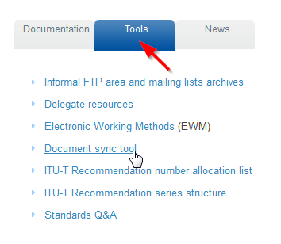
Electronic working methods (2/3)
Email reflectors
Informal FTP areas
Web access
FTP client
Sync tool
Document submission (use correct template)
Direct document posting
Mail/email/fax
AAP tracking

Slide 47
Electronic working methods (3/3)
Virtual meetings:
GoToMeeting/GoToWebinar, Adobe Connect
Cavoon (audio-conference service provider)
Databases:
Recommendations
Liaison statements
Work programme
Test signals
Formal descriptions
IPR (patents and Copyrights)
News feeds

Slide 48
Document-oriented meeting
Results should be recorded in the report and implemented in a draft Rec.
The reports and all output documents at the meeting should be available before the closing session. They should be approved at the closing session.
In that sense, ITU meeting is easy to report to colleagues or monitor from your country.

Slide 49

ICT Discovery Museum
Located at ITU Headquarters, 2nd floor Montbrillant building
Showcases the evolution of ICTs with interactive exhibitions and educational programmes
Free guided tours available in all six UN languages
(to be reserved in advance)
Open Monday to Friday, 10:00 to 17:00
info@ictdiscovery.org +41 22 730 6155
Notes:
ICT Discovery: www.itu.int/en/ictdiscovery

