Slide 1


Standardization: An Academician’s Perspective
Pramod K. Varshney
Electrical Engineering & Computer Science
Syracuse University
Syracuse, NY 13244
varshney@syr.edu
(Joint work with Swastik Brahma)

Slide 2
Outline
What is Standardization?
  Importance of the process
Research and Standardization
  Limitations of University Researchers
Current Curricula and Standardization
Conclusion

Slide 3

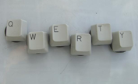
What is a standard?
A standard is—
  “A document established by consensus and approved by a recognized body, that provides, for common and repeated use, rules, guidelines or characteristics for activities or their results, aimed at the achievement of the optimum degree of order in a given context” (ISO/IEC, 2004b, p.8)
In short
  An agreement developed by several parties with the intent that all parties comply.
Examples
  Units of measurement (meter (m); seconds(s) etc.)
  Layout of QWERTY computer keyboard
  Vehicle safety test procedures

Slide 4
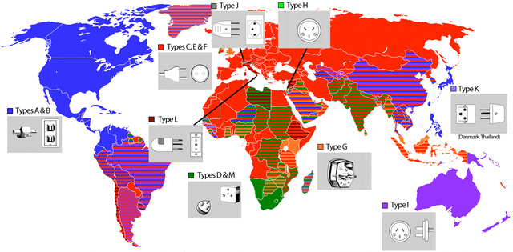
What if we had no standards?
Lack of standards can result in mere frustration….
Incompatible electrical plugs and sockets worldwide

Slide 5
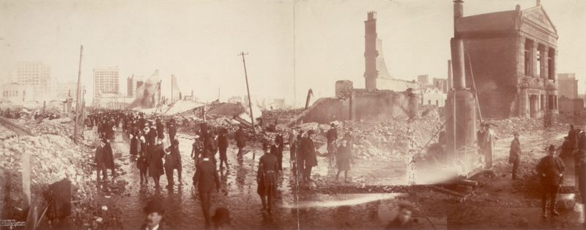
What if we had no standards?
And can even result in catastrophes …
Photo Courtesy: Library of Congress
1904 Baltimore fire: Hoses of fire fighters from
neighboring cities did not fit hydrants in Baltimore.

Slide 6
Research vs Standardization
Basic Research: Oftentimes driven by intellectual curiosity
  Increases understanding of fundamental principles
  Generates new ideas, principles and theories that lay the foundations of modern progress and development in different fields.
    Can revolutionize how practitioners deal with a problem.
  Fosters diversity of the intellectual process
    Critical for fostering competition and enabling technological advancement.
Standardization: Driven by practical concerns
  Standards create compatibility
    Networked environments (e.g., telephone, broadcasting) require standards
  Standards help coordinate technology and markets
    Prevents diversity from becoming chaotic
  They facilitate international trade

Slide 7
The Road to Standardization
Basic
Research
Prototyping & Development
Standardization
Intellectual Property (IP)
Limitations of the process
  Diverse research groups tend to produce incompatible solutions.
  Assumptions are sometimes made that may hinder deployment
  More influence of developed nations and larger organizations in the process.
  Academic involvement in standardization
    Issues of timely influence
      e.g., Wired Equivalent Privacy (WEP) standard
    Academicians are sometimes limited in their capabilities to consider the process of transition to market and standardization.
      e.g., Stochastic Resonance (SR)

Slide 8
Stochastic Resonance in Signal and Image Processing
A nonlinear phenomenon in which the output signals of some nonlinear systems can be amplified by adding noise (Gammaitoni 98)
First proposed to explain the periodicity of earth’s ice ages.
Underlying mechanism of the SR phenomenon has not been fully explored
  When can a system be improved?
  What are the conditions for improvability?
  What is the optimal SR noise?
    Gaussian? Uniform?

Slide 9
Stochastic Resonance in Nonlinear System Enhancement
T(x)
Input x
Nonlinear System
y
T(y)
SR Noise Generator
Σ
Nonlinear System
Nonlinear Systems
Signal Detection - Signal Estimation - Image Processing - Sensor Fusion

Slide 10
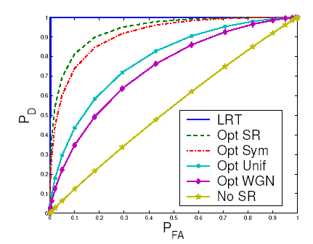
Does SR improve performance ?
ROC curve when µ= 3, σ= 1, A = 1 and N =30

Slide 11





Image Enhancement (With SR Noise)
Original Image GBA detected GBA-based SR noise-based Optimal two peak
positives enhancement detected positives SR noise-based
enhancement

Slide 12
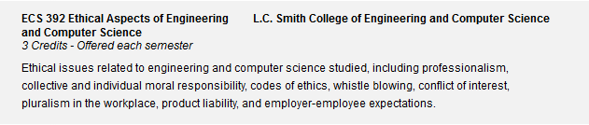
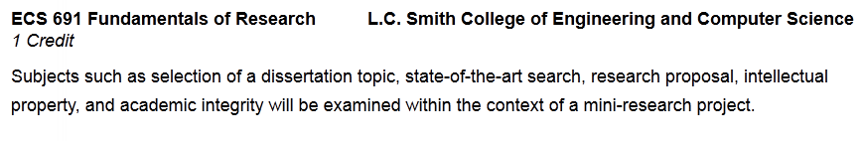
Role of Courses
Courses should familiarize students with standardization.
  Role of the government, public and private sectors needs to be highlighted
  Courses at both undergraduate as well as graduate levels.
Sample courses at Syracuse University
  Undergraduate
  Graduate
  Topics on “Standardization” are lacking !!
    They need to be added.

Slide 13
Concluding Remarks
Topics of standardization and IP is not covered in curricula
Awareness needs to be introduced

