Slide 1
Dr. Bilel Jamoussi
Chief, Study Groups Department, ITU-T
Joint ITU-CTIF-GISFI Workshop on
Education about Standardization
Atlantic City, New Jersey, 25 June 2013
Inaugural Speech
Academia and ITU-T
Alliance for innovation in ICTs standards

Slide 2

AGENDA
ITU Overview
ITU-T’s key topics
ITU and Academia
  Membership
  Kaleidoscope academic conferences
  Other ITU academic initiatives
  Education about Standardization

Slide 3

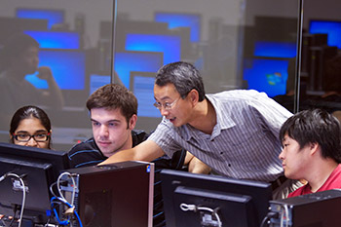
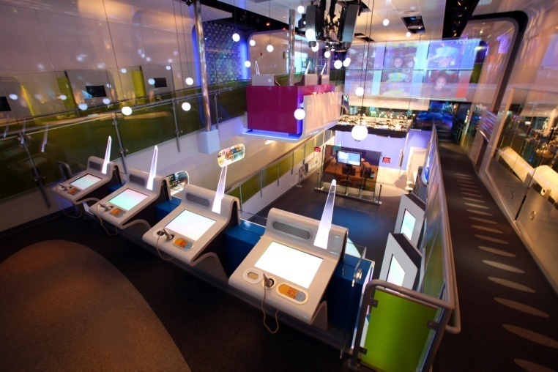
ITU membership now open to Academia
Academia, universities and
associated research establishments
can join ITU’s three sectors in their own right
Resolution 169 (ITU PP-10)
More info at: http://www.itu.int/en/ITU-T/membership/Pages/default.aspx

Slide 4


ITU’S network of academia members
56 universities (38 ITU-T) in 37 countries

Slide 5
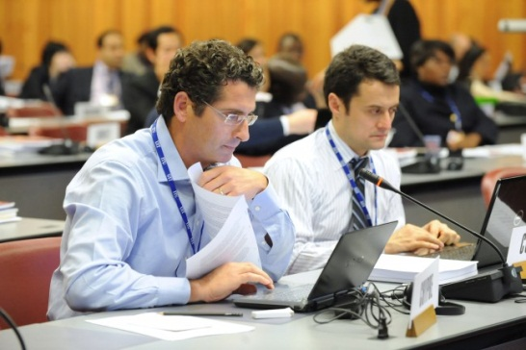


Rights
Access to all ITU-T Study Groups
Submit contributions
Leading positions: rapporteur or editor
Unlimited participation of delegates
Benefits
Working with Member States and regulatory bodies from all around the world
Meeting key players in the ICT industry
Partner with the most innovative research institutes and universities

Slide 6

WTSA-12 Resolution 71
Considering PP-10 Res.169
Recognizing Kaleidoscope events
RESOLVES
To allow expanded participation of academia, including at GSS, TSAG and WTSA.
INSTRUCTS TSB Dir
To continue organizing Kaleidoscope annually
INVITE THE COUNCIL
To consider the positive contribution made by academia and recommend that they be admitted to participate in the work of the three Sectors of ITU on a permanent basis.

Slide 7


WTSA-12 Resolution 80
Recognizing WTSA-12 Res. 71
Considering the importance of publications for academia
RESOLVES
That it’s important to acknowledge significant contributors to the work of ITU-T
INSTRUCTS TSB Dir
To acknowledge the value of active participation of academia members in the work of ITU-T and highlight the importance of contribution to ITU-T SGs deliverables
INSTRUCTS TSAG
To study options of how to clearly acknowledge significant contributors and define objective criteria
INVITES MEMBER STATES
To give visibility and acknowledgment of academia contributions so as to be considered eligible activities for research and development productivity evaluation

Slide 8
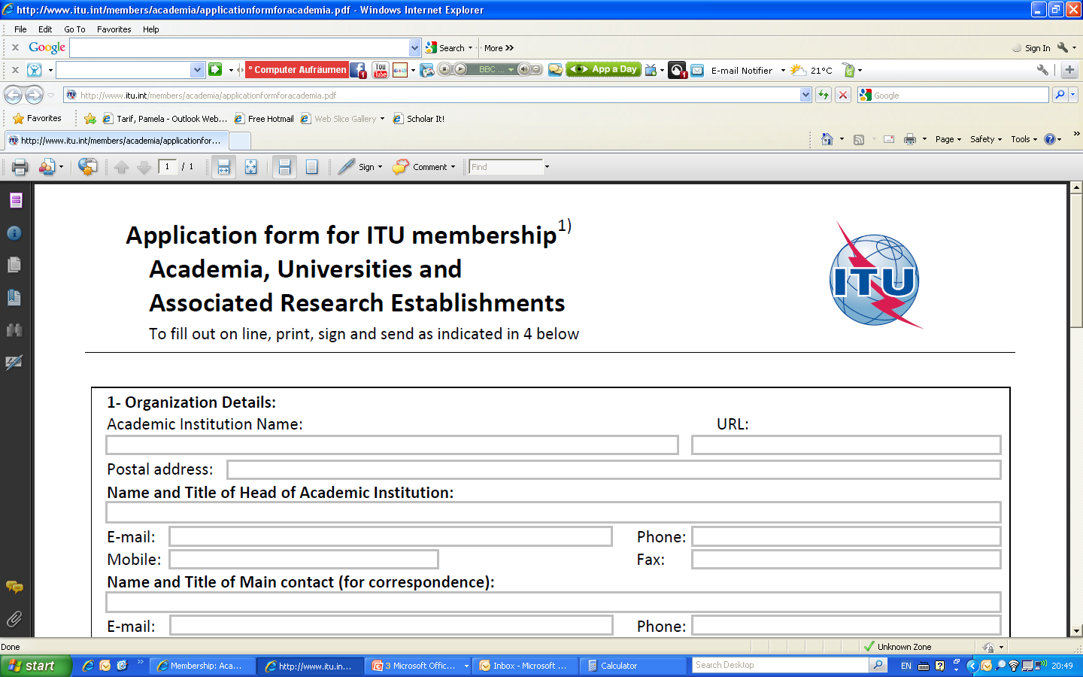

Become a Member!
Annual Membership fee:
For developed countries: 3.975 CHF
For developing countries: 1.987 CHF
Step 1: Fill the Form
www.itu.int/members/academia/applicationformforacademia.pdf
Step 2:
Send the form
membership@itu.int

Slide 9




ITU Kaleidoscope academic conferences
International events bringing academia, governments, and industry together
Brainstorming on future ICT networks and services
Rigorous, double-blind, peer-review process
Top 3 papers win prize money totaling USD$ 10,000

Slide 10

ITU Kaleidoscope 2013 (1/2)
    Building Sustainable Communities
    Kyoto University, 22-24 April 2013
3 Invited Papers
2 Keynote Speakers
2 Special Sessions
2 Side events:
  Showcase
  Workshop on Education about Standardization
Over 180 participants from 22 countries
http://itu-kaleidoscope.org/2013
Notes:
SHOWCASE: the latest ICTs research and development products and services that contribute to "building sustainable communities" through the cooperation of academia, research institutes and industry.

Slide 11
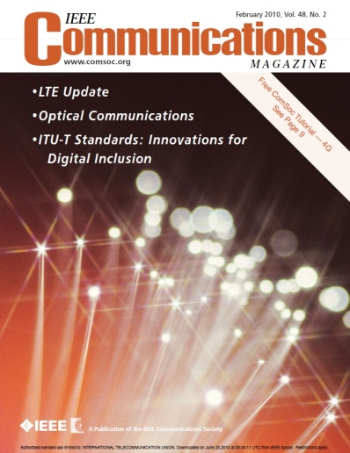
ITU Kaleidoscope 2013 (2/2)
30 accepted papers (out of 99 submitted):
Presented at the conference
Published in the conference proceedings
Published in IEEE Xplore
Considered for publication in a special edition of IEEE Communication Magazine
… featuring
Kaleidoscope 2009

Slide 12
Stay tuned for next Kaleidoscope… itu-kaleidoscope.org
ITU Kaleidoscope 2014
Bonch-Bruevich Saint-Petersburg State University of Telecommunications (SPbSUT)
Russian Federation
June 2014

Slide 13

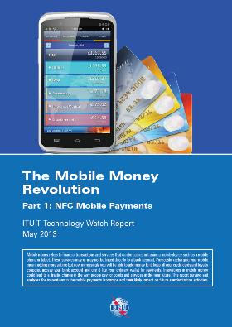
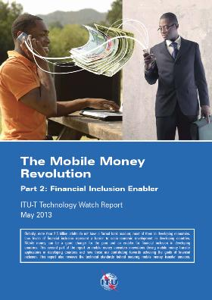










ITU-T Technology Watch
Submit topic proposals and abstracts for future reports in the Technology Watch series!
http://www.itu.int/en/ITU-T/techwatch/Pages/default.aspx

Slide 14
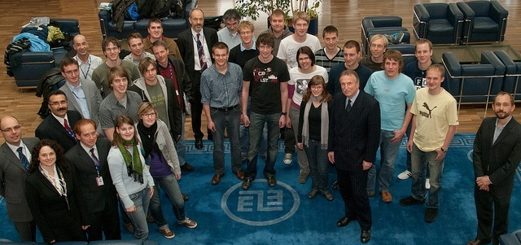
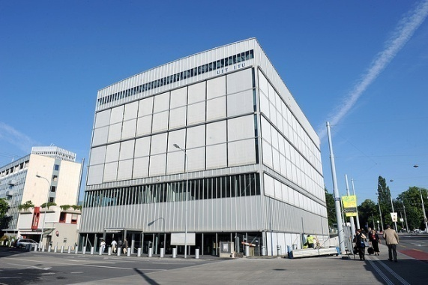
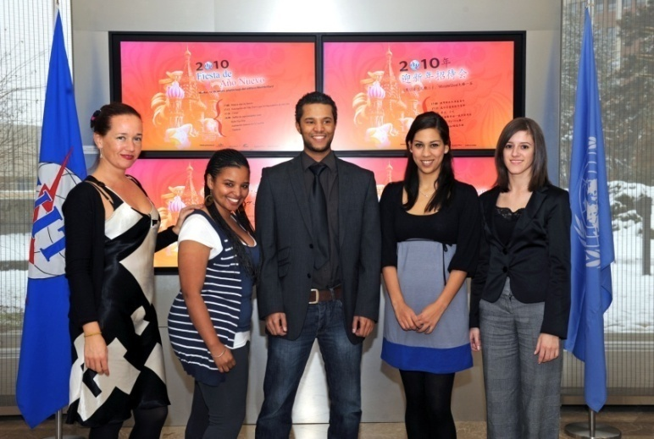
Seminars to meet ITU-T experts
Workshops
in ITU and all over the world
Lecture Series
in ITU and universities
Internships
for students

Slide 15



Promote Your University
Saving the Climate
Toolkit developed with 50 partners including:
Imperial College
National Inter-University Consortium for Telecommunications
Scuola Superiore Sant’Anna of Pisa, Italy
United Nations University (UNU)
University of Genoa, Italy
University of Zagreb, Croatia

Slide 16

ITU Academy
Human Capacity Building Programme
Objective
Assist developing countries by making available ICT education, training and development opportunities at the highest possible levels of quality. These offerings are delivered in cooperation with numerous partners, around the globe through face-to-face events and distance learning.

Slide 17

WSC Academic events
The ICES Workshop and WSC Academic Day, 12-14 June 2013, Sophia Antipolis, France
The ICES Conference and WSC Academic Day, Bali (Indonesia), 10 and 11 May 2012
WSC Academic Day 2011, Hangzhou (China) on 29 June 2011
WSC Academic Week 2010, 5 to 9 July 2010
International Conference Centre (CICG)
Geneva (Switzerland)

Slide 18

Introduce standards in
academic curricula: workshops
Joint ITU-CTIF-GISFI Workshop on Education about Standardization - Atlantic City, New Jersey, TODAY, 25 June 2013
Joint ITU-IEICE-CTIF-GISFI Workshop on Education about Standardization – 25 April 2013, Kyoto, Japan – a Kaleidoscope 2013 side event
Joint ITU-GISFI-DS-CTIF Standards Education Workshop - 8-9 October 2012, Aalborg University, Denmark
ITU Webinar on Standards Education - 30 April 2012

Slide 19
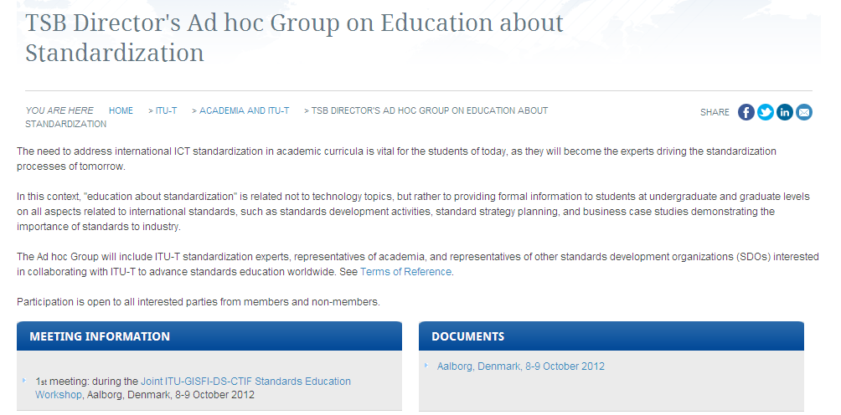
TSB Director’s Ad hoc Group on
Education about Standardization – AHG SE (1/6)
Webpage: http://itu.int/go/standardseducation
Documents store: http://itu.int/go/standardseducation/docs

Slide 20
AHG SE - Terms of reference (2/6)

Slide 21
AHG-SE - Meetings (3/6)
1st meeting: during the Joint ITU-GISFI-DS-CTIF Standards Education Workshop - 8-9 October 2012, Aalborg University, Denmark
2nd meeting: during the Joint ITU-IEICE-CTIF-GISFI Workshop on Education about Standardization – 25 April 2013, Kyoto, Japan – a Kaleidoscope 2013 side event
Next meeting: back to back with ITU Kaleidoscope 2014

Slide 22
AHG-SE – 2nd meeting Final Report:
Participants’ comments (4/6)
Chairman asked the participants to provide comments on the following (by the beginning of September 2013):
UNECE document AHG-SE-004 Att.2
Requirements for International Discussions on Skill standard － Evaluation for human resource’s skills required for standardization
www.y-adagio.com/public/ccommt/temp/skill-std-hrrs_eng_v0.98.pdf
Revised action plan
Report of 2nd meeting

Slide 23
AHG-SE – 2nd meeting Final Report:
Next steps (5/6)
1. Promotion (three areas): activities of the AHG; importance of international standards; academic membership of ITU.
2. Collect information on courses on standardization currently offered worldwide.
3. Identify relevant organizations and explore collaboration efforts.
4. Identify gaps, once seen the above.
5. Develop a tutorial and identify members to contribute.
6. Organize workshops in future and look for support from members of group in this area.
7. Develop a strategy towards the development of materials for education about standardization, as well as identification of common requirements.

Slide 24
AHG SE – Subscribe! (6/6)
Secretariat Mailbox: tsbstdsedu@itu.int
Mailing list: standardsedu@lists.itu.int
How to subscribe to the mailing list:
An account is needed…
Members: use a TIES account (members-only)
  For creating/managing TIES accounts, see http://itu.int/TIES/
Non-members: create or use a Guest account
  For instruction on creating a Guest account, see http://itu.int/ITU-T/edh/faqs-guest.html
Once you have a TIES or Guest account, you can subscribe to the mailing list using the ITU-T Electronic Registration and Subscription Service:
  http://itu.int/ITU-T/services

Slide 25
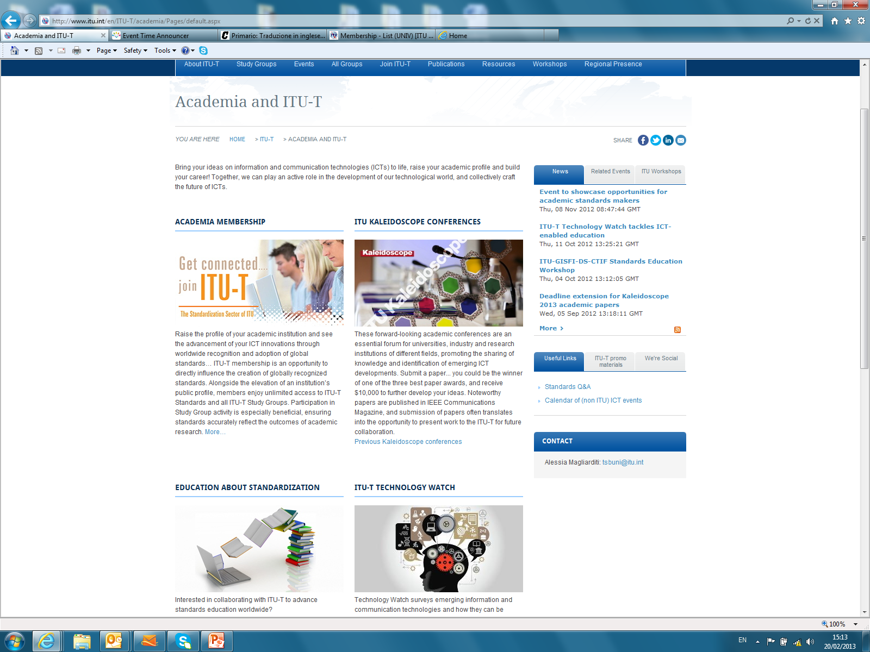
Academia and ITU-T webpage
http://www.itu.int/en/ITU-T/academia/Pages/default.aspx
Notes:
25

Slide 26
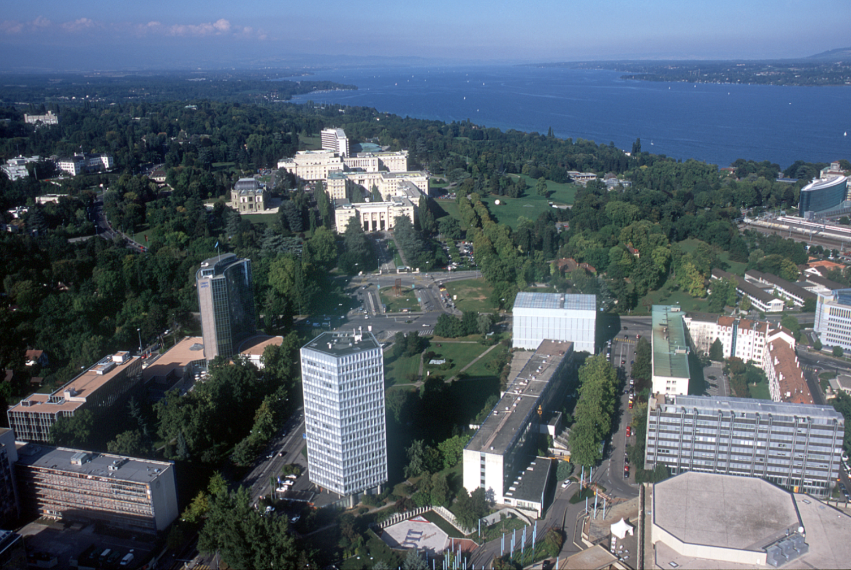
Thank you
Notes:
26

