Slide 1


DEFINING NFV
NFV → Network Function Virtualization
ITU Workshop on
Software Defined Networking (SDN)
Standardization Landscape
(Geneva, Switzerland, 4 June 2013)
Yun Chao Hu
NFV INF WG Co-chair,
yunchao.hu@huawei.com

Slide 2
Agenda
Trends and Challenges
Network Functions Virtualization
Strategic Networking Paradigms & SDN
ETSI NFV Industry Specification Group
Current Status
Summary

Slide 3
Trends and Challenges
Trends
Mobility, explosion of devices and traffic
Emergence of cloud services
High performance industry standard servers shipped in very high volume
Convergence of computing, storage and networks
New virtualization technologies that abstract underlying hardware yielding elasticity, scalability and automation
Software-defined networking techniques emerging
Challenges
Huge capital investment to deal with current trends
Network operators face an increasing disparity between costs and revenues
Complexity: large and increasing variety of proprietary hardware appliances in operator’s network
Reduced hardware lifecycles
Lack of flexibility and agility: cannot move network resources where & when needed
Launching new services is difficult and takes too long. Often requires yet another proprietary box which needs to be integrated into existing systems

Slide 4
Network Functions Virtualization
Network Functions Virtualisation is about implementing network functions in software - that run today on proprietary hardware - leveraging (high volume) standard servers and IT virtualization
Supports multi-versioning and multi-tenancy of network functions
      Allows use of a single physical platform for different applications, users and tenants
Enables new ways to implement resilience, service assurance, test & diagnostics and security surveillance
Facilitates innovation towards new network functions and services that are only practical in a pure software network environment
Applicable to any data plane and control plane functions, (fixed or mobile networks)
Automation of management and configuration of functions important for NFV to scale
NFV aims to ultimately transform the way network operators architect and operate their networks – though change will be incremental

Slide 5











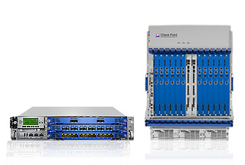
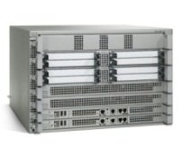
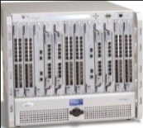
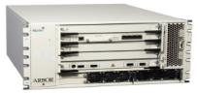

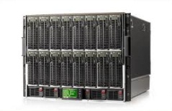
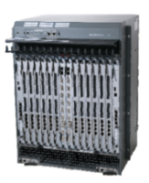
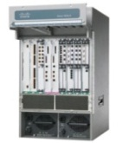
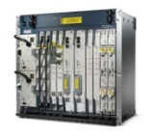
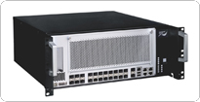

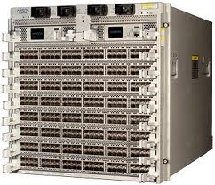
Network Functions Virtualisation: Vision
Network Functions Virtualisation Approach
Classical Network Appliance
Approach
Independent
Software Vendors
Competitive &
Innovative
Open Ecosystem
Message
Router
CDN
Session Border
Controller
WAN
Acceleration
Orchestrated,
automatic & remote install.
DPI
Firewall
Carrier
Grade NAT
Tester/QoE
monitor
High volume standard servers
SGSN/GGSN
PE Router
BRAS
Radio/Fixed Access
Network Nodes
High volume standard storage
Fragmented, purpose-built hardware.
Physical install per appliance per site.
Hardware development large barrier to entry for new vendors, constraining innovation & competition.
High volume Ethernet switches

Slide 6
Benefits of NFV
Flexibility to easily, rapidly dynamically provision and instantiate new services in various locations (i.e. no need for new equipment install)
Reduced time-to-market by minimizing the typical network operator cycle of innovation. More service differentiation & customization
Improved operational efficiency by taking advantage of the higher uniformity of the physical network platform and its homogeneity to other support platforms
Reduced equipment costs through equipment consolidation on high volume industry standard servers leveraging the economies of scale of the IT industry
Reduced operational costs: reduced power, reduced space, improved network monitoring
Software-oriented innovation (including Open Source) to rapidly prototype and test new services and generate new revenue streams
IT-oriented skillset and talent (readily available in global geography, flexible)

Slide 7
Strategic Networking Paradigms & SDN
Open
Innovation
Software
Defined
Networking
Creates competitive supply of innovative applications by third parties
Creates network abstractions to allow application-aware behaviour, and increased flexibility
Network
Functions Virtualisation
Leads to agility, Reduces CAPEX, OPEX,
NFV and SDN are highly complementary, they are mutually beneficial but not dependent on each other (NFV can be deployed without SDN and vice-versa)
SDN can enhance NFV performance, simplify compatibility, facilitate operations
NFV aligns closely with SDN objectives to use software, virtualization and IT orchestration and management techniques

Slide 8
ETSI NFV ISG
Global operators-initiated Industry Specification Group (ISG) under the auspices of ETSI (>20 global network and mobile operators). Wide industry support (> 50 vendors).
ISG Chair: Prodip Sen, Verizon
ISG Vice-Chair: Uwe Michel, Deutsche Telecom
Network Operators Council (NOC): technical advisory body representing network operators, chaired by – Don Clarke, British Telecom
Currently four (4) WGs and two (2) expert groups (EGs), coordinated by Technical Steering Committee (TSC), chaired by – Diego Lopez, Telefonica
Open membership
  ETSI members sign the “Member Agreement”
  Non-ETSI members sign the “Participant Agreement”
  Operates by consensus (formal voting only when required)
Deliverables: White papers addressing issues to be addressed, architectural frameworks, requirements, standards liaisons

Slide 9
ETSI NFV ISG WG Structure
Technical Steering Committee
Chaired by Technical Manager : Don Clarke (BT)
Assistant Technical Manager : Diego Lopez (TF)
Other members: ISG Vice Chair + WG Chairs + Expert Group Leaders
Programme Managers : Zong Ning (Huawei), Francois Menard (Aeponyx)
Working Group
Architecture of the Virtualisation
Infrastructure
Co-Chairs: Steve Wright (ATT) + Yun Chao Hu (HW)
Expert Group
Performance & Portability
Chair: Francisco Javier Ramón Salguero (TF)
Working Group
Management & Orchestration
Co-Chairs: Raquel Morera (VZ) + vacant
Expert Group
Security
Chair: Igor Faynberg (ATT)
Working Group
Software Architecture
Co-Chairs: Fred Feisullin (Sprint) + Marie-Paule Odini (HP)
BT = British Telecom
HW= Huawei
TF = Telefonica
VZ = Verizon
Working Group
Reliability & Availability
Co-Chairs: Naseem Khan (VZ) + Markus Schoeller (NEC)

Slide 10
NFV Work Program

Slide 11

NFV Use Cases
Use Case 1: Virtualization of Mobile Core Network Nodes (including IMS)
Use Case 2: Virtualized Home Environment
Use Case 3: Virtualization of CDNs
Use Case 4: Service Chaining
Use Case 5: Virtualization of Mobile Base Station
Use Case 6: Coexistence of Virtual and Legacy Mobile Core Networks

Slide 12
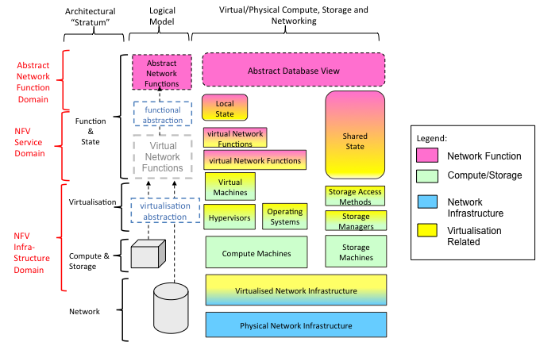
NFV Architectural Model

Slide 13
Key Take Away
Network operators have proven NFV feasibility via proof of concept test platforms
Network operators and vendors have identified numerous “fields of application” spanning all domains (fixed and mobile network infrastructures)
Significant CAPEX/OPEX benefits, leveraging also the economies of scale
Emerging virtual network appliance market
Novel ways to architect and operate networks, spawning a new wave of industry wide innovation
Network Functions Virtualization can dramatically change the telecom landscape and industry over the next 2-5 years
NFV ISG formed under ETSI (Nov. 2012), led by network operators with wide industry participation
Next NFV meeting: July 24-26, Bonn, Germany
Further information: http://portal.etsi.org/portal/server.pt/community/NFV
Opportunities for new market players - get involved !!!

Slide 14
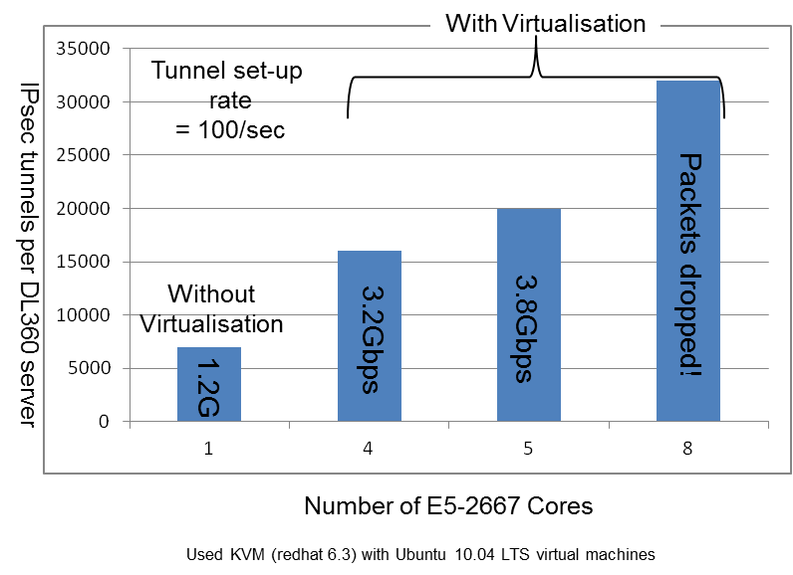
Why we believe NFV is the future
Recent tests by network operators and
vendors have demonstrated that network
functions can operate at the level of
several millions of packets per sec, per
CPU core
Demonstrates that standard high volume
servers have sufficient processing
performance to cost-effectively virtualized
network appliances
  The hypervisor need not be a bottleneck
  The OS need not be a bottleneck
Total Cost of Ownership advantages are a huge driver – could be scenario specific but expect significant benefits, e.g., energy savings
Advances in virtualization & server technologies have propelled the importance and use of software in many applications and fields
A concerted industry effort is underway to accelerate this vision by encouraging common approaches which address the challenges for NFV
ETSI NFV Industry Specification Group

Slide 15
Fields of Application (examples)
Application-level optimisation: CDNs, Cache Servers, Load Balancers, Application Accelerators
Mobile networks: HLR/HSS, MME, SGSN, GGSN/PDN-GW, Base Station, EPC
Home environment: home router, set-top-box
Security functions: Firewalls, intrusion detection/protection systems, virus scanners, spam protection
Tunnelling gateway elements: IPSec/SSL VPN gateways
Traffic analysis/forensics: DPI, QoE measurement
Traffic Monitoring, Service Assurance, SLA monitoring, Test and Diagnostics
NGN signalling: SBCs, IMS
Converged and network-wide functions: AAA servers, policy control and charging platforms
Switching elements: BNG, CG-NAT, routers

Slide 16
ETSI NFV’s objectives
Identify technical issues – examples are:
    Achieving high performance with portability between different hardware vendors (and hypervisors)
    Achieving co-existence with bespoke hardware based network platforms whilst enabling an efficient migration path to fully virtualised network platforms
    Managing and orchestrating many virtual network appliances while ensuring security from attack and mis-configuration
    Achieving scale through automation
    Integrating multiple virtual appliances from different vendors (“mix & match”) without incurring significant integration costs, and while avoiding lock-in
Encourage common approaches to solving these technical challenges to present a global market, and to avoid market fragmentation
    Re-use existing standards and not to produce new ones unless absolutely necessary
The NFV ISG provides a forum for the industry & operators to collaborate, to converge requirements, agree common approaches, and to validate recommendations
    Produce a set of requirements/specifications, quick turnaround (18-24 months)

Slide 17
How did we get here…
Carriers had already independently progressing research on network functions virtualisation with different hardware and software vendors
We had independently concluded that while the fundamental technology is ready, it would not be commercialised quickly for scale deployment without industry cooperation and support
Cooperation amongst the carriers began with informal discussions at the Open Networking Summit (Apr. 2012)
We gathered more carrier support and started informal discussions on convening an industry forum
At a meeting in San Francisco (Sep. 2012), it was decided - after consideration of several options - to parent under ETSI as an “Industry Specification Group”
The joint white paper on Network Functions Virtualisation was published on target at the OpenFlow/SDN World Congress (Darmstadt, Oct. 2012) and the ETSI Board approved creation of the NFV ISG (Nov. 2012)
Founding members: AT&T, BT, Deutsche Telekom, Orange, Telecom Italia, Telefonica, Verizon
1st formal meeting was held in ETSI HQ (Sophia Antipolis) in Jan 2013

Slide 18
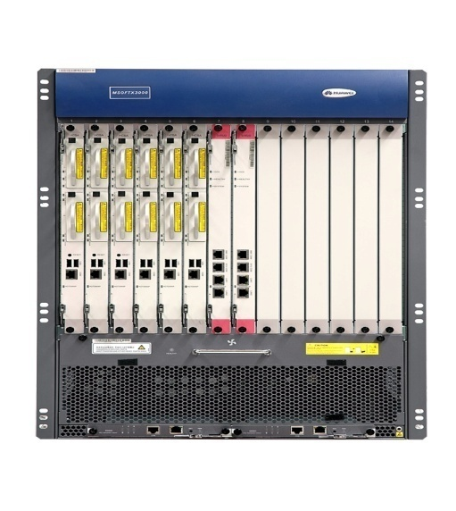
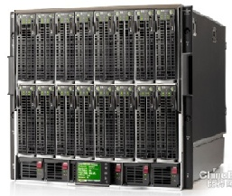

NFV HL Architecture and Scope
OSS / BSS
NFV Scope
Virtualized Network Functions (VNFs)
NFV Management and
Orchestration (MANO)
Service
End-Points
(End-users,
Other Services)
VNF
VNF
VNF
VNF
NFV Infrastructure (NFVI)
Virtual Infrastructure
Virtual Computing
Virtual Storage
Virtual Networking
Other Networks
Physical Infrastructure
Compute
Storage
Network
Geneva, Switzerland, 4 June 2013

Slide 19
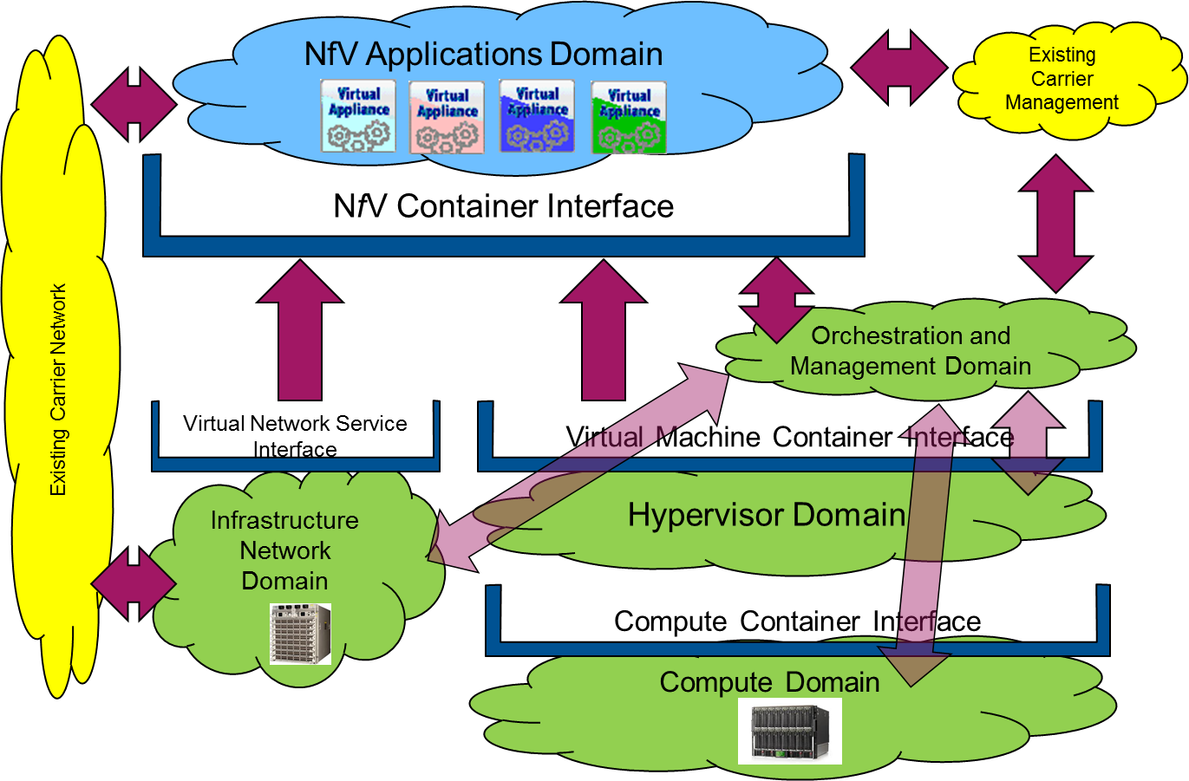
Baseline NFV Architecture
NFV Applications Domain
NFV Container Interface

