Slide 1
SDN in China
ITU Workshop on
Software Defined Networking (SDN) Standardization Landscape
(Geneva, Switzerland, 4 June 2013)
Duo LIU
Vice President
CATR, MIIT of China
liuduo@catr.cn

Slide 2
New Requirements for network
Users, Services, Providers demand much more of the Networks
Capacity
Virtualization
Dynamic
Flexibility
Cost
Software is becoming more important
Software-defined bring greater flexibility and openness
The core value of the IT industry has been transferred from the equipment manufacturers to software design
Software-defined extend to the network area

Slide 3
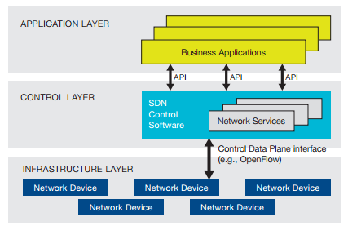
Software Defined Networking
New Networking technology which opening up inner resource to upper Application，supporting software programmable control

Slide 4
SDN’s key features
Separation of control plane and data plane
make SDN-based infrastructure networks more flexible, intelligent and adaptive to changes.
Network resource openness
enable infrastructure network providers to make new revenue through opening their networks to third party service providers in a win-win collaboration.
Decoupling of hardware and software
make it much easier to introduce new technologies to infrastructure networks and make network equipment more affordable to help boost the widespread deployment of broadband networks.

Slide 5
Universities in China
Tsinghua University
signed cooperative research agreement with Stanford in 2010
Deploy campus SDN network
Focus on future network & Openflow
Achievement including openlow function expansion and SDN controller scalability
Beijing University of Post and telecommunications
initiated “content centric open network”research project with 21vianet（Data Center Provider），construct Inter-datacenters test bed based on SDN
Campus SDN network，carrying test flow，deviding experimental network
SDN in flexible optical network

Slide 6
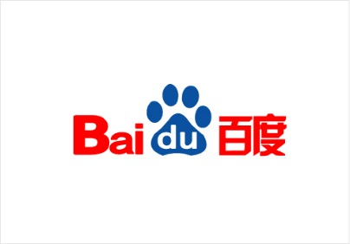
Enterprises in China
Developed SRP(Sequoia Routing Protocol) which can be deployed in Datacenter with open API
Virtualized IDC network
Development and test traffic engineering system based on SDN technology
Equipments
Solutions
Studies on Carrier Networks evolution toward software
Lab Testing
Access network, transport network, IP network……

Slide 7
Projects
The Plan for High-Tech Research and Development (863) information technology field call for proposals guide 2014
1.1 Software Defined Network key technology development and demonstration
Research topics including control and data forwarding separation, technology of dynamic perception and collaborative technology services and resources, development of SDN core equipment, software protocol stack and the corresponding prototype system, demonstration application.
Consists of three research directions:
SDN mechanism, system and
architecture
Resource flexible scheduling
SDN key technology research
And equipment development
SDN
Demonstration and Validation

Slide 8
Standardization activities in CCSA
TC1：IP and Multicast
WG4 ( New Technology and International Standards）:
SDN research report（Finished in 2012Q4）
SDN——Architecture（Standard Project：Approved）
SDN——Content Centric Network based on SDN （Research report：Approved）
SDN——Network Management （Research report：Approved）
SWG3 （Future Data Network）
Focus on future data network with the core concept of software-defined
FDN application scenarios and requirements (Almost finished)
FDN functional framework
FDN communication protocol
WG1 (Network protocol system and device)
Openflow Switch technologic requirements/test methods（Standard Project：Approved, 2013~2015）
TC3: Network and Switch
Network virtualization
Notes:
CCSA TC1
In May 2012, TC1 WG4 published SDN research report
In nov 2012, TC1 established a new SWG ,which name is FDN, future data network, this group focus on 。。。
The docment of FDN application scenarios and requirements is almostly finished.

Slide 9
China SDN Conference
2012 China SDN & open networking summit
2013 China SDN Conference
Hosted by：
China Institute of communication
China Communication Standard Association
Guest Speakers from：
ONF, CATR, ChinaTelecom, ChinaUnicom, ChinaMobile, BUPT, BJTU, Tsinghua University, Arista Networks, Cyan, Dell, Huawei, IBM, H3C, NEC, Net Optics, ZTE, Tencent
Exhibition of Product
Dell, NEC, Arista, IBM, Huawei, Cyan
Experts panel discussion
TOPIC: SDN and its future trends
Carriers panel discussion
TOPIC: What’s the impacts that SDN bring to telecom carriers?

Slide 10
Carrier SDN
Software-Defined Networking (SDN) is a long-term technical trend that will profoundly reshape the ICT industry in the decades to come.
SDN for carrier networks, Carrier SDN will be crucial for the future development of telecommunication industry.
Carrier SDN can benefit both developed and developing countries, where people can benefit from the affordable broadband networks using up-to-date technologies, which otherwise will be rather difficult.

Slide 11
Carrier SDN study is the role of ITU-T
Lack of a system of deployable standards will prevent carrier SDN from being broadly applied in ICT, especially in telecommunication.
In recognition of this fact, ITU-T should play a leading role in the development of a system of Carrier SDN standards, to facilitate the Carrier SDN’s broad application in ICT industry.

Slide 12
To establish FG on Carrier SDN
Resolution 77 is produced in WTSA 2012 to encourage TSB to organize SDN workshop in 2013 and instructs TSAG to identify the relevant study group(s) in which to follow up actions and establish a suitable organizational arrangement on SDN. ITU CTO meeting in November 2012 also recommended that ITU should take necessary actions guided by a strategic vision.
Different possible approaches should be explored including the creation of an FG specialized on carrier SDN.

Slide 13
The benefits for FG Carrier SDN
FG Carrier SDN can be a place to attract those non-ITU members to come to contribute ideas to show how SDN techniques can use in the legacy telecom network. Those players from academic background, from IT industry and from internet application area such as OTT can bring new ideas on how carrier networks embrace SDN concept and SDN techniques.
FG Carrier SDN is also a place to have experts from different SGs to participate and contribute.

Slide 14
Conclusions and Recommendations
SDN has shown clearly its great potential of being one of the few ground-breaking technologies in the history of ICT that will profoundly reshape the ICT industry in the decades to come.
Carrier SDN will be crucial for the future development of telecommunication industry.
To set up FG Carrier SDN under TSAG.

Slide 15
Thanks for your attention!

