Slide 1
Overview of ITU activities on 5G
Martin Adolph, Programme Coordinator, ITU Telecommunication Standardization Bureau

Slide 2
Background: IMT-2000, IMT-Advanced, IMT-2020
All of today’s 3G and 4G mobile broadband systems are based on the ITU’s IMT standards.
ITU established the detailed specifications for IMT-2000 and the first “3G” deployments commenced around the year 2000.
In January 2012, ITU defined the next big leap forward in wireless cellular technology – IMT-Advanced – and this is now being progressively deployed worldwide.
The detailed investigation of the key elements of IMT-2020 is already well underway, once again using the highly successful partnership ITU-R has with the mobile broadband industry and the wide range of stakeholders in the 5G community.

Slide 3
Organizations involved in the development of IMT
3GPP,
3GPP2
5G Americas
5G Infrastructure Public Private Partnership
5G Innovation Centre
APT Wireless Group
Fifth Generation Mobile Communications Promotion Forum
ARIB
ATIS
CCSA
CDG
ETSI
EU METIS Project
GSMA
IEEE
IMT‐2020 Promotion Group
ITRI
NGMN
NYU Wireless
TSDSI
TIA
TTA
TTC
UMTS Forum
WiMax Forum
Wireless World Research Forum
We welcome any other interested partners

Slide 4
ITU-R WP 5D is working together with these partners in the same open process to establish the criteria for IMT-2020.
Recommendation ITU‑R M.2083‑0, approved in September 2015, defines the framework and overall objectives of the future development of IMT for 2020 and beyond.

Slide 5
2014
2015
2016
2017
2018
2019
2020
WRC-15
WRC-19
5D
#18
5D
#19
5D
#20
5D
#21
5D
#22
5D
#23
5D
#24
5D
#25
5D
#26
5D
#27
5D
#28
5D
#29
5D
#30
5D
#31
5D
#32
5D
#33
5D
#34
5D
#35
5D
#36
Report Technology trends (M.2320)
Technical Performance Requirements
Proposals IMT-2020
Evaluation
Report IMT feasibility above 6 GHz
(M.2376)
Evaluation criteria & method
Consensus building
Recommendation Vision of IMT beyond 2020 (M.2083)
Outcome & Decision
Requirements, Evaluation Criteria, & Submission Templates
Modifications of Resolutions 56/57
Workshop
IMT-2020 Specifications
Circular Letters & Addendum
Background & Process
Note: While not expected to change, details may be adjusted if warranted.

Slide 6
ITU 5G Vision (i)
Source: Recommendation ITU-R M.2083, https://www.itu.int/rec/R-REC-M.2083-0-201509-I/en (09/2015)
Notes:
Recommendation ITU‑R M.2083‑0, approved in September 2015, defines the framework and overall objectives of the future development of IMT for 2020 and beyond.

Slide 7
ITU 5G Vision (ii)
“To achieve ultra-low latency, the data and control planes may both require significant enhancements and new technical solutions addressing both the radio interface and network architecture aspects.”
Source: Recommendation ITU-R M.2083, https://www.itu.int/rec/R-REC-M.2083-0-201509-I/en (09/2015)
Notes:
IMT-2020 would be able to provide 1 ms over-the-air latency, capable of supporting services with very low latency requirements.

Slide 8
New radio interfaces
The broad range of IMT-2020 requirements and use cases envisaged may necessitate specification of new radio interfaces as well as operation in new frequency bands
Extremely high data rates
Very low latency
Long range, low power applications
Interworking with IMT-Advanced will need to be ensured
Need to limit the complexity of terminal equipment (handsets, but more generally, things)

Slide 9
ITU-T Focus Group IMT-2020
Studying the requirements and standardization needs of the wireline in support of 5G (explicitly non-radio/RF based)
Chair: Huawei; Vice-Chairs: CMCC (China), NTT (Japan), TI (Italy), ETRI (Korea)
Using ITU-R M.2083 and other 5G whitepapers as starting point, extrapolate what a 5G wireline network would look like
Led production of report with 85 identified gaps, http://itu.int/en/ITU-T/focusgroups/imt-2020

Slide 10
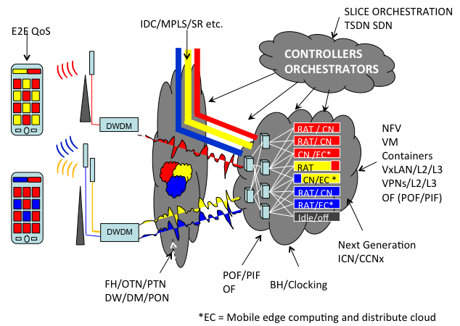
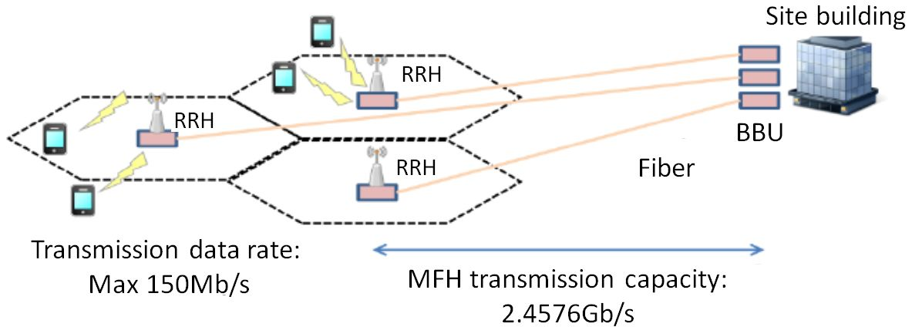
2015: Identifying the non-radio gaps
Executive Summary + Gaps + Supplemental info
Useful background
A.17 OAM protocols | Priority: High
Description: OAM protocols are not standardized in some parts of IMT networks such as the front haul network. Standard OAM protocols should be studied for fault management and performance management between network equipment that may be commonly used across the IMT-2020 network.
Related work:
A.18 End-to-end network management in a multi-domain environment | Priority: High
Description: Multiple network management protocols in different network domains make it difficult to support unified network operations over multiple network domains. A unified end-to-end network management should be considered to ensure compatibility and flexibility for the operation and management of an IMT-2020 network.
Related work: SG13
A.19 Mobility management for distributed flat network | Priority: High
Description: As the IMT-2020 core network is envisioned to be a flat distributed network, which is composed of the multiple distributed gateways to cope with traffic explosion and latency requirements of applications, mobility management should be studied aligning with those architectural changes.
Related work: 3GPP, SG13
Network Architecture
E2E QoS
Network Softwarization
Information centric networking
Fronthaul/ Backhaul
Notes:
85 gaps:
E2E QoS; Network softwarization; Fronthaul/Backhaul; Network architecture; Emerging networking technologies – information centric networking
Network slicing.

Slide 11
2016: Standards and PoCs
Tackling the gaps through:
Draft international standards:
Network softwarization, incl. slicing for front haul/back haul;
Information centric networking;
Network architecture refinement and fixed mobile convergence;
New traffic models and associated QoS and OAM aspects applicable to 5G architecture.
Demonstrations and prototyping:
Candidate: E2E network slicing
Notes:
Output A: Several draft Recommendations close to final, to be progressed by ITU in 2017
Output B: Proofs of concept, e.g., E2E network slicing leveraging open source projects

Slide 12
2016: Collaboration with Open Source initiatives
Service Providers
FG IMT-2020
Vendors
1
Containers –
Docker
Kubernetes
OPNFV
Open-O
O3 Project
OpenStack
OpenLTE
OpenAirInterface.org
TransportSDN (Englewood)
OpenDaylight
ONOS
Android
Linux
Fabric as a Service (FaaS)
Open CCN
Proof-of-Concept #1
2
Help consolidate POC ideas and work with Open Source bodies.
Co-ordinate POC tests/demos
1
2
Proof-of-Concept #N

Slide 13
Moving forward
8-11 March 2016, Seoul, Korea (hosted by KT): Initiated work on draft standards, saw demos and discussion of PoCs.
17-20 May 2016, Beijing, China (hosted by China Mobile, Datang): Progress reports/draft standards; narrow down, agree on scope of PoCs and demos.
TBC: 6-9 September 2016, Palo Alto, United States (hosted by PARC): Progress reports/draft standards; progress the development of PoCs and demos.
TBC: 8-11 November 2016, Geneva, Switzerland (ITU HQ): Finalize and adopt reports/draft standards; presentation of PoCs and demos.
25 May 2016, San Diego, United States: ITU/NGMN Workshop on Open Source and Standards in 5G.

