Slide 1
ITU Workshop on QoS and QoE of Multimedia Applications and Services
Haarlem, The Netherlands 9-11 May 2016
Standards for video QoE assessment
Paul Coverdale
Consultant, Huawei Technologies Co. Ltd.

Slide 2
Methodologies for assessing video QoE
In principle, assessment of video Quality of Experience (QoE) must be performed using subjective tests, with metrics such as the mean opinion score (MOS)
However, it is also possible to estimate QoE based on objective measurement of key parameters, and associated quality estimation models

Slide 3
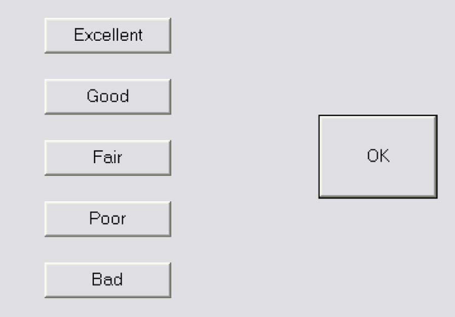
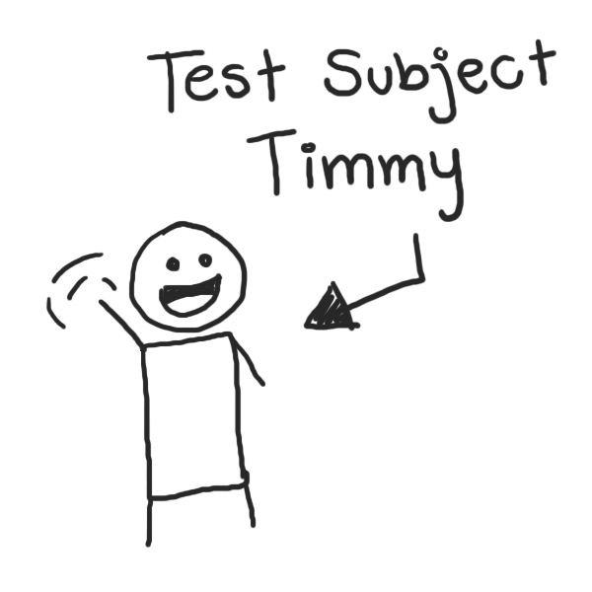
Subjective testing
Subjective testing needs more resources and effort because it requires human subjects, and is not so convenient in a live-service setting

Slide 4
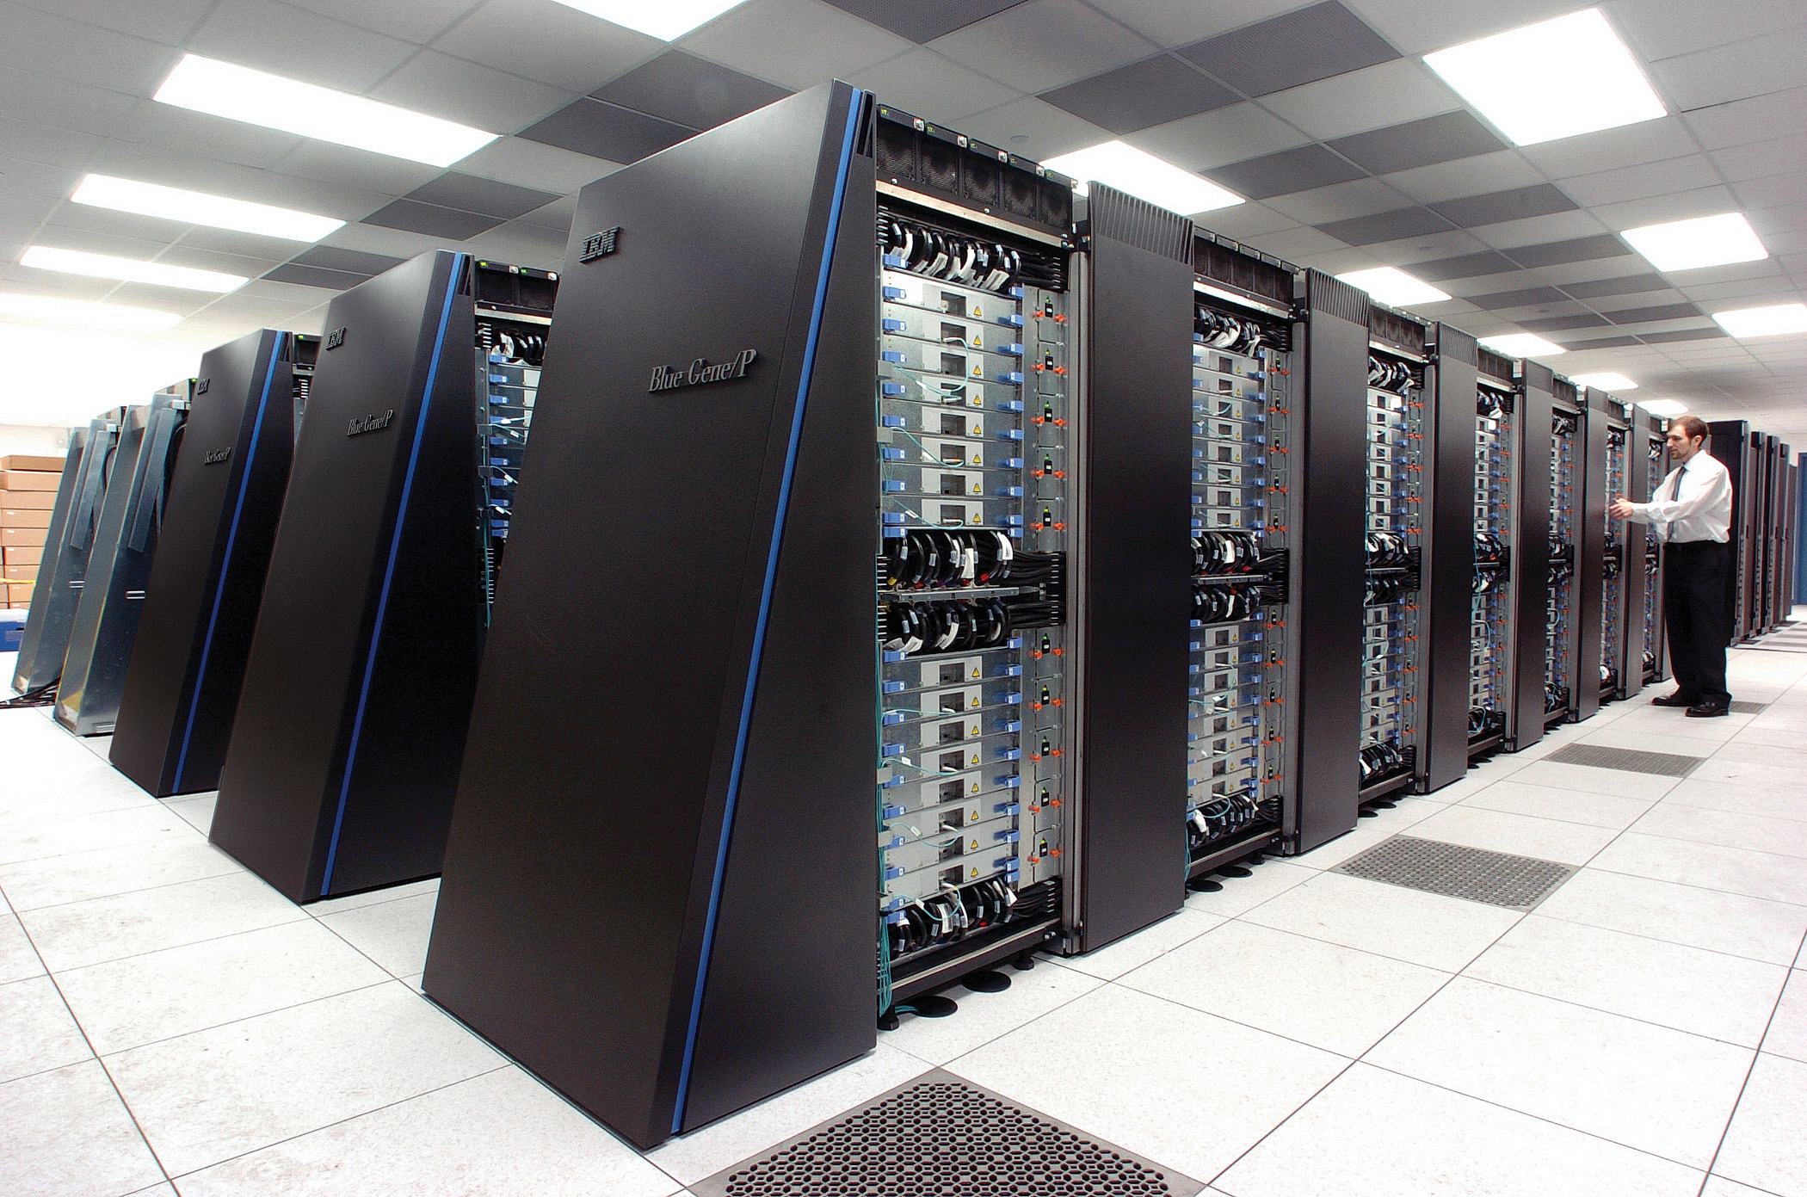
Objective measurement and QoE calculation
Objective measurement and QoE calculation is generally much faster and more convenient, especially in a live-service environment, but the accuracy of the QoE estimation depends on the complexity of the models, and an understanding of the important human factors

Slide 5
Application of video QoE assessment methodologies
Planning
  refers to estimating the QoE of networks/systems before they are implemented. Since it is not used in a real-time environment, no real-time inputs are required to the objective model. Accuracy of quality estimation is generally more of a concern than computational complexity.
Lab-testing
  refers to estimating the QoE of networks/systems in the laboratory while the equipment is being developed. Requires real-time inputs. Accuracy of quality estimation is generally more of a concern than computational complexity.
Monitoring
  refers to estimating the quality of experience of networks/systems that are operational. Requires real-time inputs. Trade-off between accuracy of quality estimation and computational complexity.

Slide 6
Types of objective video QoE assessment models
There are five different types of objective video QoE assessment models:
Media-layer (Perceptual) models
  The input to the model is the media itself (the video signal).
  3 basic approaches for gaining access to the media
    Full-Reference (FR) (also known as intrusive, active, double-ended)
    No Reference (RR) (also known as non-intrusive, passive, single-ended)
    Reduced Reference (RR)

Slide 7
Types of objective video QoE assessment models
Packet-layer (Parametric) models.
  The input to the model is information derived from the packet stream and client state information. A parametric model also needs additional side-information such as codec type and bit-rate.
Bitstream-layer models.
  The input to the model is information derived from the bit-stream and other packet information. Possible input is also client state information.

Slide 8
Types of objective video QoE assessment models
Hybrid models.
  The input to the model is the media and the bit-stream. Possibly also general packet information and client state information.
Planning models
  The input to the model includes the quality planning parameters of networks or terminals. It usually requires prior knowledge about the system under test.

Slide 9
Existing ITU-T video QoE Standards (from Rec. G.1011)
Application | Media | Conversational (CONV)/Non-conversational (NONCONV) | Subjective test methodology | Objective test methodology
 |  |  |  | Model | FR/RR/NR | Primary usage
Video telephony | Multimedia | NONCONV | [ITU-T P.1302]
 |  | CONV | [ITU-T P.920] [ITU-T P.1301] | [ITU-T G.1070] (NB/WB) | NR | PLN
Important to have a unique standardised model for a given application, to avoid having different QoE estimates

Slide 10
Existing ITU-T video QoE Standards
Application | Media | Conversational (CONV)/Non-conversational (NONCONV) | Subjective test methodology
 |  |  |  | Model | FR/RR/NR | Primary usage
Video streaming (Mobile TV/IPTV) | Video | NONCONV | [ITU-T P.910] [ITU-T J.140] [ITU-R BT.500-13] | [ITU-T J.144] (SD) [ITU-T J.247] (QCIF, CIF, VGA) [ITU-T J.341] (HD) | FR | LAB, MON
 |  |  |  | [ITU-T J.249] (SD) [ITU-T J.246] (QCIF, CIF, VGA) [ITU-T J.342] (HD) | RR | MON
 | Audio | NONCONV | [ITU-T P.830] [ITU-R BS.1116-3] [ITU-R BS.1285] [ITU-R BS.1534-2] | [ITU-R BS.1387] | FR/RR | MON/PLN
 | Multimedia | NONCONV | [ITU-T P.911] | [ITU-T P.1201.1] (QCIF, QVGA, HVGA) [ITU-T P.1201.2] (SD, HD) [ITU-T P.1202.1] (QCIF, QVGA, HVGA) [ITU-T P.1202.2] (SD, HD) | NR | MON

Slide 11
Current video QoE work items in SG12
P.NATS
  Parametric non-intrusive assessment of TCP-based multimedia streaming quality, considering adaptive streaming
G.OM_HEVC
  Opinion model for network planning of High Efficiency Video Coding (HEVC) media streaming quality
G.vidmos
  Guidelines for [selecting/choosing] models for assessing video quality

Slide 12
P.NATS - Scope
P.NATS is a collection of objective parametric quality assessment modules that predict the impact of IP network impairments on QoE in multi-media mobile streaming and fixed network applications using progressive download, including adaptive streaming methods.
Four modes of operation are defined to cover a range of use-cases from monitoring streams where the video is fully encrypted through to unencrypted streams where there are no limitations on processing power available.

Slide 13
P.NATS - Architecture

Slide 14
G.OM_HEVC - Scope
Network planning model which estimates the impact of IP network impairments on QoE in video applications using HEVC (H.265) coding over transport formats such as: RTP (over UDP), MPEG2-TS (over UDP or RTP/UDP).
Extension of existing Rec. G.1071 “Opinion model for network planning of video and audio streaming applications”

Slide 15
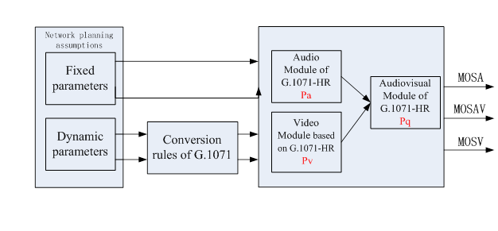
G.OM_HEVC -Architecture

Slide 16
G.OM_HEVC – Modules
Module name |  | Description | Developing consideration | Subjective tests requirements
Pa |  | Audio module | G.1071-HR audio module | No
Pv | Pv1 | blockiness module | Update of G.1071-HR parameters and coefficients | Yes | main focus
 | Pv2 | bluriness module | Module not available in G.1071 Update of P.NATS mode 0 formula? |  | secondary focus; some testing cases
 | Pv3 | jerkiness module | Not available in G.1071-HR Update of G.1071-LR or P.NATS mode 0 formula? Note: Module useful for use of G.OM_HEVC in TCP context (Q14) |  | a few testing cases
 | Pv4 | slicing module | Update of G.1071-HR parameters and coefficients |  | main focus
 | Pv5 | freezing module | G.1071-HR freezing module |  | 1 or 2 testing cases (anchors) for alignment with G.1071-HR
Pq |  | Audiovisual module | G.1071-HR audiovisual module | Yes (to validate formula)

Slide 17
G.vidMOS - Scope
Aim is to provide a global view of video QoE assessment and the relation between video QoE related Recommendations
Provides guidelines on how to choose the relevant Recommendation as an implementation reference according to different scenarios
Will also include definitions of metrics which are used in video QoE models

Slide 18


Slide 19


