Slide 1
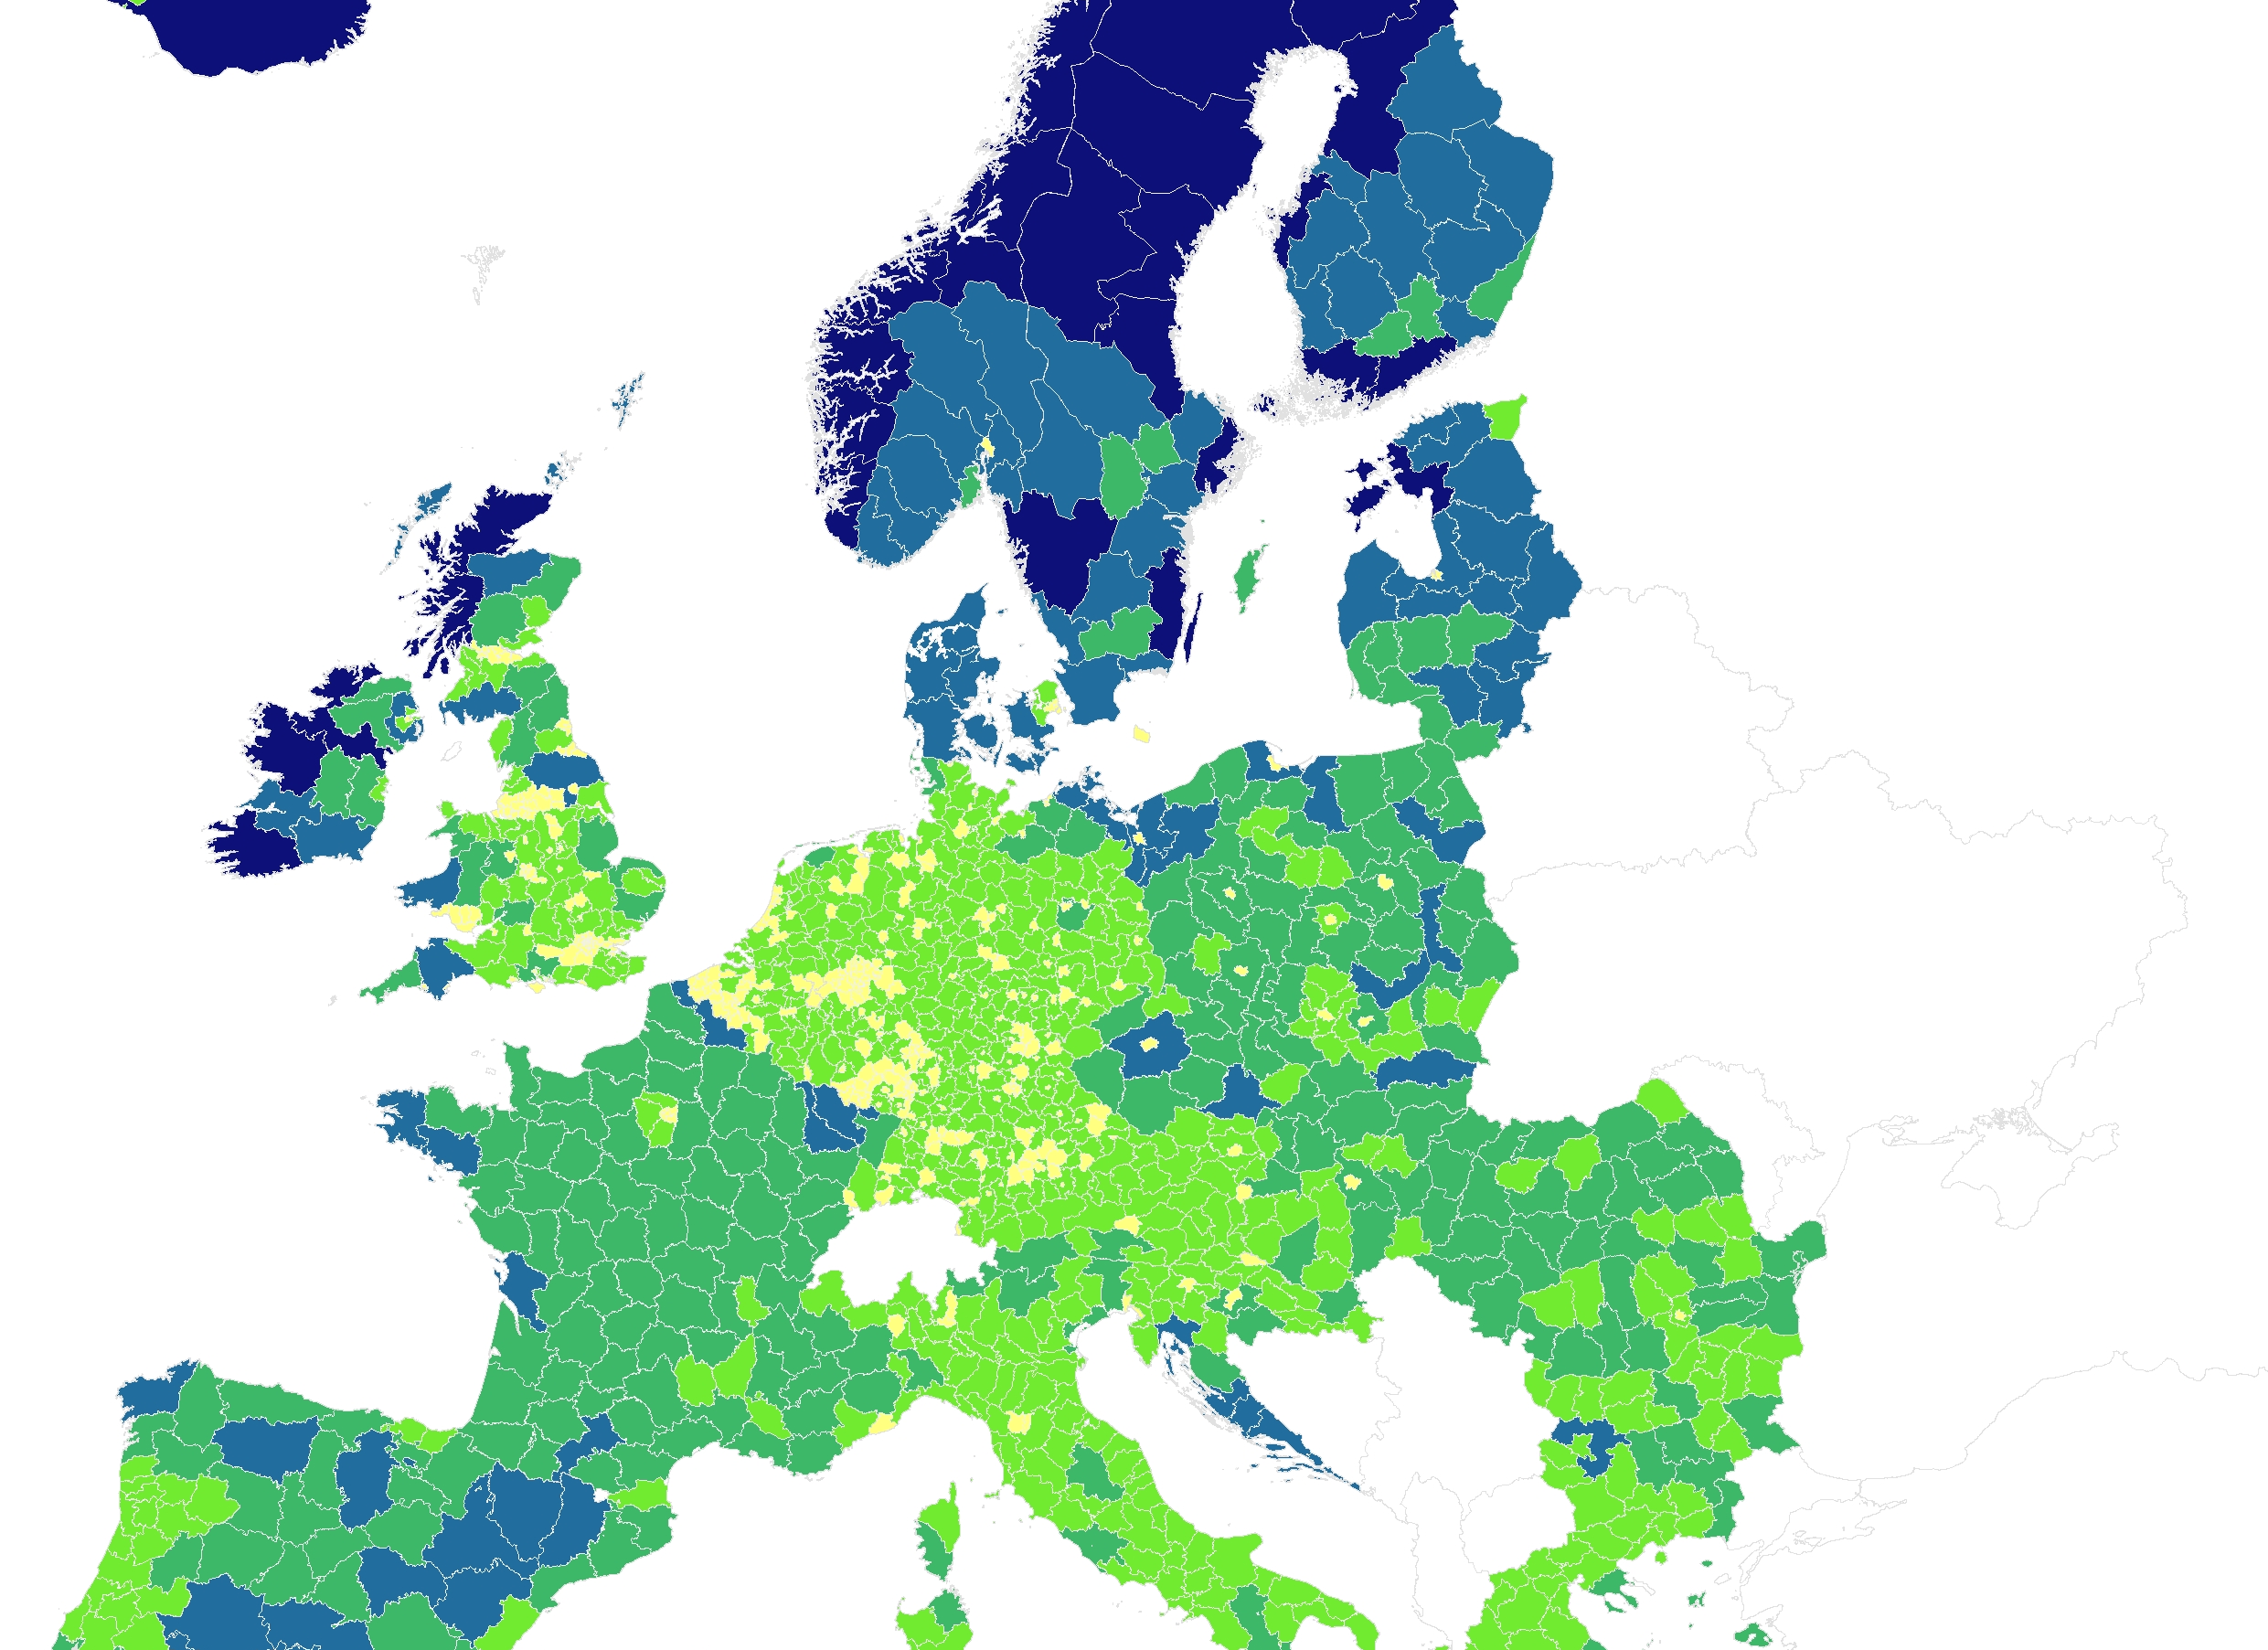
Methodology of the European Commission’s project “Mapping study (phase II): Mapping of Broadband Services in Europe - SMART 2014/0016”
Christiane Lehmann, ITU workshop, Haarlem, 10 May 2016

Slide 2
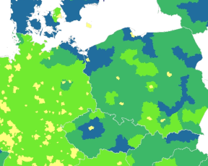
What is the European Commission‘s project about?
Development of first
European-wide interactive mapping platform and database
Data on Quality of Service (QoS)
and Quality of Experience (QoE)
on broadband connectivity
Data feeds from
existing public and private initiatives
130 data providers and experts
involved so far

Slide 3
What is the scope of the project?
All national mapping initiatives from EU and EEA
(Ministries or NRAs)
Best case: approx. 80 national data providers deliver data
Crowdsourcing tools:
Akamai
M-Lab
Netradar
Opensignal
netBravo
RIPE Atlas
Cedexis
Apteligent / MobiNEX
Public funded private initiatives (EU or state):
SamKnows
MONROE
perfSONAR
LEONE
VIRGO
mPlane
Transnational crowdsourcing, private QoE initiatives
Best case: 14 initiatives contribute to the project
Note: No data collection directly from Internet Service Providers

Slide 4
What is the final result?
Public access
Visualized data at NUTS3-level (small regions)
Pop-ups for meta-information on datasets
Link to socio-demographic data from Eurostat (EU statistical office)
Expert access (restricted group)
Display different layers to benchmark data categories
Higher granularity than NUTS3-level
Output of maps & reports, dynamic diagrams & tables with link to national GIS systems
Data collection
Secure and user-friendly upload via web-frontends
Download of templates
Briefing material, technical guidelines
Broadband in Europe
Expert access
Data collection
Find
Choose layers of data categories
i
Download
v
All time
v
DSL
≥ 30 Mbit/s
v
v
0 – 10 %
> 75 – 95 %
> 10 – 50 %
> 95 %
> 50 – 75 %

Slide 5
What are the benefits?
Central Info Hub
Network
.
Publicity
.
European-wide broadband service mapping data in one platform
Complementary monitoring tool
Access to data sets from other initiatives
Access to European mapping community of more than 100 stakeholders
Expansion of network to public and private initiatives
Higher visibility outside peer groups by cross-linking initiatives
Increase awareness on multifaceted initiatives at national and transnational level

Slide 6
What is our approach?
Use of existing data from already running initiatives
Standardized data collection via templates with flexibility to collect all data sets
Continuous liaison with all stakeholders to include feedback at all stages
Data collection:
user-friendly and low effort
National regulation and open access rules are taken into account
Practice-oriented
definitions to categorize
all data sets based on national initiatives
Objective:
Visualization of all data on NUTS3 level (small regions)

Slide 7
What are our data sets?
 | The EU-Broadband mapping project collects data on different Quality of Service (QoS) definitions
QoS-1: Theoretical
QoS-2: Practice optimal
QoS-3: Practice experienced
Internet
IAP
End User
IXP
IXP
CPE
What: Predicted network performance of existing infrastructure
How: Assessment / calculation by providers.
Example: Project by European Commission re. to all EU national initiatives (data collected by European Commission’s contractor)
QoS-1
What: Line qualification
How: Measurement through panel probes or speed tests with filter to exclude end user‘s environment
Example: German or Italian NRA initiatives, private mapping initiatives, e.g. SamKnows
QoS-2
What: Actual user’s experience when using Internet Access Service (IAS)
How: Measurement via online speed tests including end user environment
Examples: Private mapping initiatives, e.g. Akamai, Opensignal
QoS-3
Notes:
QoS1:
What: Predicted network performance / technical ability of existing infrastructure
Where: Between core network of the Internet Access Provider (IAP) and Network Termination Point (NTP), where end user’s premises / buildings are reached
How: Assessment / calculation by providers
Example: SMART 2013/0054 project by IHS Consultants, collecting coverage data on a country, regional and rural level for nine broadband access technologies
QoS2:
What: Line qualification
Where: Between reference points / interfaces of Internet Access Service (IAS) - from Internet Exchange Point (IXP) to Network Termination Point (NTP), where end user’s premises / buildings are reached. IXP refers to the place where multiple Internet Service Providers interconnect their respective networks
How: Measurement by providers or initiatives
Panel measurements through probes
Example: SamKnows, RIPE Atlas
Crowdsourcing application measurements (speed tests) with filter to exclude end user‘s environment
Example: Initiative Netzqualität (by German NRA)
QoS3:
What: Actual user’s experience when using Internet Access Service (IAS)
Where: QoS measurement initiated by end user, triggered via the user terminal equipment (wired and wireless) connected behind Customer-Premises Equipment (CPE). Measurement including individual end user’s activity and environment
How: Measurements via online speed tests
Examples: Ookla, Akamai, Opensignal

Slide 8
Availability of data sets
 | The EU-Broadband mapping project collects data on different Quality of Service (QoS) definitions
QoS-1: Theoretical | 51 (national)
QoS-2: Practice optimal | 12 in total (8 national, 4 transnational)
QoS-3: Practice experienced | 31 in total (21 national, 10 transnational)
∑ | 94 in total
Internet
IAP
End User
IXP
IXP
CPE
QoS-1
QoS-2
QoS-3
Notes:
QoS1:
What: Predicted network performance / technical ability of existing infrastructure
Where: Between core network of the Internet Access Provider (IAP) and Network Termination Point (NTP), where end user’s premises / buildings are reached
How: Assessment / calculation by providers
Example: SMART 2013/0054 project by IHS Consultants, collecting coverage data on a country, regional and rural level for nine broadband access technologies
QoS2:
What: Line qualification
Where: Between reference points / interfaces of Internet Access Service (IAS) - from Internet Exchange Point (IXP) to Network Termination Point (NTP), where end user’s premises / buildings are reached. IXP refers to the place where multiple Internet Service Providers interconnect their respective networks
How: Measurement by providers or initiatives
Panel measurements through probes
Example: SamKnows, RIPE Atlas
Crowdsourcing application measurements (speed tests) with filter to exclude end user‘s environment
Example: Initiative Netzqualität (by German NRA)
QoS3:
What: Actual user’s experience when using Internet Access Service (IAS)
Where: QoS measurement initiated by end user, triggered via the user terminal equipment (wired and wireless) connected behind Customer-Premises Equipment (CPE). Measurement including individual end user’s activity and environment
How: Measurements via online speed tests
Examples: Ookla, Akamai, Opensignal

Slide 9
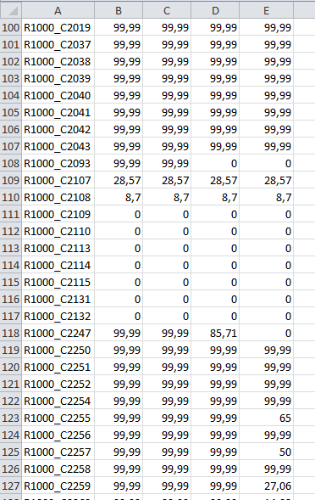
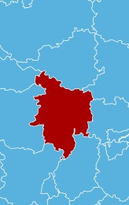
How will data be collected?
Flexible templates will be used to keep burden for data providers low
Geometry / Spatial resolution
and
(optionally)
and
(optionally)
NUTS 3
Grid 1Km
Higher resolved Grids
Data formats
or
Geo-data
Tables / Text
shp
gml
wfs
tbd
xls
csv
tbd
Content
and
(obligatory)
Attributes
Metadata
as defined
as defined

Slide 10
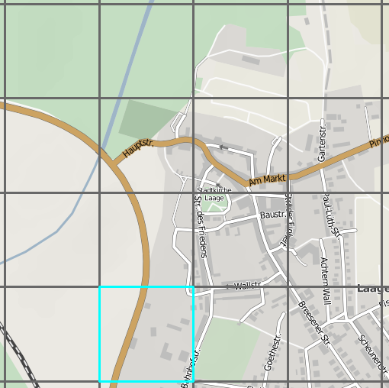
What data will be collected?
All technologies
Speeds
1 Mbit/s | X | %
2 Mbit/s | X | %
6 Mbit/s | X | %
16 Mbit/s | X | %
25 Mbit/s | X | %
30 Mbit/s | X | %
50 Mbit/s | X | %
100 Mbit/s | X | %
1 Gbit/s | X | %
Latency | X | ms
Jitter | X | ms
Packet loss | X | %
Data usage | X | TB/d
To assure comparable datasets,
the same attributes and metadata categories are collected for all 3 definitions.
Wired
Wireless
ADSL
CATV
FTTC (VDSL and vectoring)
FTTH/B
UMTS
Example
LTE
2G
All time
WiMAX / WLAN
Working days
Satellite
Weekends
All Techn. … Satellite
Day peak
All Techn. … Satellite
1 Mbit/s
…
Data usage
Upload
Day non peak
All Techn. … Satellite
Download
All Time
…
Day non peak
All Techn. … Satellite
And so on
All Techn. … Satellite

Slide 11
Open access is granted according to data providers‘ approval
Access to data sets in expert version of platform
Degree of open access is defined in Memorandum of Understanding by each data provider
National regulation is respected
Many data sets already accessible –
platform as „directory“ to each open data set

Slide 12
What is the time line?
3 years to set up the platform:
In 2016 development of data base and design of platform, consultation with data providers
By end of 2017: final and complete version of the platform is online
As of 2018: automated data collection process and data publication
Process of BEREC’s net neutrality working group is reflected in the project
Next steps:
December 2016:
2nd Workshop with data providers and Internet Service Providers
Apr – Jun 2016:
Test datasets
assessment and evaluation
7 and 8 June 2016:
1st Workshop
with Regulators + data providers
As of June:
Start of European-wide standardised data collection

Slide 13
Thank you for your attention!
Don’t hesitate to contact us for more information
Ms Christiane Lehmann - head of project at TÜV Rheinland
Project website: https://www.broadbandmapping.eu/
Email: broadband-mapping@de.tuv.com

