Slide 1
ITU Workshop on QoS and QoE of Multimedia Applications and Services Haarlem, The Netherlands 9-11 May 2016
Discovery of the new Recommendation
ITU-T G.1028:
End-to-end QoS for voice on Mobile networks 4G (VoLTE) Vincent BARRIAC, R&D, Orange Labs, Vincent.barriac@orange.com

Slide 2
Brief Reminder
G.1028 Is the number assigned after its approval further the Project of Recommendation previously
known as "G.VoLTE“.
Three Years span between the idea and the adoption
March 2013: proposal for Launching a study question (Contributions C 074 and 076) and Acceptance for inclusion into the Program of the question 11/12 ("Performance interworking and traffic management for Next Generation Networks")
November 2013: First items of shared Knowledge (Contribution C 127) and decision to launch drafting G.VoLTE
September 2014: First version of G.VoLTE (Contribution C 189)
May 2015: Second Version of G.VoLTE (Contribution C 241)
January 2016: Submission of G.VoLTE for consent of the Study Group 12 (contribution C 288, evolved to TD 873 rev 1 after session amendments and entry In the Accelerated Approval Procedure (AAP)
1-28 February 2016: Last Call for Comments (1 Comment received from Ericsson)
6 April 2016: adoption of G.1028
A lot of external standards ITU-T are referred In G.1028:
3GPP: Definitions and Specifications of mobile networks and services
IETF: Associated IMS protocol aspects for VOLTE services
GSMA: Definition of the VoLTE service from the mobile operator standpoint

Slide 3
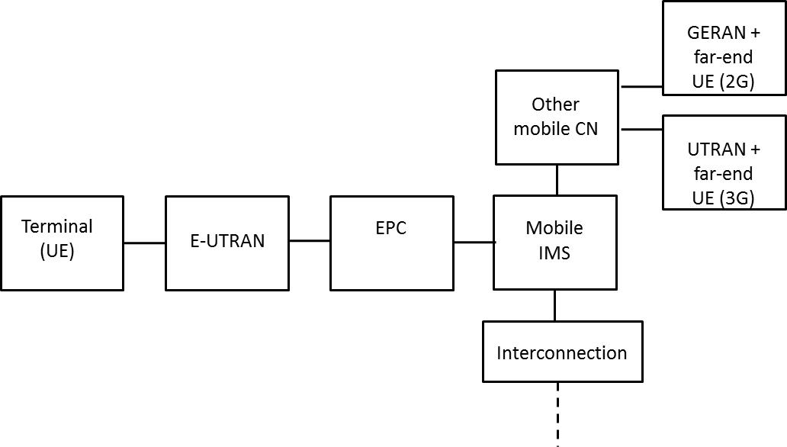
Basic Notions of the VoLTE service
Chapters 6 and 7
The VoLTE presupposes the use of the following elements
4G access network (E-UTRAN)
Compatible terminals
Core Network associated to 4G (EPC) and connected to e-UTRAN by an eNodeB
IMS Platform and use of the SIP Signalling Protocol
Interconnection with the Circuit Switch world (2G, 3G, PSTN)

Slide 4
Basic Notions of the VoLTE service (continued)
Chapters 6 and 7
The mechanisms considered as optional but taken into consideration in G.1028:
RoHC
TTI bundling
DTX, DRX
SPS
SIP Preconditions
Classification Of QOS (Use Of QCI)
5 for SIP
1 for Voice in real time
Audio Coding in AMR or AMR WB, with support of TrFO
Functionalities for future versions of G.1028
SRVCC
VoWiFi
ViLTE ?
QCI | GBR | Priority | Delay budget | Packet loss budget | Example Of Service
1 | Yes | 2 | 100 Ms | 10⁻² | Voice
5 | Non | 1 | 100 Ms | 10⁻⁶ | IMS signaling

Slide 5
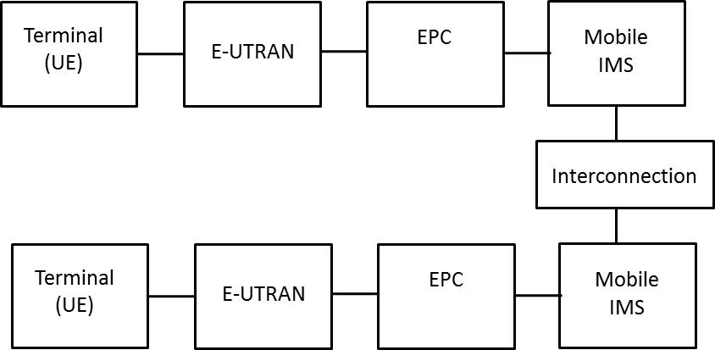
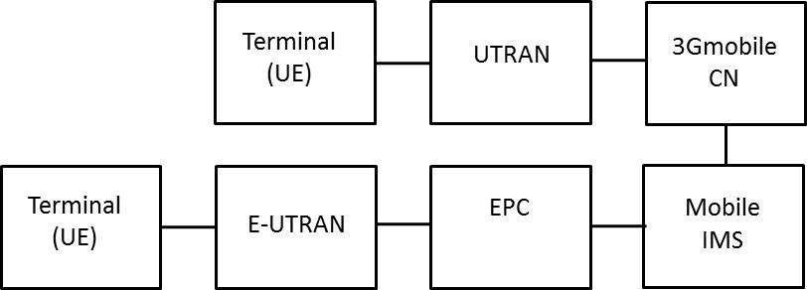
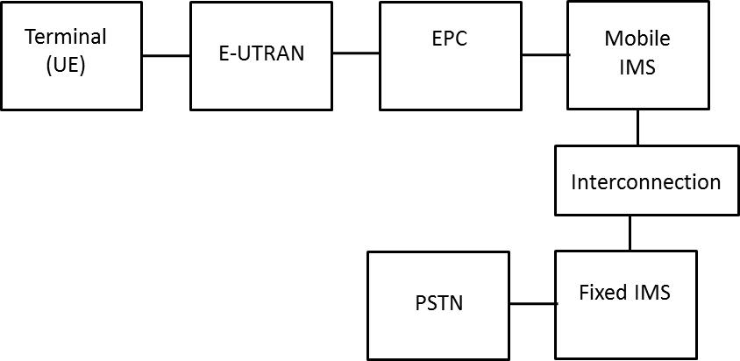
Call Cases Considered In G.1028
Chapters 7.1 to 7.4
LTE-LTE
-With and Without Roaming
LTE-3G
LTE-RTC

Slide 6
Identification of Main Degradations of Perceived Quality
Chapter 8
Annex 1
Family 1: Difficulties related to service delivery
Registration (IMS/SIP)
Call Establishment
Call End (more or less desired)
Family 2: Difficulties related to the Audio Contents of the Service (Similar To the other mobile services)
Frequency Contents (Coding, Distortions)
Interruptions, Cuts
Delay, Difficulties of interactivity
Background noise
Impact of the use of VoLTE on the other elements : not dealt within G.1028
QoS of data services
Lifetime of the Battery

Slide 7
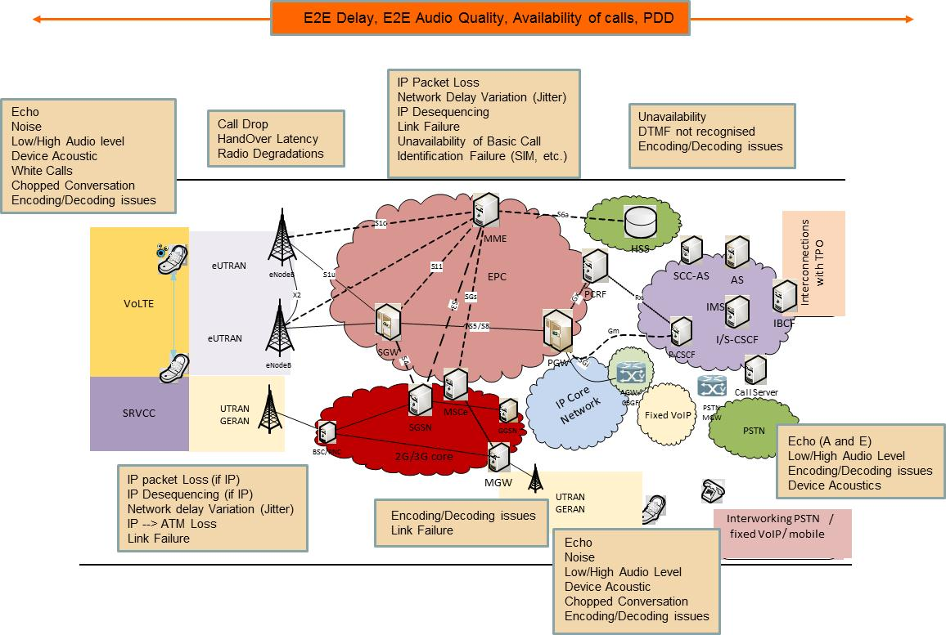
Identification of Main Degradations of Perceived Quality
Chapter 8

Slide 8
Selection of QoS indicators (1/2)
Name | Definition | Corersponding IP Metric
Registration success rate | Rate of successful registration attempts in the VoLTE service. | KPI related to IMS and based on P-CSCF counters Equivalent to 1 – Ineffective Registration Attempt (IRA) ratio (see IETF RFC 6076)
Service availability | End to end service availability in terms of capacity to establish calls from, and to, a VoLTE customer. | Network Efficiency Ratio (NER) Measures the ability of network, from the service platform point of view, to deliver calls to the VoLTE customer, For the SIP Protocol, NER = SEER (see IETF RFC 6076)
Post Dialing Delay (PDD) | Time interval (in seconds) between the end of dialling by the caller and the reception back by him of the appropriate ringing tone or recorded announcement. | SIP session set up time Interval between sending INVITE message (with SDP) and ACK (180 or 200) message by the originating side. Equivalent to successful Session request delay (SRD) (see IETF RFC 6076)
Chapter 9

Slide 9
Selection of QoS indicators (2/2)
Name | Definition | Metric IP Box
Voice Quality (MOS-LQ) | Equivalent to Speech Quality as defined in ITU-T P.10/G.100. Models like those defined in ITU-T P.862 and P.863 provide an objective view on the quality of the voice signal as it may be perceived by the customer. | Network Quality index (G.107, P.564) IP Packet loss ratio (see definition of IPLR in Y.1540): several possible measurement points
Mouth-to-Ear Delay | Time it takes for the speech signal to go from the mouth of the speaker to the ear of the listener. | IP Packet Transfer Delay (see definition of IPTD in Y.1540) Round Trip Time Corresponds approximately to twice the end-to-end delay Can be measured based on RTCP protocol messages
Call drop rate | Service continuity in terms of capacity to maintain calls to their normal end. | Session completion Rate KPI related to IMS and based on P-CSCF counters Equivalent to Session Completion Ratio (SCR), as defined (See IETF RFC 6076)
Speech bandwidth (NB, WB or SWB) | Measurement of the bandwidth used (normal NB or WB, or even partial and unwanted bandwidth limitation). | Codec statistics Information related to the selection of (AMR and AMR WB) codec and codec modes, as well as switch between them, accessible on SIP protocol messages.
Chapter 9

Slide 10
A few Objectives for Quality
Tables 3 to 6
G.1028 does not set imperative objectives
Nevertheless, on the basis of the existing knowledge , a budget of degradation is proposed
For each of the retained indicators
For each link of the transmission chain ( terminal, e-UTRAN, EPS, IMS, Interconnection), as well as for the whole.
A few examples :
Indicator | Call type | Overall budget | Specific budget
Availability | 4G-4G or 4G-fixed | 99%
 | 4G-3G | 98%
PDD | 4G-4G | 3.5 s (4 s if interconnection)
 | 4G-3G | 4.5 s
 | CSFB | 6 s
MOS-LQOSW | 4G-4G | 4 (AMR-WB And TrFO)
 | 4G-3G | 3.8 (AMR WB and TrFO)
 | 4G-RTC | 3.1 (AMR)
Transmission time | All | 400 ms | Device : 190 ms (sending + receiving) E-UTRAN: 80 ms EPS: 50 ms
Dropped call rate | 4G-4G And 4G-PSTN | 2% | RTC = 0%
 | 4G-3G | 3%

Slide 11
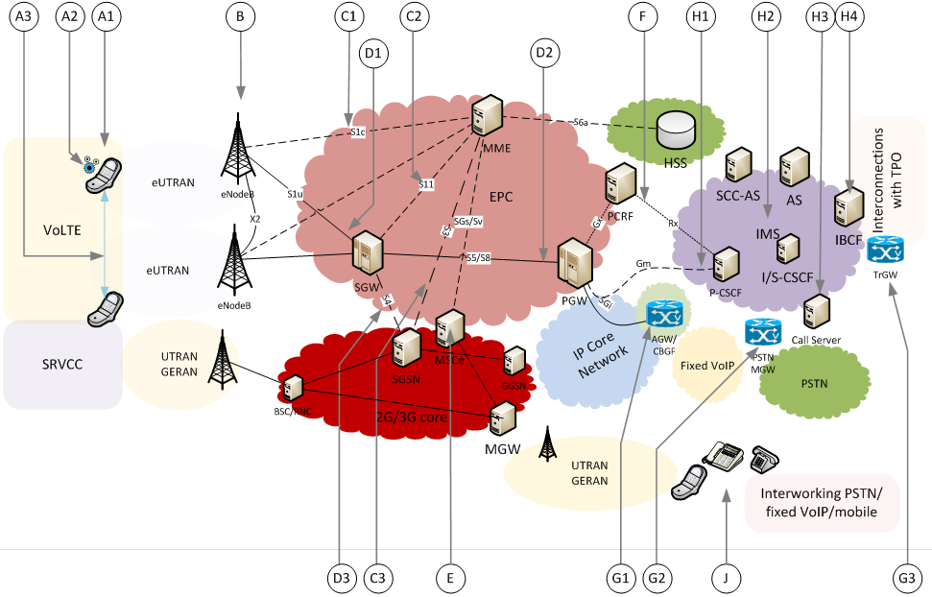
Strategy of Measurement and Supervision
Chapters 10.1 and 10.2
Several measurements points are possible
At end points, where the client have access to the service (points A and J)
At places where the transmitted signal is accessible, generally at demarcation points between Network portions (Points B, D, E and G)
At places where with an end to end service from a signaling point of view ( points C, F and H, but also E).
Three complementary approaches
For Troubleshooting
For Monitoring
For Reporting

Slide 12
Link with the ecosystem of ITU-T standards
Chapter 10.3
Several indicators, not specific to the VoLTE, are already defined
E.800: Availability, PDD
E.804: Drop call rate
P.10/G.100: Voice quality , delay, frequency Distortion
Y.1540: Metrics for IP transport
The evaluation of Voice Quality is the subject of many useful recommendations
Parametric models like P.564 (measurement) or G.107 (planning)
Signal Based models: P.863, P.563
Some acceptability thresholds in existing standards apply also to the VoLTE
G.114 for the values of delay
G.109 for the R factor (G.107)
Y.1541 for the metrics for IP transport

