Slide 1
EACO Guidelines on Quality of Service on Data Service in Mobile Networks
Orange Telkom Kenya
November 2015

Slide 2
Contents
Who are Orange Telkom Kenya
Why focus on data?
What are EACO guidelines on data quality of service
Determining good quality of service
Are these guidelines realistic

Slide 3
Who are Orange Telkom Kenya
Orange Telkom is mobile network operator based in Kenya.
The operator provides voice and broadband data services.
The primary broadband technologies are GSM/UMTS.

Slide 4
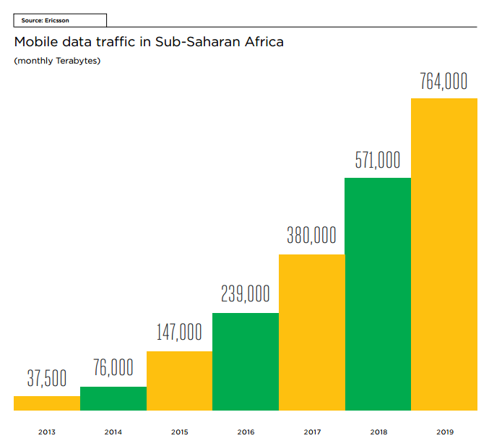
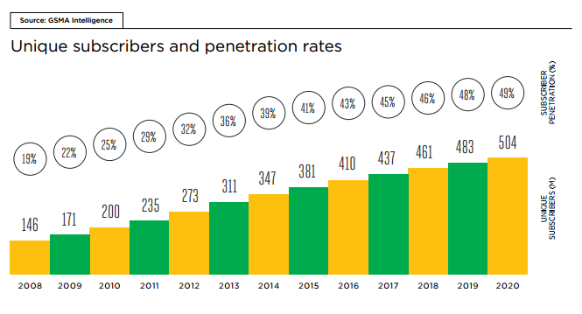
Why Focus on Data?
Quality of service for voice is well developed.
Data is a relatively new area.
Exponential growth expected.

Slide 5
What are EACO guidelines
There are different data services available with different levels of user expectation e.g. emails, streaming, web browsing, file transfer…
How can the level of quality of service (QoS) of these services be determined
EACO has provided guidance on the implementation of QoS parameters and key performance indicators
The targets are:
Service independent QoS parameters
Service dependent/Direct QoS parameters

Slide 6
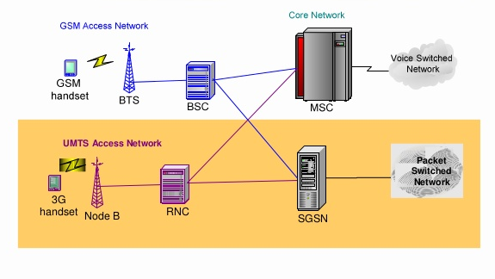
What are EACO guidelines
Attach
PDP
FTP or HTTP or Ping test

Slide 7
Determining good quality of service
Service Independent QoS parameters
Attach failure ratio
Attach setup time
PDP context activation failure ratio
PDP context activation time
PDP context cut off ratio
DNS host name resolution failure ratio
DNS host name resolution time

Slide 8
Determining good quality of service
Direct QoS parameters
FTP DL/UL session failure ratio
FTP DL/UL mean data rate
HTTP session failure ratio
HTTP mean data rate
Ping round trip time

Slide 9
Are these guidelines realistic
In Orange Telkom Keya the QoS parameters are already in use during benchmarking exercises.
Additional changes to the QoS parameters:
Size of files transferred during FTP DL/UL
Size of webpage during HTTP session
Impact of different technologies

Slide 10
Thank You

