Slide 1
QoS of data services in Mobile Networks
Ganson Lewela
Head of Regulatory
Airtel Networks Kenya Ltd
Stakeholders Forum on Quality of Service and Consumer Experience
Nairobi, Kenya, 23-25 November 2015

Slide 2
What is quality of service?
QoS is considered from the technical point of view which is a design, planning and management aspects of resources in delivering services
QoS is also considered from the consumer point of view which is subjective and may vary from consumer to consumer. This is how the customer perceives the service at every touch point during interaction.
Quality of service (QoS) mechanisms controls the performance, reliability and usability of a telecommunications service
Quality of Service (QoS) in cellular networks is defined as the capability of the cellular service providers to provide a satisfactory service which includes voice quality, signal strength, low call blocking and dropping probability, high data rates for multimedia and data applications etc

Slide 3
Competing objectives in quality of service?
I can easily utilise resources more efficiently by giving you satisfactory QoS
Traffic Management is about getting good QoS and good resource utilisation at the same time
Spend more on resources and you can easily give better QoS. But is it a sustainable strategy?
Better QoS and efficient resource utilisation are competing objectives.
For network and service providers, quality improvement is achieved by spending more “Resources” however it has to be sustainable

Slide 4

Mno span of control over data QOS in mobile networks
User Equipment (UE)
Operators will have Partial Control as UE
Radio Access Network
Operator has full Control and should be designed to achieve desired QoS
There is less control over external factors e.g buildings, interference, etc
Core Network Services
Backhaul
Quality of devices, apps downloaded in UE may impact QoS
In case of self owned backhaul, operator has full control
Leased backhaul depend highly on the owner and the SLA’s agreed upon wit MNO
Operator‐ Supplied Content
Operator has full Control and should be designed to achieve desired QoS
Internet and other external networks
Control at the point of entry/exit
Access to operator owned content is within their full control and QoS can is easy to manage
External Content
The operators only have control at the point of entry/exit
Who owns the Internet and what is it? – Basically it is content
Permitted number of transactions will impact hence impacting QoS

Slide 5
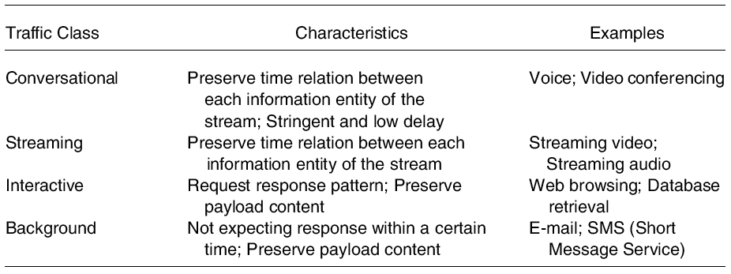
Traffic classes impactING qos
HTTP and FTP services fall under the Interactive Traffic Class

Slide 6
Conclusion
Parameters within the MNO Control
Attach failure ratio
Attach Setup time
PDP Context Activation Failure Ratio
PDP Context Activation Time
PDP Context Cut-off Ratio
MNO partial or No Control Parameters
    FTP {Download|Upload} Mean Data Rate [kbit/s]
    FTP {Download|Upload} Session Failure Ratio
    HTTP session failure ratio [%]
    HTTP mean data rate [kbit/s]
    Ping round trip time [ms]
All QoS parameters should have a clear objective
Coverage areas should be clearly defined and isolated during measurement
QoS parameters should enable improvement of consumer quality
Clear conditions under which these parameters would be applicable must be defined
QoS parameters should specify the various traffic classes

Slide 7
THANK YOU

