Slide 1
^{25th} NOVEMBER 2015
Presentation by,
Mr. Rono Gilbert.
KENYA BUREAU OF STANDARDS.

Slide 2
Market Surveillance
Market surveillance
The department
The process

Slide 3
Structure of MS
Head of Dept (CM)
Head of Surveillance
Officers
Head of Complaints and investigations
Officers

Slide 4
Placement of MS under current establishment
Background:
Function previously under QA & I
Conflict of interest
Need for firewalls
MS in the regions
Vision

Slide 5
MS Process
Definitions of MS-
Market surveillance:
The activities carried out by public authorities to ensure that products comply with the requirements set out in the relevant legislation.

Slide 6
Definition used by EAC (Market Surveillance Procedure EAC/MS/OP/01)
Activities carried out and measures taken by NSBs in Partner States to ensure that products comply with the requirements set out in the relevant compulsory standards.
These activities may be undertaken both at the design/ production stage (so called pre-market control) and the post-market surveillance stage (or market surveillance)

Slide 7
Role of MS:
Monitor products in the market with the aim of effecting product conformity to the requirements of Kenya Standards and other approved specifications.
-enhance safety and quality of products and other aspects of public interest, such as consumer protection
-create a level playing field for businesses.
Market surveillance is therefore important for the enhancement of consumer protection as well as economic development as it helps to eliminate unfair competition.

Slide 8
Objectives
Improve and monitor product compliance levels in the market according to the set targets.
Establish and implement efficient and effective consultations with stakeholders and other interested parties.
Create awareness to the public and stakeholders on pertinent issues.
Support sustainable development through application of standards at the marketplace.

Slide 9
These objectives are achieved through
1. Proactive/Preventive MS
Inspection and sampling for testing.
Outreach activities – awareness raising through seminars and workshops.
Risk assessment.
Collaboration and communication with stakeholders.

Slide 10
Contd
2. Corrective/Reactive MS
Response to emergency situations
Addressing issues when they arise e.
Investigation of consumer complaints.

Slide 11
MS therefore initiated through:
Work plans.
Results of previous MS activity.
Notification of concern from external parties.
Analysis of consumer complaints.
Information provided by consumers, other enforcement agencies, volunteers or informers and consumer protection groups.
Any other sources of information.

Slide 12
MS Tools
The Standards Act, CAP 496.
Knowledge of MS procedures, legal regulations, Standards, pertinent knowledge and any other relevant information.
Proper identification documents.
Operational forms such as checklists, market surveillance report forms, seizure forms, sample collection and declaration forms.
Relevant on-site assessment and sampling tools.

Slide 13

Kenya Bureau of Standards
Standards for Quality Life
CHALLENGES:
1. The department is lacking adequate staff to effectively
discharge its mandate throughout the country.
It also lacks some competencies in some sectors such as
electrical, civil and textile engineering, food science, chemical.
The department received a total of 8 officers to boost its operations at Headquarters and the Regions during the last recruitment

Slide 14
Kenya Bureau of Standards
Standards for Quality Life
2. Lack of onsite assessment tools such rapid testing kits, measurement gadgets to enable quick assessment of conformity.
3. Security of inspectors/officers while in the field by getting confronted and threatened by the public/ shroud business entities
4. Motor vehicles to enhance efficiency especially when raids are to be conducted country wide on a product of serious non-conformity e.g. steel bars

Slide 15
Kenya Bureau of Standards
Standards for Quality Life
4. Lack of a national policy on recall and withdrawal.
This makes it difficult for non-conforming products to be removed from the market hence the need for national quality infrastructure.
5. Poor coordination/coo-operation mechanisms with EAC partner states on the enforcement of banned products which are still accepted in some countries and always find their way into Kenyan market through porous borders e.g. banned dry cell batteries and cosmetics.

Slide 16
Kenya Bureau of Standards
Standards for Quality Life
ACHIEVEMENTS
1. Improved product compliance levels from 86% in 2011/12
In 2012/13 87 %
In 2013/14 89%
in 2014/2015 -90% (target)
Complaints resolution level is currently at 92%

Slide 17
Kenya Bureau of Standards
Standards for Quality Life
2. Destruction of seized goods
The department has destroyed seized goods ranging from reinforcements steel bars, assorted food products, non-pharmaceutical products (syringes), toilet paper, banned cosmetics and other products worth millions of shillings.
In 2014, 3,000 metric tones of dangerous and sub-standard goods worth Kes 12 M were destroyed and witnessed by the Industrialization CS Adan Mohamed.

Slide 18
Kenya Bureau of Standards
Standards for Quality Life
This year on 30th April, 2015 a further 8,000 metric
tones of seized goods valued at Kes 36 Million
were destroyed and witnessed by KEBS Managing Director.
Some of these goods were incinerated at a NEMA-approved incinerator at EPZ in Athi River while steel bars have been destroyed by cutting for smelting.

Slide 19
Kenya Bureau of Standards
Standards for Quality Life
Some of the goods that have been destroyed include:
1. Food items like sugar, rice, margarine, pasta, alcoholic drinks
2. Chemical products e.g. hypodermic syringes, geometrical sets, tissue papers, detergents, cosmetics
3. Construction materials: twisted steel bars
4. Electrical items like extension cables, power boosters, immersion water heaters

Slide 20
Kenya Bureau of Standards
Standards for Quality Life
.

Slide 21
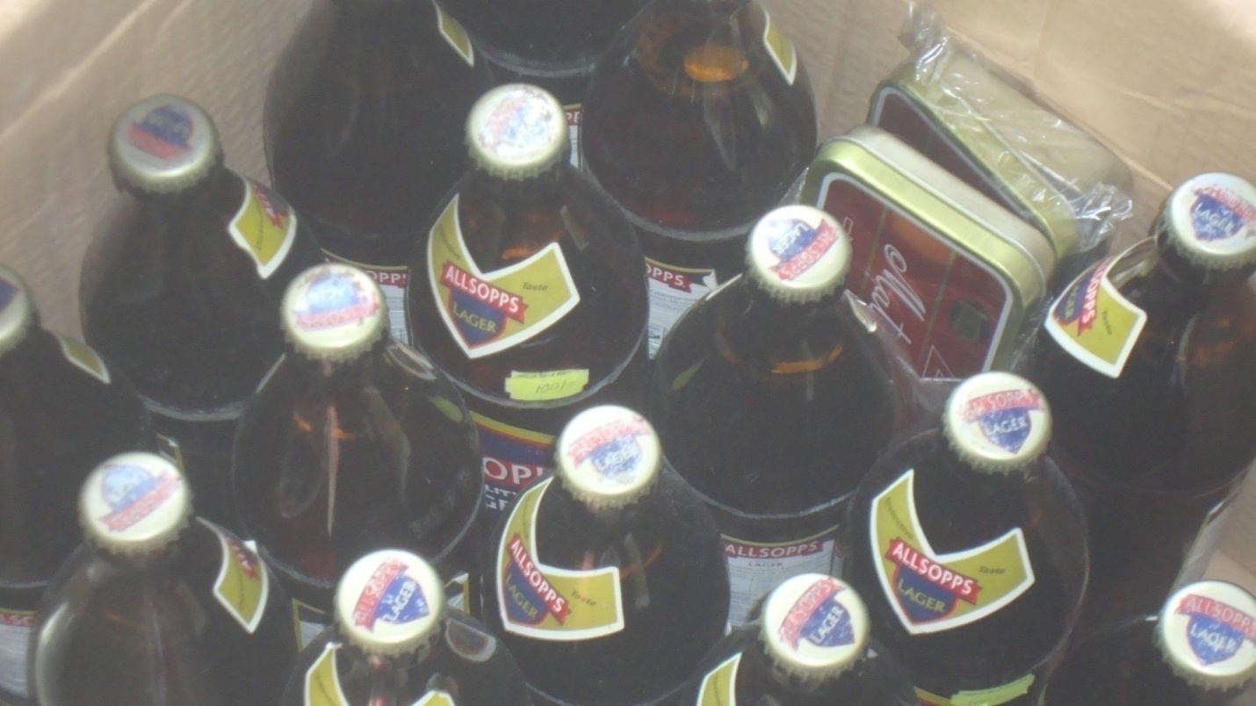
Kenya Bureau of Standards
Standards for Quality Life

Slide 22
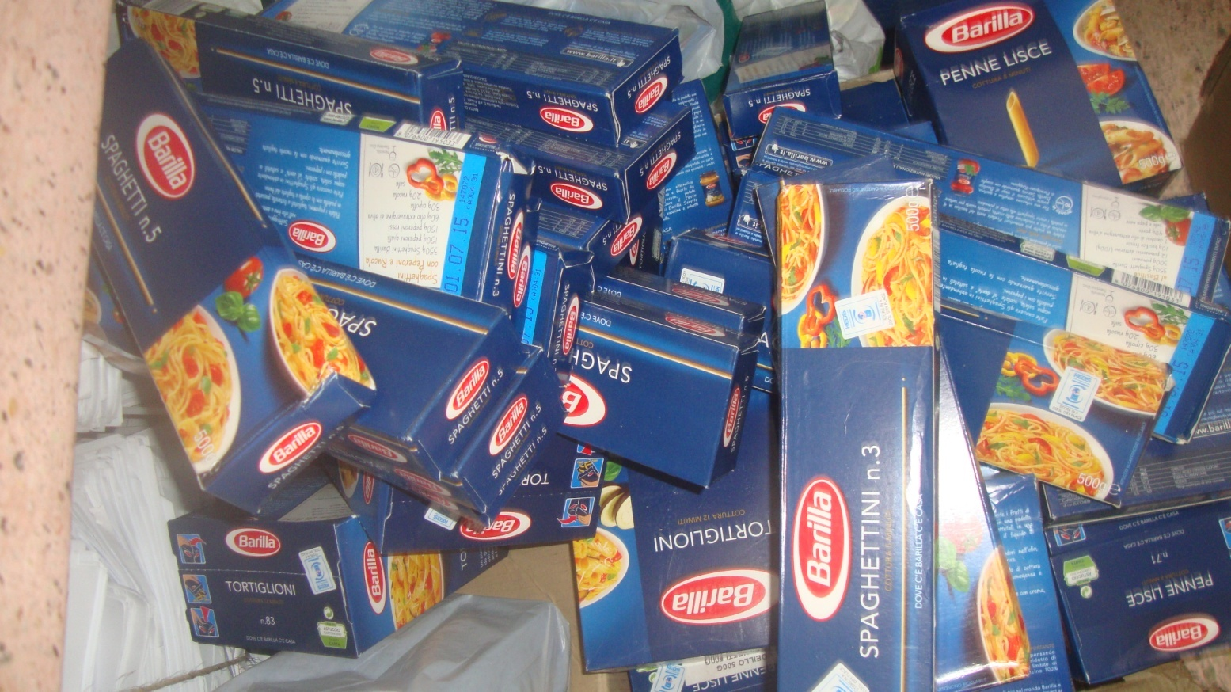
Kenya Bureau of Standards
Standards for Quality Life

Slide 23
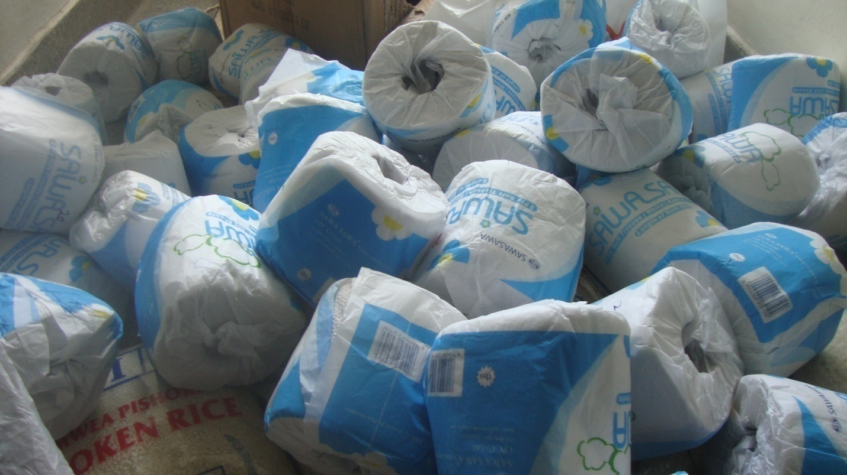
Kenya Bureau of Standards
Standards for Quality Life

Slide 24
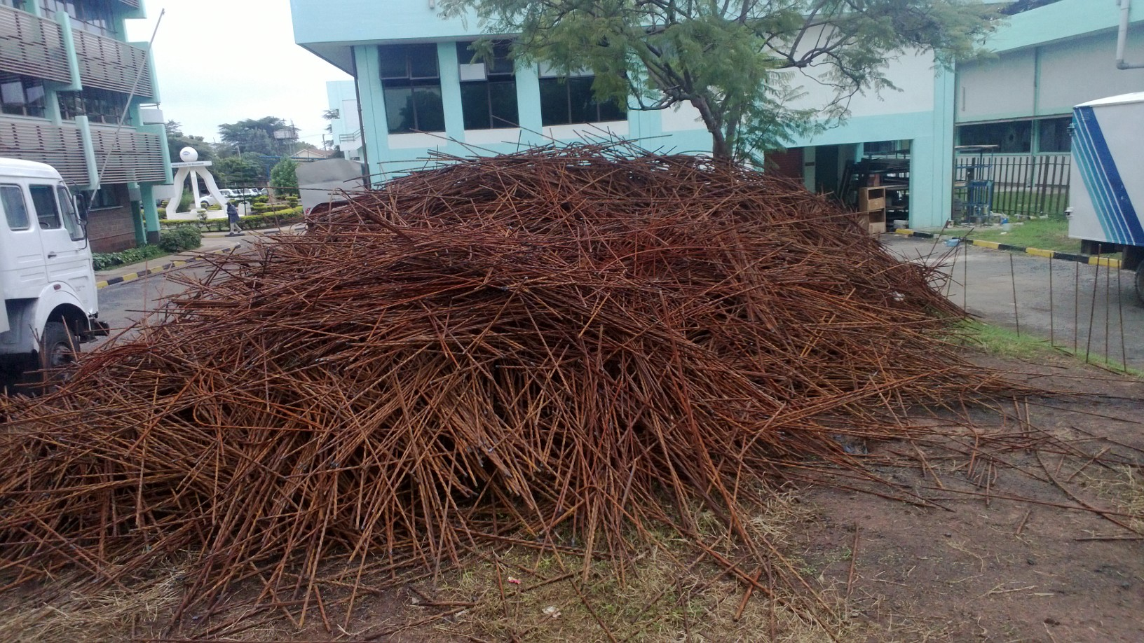
Kenya Bureau of Standards
Standards for Quality Life

Slide 25
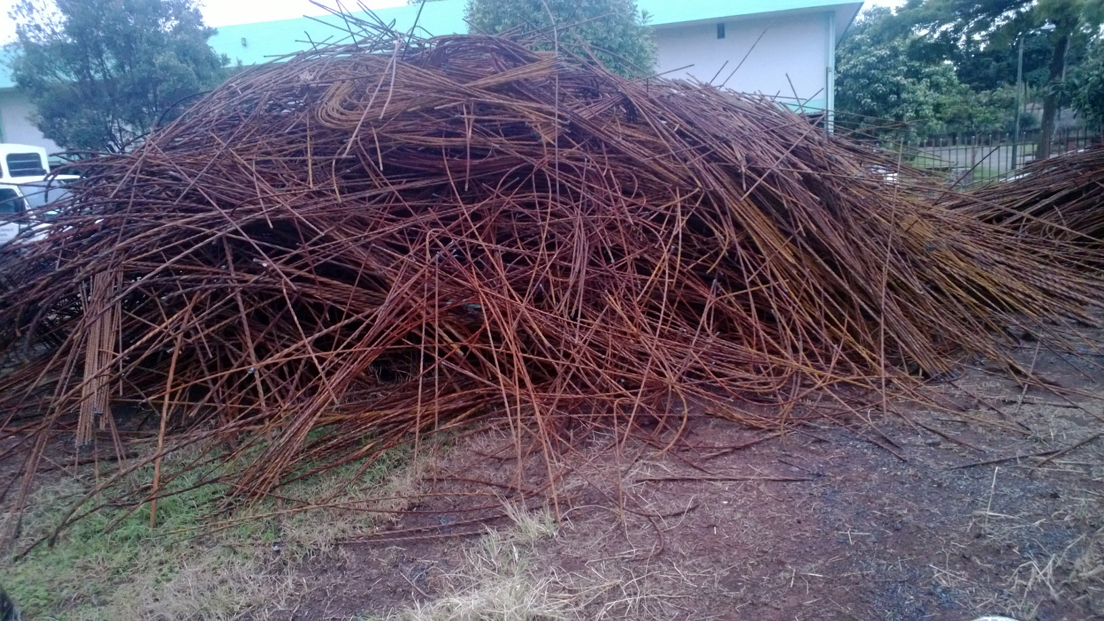
Kenya Bureau of Standards
Standards for Quality Life

Slide 26
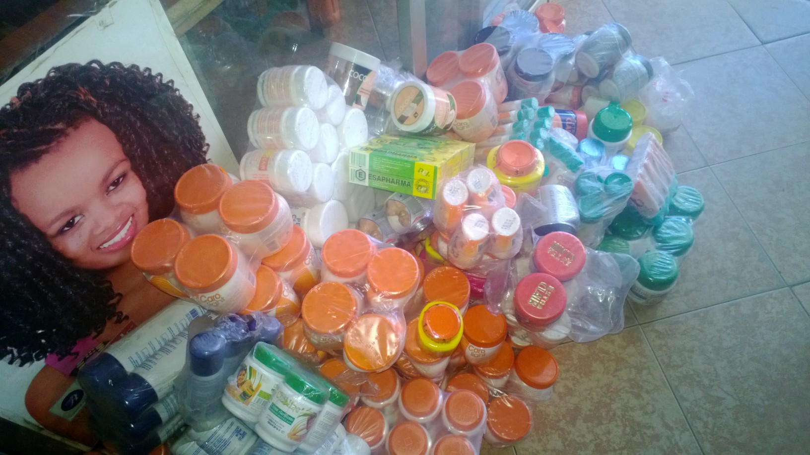
Kenya Bureau of Standards
Standards for Quality Life

Slide 27
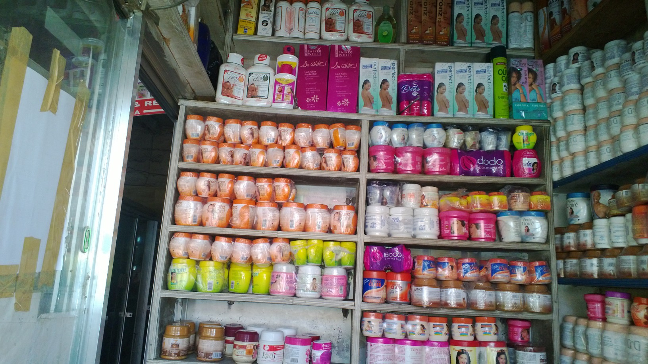
Kenya Bureau of Standards
Standards for Quality Life

Slide 28
THANK YOU
QUALITY PRODUCTS FOR QUALITY LIFE

