Slide 1
Framework for combating Importation, Supply and Use of Counterfeit/substandard terminals in EACO member states
Presenter
Mwende Njiraini
Communications Authority of Kenya

Slide 3
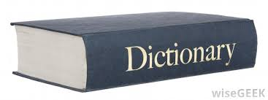
Counterfeit Definition
“Any good including packaging, bearing without authorization a trademark which is identical to the trademark validly registered in respect to such goods or which cannot be distinguished in its essential aspects from such a trademark and which thereby infringes the rights of the owner of the trademark in question under the law of the country of importation”

Slide 4
Substandard terminal definition
A terminal that does not meet applicable national and international technical standards, conformity processes and national regulatory requirements or other legal requirements

Slide 5
Impact of counterfeit/substandard terminals
Industry
Competition with low cost counterfeit/substandard devices
Payment of loyalties
Lowering of quality of service on networks
Disruption of supply chain

Slide 6
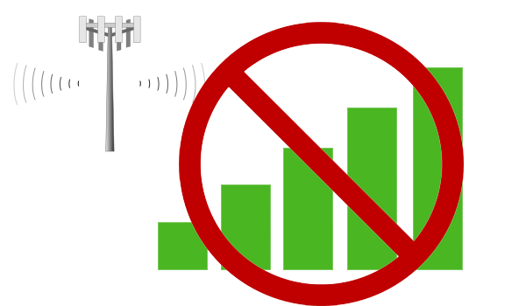
Impact of counterfeit/substandard terminals
Consumers
Exposure to high levels of hazardous substances
Safety risk as not subjected to extensive testing
Receive poor services – receive sensitivity and transmit performance
No warranty
Not easily traceable -used to commit crime
Short life span

Slide 7
Impact of counterfeit/substandard terminals
Governments
Lose of taxes – use of informal routes
Challenge in creating and enforcing laws
Inflated regulatory cost – manpower and collaborative effort to safeguard industry and consumers
Electronic waste

Slide 8
Proposed Practical Measures
Implementation of type approval
Define devices requiring type approval
Define standards
Determine whose responsible for technical evaluations
Issuance of type approval certificate
Affixing of type approval label
Periodic inspections

Slide 9
Proposed Practical Measures
Type approval challenges
Country standards that do not have international benchmarks
Cost of type approval
Period for type approval process
Lack of test centers
Implementation of proposed type approval procedures

Slide 10
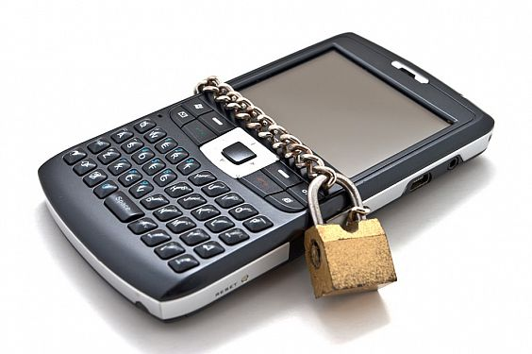
Proposed Practical Measures
International Mobile Station Equipment Identity (IMEI) database
Requires membership to GSMA
Check IMEI of mobile devices before importation and purchase

Slide 11
Proposed Practical Measures
Challenges of implementing IMEI database
Access to database by subscription
Additional cost to the user
Continuous consumer education
Duplicate/cloned IMEI difficult to verify authenticity

Slide 12
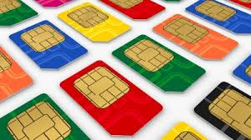
Proposed Practical Measures
Implementation of International Mobile Subscriber Identity (IMSI)
Every registered user has an original IMSI with a valid IMEI stored in their SIM
Provides information of network operator, SIM card and location

Slide 13
Proposed Practical Measures
Challenges of Implementation of IMSI
SIM card registration not fully implemented
Fraudsters can access SIM cards with invalid information
IMSI considered confidential – legal challenge in terms of access

Slide 14
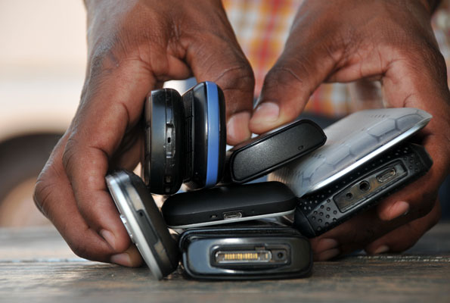
Proposed Practical Measures
Equipment Identity Register (EIR)
Matching of IMSI to IMEI
Mandate all operators to have EIR database
Challenges
The EIR is a considerable investment
The process of developing the EIR could take long to achieve accuracy and completeness
Duplicate/cloned IMEI cannot be stopped
Membership to GSMA

Slide 15
Proposed Practical Measures
Triple play approach
Use of IMEI, IMSI and MSISDN
Device locking rules
A particular MSISDN/IMSI and particular IMEI locked to each other– the MSISDN can only use the device of specified IMEI
Lock IMEI to specific MSISDN/IMSI but MSISDN/IMSI can used with another IMEI
Lock MSISDN/IMSI to specific IMEI but IMEI can be used by any subscriber (MSISDN/IMSI )

Slide 16
Proposed Practical Measures
Triple play Benefits
stops duplicate/cloned IMEI
Provides for full tracking and security
Encourages investment as governments can guarantee exclusive distribution rights
No SIM boxing – improved quality of international calls and increased revenue

Slide 17
Proposed Practical Measures
Triple play benefits(cont’d)
Reduced device theft
Can integrate with customs for tax collection
Taxation application to specific types of devices such as luxury phones
Governments can subsidize the cost of genuine phones
Combat device smuggling

Slide 18
Proposed Practical Measures
Challenges of triple play
Expensive and requires close collaboration among stakeholders
Technical expertise required to implement

Slide 19
Risk Analysis
Competing political, commercial and technical interests
Consumers not keen to acquiring and using genuine terminals

Slide 20
Responsibility
Governments need to :
Subsidize the cost of genuine terminals
Ensure collaboration of stakeholders
Ensure public awareness
Invest in training of technical personnel

Slide 21
Situational Analysis
Uganda
Working committee to develop solution to deal with counterfeit/substandard terminals
Equipment barring counterfeit/substandard terminals access to network purchased and housed at regulator (UCC)

Slide 22
Situational Analysis
Tanzania
Regulations on type approval in place
TCRA conducts inspections
Proposed set up of testing laboratory

Slide 23
Situational Analysis
Kenya
Anti counterfeit Act, 2008 and Type approval regulations, 2010
Switch off of 1.4 million devices with null or no IMEIs on 5 October 2012
Service provider for SMS (1555) IMEI verification
Collaboration with Anti Counterfeit Agency, Kenya Bureau of Standards, Kenya Revenue Authority, Original Equipment Manufacturers and Mobile Network Operators

Slide 24
Situational Analysis
Rwanda
Type approval procedure in place
RURA in process of acquiring SMS platform to interrogate GSMA database

Slide 25
Situational Analysis
Burundi
Legislation Decree 1/011 of 1997, Decree 100/97 of 2014
ARCT identified technical partner to set up solution to fight counterfeit/substandard devices
Technical and financial feasibility established before signing of contract

Slide 26
Thank you!

