Slide 1
ITU-T Focus Group Digital Financial Services – Consumer Protection
Stakeholders Forum on QoS and Consumer Experience
(Nairobi, Kenya, 27-28 October 2015)
Vijay Mauree
Programme Coordinator, TSB
ITU

Slide 2
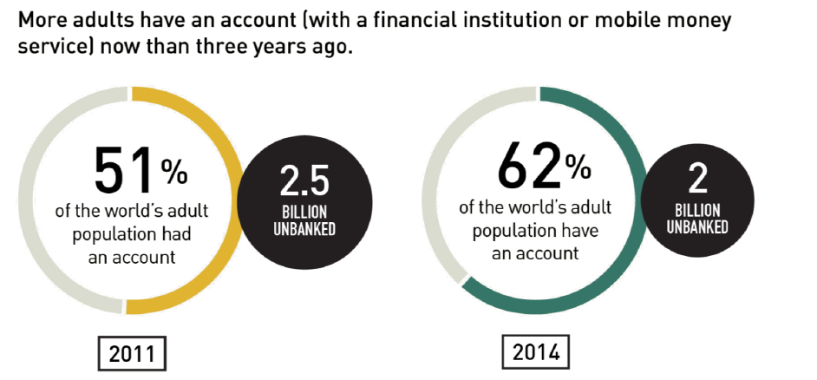
I. Financial Inclusion
1.6 billion have a
mobile phone
Source: FINDEX 2014

Slide 3
II. Mobile Money Market Situation
NUMBER OF LIVE MOBILE MONEY SERVICES FOR THE UNBANKED BY REGION - 2014
Source: GSMA

Slide 4
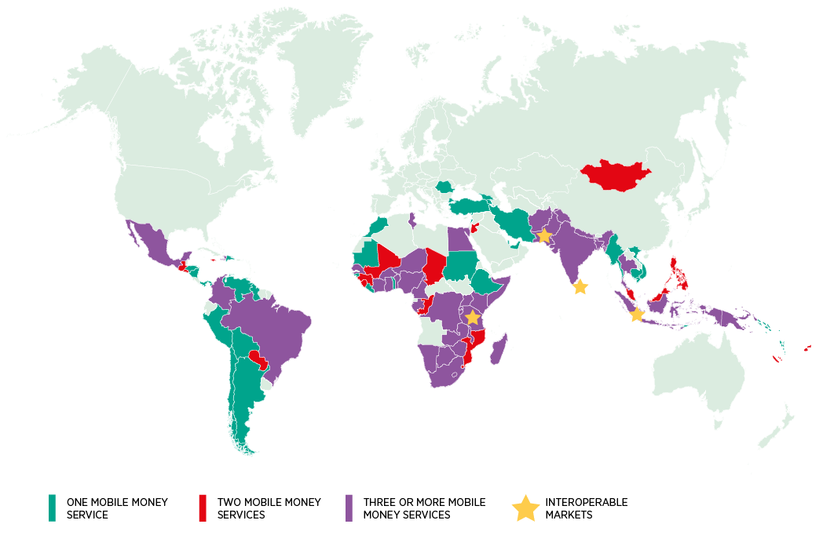




II. Mobile Money Market Situation
56 markets have 2 or more live services.
38 markets have 3 or more live services.
In 2014, MNOs implemented A2A interoperability in three markets
    Pakistan
    Sri Lanka
    Tanzania
  following in the footsteps of MNOs in Indonesia.
MNO: Mobile Network Operator
A2A: Agent to Agent
Source: GSMA Survey of Mobile Money Adoption in 89 Countries, 2014
Source: GSMA Survey of Mobile Money Adoption in 89 Countries

Slide 5
III. Critical Success Factors
Interoperability
Regulatory Dialogue
Consumer Protection
Competition
Security Issues
User Friendliness

Slide 6
IV. ITU FG DFS
  GOAL: Recommend a standardization roadmap for interoperable digital financial services for financial inclusion.
  Objectives
  Identify the technology trends in digital financial services
  Describe the ecosystem for digital financial services.
  Identify successful use cases for implementation of secure digital financial services.
  Study the best practices related to policies, regulatory frameworks, consumer and fraud protection, business models and ecosystems for digital financial services.
  Suggest new work items for ITU-T Study Groups

Slide 7
ITU-T Focus Group Digital Financial Services (FG DFS)
IV. ITU FG DFS
Duration: 2 years
Open to all stakeholders
1st Meeting: Geneva, 5th December 2014.
    97 participants, 25 countries
2nd Meeting: Washington DC, 21st April 2015.
    78 participants, 23 countries
3rd Meeting: 30 Sept – 2 October 2015, Malaysia
4th Meeting:
  15-16 December 2015, ITU, Geneva
  14 December: Workshop on Digital Financial Services and Financial Inclusion
www.itu.int/en/ITU-T/focusgroups/dfs/

Slide 8

























Stakeholders
IV. ITU FG DFS
Better Than Cash
Alliance
Notes:
Multistakeholder Concept – participation from diverse group
International Organizations
Central Banks
Telecom Regulators
Mobile Money Operators
Payment Service Providers
DFS Platform Providers
Standards Development Bodies

Slide 9
Main Activities
IV. ITU FG DFS
Establish liaisons and relationships with other organizations (i.e. WB, PAFI, AFI, GSMA, ITU-SGs) to avoid duplication of efforts and leverage expertise
Identify and study best practices related to policies, regulatory frameworks, consumer and fraud protection systems, business models and ecosystems for digital financial services
Refine vision of success
Identify and monitor technology trends in digital financial services and how the role of various stakeholders in this ecosystem will evolve
Identify successful use cases for implementation of secure digital financial services including developing countries with a particular focus on the benefits for women.
Work towards the creation of an enabling framework for digital financial services

Slide 10
IV. ITU FG DFS
AML + KYC
Settlement
Payment licenses
Micro loans
Deposit
  Insurance
    Licensing
    Costs
    Network Integrity
    QoS
    SIM Registration
Telecom Regulator
Financial Services Regulator
Open Access Dispute Res.
Pricing
Competition
Security
Taxation

Slide 11
Four Working Groups Have Been Established to Lead the Focus Group’s Efforts
IV. ITU FG DFS
Main areas of work
Interoperability
Consumer Experience & Protection
Technology, Innovation & Competition
DFS Ecosystem

Slide 12
Consumer Experience and Protection
V. Consumer Experience and Protection WG
Co-Chairs:
  Jami Solli, Consumer International
  Kate McKee, CGAP
  Adel Bedoui, Tunisie Telecom
  Sumit Jamuar, KYC Trust Ltd (UK)
Deliverables
  Guidelines for Consumer Protection for DFS
  Quality of Service Parameters for DFS

Slide 13
Consumer Experience and Protection
V. Consumer Experience and Protection WG
Activities
  Analysis of the legal framework for consumer protection (Nigeria, Bangladesh, India, Peru, Uganda
  Analyze terms and conditions in contracts of DFS service providers
  Develop guidance on best practices for protection for consumers against fraud
  Collaboration with SG12 on developing KPIs for QoS for DFS

Slide 14
DFS Workshop – 14 December 2015
V. Consumer Experience and Protection WG
Session on Consumer Protection
The discussion will focus on
  protecting consumers from fraud,
  Financial literacy programme effectiveness
  providing adequate redress mechanisms for consumers.
EACO Participation is invited

Slide 15
Collaboration on Deliverables
VI. Collaboration
Collaboration with
  ISO
  World Bank
  Consumer International
  Alliance for Financial Inclusion
  ITU-T SG 2, 3, 12 and 17
  CRASA
  Mobey Forum

Slide 16
Collaboration on Deliverables
VI. Collaboration
Invites EACO to participate in the meetings of FG DFS and the e-meetings of the working groups
Appoint a focal point for FG DFS
Make proposals to FG DFS deliverables for December meeting

Slide 17
Future Meetings
VII. Way Forward
27 – 29 April 2016: World Bank, Washington D.C
September 2016: Africa (tbc)
December 2016 : ITU, Geneva

Slide 18

THANK YOU
www.itu.int/en/ITU-T/focusgroups/dfs/.

