Slide 1
Stakeholders Forum on QoS and Consumer Experience (Nairobi, Kenya, 23 to 25 November 2015)
Role of Global & Regional Communities, Policy Makers, Regulators and Operators in the QoS Provision of Broadband in a Net-Neutrality Environment
Kwame Baah-Acheamfuor
Chairman, ITU-T Study Group 12
kwame.baah-acheamfuor@nca.org.gh

Slide 2
Outline
The Net Neutrality environment
How QoS matters in net neutrality
Roles of players in QoS provision of Broadband services in a Net Neutrality environment

Slide 3
Net Neutrality

Slide 5
WHAT IS NET NEUTRALITY?

Slide 7
How QoS matters in Net Neutrality

Slide 8
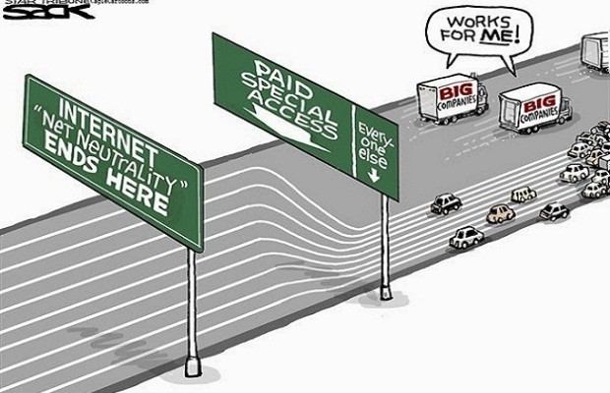

Slide 9
QoS defined in ITU-T Rec. E800
Quality of Service is:
“Totality of characteristics of a telecommunications service that bear on its ability to satisfy stated and implied needs of the user of the service.”

Slide 10
What does the Consumer really want with internet speed?
"Subscribers are demanding a superior quality of experience (QoE) and hold the operator responsible for it; but, at the same time, they are giving operators the green light to do what needs to be done to improve QoE by approving fast lanes for premium content.
Our survey results demonstrate that operators recognize the need for mobile video and data optimization to stay competitive, and are continuously looking for acceleration technologies to enable them to speed up their LTE networks, and ultimately provide a better experience for subscribers."
- Eyal Hilzenrat, Vice President of Product and Marketing, Flash Networks

Slide 12
Y.1540-Scenerio of IP performance Parameters

Slide 13
Consumer Protection
Consumer protection is a group of laws and organizations designed to ensure the rights of consumers as well as fair trade, competition and accurate information in the marketplace.
The laws are designed to prevent businesses that engage in fraud or specified unfair practices from gaining an advantage over competitors.
The law may also provide additional protection for those most vulnerable in society.

Slide 14
How does Consumer Protection apply to Net Neutrality
access to information/transparency
equity/right of access to services
quality of service

Slide 15
Roles of players in QoS provision of Broadband Services in Net Neutrality environment

Slide 16
Role of Global and Regional Communities
Definition of Net Neutrality
Determination on whether Net Neutrality has policy and regulatory implications
Standards to ensure net neutrality in service provisioning

Slide 17
Role of Policymakers
Review the existing legal framework to determine that all necessary legal powers exist to enable and ensure net neutrality.
Draw together all of the relevant stakeholders with an interest in net neutrality, in particular:
• Government agencies
• Internet Service Providers (ISPs) and other Electronic Service Providers (ESPs)
• Academic and research community
• Innovation Incubators

Slide 18
Role of Regulators
Establish the regulatory mechanisms to enable and ensure guaranteed quality of service.
Educate consumers and the general public on the realities of net neutrality and the responsibilities of the consumer.

Slide 19
Role of Operators
Invest to provision and guarantee desired quality of service to Consumers
Avoid anti-competitive practices against Service and Application Providers

Slide 20
Role of Consumers
To pay for and enjoy guaranteed quality of service

Slide 21
THank you For your attention!

