Slide 1
Quality of service development group monitoring quality of service experience
Maputo 14th- 16th April 2014
Muhannad Alabweh
Muhannad.alabweh@ascom.com
ascom, UAE

Slide 2
ASCOM introduction
 www.ascom.com/nt

Slide 3

ASCOM
  Ascom employs about 1,900 people worldwide.
  Ascom has subsidiaries in approx. 17 countries.
  Ascom registered shares (ASCN) are listed
  on the SWX Swiss Exchange in Zurich.
  www.ascom.com
25 YEARS OF INNOVATION

Slide 4

A PERSPECTIVE ON VOICE AND
DATA SERVICES BENCHMARKING (QoS & QoE)
Notes:
Presentation Name Month Year
4
I would like to welcome you to this forum, and i hope by the end of it you will have a solid understanding of Network testing and the importance of Testing and Monitoring the network in terms of QoS and QoE from both the network and customer perspective. And how wlil ascom help you to laverage form this knowledge to enhance your network performance and increase the customer satisfactoin, hence retain ,pore customer and increase your revenue.

Slide 5
Global Technology Split 2010-2016
Wireless Intelligence Q1 2013
GSM will still keep its leading position beyond 2016; However, will loose a big percentage of its connections to UMTS.
 | Q1 2010 | Q12011 | Q12012 | Q12013 | Q12014 | Q12015 | Q12016
GSM | 78.3% | 75.78% | 72.04% | 68.43% | 64.32% | 59.75% | 55.05%
WCDMA (Family) | 11% | 13.71% | 17.27% | 20.11% | 23.1% | 26.1% | 28.76%
CDMA (Family) | 9.82% | 9.37% | 8.8% | 8.42% | 8.03% | 7.66% | 7.60%
LTE | Less than 1% |  |  |  | 1.86% | 3.15% | 4.85%
Notes:
82 HSPA+ networks launched by 2011Q4, rank No.1 ; Taking 41% among the total 202 HSPA+ commercial networks in the worldwide.
31 DC-HSPA+ networks launched by 2011Q4, rank No.1 ; Taking 40% among the total 77 DC-HSPA+ commercial networks in the worldwide

Slide 6
Regional GSM Share
Wireless Intelligence Q1 2012
Africa, Asia Pacific, Latin America have seen significant increase in GSM connections over the past 2 years (2010Q1 to 2012Q1); while GSM connections have been dropping in Eastern Europe, Western Europe and USA/Canada and the trend will continue.
Emerging markets in Asia Pacific (India, China) lead in growth rate and will constitute the major part of overall GSM growth, with Africa following the suit.
Based on the trends, it can be concluded that GSM will still have significant presence beyond 2020, in all the regions (lead by Asia Pacific) except Western Europe and USA/Canada; where it will near erosion by that time.
Notes:
Africa: Algeria, Angola, Benin, Botswana, Burkina Faso, Burundi, Cameroon, Cape Verde, Central African Republic, Chad, Comoros, Congo, Congo, Democratic Republic, Côte d'Ivoire, Djibouti, Egypt, Equatorial Guinea, Eritrea, Ethiopia, Gabon, Gambia, Ghana, Guinea, Guinea-Bissau, Kenya, Lesotho, Liberia, Libya, Madagascar, Malawi, Mali, Mauritania, Mauritius, Mayotte, Morocco, Mozambique, Namibia, Niger, Nigeria, Réunion, Rwanda, Sao Tomé and Principe, Senegal, Seychelles, Sierra Leone, Somalia, South Africa, South Sudan, Sudan, Swaziland, Tanzania, Togo, Tunisia, Uganda, Zambia, Zimbabwe
Asia Pacific: American Samoa Australia Bangladesh Bhutan Brunei Darussalam Cambodia China Cocos (Keeling) Islands Cook Islands Diego Garcia Fiji French Polynesia Guam Hong Kong India Indonesia Japan Kiribati Korea, North Korea, South Laos Macao Malaysia Maldives Marshall Islands Micronesia Mongolia Myanmar Nauru Nepal New Caledonia New Zealand Niue Northern Mariana Islands Pakistan Palau Papua New Guinea Philippines Samoa Singapore Solomon Islands Sri Lanka Taiwan Thailand Timor-Leste Tonga Tuvalu Vanuatu Vietnam
Europe: Eastern: Albania Armenia Azerbaijan Belarus Bosnia and Herzegovina Bulgaria Croatia Czech Republic Estonia Georgia Hungary Kazakhstan Kosovo Kyrgyzstan Latvia Lithuania Macedonia Moldova Montenegro Poland Romania Russian Federation Serbia Slovakia Slovenia Tajikistan Turkmenistan Ukraine Uzbekistan
Europe: Western: Andorra, Austria, Belgium, Cyprus, Denmark, Faroe Islands, Finland, France, Germany, Gibraltar, Greece, Greenland, Guernsey, Iceland, Ireland, Isle of Man, Italy, Jersey, Liechtenstein, Luxembourg, Malta, Monaco, Netherlands, Norway, Portugal, Spain, Sweden, Switzerland, United Kingdom
Middle East: Afghanistan Bahrain Iran Iraq Israel Jordan Kuwait Lebanon Oman Palestinian Territories Qatar Saudi Arabia Syria Turkey United Arab Emirates Yemen
USA/Canada: Canada United States of America

Slide 7
Africa
Overtook Latin America in 2011 to become the second largest GSM market after Asia Pacific
Significant growth over past 2 years (2010Q1-2012Q1)
Will keep growing (reach 693.07 Million) by the end of 2014.
Will start to decline slightly 2015 onwards (increase in UMTS connections)
Leading countries (Nigeria, Egypt, South Africa) and operators (MTN, Vodacom) report significant GSM subscriber gain over the past quarter and will continue to invest on GSM as the main mobile technology, as most of the subscribers are using 2G.
GSM will still keep significant presence ad dominance even beyond 2020.
 | Q1 2010 | Q12012 | Q1 2016
Total Connections (Millions) | 478.1 | 663.3 | 949.9
GSM Connections(Millions) | 444.24 | 591.63 | 680.90
GSM Percentage | 92.92 % | 89.24 % | 71.69 %
Net GSM Additions(Q12012) | 16.01 | 16.28 | -6.30
GSM Growth Rate (YOY) | 18.15 % | 14.18 % | - 1.73 %
GSM Market Penetration | 43.77 % | 55.71 % | 58.54%
Wireless Intelligence Q1 2012
Technology Split
GSM Connections (Millions): Nigeria (90.55), Egypt (73.85), South Africa (48.14), Algeria (38.82), Morocco (30.01), Kenya (25.83), Tanzania (22.58), Ghana (20.63), Côte d'Ivoire (19.33), Sudan (16.68)
Net GSM Additions (Millions): Nigeria (3.26), Algeria (1.26), South Africa (1.18), Sudan (1.13), Ethiopia (1.01)
GSM connections – Operators (Millions) : MTN(Nigeria) (41.76); Vodafone(Egypt) (31), Mobinil(Egypt) (29.6), Vodacom(SA) (21.16), Glo Mobile(Nigeria) (19.42)
Net GSM Additions(Millions): Djezzy(Algeria) (1.09), Etisalat(Nigeria) (1.05), MTN(Nigeria) (1.04), Ethio-Mobile(Ethiopia) (1.01), Vodacom(SA) (0.73), Glo Mobile(Nigeria) (0.72)

Slide 8
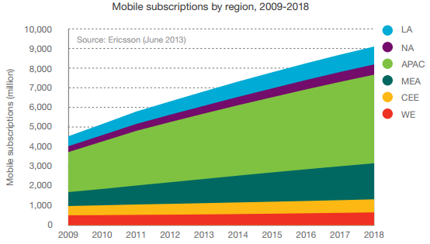
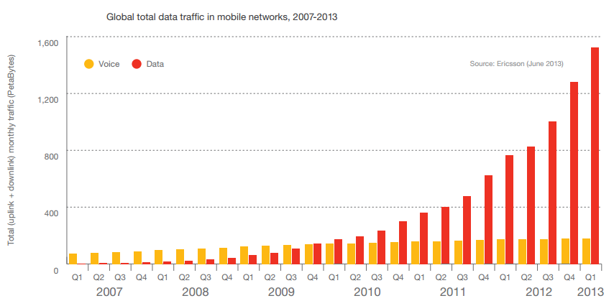
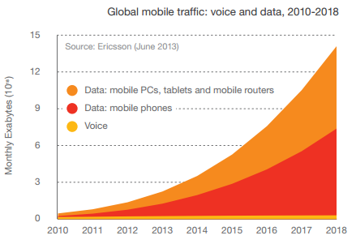
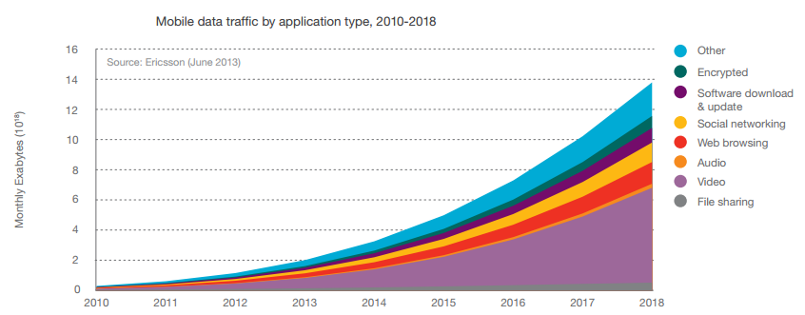
KEY figures

Slide 9
ARPU FORECAST (USD) WORLD TOTAL
ARPU (USD)
Source: WCIS Revenue Forecast October 2013

Slide 10
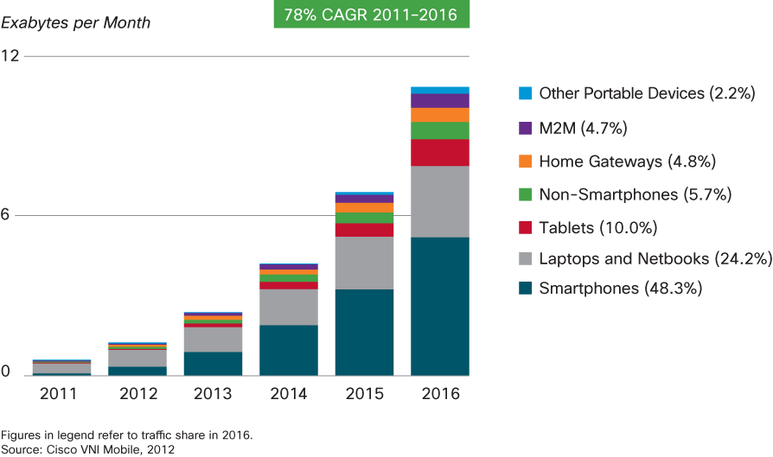
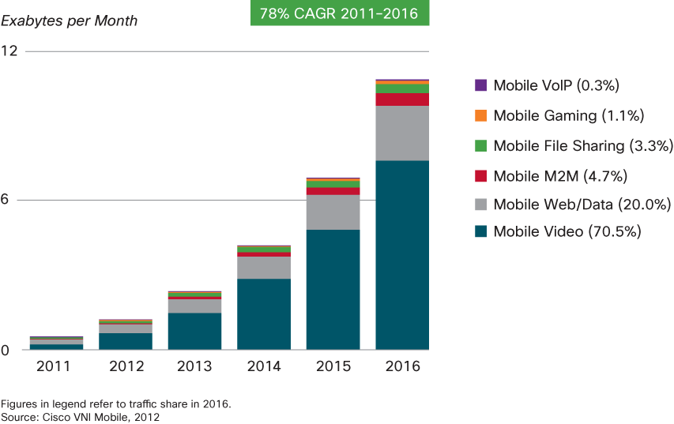
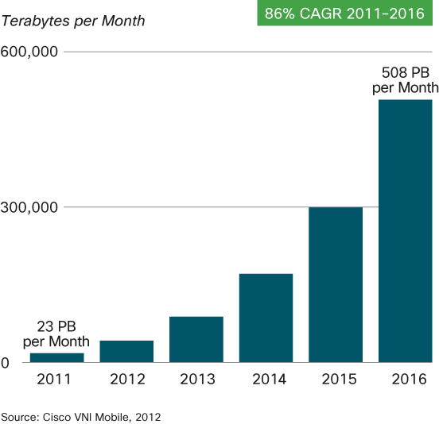
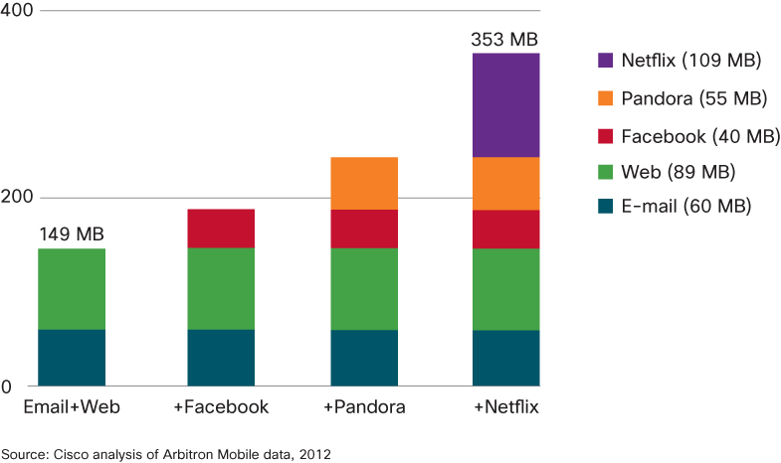
TRENDS IN THE ECOSYSTEM
Variety of Devices:
Mobile Data Application
Distribution
Mobile Cloud Adoption
The Mobile Internet of Things
(M2M)
Smartphones and video apps, the main drivers of the 4G ecosystem,
show customer centric trends
25 YEARS OF INNOVATION
Notes:
Let’s first take a look at the trends as detected by the 2012 CISCO analysis
2011-16 trends; their causality and interdependency; something we already know, but I would like to point out few things:
Smartphones will dominate; with laptops/tablets carrying still a significant portion
The driving mobile app is the video within a 10 fold traffic increase (massive traffic consumption against a limited spectrum)
Video-audio apps are suited more for the Mobile Cloud; usage drives automatically to the adaption of the mobile cloud; by 2016 71% (accounting for a monthly 7.6 EB = 10^6 TB=10^6 * 10^3 GB) of the mobile traffic will be cloud based
On top, a completely different type of traffic than the customer’s, the M2M (“Internet of Things”) traffic will mark a 17% growth by 2016. Although accounting for only 4.7%, due to the high demand for signalling, it could have a significant impact on a customer centric data traffic within a spectrum limited world.
More words:
The detected trends show a waterfall effect.
The impact of smart phones strongly influenced a certain pattern of the mobile application evolution and usage. Video apps are taking the leading and therefore naturally enabling the Mobile Cloud adoption which suits video-audio apps (need for storage); a video-audio apps user is going to generate more than twice the volume of traffic generated by a user adopting only email and web applications. 71% of total mobile traffic (7.6EB/month) in 2016 will be cloud based

Slide 11
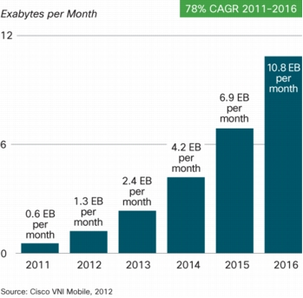
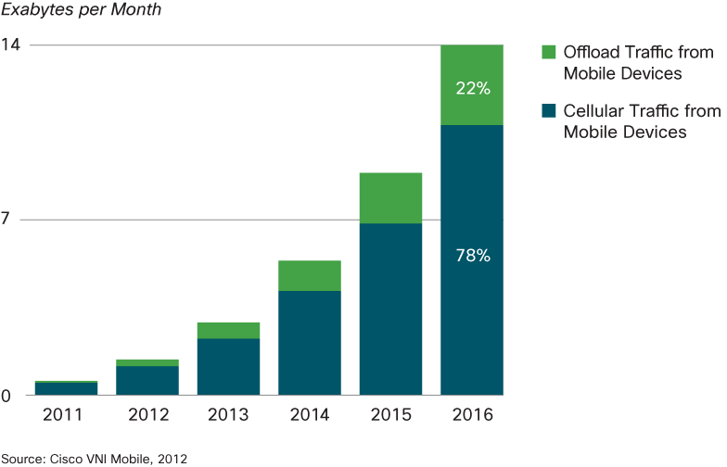
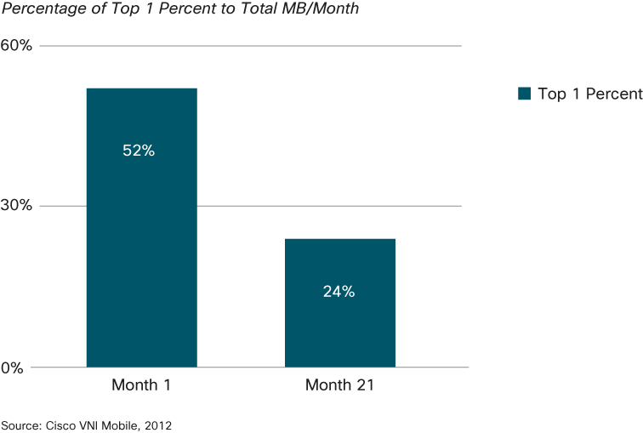
TRENDS IN THE ECOSYSTEM
Mobile Data Traffic Offload
Without offload, the global mobile traffic
would grow at 84% CAGR 2011-2016
Mobile Data Traffic
Data Usage Democratization
25 YEARS OF INNOVATION
Notes:
The previous trends indicate a fast growing customers’ appetite for smart phones and mobile video apps that obviously drive to equally fast growing operators’ concerns for making sure they can cost efficiently sustain the total mobile data traffic growth.
The trends show that facing a 2.3 –fold growth (133%) in 2011 (the fourth year in a row despite global economic uncertainties) and a 2.1-fold (110%) estimated growth; operators are looking for leveraging the growth with two measures: tiered mobile data packages (data usage democratization), and an increase in the amount of mobile traffic offloaded to the fixed networks. Offload volume is determined by smart phone penetration, dual-mode share of handsets, percentage of home-based mobile Internet use, and percentage of dual-mode smart phone owners with Wi Fi fixed Internet access at home. Much mobile data activity takes place within the user’s home. For users with fixed broadband and Wi-Fi access points at home, or for users served by operator-owned femtocells and picocells, a sizable proportion of traffic generated by mobile and portable devices is offloaded from the mobile network onto the fixed network.
FYI: The current growth rates of mobile data traffic resemble those of the fixed network from 1997 through 2001, when the average yearly growth was 150 percent and remained at this rate for 5 years.
Tiered pricing: constrain the top 1% percent of mobile data consumers (initially accounting for 52% of the traffic); who prove to be heavy mobile data users in the top 5% percent, because the top 1% of users varies each month; top 5% have the potential of being in the top 1% in any given month and substitute for each other in subsequent months; trend caused by the nature of consumption of mobile data applications. “Traffic democratization” shows that effectively constraining the top 1% allows growth to be made up by those outside the top 1%;
.

Slide 12
INDUSTRY CHALLENGES
Notes:
Presentation Name Month Year
12

Slide 13
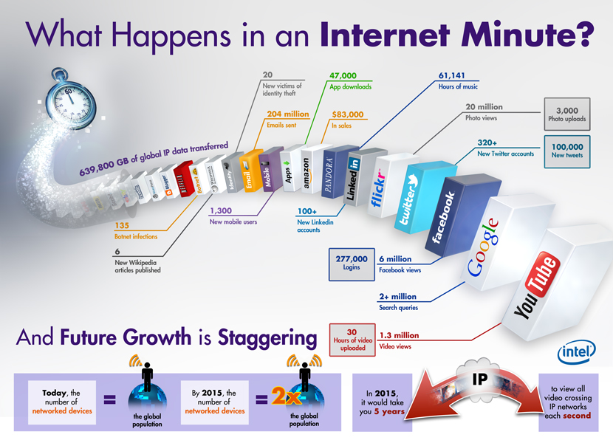
THE INTERNET OF THINGS

Slide 14



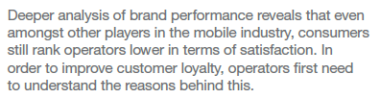

Slide 15

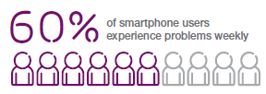
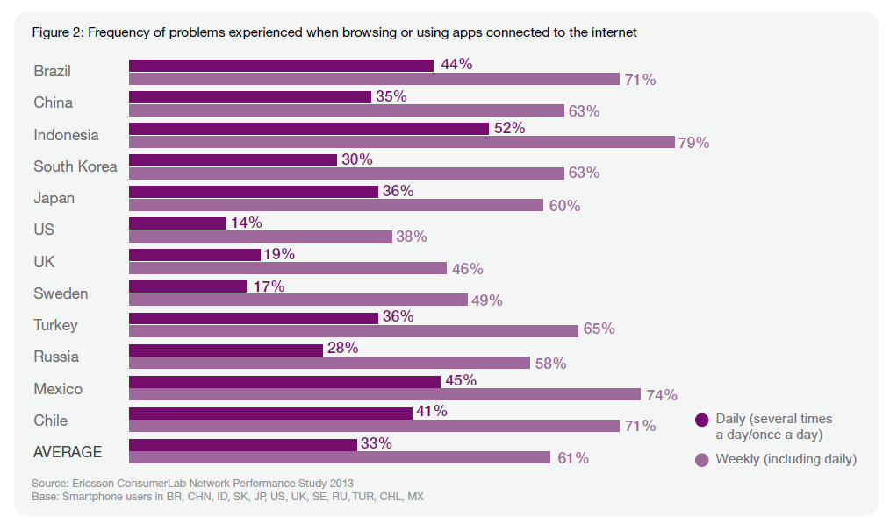
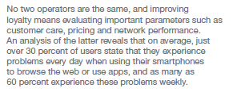
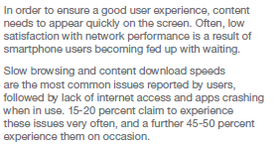

Slide 16

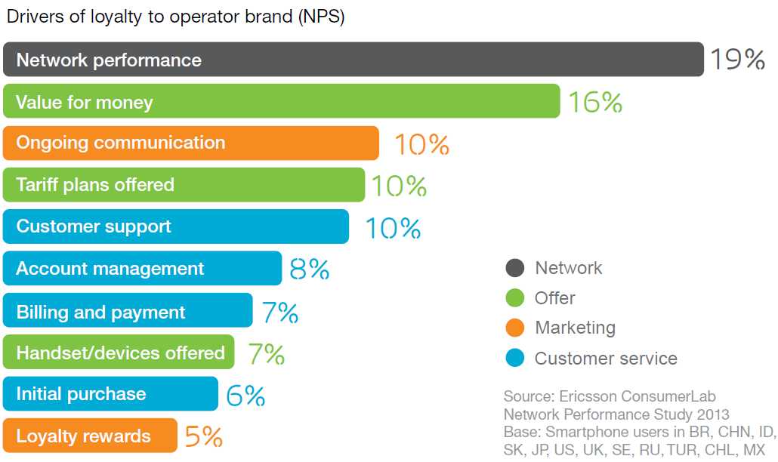

Slide 17


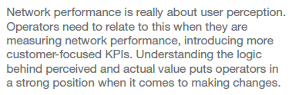
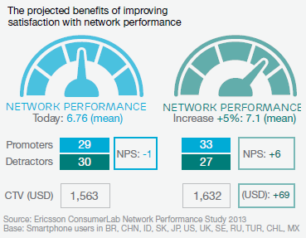

Slide 18

QoS & QOE Control
MBB is stimulating exponentially increase of traffic
Goals
Utilize network resources in a more optimal way
Ensure satisfaction for premium users
Control cell congestion
Control heavy users
Differentiate further on pricing and services

Slide 19













End-to-end look on qos & qoe
 | Test | Monitor | Optimize
QoS
QoE
TI & TP
TSS & TA
TDD
&
TDN
TEMS Monitor Master
Users
User Equipment
Radio Access
Core Network
VAS Network
SGSN
GGSN
Service
BTS/Node B
Application
Servers
Node B/
BSC/RNC
Billing
MSC
SMS-C
WAP GW
HLR
DNS

Slide 20

TEMS MONITOR MASTER
[ OVERVIEW ]
End-to-end service monitoring
  Monitor from the end user’s perspective any multimodal service
  Pinpoint performance and availability issues
  Speed up the resolution of issues
  Monitor trends
Regression testing
  Test services as infrastructure is changed or upgraded
  Prove correctness before launch
Roaming
  Extend testing and monitoring for inbound and outbound cases
Revenue assurance
  Find and fix revenue leaks
Notes:
Examples of multi-modal tests
Mobile TV
Ringback
UMA/GAN
VoIP
Wallpaper download
Voice regression testing
Site integrity

Slide 21
Video stream Value chain Testing AND monitoring

Slide 22


Video stream Value chain Testing AND monitoring
3rd party video streaming service
Geographic locations
APN 1
APN 2
…
APN X
GGSN 1
GGSN 2
…
GGSN Y
Multiple video and encoding formats
HTTP Live Streaming (HLS)
HTTP Dynamic Streaming (HDS)
Flash
Dynamic Adaptive Streaming over HTTP (DASH)
3rd party live TV
3rd party subscription TV
TEMS Monitor Master is used to actively test video streaming services
Content delivery network must deliver video with different encoding schemes correctly
Access point names (APNs) must deliver different service correctly
Load must be distributed over different GGSNs
Mobile network must deliver from geographical locations 24x7
The subscriber experience must be good

Slide 23
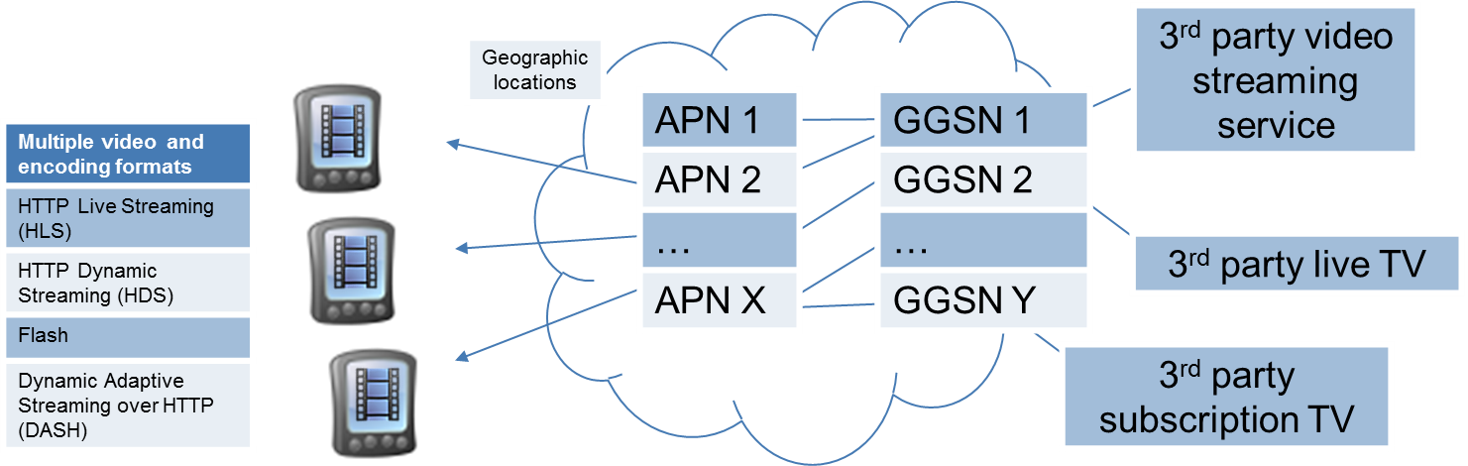
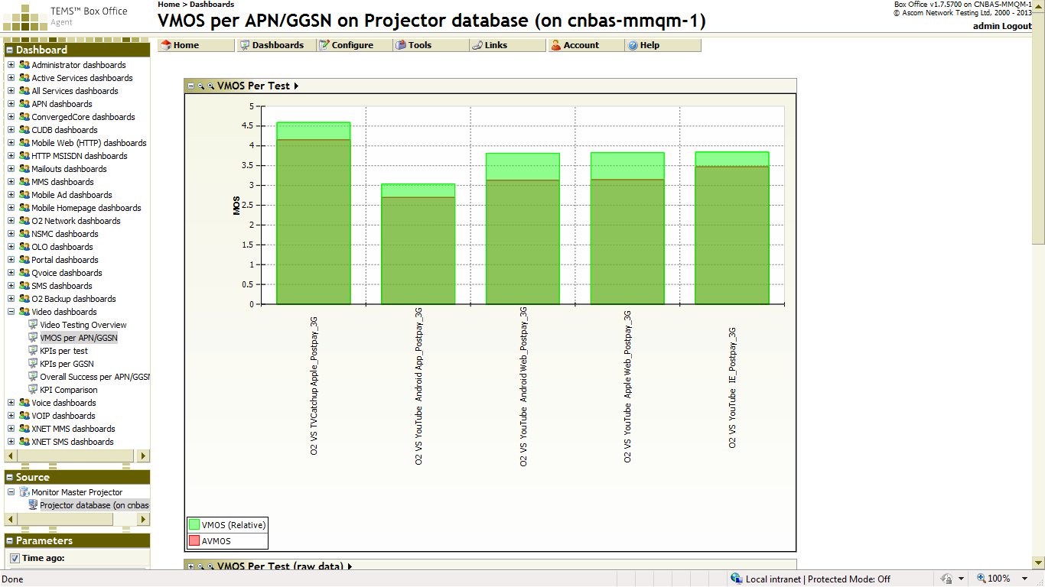

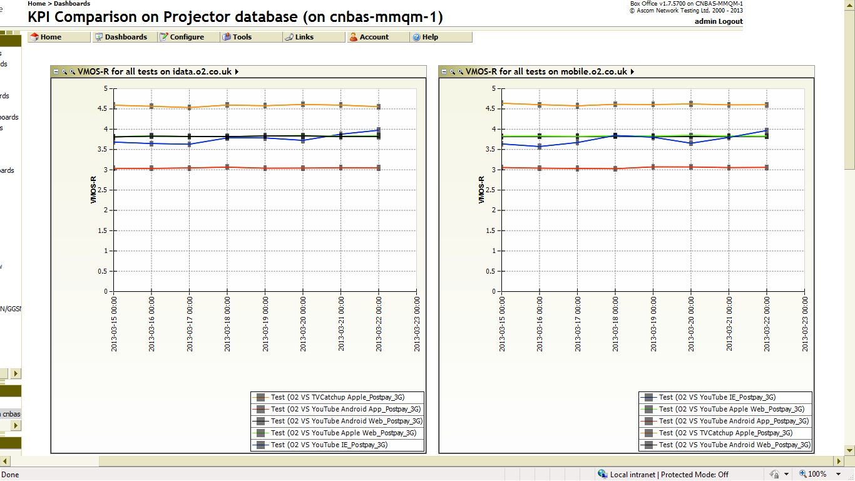
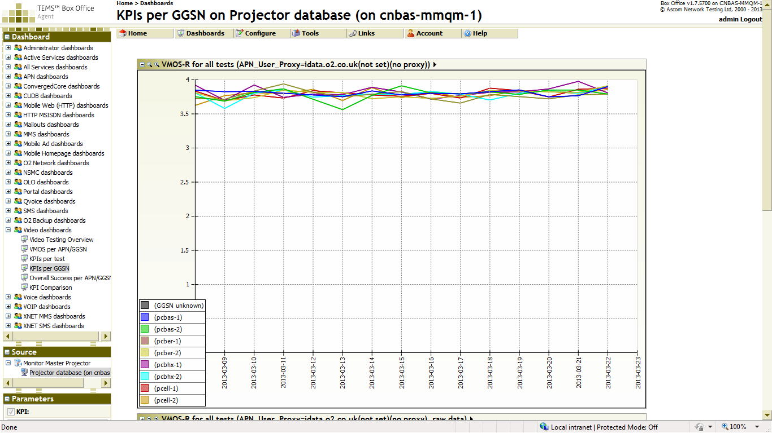
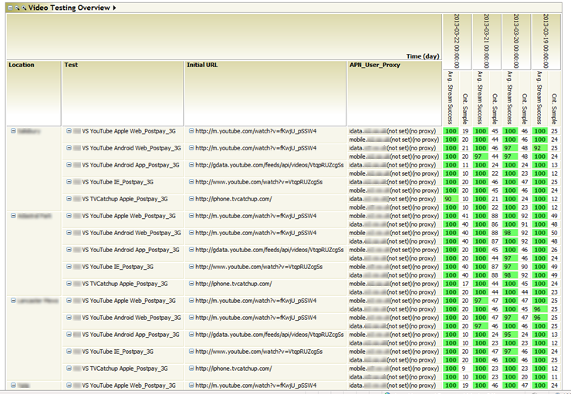
Solution overview
Reports
Video value chain
Clients
Locations
APNs
GGSNs
Video content
TEMS Monitor Master probes set up with scripts to test video services
Simulate multiple clients accessing video streamed content delivered in multiple encoding formats
Probes located at multiple physical locations
Tests configured to access multiple access point names (APN)
Uses IP address range to determine GGSN identity
Engineering trace detail allows determination of low level IP details such as throughput, error rate
Integrated with Telchemy VQMon to yield state of the art objective scores for video streams including MOS
Multiple reports configured specifically to meet the customer’s requirements and add value

Slide 24
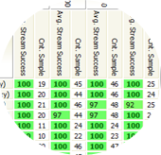
Detailed Results and Value
Locations
Clients
Video content
APNs
Value chain
Report shows daily performance for different parts of the value chain
Shows at a glance that service is performing correctly across the whole value chain
Allows faults to be isolated and pinpointed for more rapid resolution and improved MTTR

Slide 25
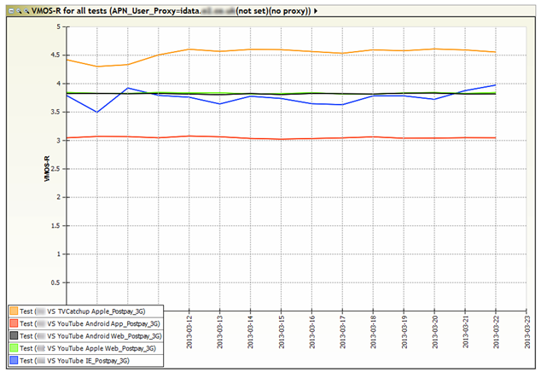
Daily summary showing average video MOS
Shows different combinations of client, APN and content
Shows MOS as a function of time to isolate trends and allow prioritisation to happen
APNs
Clients
Video content
Value chain

Slide 26
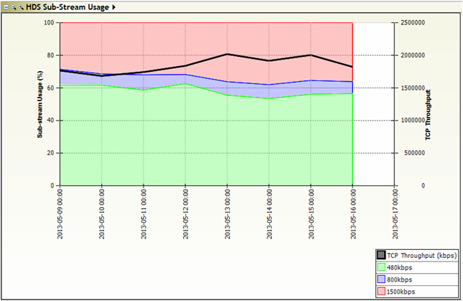
HTTP Dynamic Streaming – Client response
Report showing the percentage of a session using available substreams
Three substreams are available 480, 800 and 1500 kbs
HDS clients are able to adapt to use the highest throughput substream.
Report shows that more of the higher throughput substream is used when the current network condition allows.
This shows the content delivery network is functioning correctly with the client
Clients
Video content
Value chain

Slide 27
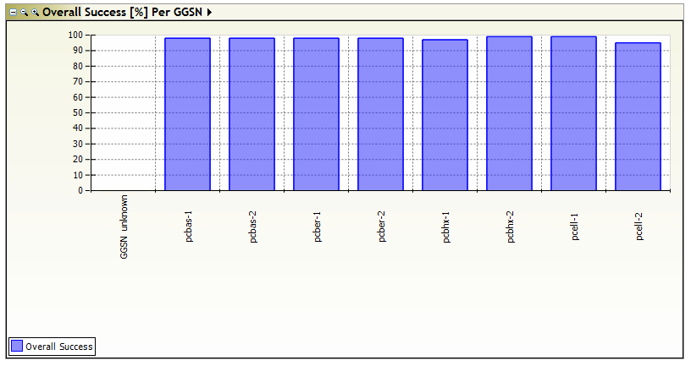

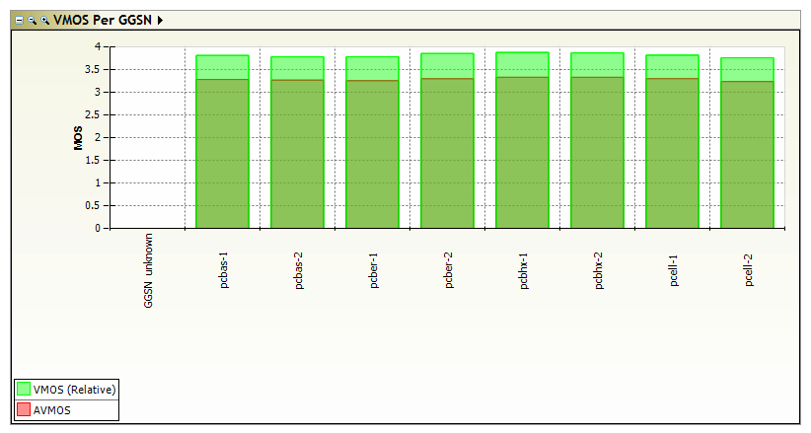

VIDEO Service delivered through GGSNs
Report showing average Video MOS by GGSN
Allows relative performance of GGSNs to be seen
Shows load balancing within the content delivery network is set up correctly
Allows faults to be seen and resolved more quickly.
GGSNs
Value chain

Slide 28
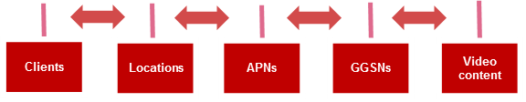
Value summary
TEMS Monitor Master active video tests proved the end to end performance of the video stream value chain
This includes multiple aspects Client Location APN GGSN Content To allow issues to be pinpointed to the specific part of the value chain.
Results used to prove pre-launch fitness for purpose.
Results used post-launch 24x7 to assure service and improve MTTR.

Slide 29


Youtube broadband monitoring
[PRODUCT PORTFOLIO]
This is based on an example of a wireless operator in South Africa
First Mile
Location
Last Mile
Wireless
Location
RAN
Location
In Country
Location

Slide 30
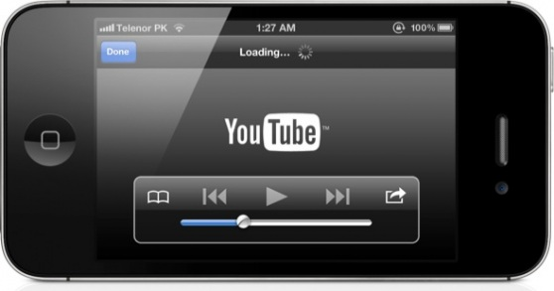
Youtube broadband monitoring
[PRODUCT PORTFOLIO]
Internet Backbone
location
Operator NW
location
First Mile
In Country
RAN
Last Mile
Carrier
RAN
Radio
Cache
Performance
Cache
Performance
Performance

Slide 31
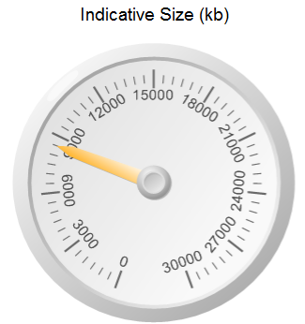
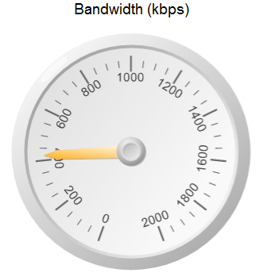
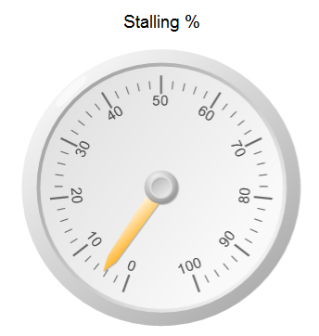
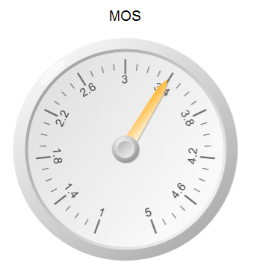
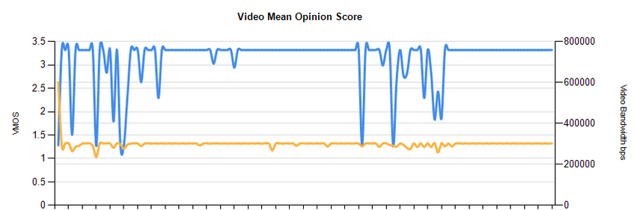
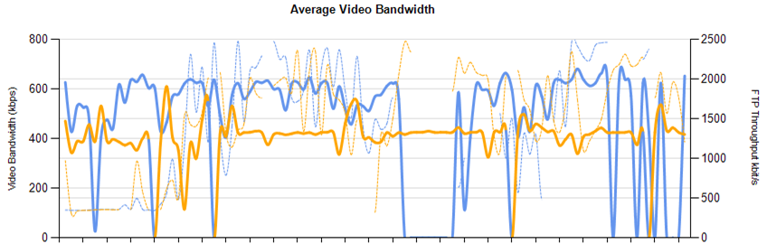
Youtube video kpi chart

Slide 32
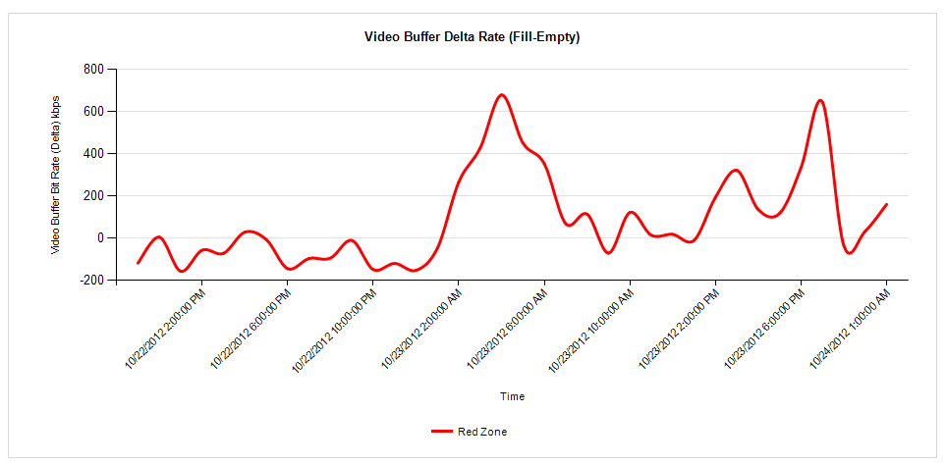


Video quality – buffering and stalling

Slide 33
Whatsapp Monitoring

Slide 34
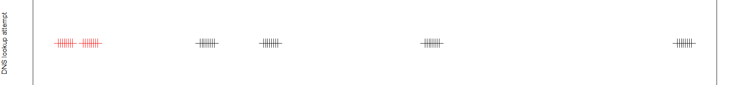
Whatsapp Case Study: extra DNS lookup on outage
Each vertical line represents a DNS lookup attempt by a single client following a general outage of the WhatsApp service
When the WhatsApp service is unavailable, the client (app) is observed to perform DNS lookup attempts every five seconds in short bursts
Different colours indicate different URL accesses being attempted as client tries and retries “available” options
For carriers with large WhatsApp adoption this has created significant traffic resulting in negative effect on the mobile network performance

Slide 35

Whatsapp case study: monitor master solution Test overview
Whatsapp signon https://r.whatsapp.net
WhatsappService
Ping r.whatsapp.net
Core network
DNS lookup r.whatsapp.net
Monitor Master emulates the WhatsApp client and attempts part of the Whatsapp logon.
Locations
TEMS Monitor Master three stage test
DNS lookup
Ping
WhatsApp signon
Clients
OTT “value chain”

Slide 36
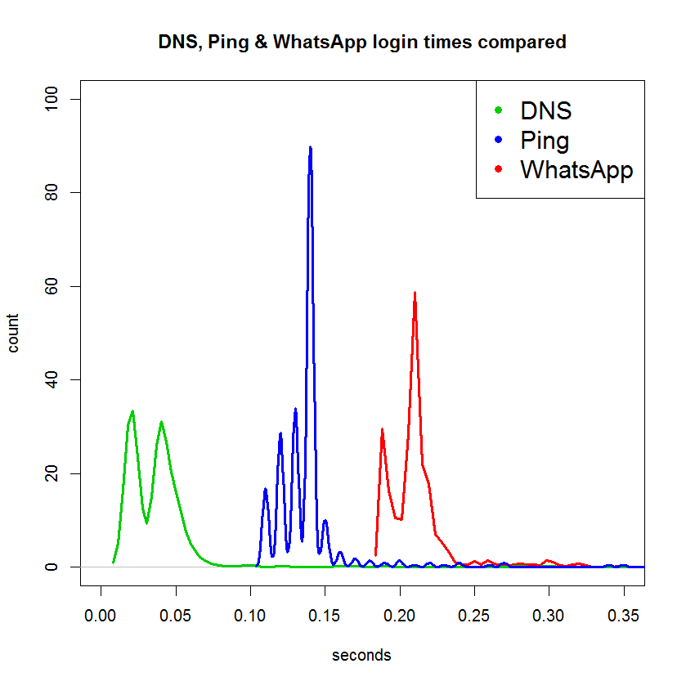
Whatsapp case study: Results
By understanding expected behavior Monitor Master can identify and alert on failures
Core network
WhatsappService
OTT “value chain”
DNS time is the time to find the IP address of the server
Ping time is the time to locate the server
WhatsApp time is the time to connect and login to the server
Sign on time to WhatsApp application ~0.2s

Slide 37
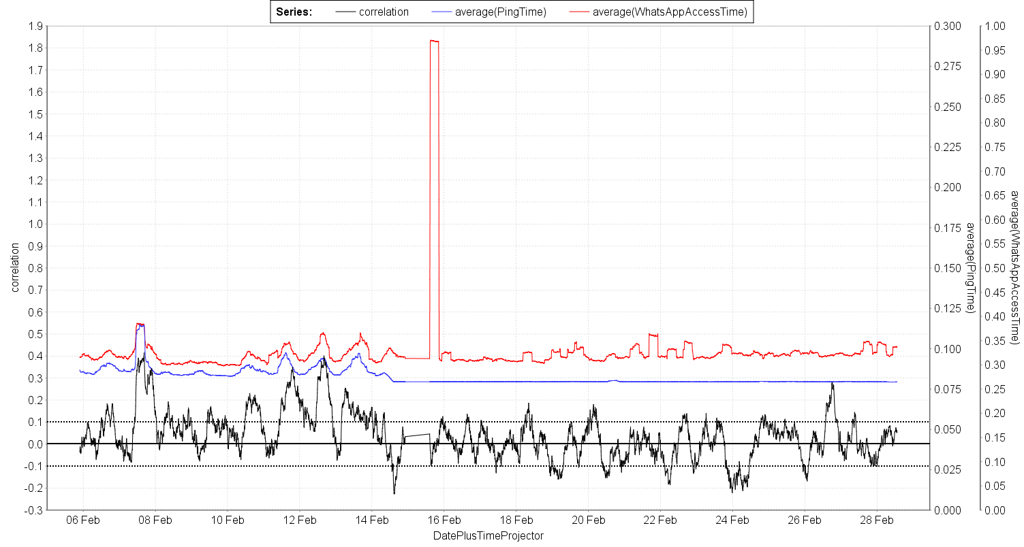
Whatsapp case study: Pinpointing problems
Correlation between Ping and Logon times shows when an issue is outside the control of the operator

Slide 38

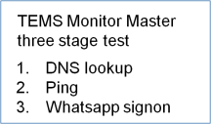
Whatsapp case study: 24 by 7 monitoring and location of errors
Cell colour indicates average error
 | DNS | Ping | Whatsapp
1
2
3
Locations
4
Vertical red means general failure
Horizontal red means error at a specific location
1
2
3
4
Clients
Different locations or access methods
Different resolution actions in each case

Slide 39
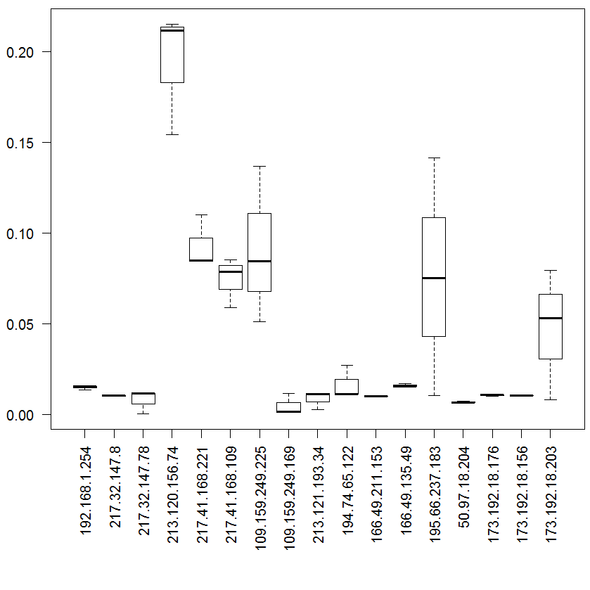
Diagnostic detail
Traceroute timing details between client and WhatsApp application
IP addresses indicate who owns the component
Large timing variations indicate focus areas
Core network
Locations

Slide 40
Facebook Application benchmarking

Slide 41





Facebook benchmarking between carriers
Facebook
Internet
Internet
Complex multi party interactions
Carrier3
Carrier1
Carrier RANs
Carrier2
Clients
TEMS Monitor Master is used to actively test Facebook interactions for different carriers
Different aspects of the service interaction must be supported by the carrier network
Interactions include logon, messaging, content upload, homepage display
Results used to improve core network and interworking connection
Results also important for marketing
Facebook “value chain”

Slide 42

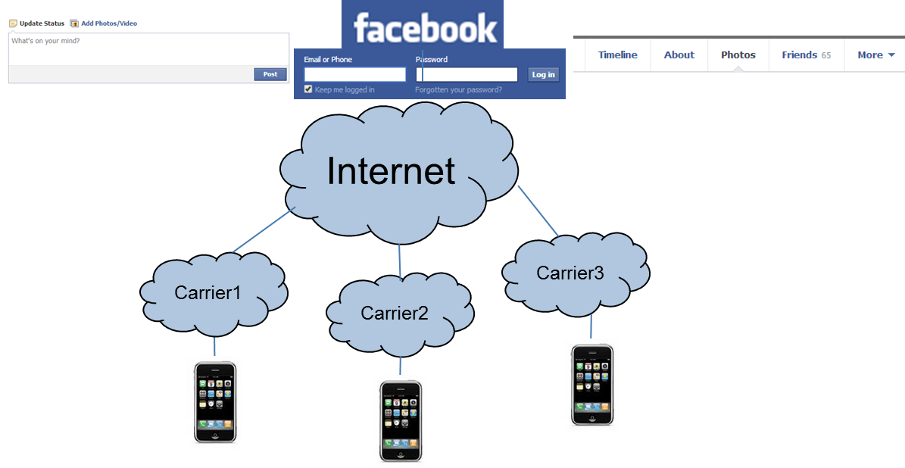
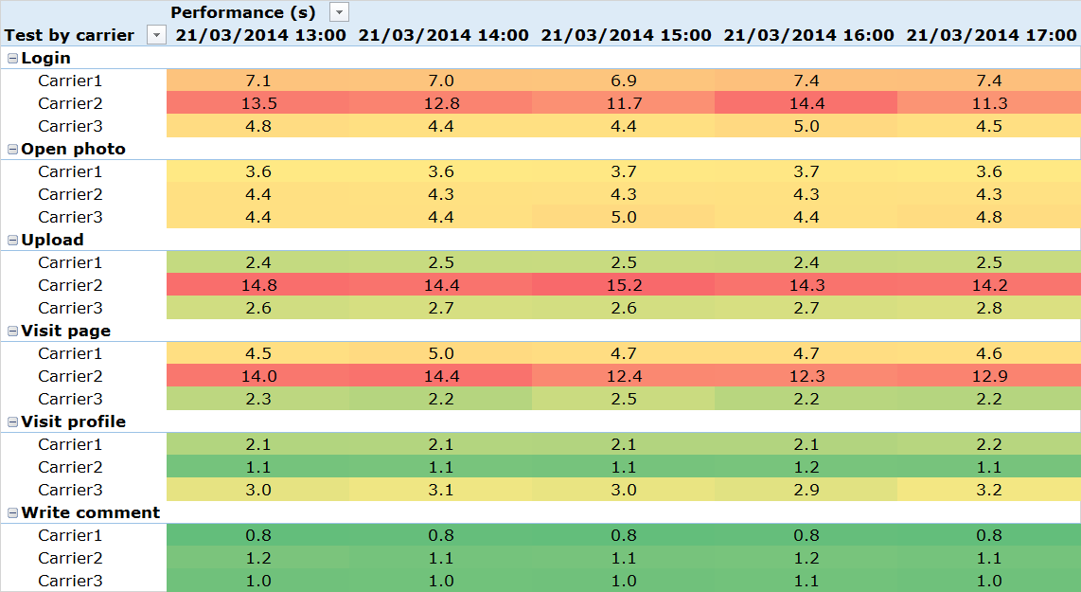
SOLUTION OVERVIEW
TEMS Monitor Master probes set up with scripts to test Facebook interactions
Active testing access using multiple different carriers
Tests simulate different clients such including PC and Smartphone and use different bearers
Tests exercise all the important functionality of Facebook from the user’s perspective
Engineering detail gives radio and IP trace to help pinpoint where issues occur
Multiple reports configured specifically to meet the customer’s requirements and add value

Slide 43
Detailed results and Value
Facebook
Carrier RANs
Reports shows average performance of key Facebook interactions for different carriers
Shows at a glance how different carriers are performing
Shows how different aspects of the Facebook service perform
Results used to support marketing campaigns
Detailed results used to troubleshoot errors and improve MTTR for the owning carrier
Differences between bearer also used to troubleshoot
Different clients also used to give further insight into performance
Facebook “value chain”

Slide 44
Circuit Switched Fall Back

Slide 45
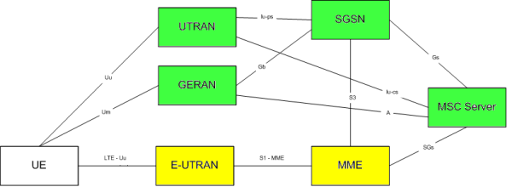
Circuit switched Fall back
Question: How will voice and SMS be supported on LTE if VoIP (VoLTE) is not possible?
Answer: Use legacy circuit switched network
Technically: A complex coordination is required within the network and at the user equipment
Key questions:
Availability: Does it work at all?
How long does it take to setup a voice call?
How long does it take to revert back to LTE?
Important aspects:
Mobile originated
Mobile terminated
Active LTE session
Idle LTE session
3GPP TS 23.272, Circuit Switched (CS) fallback in Evolved Packet System (EPS)

Slide 46

Monitor Master CSFB solution
New CSFB functionality conveniently packaged for easy implementation
New CSFB probe
The hardware
New or existing central system
RTU5
QM
Smart1 probe containing
1 RTU-5
2 EMUs
Scripts
Projector
EMU
EMU
Samsung Galaxy SIII
Samsung Galaxy SIII
Value
Allows key CSFB services to be tested and monitored to confirm service availability and measure key metrics 24x7
Results
Reports
Upgrade or new sale
Also capable of LTE testing using modems in RTU-5

Slide 47
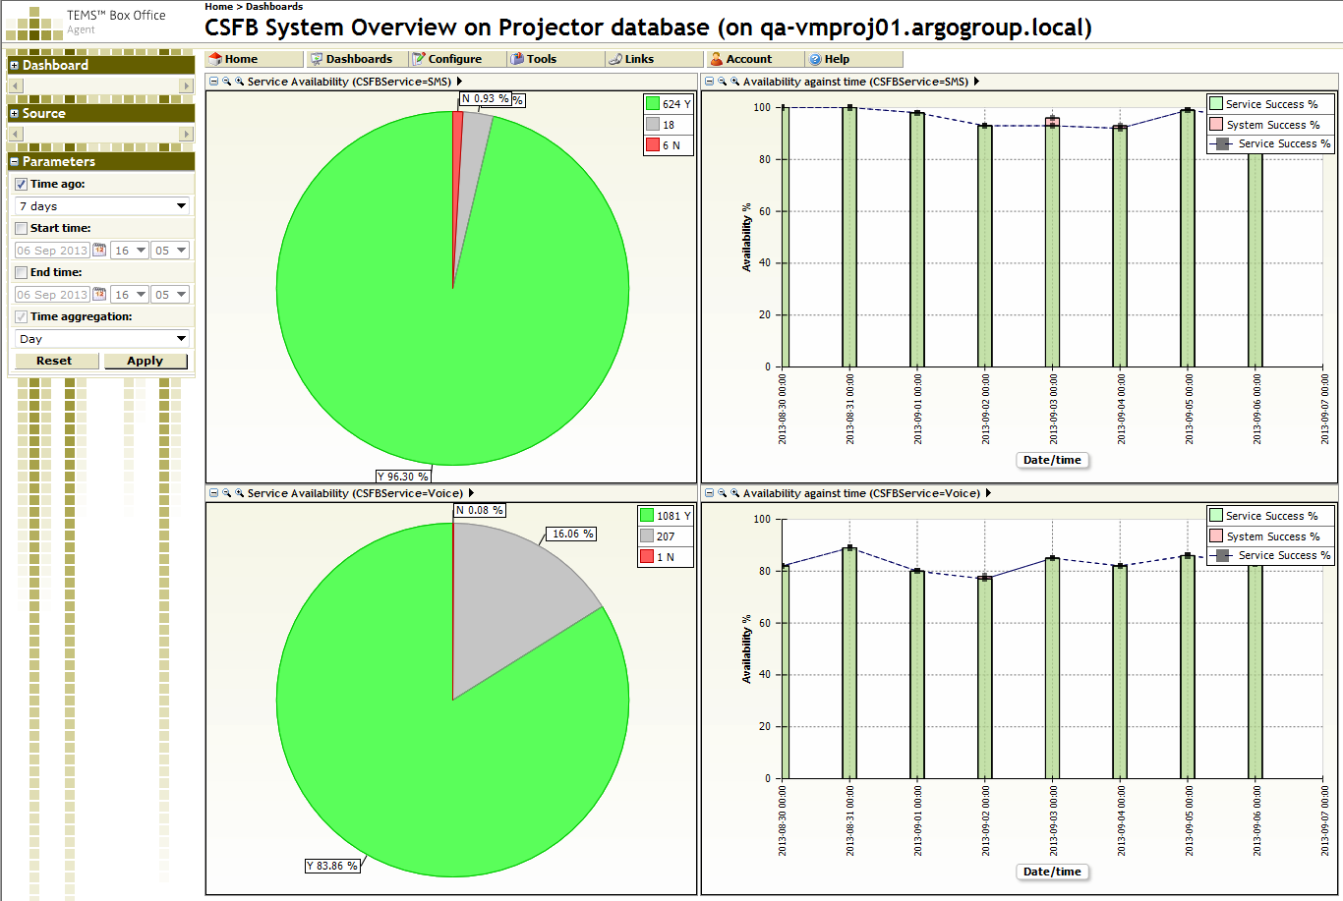
Results – High level summary – status at a glance
Box Office dashboard
Voice and SMS service availability
Is the service available?
Click through to more detail for diagnosis

Slide 48
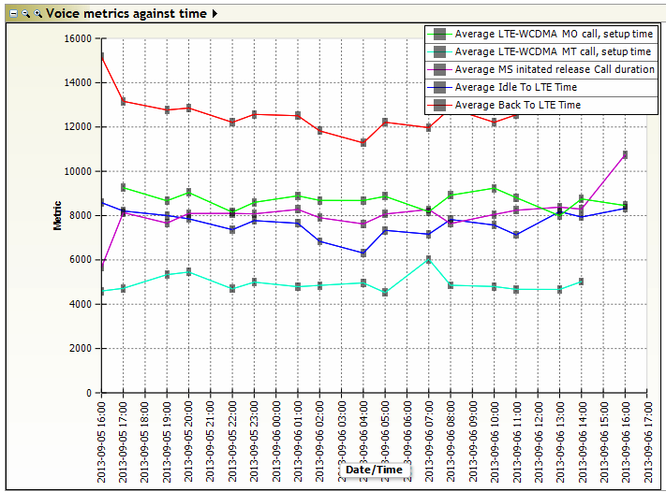
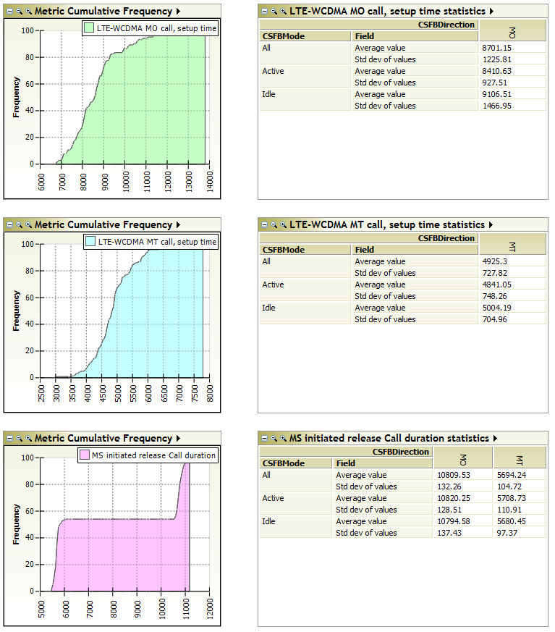
CSFB – some Detailed metrics
Key KPIs
Note many different aspects such as MO/MT/Active/Idle

Slide 49

Regression Testing: Typical Dashboards
A calling B Dashboard
i.e. VoLTE, SMS
Network Status (monitoring)
Or Regression test status
Calling different Locations
Services
Dashboards provide at a glance views into test status:
  Across services
  Across locations
  Over time
General rule: Green indicates success
Locations
Locations
National Service monitoring
Individual Service monitoring
All Services – Over Time
One Service – Over Time
Services
Locations

Slide 50

Inqueries: ali.sassi@ascom.com

Slide 51
LEGAL DISCLAIMER
This document contains specific forward-looking statements, e.g. statements including terms like “believe”, “expect” or similar expressions. Such forward-looking statements are subject to known and unknown risks, uncertainties and other factors which may result in a substantial divergence between the actual results, financial situation, development or performance of Ascom and those explicitly presumed in these statements.
Against the background of these uncertainties readers should not rely on forward-looking statements. Ascom assumes no responsibility to update forward-looking statements or adapt them to future events or developments.

