Slide 1
Bahrain Broadband
Impact of Recent
Cable cut
Eric Dunand
2014

Slide 2
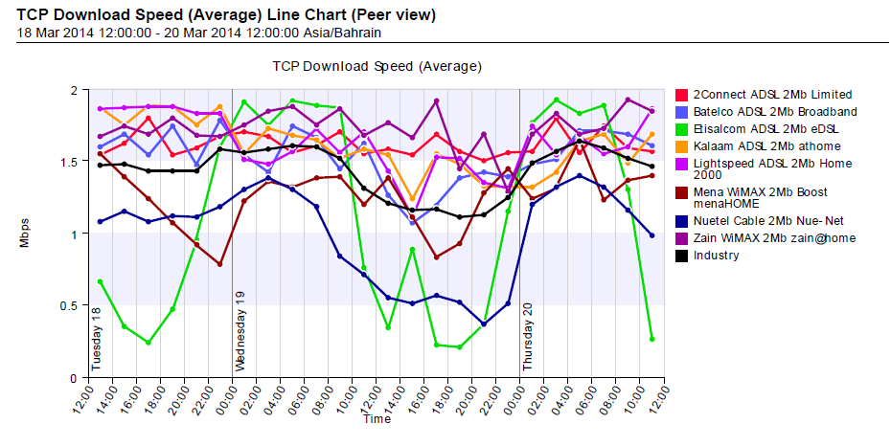
Bahrain monitoring system measurements

Slide 3
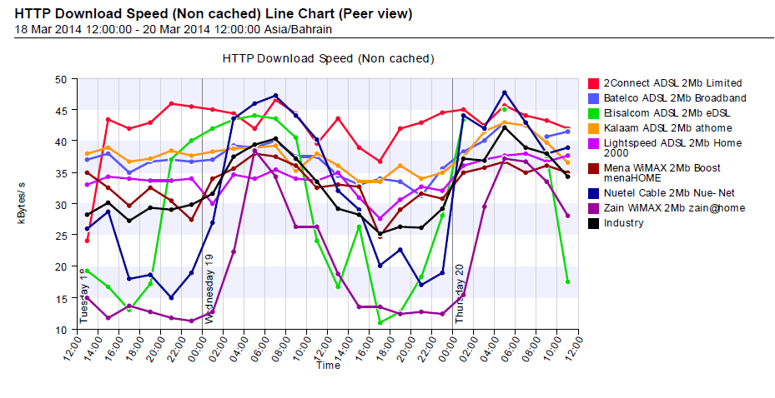
Bahrain monitoring system measurements

Slide 4
Bahrain Internet Ecosystem
Data provided by Jim Cowie

Slide 5
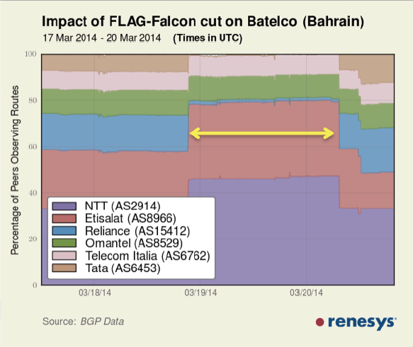
Routes affected by Falcon cut

Slide 6
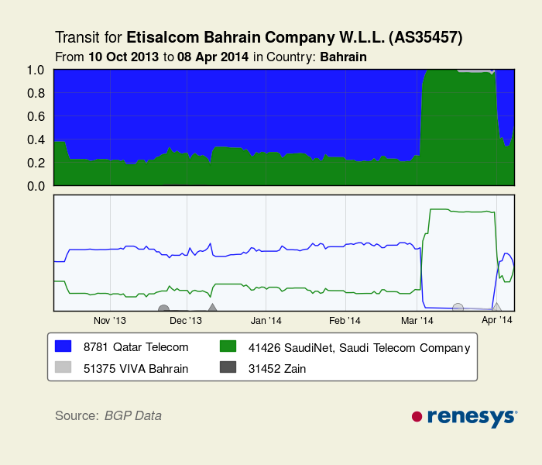
Routes affected by Falcon cut

Slide 7
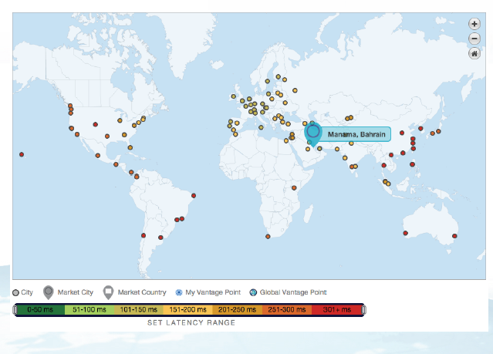
Typical Network Latencies from Bahrain

Slide 8
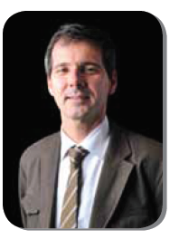
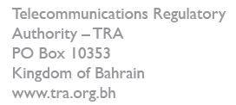

Slide 9
Thank You..!

