Slide 1
SOLUTIONS FOR ADDRESSING THE COMPLEX QoS CHALLENGE RPM SYSTEM Revolutionary QoS monitoring Tool for Telecom Regulators
PLANET NETWORK INTERNATIONAL
Presented by : CHRISTIAN BLANCHARD

Slide 2
Contents
Service and QoS Definition
QoS Measurement
Relationship between NP and QoS Existing QoS solutions and their limits
Quest for Effective QoS Monitoring Solutions
RPM System Overview
RPM system vs other QoS solutions

Slide 3
QoS OVERVIEW
QoS DEFINITION and MEASUREMENT
WHAT IS QoS ?
Quality of Service (QoS) as defined in CCITT Recommendation E.800 [1]
« QoS is the collective effect of SERVICE PERFORMANCE which determine the degree of satisfaction of a user of the service »
Levels of quality of Service in telecommunications
Intrasec Quality of Service
Perceived Quality of Service
Assessed Quality of Service (QoE )
(QoS for mobile operators)
QoS for Regulators
(QoS for end users )

Slide 4
QoS OVERVIEW
QoS MEASUREMENT
ITU definition in 1994 in ITU-T Recommendation E-800 (First in Telephony)
Service Qualification based on six 6 primary components:
90%
Network related QoS criteria
Operability,
Accessibility,
Retainability,
PERFORMANCE
Integrity,
Security,
Support.
10%
Non network related QoS criteria
ASSURANCE
Measure of QoS Definition
Measure of Quality of Service can be briefly defined as the measurement of two main indicators :
Key Performance indicators (KPIs)
Key Quality Assurance Indicators (KQIs)

Slide 5
QoS OVERVIEW
Network Provider
USER/CUSTOMER
Service Provider
Network Related Criteria
QoS
Requirements
Network Performance objectives
QoS
Offered
Non Network Related Criteria
QoS
Achieved
Network Performance Measured
QoS
Perceived

Slide 6
QoS OVERVIEW
all of them are nested
Regulator
Operators
End users

Slide 7
QoS Measurement
Several Methods for evaluating the QoS of operators
QoS Classic approach
Assessing the coverage, capacity and Quality of Service (QoS) of a mobile radio network
Benchmarking, Network optimisation and Troubleshooting, Fine-tuning Network parameters for newly deployed sites.
Drive Test
Qualifying a given service from the acess point through to PSTN from an end users perspective.
QoE, Interoperability between mobile operators, benchmarking.
End to End Measurement
Aimed at assessing the end-user's perception and acceptance of services.
QoE, Benchmarking.
End user surveys
Churn – Rate Monitoring
Determine the degree of satisfaction or dissatisfaction of a user of a service.
QoE, Check on Customer support reactivity.

Slide 8
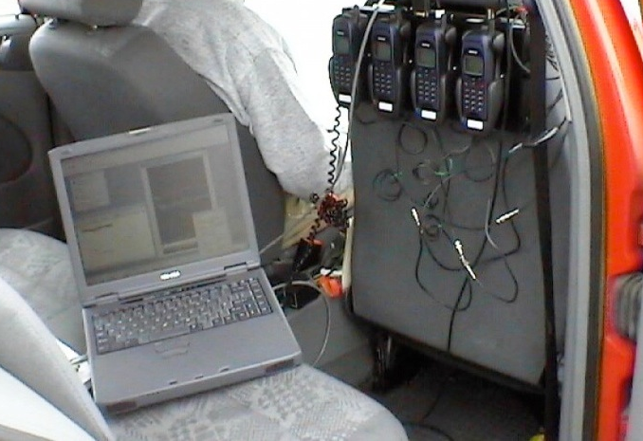
Limits of existing QoS Solutions
Several methods for evaluating the QoS of operators
Drive Test
cumbersome equipment and high cost in maintenance and upgrade
partial view of the network at any given time
inaccessible areas are left out drive test campaigns
post-processing downtime
limits to air interface and user equipment
Reports are not actionable
limits

Slide 9
Limits of existing QoS Solutions
Several methods for evaluating the QoS of operators
End to End Measurement
high cost of implementation
consumes lots of human resources and time
results are subjective and dependant on external environmental factors
lots of human related errors during perception judgement
partial view of the network at any given time
… etc
Limits

Slide 10
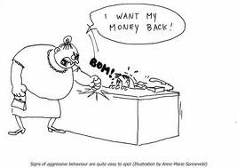
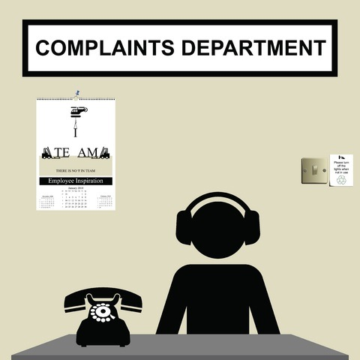
Limits of QoS Solutions
Several methods for evaluating the QoS of operators
End user survey and Churn – Rate Monitoring
uneven representation of endusers
post processing could be nearly impossible given locations of data collection and processing offices
inaccessible areas are left out during surveys
… etc
Limits

Slide 11
Quest For Better QoS Monitoring tool
Questions that keeps Regulators up at night that no one has answers to…
How can we create a level playing field for all operators and protect the interest of all consumers not just those in the urban areas.
How can we monitor simultaneously 24H/7 the state of all network elements/acess technologies in an operator network passively without compromising their daily operations
How can we control service degradation and sometimes outages to the benefit of the government and the masses.
Any system or platform out there that can monitor the performance of mobile operators independent of the vendor and technology
Flexible Benchmark Audit weekly, monthly or quarterly.
Track the evolution and expansion of the mobile operators network.
Reduce churn rate of endusers directly or indirectly
A robust platform or system that is easily upgraded to meet the rapid evolution of mobile technology.
A platform that will facilitate actionable decision making to the benefits of all parties involved with little or no running costs.
RPM SYSTEM provides answers to these questions and more

Slide 12
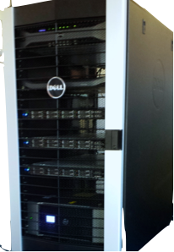
Unmatched Revolutionary QoS Monitoring Tool
Regulators’ (QoS) Performance Management System is the perfect and novel solution that handles the task of interfacing all the operators’/service providers’ network monitoring systems, collect perfomance data records and create KPI reports that renders a given network performance against published benchmarks.
Main Features
QoS monitoring and reporting 24/7 all year round
Unlimited number of Users/ Single License
Multi vendor Multi access technology
Automatic Reporting and 3D GIS display(compatible with google earth
Friendly and intuitive web user interface
No running costs and upgrades easily as mobile access technology evolves
Built in compliance with ETSI TS 102 250-4

Slide 13
System architecture
WHAT IS CONSISTS OFF?
OMC Data
OMC Data
1-Data acquisition
2-Data Processing and Organisation
3-Data handling
Intranet/Internet (secured ssh/https )
Aministrator
User 1
User…n

Slide 14
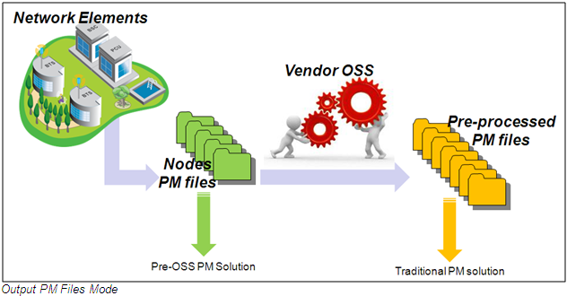
Raw Data Collection
Raw Data Acquisition
RPM server

Slide 15
RPM System vs other QoS solutions
Other QoS Solutions are only complementary to RPM System.
 | RPM SYSTEM | DRIVE TEST/WALK TEST | SURVEY/CHURN RATE
24H/7 Active/ Passive Monitoring | ooooo | —— | —-
Timeliness of Data / Qos reports | ooooo | oo | oo
Benchmarking / Actionnable decision making | ooooo | o | o
Real Network Coverage measurement | o | ooooo | ——
TRACK operators Network Expansion | ooooo | —— | ——-
Running Costs | ——- | ooooo | ooooo
QoS solutions
CRITERIA
RPM SYSTEM gives the Regulators the EDGE in QoS monitoring.

Slide 16
