Slide 1

Evaluating the QoS of mobile Internet
Methodology and tools for 3G networks
Case of Morocco
ITU Workshop on
“Benchmarking QoS evaluation of Multimedia Networks”
(Ouagadougou, Burkina Faso, 18 July 2013)
Hassan TALIB
Vice-Chair ITU-T SG 12
talib@anrt.ma // htalib@ties.itu.int

Slide 2
Presentation outline
Introduction: Basic principles of QoS
The 3G mobile Internet service in Morocco
Types of measurement:
  3G mobile Internet on PC
  3G mobile Internet on smartphones
  FTP or HTTP measurements
Indicators measured (definitions)
Measurement server platform
Measurement tools
  Conclusions and recommendations
Ouagadougou, 18 July 2013

Slide 3
Basic principles for monitoring of QoS/QoE at ANRT
QoE mechanism: QoE portal and downloadable applications
Adoption of a communication strategy (publications)
An international regulatory framework (standards):
ITU-T: series E, G, P, Y, QoS handbook, ...
Regional: ETSI
(series EG), IEEE, …
A national regulatory framework:
Duties
Operators’ QoS obligations
Benchmarking of best practices and technology watch
ANRT regularly monitors QoS
User feedback:
Complaints
Media
Consumer associations
…
Analysis of data received from operators in terms of performance, KPI and QoE measurements
Field measurements (campaigns) conducted by ANRT
Ouagadougou, 18 July 2013

Slide 4
Basic principles of QoS monitoring
Establishment of a global mechanism for receiving KPIs from operators: all networks and all services
Complete operational model of KPI data based on pre-established time intervals
Elaboration of reference documents, agreed by all players, setting out the QoS field measurements
Controlled externalization of measurements and use of results by operators
Ouagadougou, 18 July 2013

Slide 5


Basic principles of QoS monitoring
The methodology used for evaluating QoS data for 3G networks (UMTS or CDMA2000 on PCs or smartphones) is perfectly valid for future generation mobile networks:
4G ( ),
Wifi Outdoor (offloading ),…
Ouagadougou, 18 July 2013

Slide 6
Presentation outline
Introduction: basic principles of QoS
The 3G mobile Internet service in Morocco
Types of measurement:
3G mobile Internet on PC
3G mobile Internet on smartphones
FTP or HTTP measurements
Indicators measured (definitions)
Measurement server platform
Measurement tools
Conclusions and recommendations
Ouagadougou, 18 July 2013

Slide 7
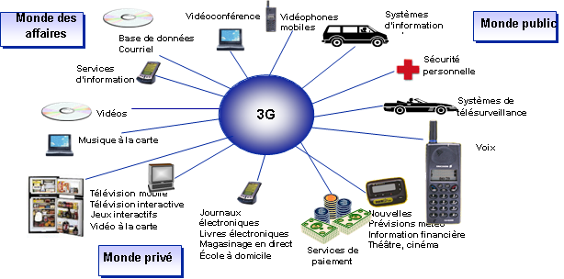
The 3G mobile Internet service in Morocco
Three 3G operators (global operators):
  Itissalat Al-Maghrib (Maroc Telecom) and Médi Telecom: UMTS technology
  Maroc connect (Wana Corporate): CDMA-2000 technology.
3G services, launched in Morocco in March 2007, will enhance development of the Internet in Morocco
Business sector
Videoconferencing
Mobile videophones
Information
systems
Public sector
Database
E-mail
Information services
Personal security
Video
Remote surveillance systems
Music on demand
Voice
Mobile TV
Interactive TV
Interactive gaming
Video on demand
E-newspapers
E-books
Online shopping
Home schooling
News
Weather forecasts
Financial information
Theatre, cinema
Private sphere
Payment services
Private sphere
Ouagadougou, 18 July 2013

Slide 8
The 3G mobile Internet service in Morocco
Growth in the Internet subscriber base and penetration rate
ADSL
3G Internet
Other Internet offers
Subscriber base for other Internet offers
ADSL subscriber base
3G Internet subscriber base
Internet penetration rate
The Internet subscriber base has seen sustained growth, particularly over the past four years.
This growth is essentially due to the development of 3G mobile Internet offers.
Of the over four million subscribers, almost 82% currently use 3G mobile connections as against 17.8% for fixed ADSL.
8
Ouagadougou, 18 July 2013

Slide 9
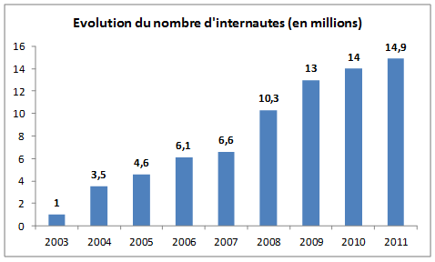
The 3G mobile Internet service in Morocco
Growth in the number of Internet users (millions)
14.9
10.3
6.1
6.6
4.6
3.5
Ouagadougou, 18 July 2013

Slide 10
The 3G mobile Internet service in Morocco
International bandwidth and domain names
Growth in the number of ".ma" domain names
300 000
250 000
200 000
150 000
100 000
50 000
March 13
The number of ".ma" domain names continues to grow, standing at 48 104 accounts at end March 2013.
Domain names created directly under the extension ".ma" predominate.
International Internet bandwidth has seen a remarkable 113.83% growth rate in 2012, with a capacity of 266 000 Mbps.
10
Ouagadougou, 18 July 2013

Slide 11
Decrease in the average Internet invoice
The 3G mobile Internet service in Morocco
The average monthly invoice per Internet customer fell by 73% from 2008 to 2012, standing at
42 DHHT (dirhams pre-tax) at end December 2012 as against 154 DHHT/month/
customer at end 2008.
For 3G Internet, the average invoice at end 2012 amounted to 27 DHHT/
month/customer as against 100 DHHT at end 2008, a decrease of 72%.
The ADSL Internet invoice fell from 165 DHHT/month/
customer at end 2008 to 111 DHHT at end 2012, a decrease of 33%.
3G Internet
Ouagadougou, 18 July 2013

Slide 12
Presentation outline
Introduction: basic principles of QoS
The 3G mobile Internet service in Morocco
QoS measurements – types and conditions:
  3G mobile Internet on PC
  3G mobile Internet on smartphones
  FTP or HTTP measurements
Indicators measured
Measurement server platform
Measurement tools
  Conclusions and recommendations
Ouagadougou, 18 July 2013

Slide 13
QoS of 3G mobile Internet
QoS measurements - types and conditions:
  3G mobile Internet on PCs: USB dongles (prepaid or postpaid) on computers, for UMTS or CDMA-2000.
  3G mobile Internet on smartphones: SIM/3G for subscribers using smartphones/tablets, for UMTS only.
  Measurements in FTP or HTTP mode: carried out using files of specific sizes for the purposes of the measurements (upload/download):
  1 MB, 5 MB, …
Ouagadougou, 18 July 2013

Slide 14
QoS of 3G mobile Internet
QoS measurements - types and conditions:
  Evaluation of QoS ≠ Evaluation of coverage.
  Measurements are to be taken only in areas declared as being covered by all the operators concerned: exercise involving geographic sampling and coverage mapping.
  The coverage mapping exercise is to be carried out by district, not by town/city.
Ouagadougou, 18 July 2013

Slide 15
Presentation outline
Introduction: basic principles of QoS
The 3G mobile Internet service in Morocco
Types of measurement:
  3G mobile Internet on PC
  3G mobile Internet on smartphones
  FTP or HTTP measurements
Indicators measured
Measurement server platform
Measurement tools
  Conclusions and recommendations
Ouagadougou, 18 July 2013

Slide 16
QoS of 3G mobile Internet
What are the relevant indicators for each type of measurement?
  Jitter, delay, rate, data losses, …?
  Pragmatic objectives (determined by means of satisfaction surveys) of relevance to the user experience: measurement of accessibility (connection ratio and time), reliability and speed (transmission and reception rates).
  Conversion of these data items into ten indicators:
Ouagadougou, 18 July 2013

Slide 17
QoS of 3G mobile Internet
List of the ten indicators measured:
  Successful connection rate: a connection is successful when it is set up in less than one minute. The successful connection rate is calculated on the basis of all of the measurements taken.
  Successful connection in under ten seconds rate: the successful connection in under ten seconds rate is calculated on the basis of all of the measurements taken.
  The rate for 1 MB files transferred in less than two minutes: a file is considered to have been sent when it has been transmitted in its entirety, and with its content in order, within a period Dmax. The rate is calculated on the basis of the total number of files sent.
  The rate for 5 MB files received in less than five minutes: a file is considered to have been received when it has been downloaded in its entirety and with its content in order. The rate is calculated on the basis of the total number of files downloaded.
Ouagadougou, 18 July 2013

Slide 18
QoS of 3G mobile Internet
List of the ten indicators measured:
  Data rate achieved for 90% of 5 MB files sent: corresponds to the 90th percentile of files sent.
  Data rate achieved for 50% of 5 MB files sent: corresponds to the 50th percentile of files sent.
  Data rate achieved for 10% of 5 MB files received: corresponds to the 10th percentile of files sent.
Ouagadougou, 18 juillet 2013

Slide 19
QoS of 3G mobile Internet
List of the ten indicators measured:
  Data rate achieved for 90% of 5 MB files sent: corresponds to the 90th percentile of files sent.
  Data rate achieved for 50% of 5 MB files sent: corresponds to the 50th percentile of files sent.
  Data rate achieved for 10% of 5 MB files received: corresponds to the 10th percentile of files sent.
Ouagadougou, 18 juillet 2013

Slide 20
QoS of 3G mobile Internet
Measured indicators:
  Important note:
  The data rate for 3G networks is shared among users. The data rate actually used is always lower than the theoretical data rate (as marketed). This is due to technological constraints.
  However, this data rate is measurable for all operators, using the same mechanism.
Ouagadougou, 18 juillet 2013

Slide 21
QoS of 3G mobile Internet
Supplementary indicator: Rate of use of contractual data rate, corresponding to the ratio of the data rate actually used (observed) to the contractual rate (marketed) with a given operator. The ratio is expressed as a percentage.
Actual example for a 3G network:
Data rates observed vs. data rates marketed (%) (Rate attained for 50% of files received)
Marrakesh
Fez
Tangiers
National
average
Ouagadougou, 18 juillet 2013

Slide 22
Plan de la présentation
Introduction: Basic principles of QoS
The 3G mobile Internet service in Moroccco
Types of measurement:
  3G mobile Internet on PC
  3G mobile Internet on smartphones
  FTP or HTTP measurements
Indicators measured
Measurement server platform
Measurement tools
  Conclusions and recommendations
Ouagadougou, 18 juillet 2013

Slide 23
QoS of 3G mobile Internet
Measurement server platform:
  Measuring the performance of a 3G mobile Internet network means measuring the QoS of a connection, via that network, between a terminal and a data server.
  Various external factors may affect any given test path segment, and this may lead the operator concerned to challenge the measurement results.
  The option of using an international server for measurement must be ruled out.
Ouagadougou, 18 juillet 2013

Slide 24
QoS of 3G mobile Internet
Measurement server platform:
  Problem: lack of a server (available to hosting providers) at the national level with simultaneous connections to all networks and with a capacity exceeding the highest available data rate!
  Solution: design a measurement server platform to operate within the regulator’s premises, with link capacities exceeding the data rates measured (e.g. 10 Mbps to measure 7.2 Mbps and 20 MBps to measure 14.4 Mbps).
Ouagadougou, 18 juillet 2013

Slide 25
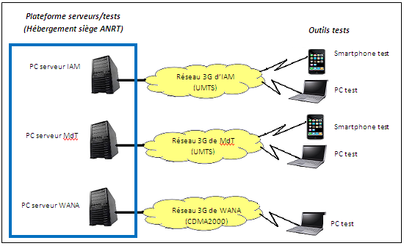
QoS of 3G mobile Internet
Server platform:
All test files are installed in each platform server, with a fibre-optic connection to the operator’s 3G network.
Test server platforms
(hosted at ANRT HQ)
Test tools
IAM PC server
IAM 3G network
(UMTS)
MdT PC server
Mdt 3G network
(UMTS)
WANA PC server
WANA 3G network
(CDMA2000)
Ouagadougou, 18 juillet 2013

Slide 26
Presentation outline
Introduction: Basic principles of QoS
The 3G mobile Internet service in Moroccco
Types of measurement:
  3G mobile Internet on PC
  3G mobile Internet on smartphones
  FTP or HTTP measurement
Indicators measured
Measurement server platform
Measurement tools
  Conclusions and recommendations
Ouagadougou, 18 juillet 2013

Slide 27
QoS of 3G mobile Internet
Measurement tools (precautions)
  Terminal equipment (PCs, smartphones and USB dongles) - selection criteria:
    Selection from among the most widely used mass-production models in the domestic market.
    Performance must in all cases accommodate the higher data rates to be measured. For PCs (OS, firewalls, antivirus, etc.) and for terminals (Twindowsize, MTU, CPU , RAM, etc.).
Ouagadougou, 18 juillet 2013

Slide 28
QoS of 3G mobile Internet
Measurement tools (precautions)
  Subscription types taken into account:
    Postpaid or prepaid.
    Be aware of possible data rate downgrade if total download volume reaches threshold values.
    Tests on smartphones must be done in forced 3G mode rather than dual mode (avoid confusion with GPRS or EDGE).
    For each operator (one server and one link), a single measurement at a time is to be taken.
Ouagadougou, 18 juillet 2013

Slide 29
QoS of 3G mobile Internet
Measurement tools
  Software application (agents installed in terminals, i.e. PCs and smartphones):
    At each data connection, the application provides feedback to allow automated calculation of all QoS indicators for that connection (field level, SC, failures, successes, etc.), and the GPS location.
    The application allows direct and automatic storage of all results (indicators) on a server which centralizes reporting for the dedicated portal.
Ouagadougou, 18 juillet 2013

Slide 30
Presentation outline
Introduction: Basic principles of QoS
The 3G mobile Internet service in Moroccco
Types of measurement:
  3G mobile Internet on PC
  3G mobile Internet on smartphones
  FTP or HTTP measurement
Indicators measured
Measurement server platform
Terminal equipment
  Conclusions and recommendations
Ouagadougou, 18 juillet 2013

Slide 31
Conclusions and recommendations
Recommendation 1
  Continuous consultations on methodology with operators upstream. Adoption of a standard coordinated follow-up procedure.
Recommendation 2
  Details of measurement sites or periods are not communicated to any operator.
Ouagadougou, 18 juillet 2013

Slide 32
Conclusions and recommendations
Recommendation 3
  Perform a large number of demonstration QoS measurements using the same tools as those used in real measurement campaigns, preferably in the presence of representatives of the operators concerned (to minimize the likelihood of subsequent challenges by operators).
Ouagadougou, 18 juillet 2013

Slide 33
Conclusions and recommendations
  Recommendation 4
  Operator action: positive use of results by operators (use of the test server platform; possible operator funding of campaigns).
  Recommendation 5
  Publish (comparative) results, adopt a communication strategy and consider possible sanctions as a last resort in the event of anomalies.
Ouagadougou, 18 juillet 2013

Slide 34
Conclusions and recommendations
  Recommendation 5 (continued)
  Publication of measurement results:
Initial voice campaign based on a broad sample (30 or so urban centres and populated areas such as airports, tourist centres, etc.)
First quarter.
Second campaign, similar to the first, using more or less the same sample.
Last quarter.
Communicate results to
operators
Allow 5 to 6 months for correction
of anomalies identified
by ANRT
(Publication of results and communication)
Ouagadougou, 18 juillet 2013

Slide 35
Thank you for your attention.
Questions/Answers
talib@anrt.ma // htalib@ties.itu.int
Ouagadougou, 18 juillet 2013

