Slide 1

Data Testing Methodology and Analysis Guidelines for Mobile Networks- A Case-study of Ghana’s Regulator
31st ITU-T SG12 QSDG Meeting & Workshop
(Dubai, UAE 2-3 November 2014)
Samuel K. Agyekum, QoS Officer, NCA
samuel.agyekum@nca.org.gh

Slide 2
Presentation Outline
Data Test Measurement System (Test-MS)
Overview & Architecture
Hardware Components & Interface
Data Test Measurement methodology
Measurement Profile & Sequence
Measurement Configuration
Post-Processing System (Post-PS)
Parameter Definitions, Formulae & Targets
Analysis & Reporting- Data Test Case Study of Ashanti Region of Ghana
Appendix

Slide 3
Data Test Measurement System- Overview & Architecture
ASCOM MTP-4 Symphony is equipped with:
MTP-4 mainboard that contains powerful processors and different measurement interface modules (MIFs) containing Sierra Minicard 7710/ Huawei EM6600
external antenna
external GPS

Slide 4
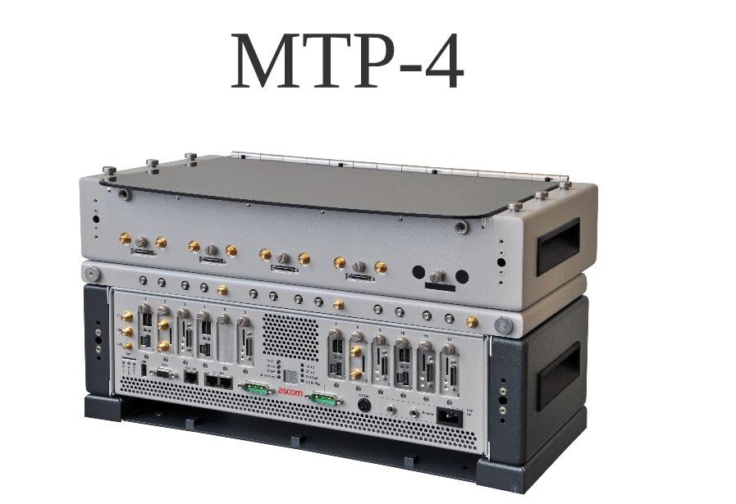
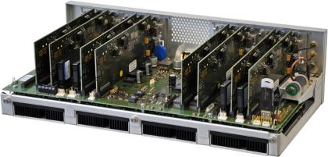
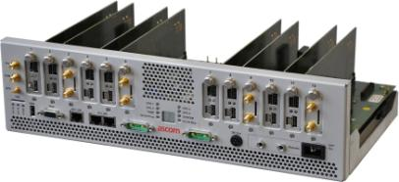
Test MS- Hardware & Interface
MIF modules
4 x CPU

Slide 5
Test Methodology-
(Measurement Profile & Sequence)
Measurement profiles define a set of conditions that must be verified in order to correctly assess the quality of service and to guarantee the reliability of the tests.
They also include process standardization and the definition of testing and measurement parameters, thus making it possible to perform analyses and compare results.
Test is conducted in a technology-neutral stationary mode and requires no channel/band locking
A 10MB txt file on a remote ASCOM server is downloaded via FTP link followed by an HTTP browser session to a google and yahoo server.

Slide 6
Test Methodology-
(Measurement Configuration)
FTP DL |  | HTTP
Sample Time (s) | 1000 | Count | 1
Activity mode | True | Measurement duration (s) | 30
Measurement duration (s) | 90 | Pause duration (s) | 10
FTP Public |  | Consider MMD failed | True
Remote file | 10MB.txt | Proxy
FTP to QVS |  | HTTP to QVS page | QVS 10kB
File type | Binary
File Size | 30kB
File Size Binary | 50

Slide 7
Post-Processing Systems
TEMS Discovery Professional Suite comprises:
SQL-based database server
Client machine containing Release 4.0.13 TDE software
Automatic Data Processing feature
Interconnecting network path

Slide 8
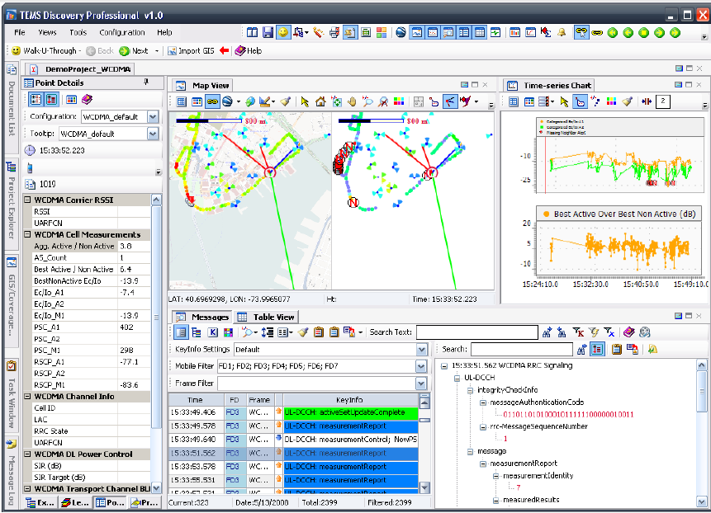

Slide 9
Parameter Definitions, Formulae & Target
Data Access Time
Data Access Time is a measure of the time lapse in activating a PDP Context for data service.
– Moment PDP Accept message is received, point E (see Fig. 1a)
– Moment PDP Request message is sent, point A (see Fig. 1a)
Mathematically, using the TEMS Excel:
Data Access Time [ms]: = percentile [array (PDP Context Activation Time), 1]
Data Access Time should be less than five seconds (<5secs) in 100% of cases.

Slide 10
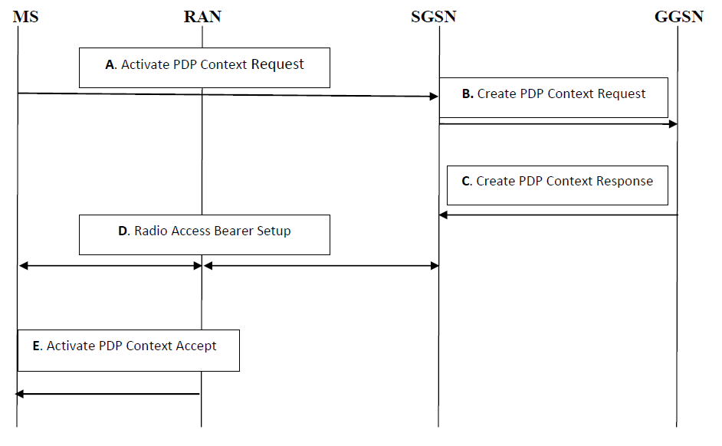
Fig. 1a: Session Setup (UE-side)

Slide 11
Parameter Definitions, Formulae & Target
Date Access Success Rate is the probability of success in connecting to the public server.
Data Access Success Rate =(No. Of “Successful” PDP Context Activations)/(No. Of PDP Context Activation Requests)
Data Access Success Rate should be equal or better than ninety five per cent (95%)

Slide 12
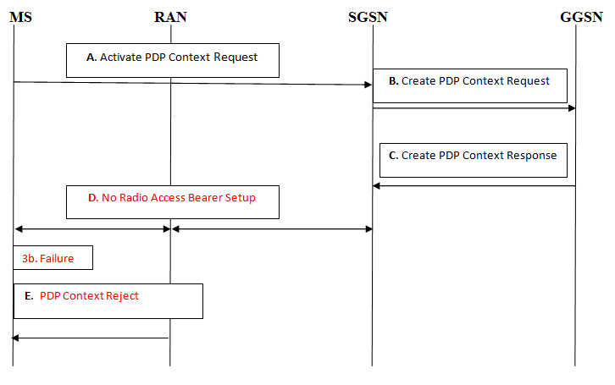
Fig 1b: Session Setup (UE side)

Slide 13
Parameter Definitions, Formulae & Target
Data Drop Rate is the probability to drop in connection to public server without end user’s intervention
Data Drop Rate = (No. Of “aborted” PDP Context Activations / (No. Of PDP Context Activation Requests)
Data Drop Rate should be equal or less than one per cent (1%).

Slide 14
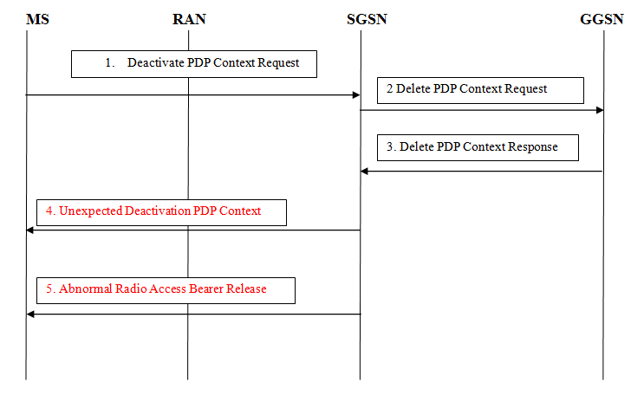
Fig 1c. “Aborted” Session-in-progress (UE-side)

Slide 15
Parameter Definitions, Formulae & Target
Throughput is the rate of data transfer.
Mathematically, using the TEMS Excel report: Throughput [kbps]: = percentile [array (Mean DL Throughput), 1]
As per the QoS Regulations and National Broadband Policy the minimum data transfer rate for at least 90% of data connections should be 1.00 Mbps

Slide 16
Analysis & Reporting- Ashanti Region CASE STUDY
QoS monitoring for data service provisioning was conducted at 10 hotspot locations in the Ashanti Region from 5th to 12th April 2014 from 10:00am to 4:00 pm.
Below are the findings as performed on MTN:
Total data requests
# PDP Context Activation Requests = 347
Packet data succeeded(in counts)
PDP Context Activated = 347
Packet data failed (in counts) = 0
Data Access Success Rate (%)= #PDP Context Activated / #PDP Context Activation Requests = 347/347*100% = 100%
Packet Data dropped (in counts)
#PDP Context Aborted= 0
Data Drop Rate = #PDP Context Aborted/# PDP Context Activation Requests = 0/347 * 100 = 0%

Slide 17
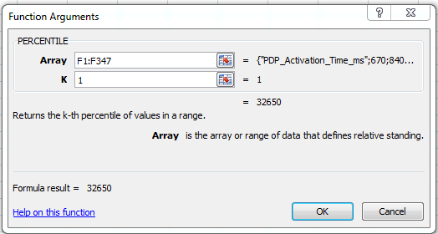
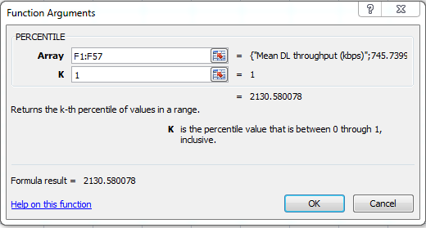
Analysis & Reporting- Ashanti Region CASE STUDY
Data Access Time (ms) = percentile [array (PDP Activation Time), 1]
= percentile [(F1:F347,1)] = 32650 ms.
The “Operator” failed to meet its target for Data Access time due to poor coverage leading to ping-pong cell –reselections.
Throughput [kbps]: = percentile [array (Mean DL Throughput), 1]
= percentile[(F1:F57,1)] = 2130 kbps

Slide 18
Analysis & Reporting- Ashanti Region CASE STUDY
The summary of the results of the four data KPIs under consideration for “OPERATOR” are as in the table below:
Total Data (PDP) Requests | Data Access Success Rate (%) (> or =95%) | Packet data succeeded(in counts) | Data Drop Rate (%) (< or = 1%) | Packet Data dropped (in counts) | Data Access Time (s) (< 5sec) | Throughput (Mbps) ( > or = 1Mbps)
347 | 100 | 374 | 0 | 0 | 32.65 | 2.13

Slide 19
Appendix
TEMS DATA TEST ANALYSIS
STEP 1
Determine “Total Data (PDP) Request” as follows:
Drop-down parameter labeled “Advanced Metric & Event (Pre-defined)”
Drop-down “Discovery Events”
Select “Events”
Select “PDP Activation”
Select “PDP Context Activation Request” NB: Right-click and send to “Table View”
STEP 2
KPI calculation is as follows:
DATA ACCESS SUCCESS RATE
Drop-down Sierra Minicard 7710/ Huawei EM6600
Drop-down parameter labeled “Advanced Metric & Event (Pre-defined)”
Drop-down “Discovery Events”
Select “Events”
Select “PDP Activation”
Select “PDP Context Activations”
Divide count obtained by “# PDP Context Activation Requests”

Slide 20
Appendix
DATA DROP RATE
Drop-down Sierra Minicard 7710/ Huawei EM6600
Drop-down parameter labeled “Advanced Metric & Event (Pre-defined)”
Drop-down “Discovery Events”
Select “Events”
Select “PDP Activation”
Select “PDP Context Activation Abort”
Divide count obtained by “# PDP Context Activation Requests
DATA THROUGHPUT
Drop-down Sierra Minicard 7710/ Huawei EM6600
Select Data Service HTTP/FTP Overall
Select “Mean DL Throughput (kbps)” NB: Right click into “Table View”→ Export to Excel
Data Throughput [kbps]: = percentile [array (Mean DL Throughput), 1]

Slide 21
Appendix
DATA ACCESS TIME
Drop-down Sierra Minicard 7710/ Huawei EM6600
Drop-down parameter labeled “Advanced Metric & Event (Pre-defined)”
Drop-down “Discovery Events”
Select “Metrics”
Select “PDP Activation”
Select “PDP_Activation_Time_ms”
Data Access Time [ms]: = percentile [array (PDP_Activation _Time), 1]

Slide 22
Thank You for your Kind
Attention

