Slide 1
ITU-TQSDG - DUBAI
ASCOM PRESENTATION:
QoS and qoe in lte mobile networks

Slide 2
Who We Are
Independent Auditor
+40
patents
worldwide
1
Next-generation technology
650 Customers Globally
More than
30 patents
worldwide
Wireless network performance
ITU-T
ETSI
VQEG
Innovative
Leader
Formative Player

Slide 3
Agenda
LTE QoE- QoS- KPI MAPPING RELATIONSHIPS
CHALLENGES EMERGING FROM LTE
ASCOM LTE QoS/QoE TESTING APPROACHES
SHARING EXPERIENCE: SOME USE CASES
CONCLUSIONS

Slide 4
LTE QoE-QoS KPI MAPPING RELATIONSHIPS

Slide 5
ASCOM’s APPROACH ON QoS/QoE CYCLE => SAME AS ITU’s
(ITU-T G.1000)
Subscriber
MNO
Alignment gap
QoE Requirements of Subscriber
QoS Targeted by MNO
(Target SLA)
Value gap
QoE/QoS
Cycle
Execution gap
KPIs, QoS
TEMS
QoE Perceived by Subscriber
Perception gap
QoS Delivered by MNO
(Achieved SLA)
Network-centric
Quality (QoS)
Subscriber-centric
Quality (QoE)
QoE
TEMS

Slide 6






LTE QoE- QoS - KPIs MAPPING
Network Performance
Customer Experience
Application Layer
(accessibility, retainability, integrity)
Upper Layers (IP/UDP, IP/TCP)
(throughput, delay
Layer 2&3 MAC, RLC, LLC (reports related to QoE dimensions = PDP context, HO info, codecs)
Physical layer
(coverage, interference)
QoE
QoS
KPIs
Notes:
What is different in LTE?
Myriad new services enabled by smartphones and therefore a new customer experience and perception; e.g: multimedia telephony (VoLTE, VilTE, RCS: integrated SMS, MMS, presence, file sharing etc), adaptive multimedia streaming delivery, LTE broadcast
Flatter architecture (no RNCs)
New IMS network
As a result of all these and the increased complexity, LTE demands a cost efficient top – down evaluation and optimization based on pre-defined QoE-QoS-KPIs mappings per service type

Slide 7
COST EFFICIENT TOP DOWN APPROACH ENABLED BY PRE-DEFINED LTE QoE-QoS-KPIs MAPPINGS
Increased
operational efficiency
Top-down customer experience centric approach
Voice Service: ‘97 Auryst, ‘03 PESQ, ‘12 POLQA
Video-Audio Services: ‘08 VSQI/MTQI, ’12 PEVQ, ‘12 VQmon
Application Layer
(accessibility, retainability, integrity)
QoE
QoS
Network performance KPIs
Upper Layers (IP/User Data Protocol , IP/Transport Control Protocol): Throughput, Delay, Packet Loss, Rebuffering
Layers 2 & 3 messaging reports related to QoE dimensions like PDP context, HO info, codec usage
Physical layer details like
coverage and interference
Reduce troubleshooting time by using QoE centric mapping to QoS and KPIs per service type
7
Notes:
Our approach is top –down, customer experience centric ensuring CAPEX/OPEX optimization and it is based on customized KPIs/QoS/QoE mappings and QoE evaluation metrics developed within ITU-T with us one of the main drivers and contributor for more than a decade.
Let’s take an example: YouTube service
QoE: MOS
QoS: packet loss, re-buffering
See correlation of the MOS behavior vs. re-buffering; therefore re-buffering rather than packet loss is the main cause
Few KPIs to be further analyzed:
- IP: low throughput indicating possible congestion at IP level
- RF: poor coverage or increased interference that can cause retransmissions at TCP level and therefore long delays which could cause re-buffering effects.
KPIs: concept by which network characteristics can be defined, measured, and controlled to achieve a satisfactory level of service quality. Very large number of KPIs; performance information coming from different KPIs will overlap; performance problem generally reflected in the values of a set of KPIs.
QoS: weighted functions of KPIs gathered from various parts of the network and covering categories of a network’s quality: network reliability (availability, accessibility, retainability) and integrity, serving as SLAs.
QoE. Subscribers requirement and perception of the service quality provided by the operator.
Expressed as Mean Opinion Scores (MOS) or as percentages of satisfied subscribers, both of which meaningfully reflect the subjective perception of the quality.
Objective algorithms
Users’ questionnaires

Slide 8
CHALLENGES EMERGing FROM LTE

Slide 9
VoLTE-ViLTE-RCS EXPERIENCE
Call
Experience
(QoE)
Codecs
(KPI)
Network
(QoS /KPI)
Devices
Clients
(KPI)
Call Quality as Perceived by Subscribers
  MOS / ITU-T P.863; J.247 & P.120x.x based (video)
  On device VoLTE client: re-buffering/time scaling for voice; error concealment type for video
  Voice path delay (“mouth to ear”), echo, video – voice lip sync
  RTP Packet loss, latency, jitter
  HOIT (LTE HO, eSRVCC)
  Throughput
  Voice /video codec type and bit rates
  Call control performance
  Session set-up: SIP signaling statistics / IMS Registration, RTT
  Session Accessibility, Retainability
  QCI allocation verification
  LTE RRC connection and HO statistics
Notes:
QoE factors:
Codecs: Adaptive bit rates, Error concealment schemes, Voice triple bandwidth, Video compression schemes
Terminals/devices/clients: Time scaling for HOIT and PL concealment
Voice Enhancement Devices (AGC, NR, EC), Multiple video resolutions, bit and frame rates, displays (3D trends)
Network: IMS: mobility (MME-HSS diameter signaling for authentification/authorization), LTE data centric only moving to LTE data + voice –
HOIT 100ms-300ms (Inter/I-RAT, retransmissions, bursty call path routing changes resulting in packet lost and out of sequence – jitter/delay and loss;

Slide 10

MOBILE VIDEO STREAMING EXPERIENCE
Codec types:
    High
    Low
    Adaptive bit rates
Network centric:
    Packet loss
    Jitter
    Allocated GBR and QCI
    HTTP/TCP vs. RTP/RTSP
      Devices & Clients
      Different form factors
      Different 2D/3D displays
      Different adaptive error concealment schemes
Service-Centric
    Wide variety of content & bit rates

Slide 11
VoLTE QoE AND ITS ROOT CAUSES (QoS, KPIs SOURCES)
Perceived
frequency
Spectrum (QoE)
Interruptions (QoE)
(incl. time clipping)
“Mouth to ear delay” (QoE)
Perceived call session performance (QoE)
Noisiness (QoE) (incl. musical noise)
Network (QoS):
Limited
Bandwidth
Network (QoS/KPIs)
(IP/IMS loss, jitter, RAN erroneous bits, RAN HO)
Network (QoS)
(IMS path can be key contributor)
Network (QoS):
Limited BWD with noisy speech (speech contamination)
IMS network (QoS/KPIs): SIP statistics, IMS registration
Device (KPIs):
Spectral
shaping
Reverberations
Device based signal process-ing (KPIs) (e.g. NR, EC)
Codec/device signal processing (KPIs)
Device (KPIs):
Imperfect NR (musical noise)
Loudness during silent periods
Non-optimal loudness levels
Codec/client (KPIs):PL concealment schemes Aggressive VAD schemes
ITU-T on going work:
G.VoLTE,
P.TCA (Technical Cause Analysis)
Codec/client (KPIs)
PLC interpolation based (“additive artifacts”)

Slide 12


MOBILE VIDEO STREAMING QoE AND ITS ROOT CAUSES (QoS, KPIs SOURCES)
Low throughput (limited bandwidth)
QoS
Packet loss, discard, late arrival
IP delays / jitter
KPIs
Video resolutions/re-scaling
Encoding/transcoding rates
Compression schemes
Possible transcoding
KPIs
Limited coverage, interference
Bandwidth estimation algorithms impact the bit rate selection
Content server load,
(competing video streams)
Visual impairments:
Blockiness,
Bluryness,
Jerkiness,
Freezing with and/or without skipping
QoE
Content complexity (variable movement)
KPIs
Client under/over flow;
improper buffer lengths/adaptation length
Initial buffering settings
Perceived service accessibility
/ access time
Display resolutions, form factors

Slide 13
ASCOM LTE QoE/QoE TESTING APPROACHES

Slide 14


UNDERSTAND AND USE ITU-T BASED QoE METRICS
BEST FITTED TO THE SERVICE BEING TESTED
LTE VOICE AND MOBILE VIDEO SERVICES
LTE Broadcast Streaming server
Video stream
(YouTube, eMBMS)
Encoding
IP recordings (RTP KPIs/QoS) synchronized with RAN KPIs
Cellular Voice & Data Network
Decoding
Conversational Video
Solutions
Voice: MOS P.OLQA
Video: MOS PEVQ
Voice
IP transport/payload
parameters
Voice/Conversational Video
Video stream
Full Reference listening media quality evaluation
(intrusive, perceptual) measurement
Direct RTP KPIs/QoS
MOS, media based KPIs
Solutions
Voice: MOS - ITU P.564 based
Video-audio: MOS – P.120x.x based (VQmon)
Non Reference listening media quality evaluation
(non-intrusive, parametric)
MOS, network based KPIs
Notes:
POLQA the standard, is this not enough to take and implement it?
Need to understand the behavior with VoLTE typical degradations (e.g. time scaling) providing VoLTE simulated conditions, select the proper test samples to avoid artificial effects such as speaker bias
Ful Reference for E2E QoE monitoring
Advantages:
Direct estimator of subscriber’s opinion; Quality ensured by the entire network; Requires access only to the end point
Disadvantages:
May push a network to capacity limits; Limited space-time granularity; More difficult media to network behavior correlation
Non Reference (parametric) for troubleshooting in correlation with Full Reference metric
Advantages:
Normal use of the network; High time and space granularity (every 1sec, VQmon); Content - motion based (VQmon); Quick correlation with network behavior; Consistent quality ranking accuracy
Disadvantages:
Lower absolute accuracy; Quality evaluation “one-dimensional,” taking into consideration metrics belonging to a single segment of entire network (generally IP)

Slide 15
SHARING EXPERIENCE: SOME USE CASES

Slide 16
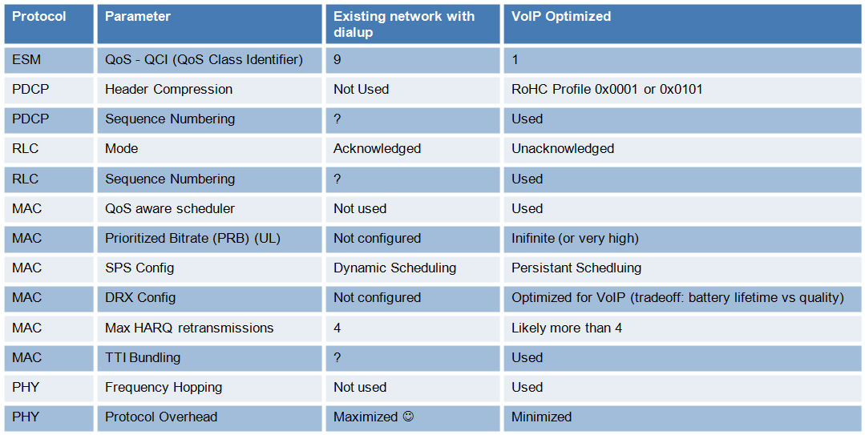
VoLTE MOS SCORE and VoLTE KPI’s/QoS
Speech & Client
centric reasons
Network centric reasons
MOS
Network
Client
Speech
QoE Evaluation & Troubleshooting
TEMS Discovery
Measure: KPIs
Deliver VoLTE
Stack Optimization
TEMS Investigation
TEMS Pocket
POLQA; speech path delay, volume, echo
Client Information (re-buffering, codec)
ESM configuration (QCI, RoHC)
Real time IP trace & L3 logging
IP recording (RTP stats), SIP stats
RAN (HOIT, Scheduling, RSRP, CINR, CQI, PMI/RI, UE category, MTU Size, Protocol stack configuration)
Notes:
We are measuring QoE, QoS and KPIs at all network layers and then post-processing, analyzing and diagnosing the collected data we provide:
Performance statistics
Diagnosis results
Analysis on the optimized VoLTE protocol stack

Slide 17

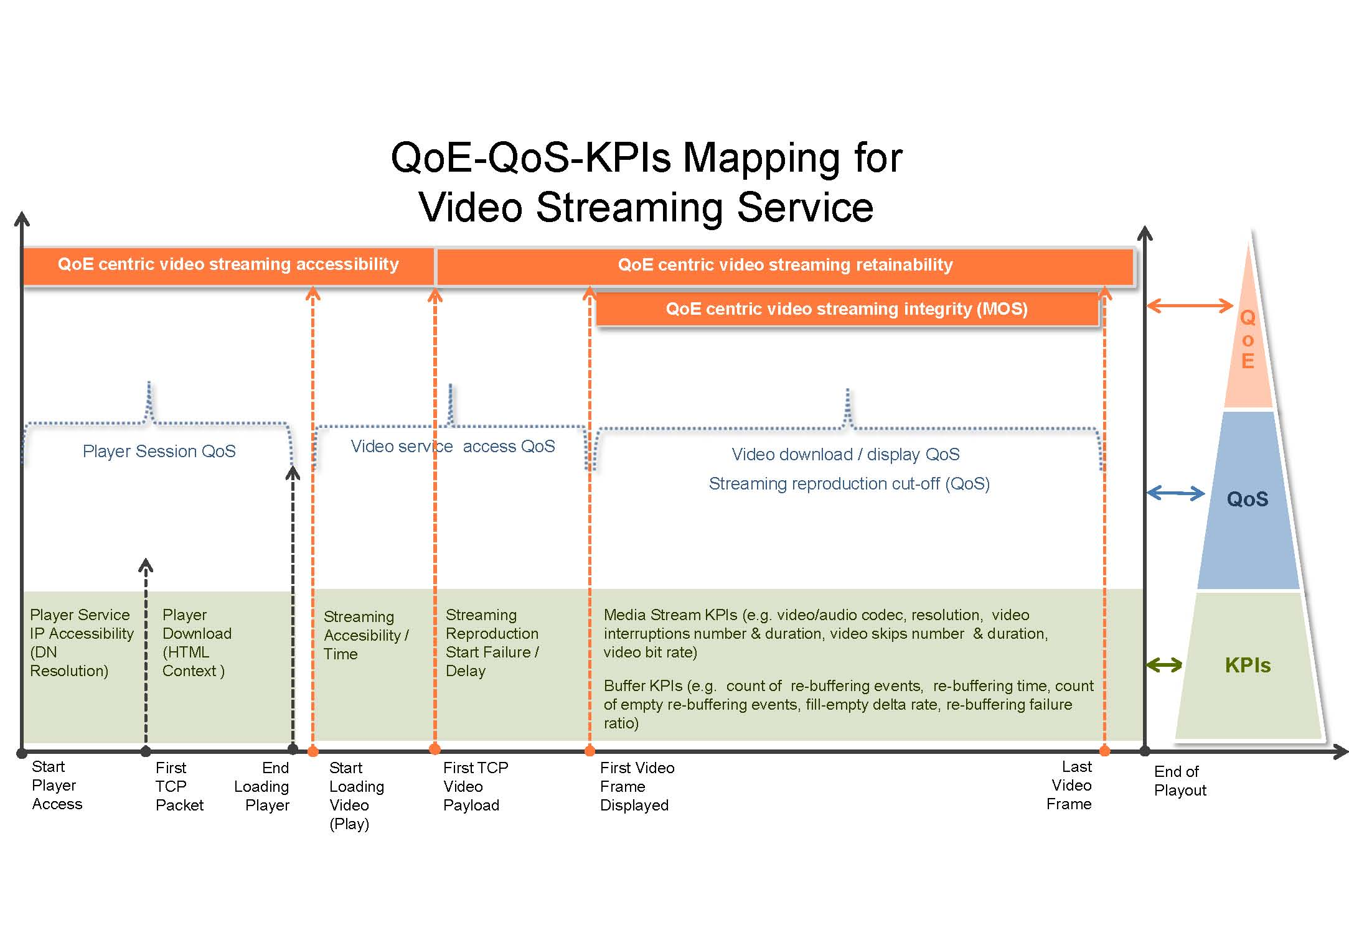
ADAPTIVE STREAMING QoE AND QoS/KPIs
Dynamically
adaptive
HTTP/TCP
ETSI TS 102.250-2,
ETSI TR 101.578 Measurement Guidance for TCP based video services

Slide 18
CONCLUSIONS

Slide 19

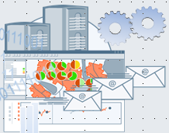
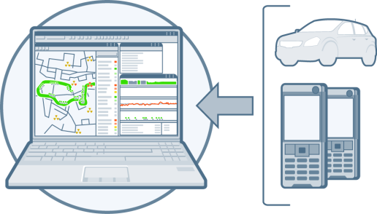


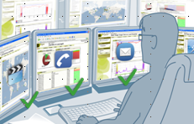
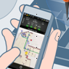
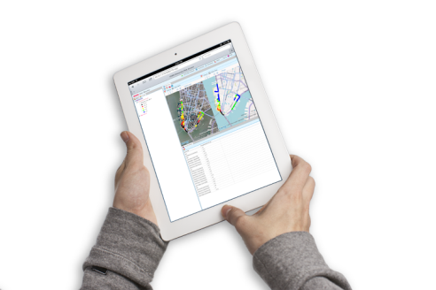
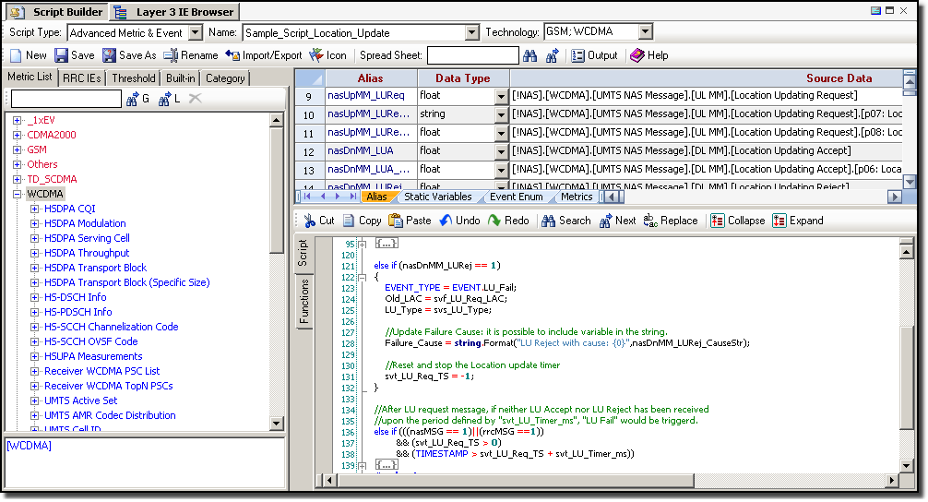

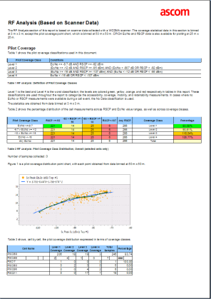
A FULL QoE/QOS CYCLE SOLUTION FOR LTE NETWORK AND SERVICES
My Customer Experience Data
Automated data correlation
and presentation
My competitors’ customers (Benchmark)
  Providing network and customer experience -centric diagnoses for voice (VoLTE, OTT, VoHSPA), and video-audio services (OTT, RCS-e/Joyn)
My customers, real field agents
Built-in best practices scripted data analytics provide automated root cause analysis
Automated “what,” “why” and engineer- trusted “how” scenarios

Slide 20
CONCLUSIONS
  PLEASE VISIT OUR WEBSITE:
  http://www.ascom.com/nt/en/index-nt/about-us-network-testing/nt-about-us-resources.htm/
    White papers: VoLTE, Video Streaming, HetNets, Carrieir Aggregation and...watch the space: LTE Broadcast testing to come soon
    Informa Webinar: Advanced testing with Ascom in LTE networks
    Webinars: VoLTE, Video Streaming

Slide 21
Thank you

