Slide 1
Benchmarking Visualization Platform

Slide 2
The Platform
Brief description

Slide 3
Platform Scope
A Portal containing complete information for the provided telecommunications services nationwide with any Quality Indicator from any source:
Mobile Network Measurements
Fixed Network Measurements
Helpdesk/Directory Services
Any other category
A visualization & benchmarking tool
A blog for posting all the related information (Laws, Announcements, etc)

Slide 4
Platform Technical Description
Based on a CMS (highly customizable, modular architecture, multilingual)
Open source components (Google Maps, d3js Visualization tools)
Responsive Design (bootstrap framework)
Fast Javascript Visualizations and data handling (Angular JS)
Custom advanced visualization techniques (map – multiple charts synchronization, Statistics)
Open Data/Files (Web Services, CSV files)
Database Engine (MS SQL Server)
Notes:
May require more than one slide

Slide 5
Main Platform Advantages
Visitor
Simple Interface and guidance for not specialized visitors
Filter & Present measurements with:
Area / Period / KPI
Administrator
Dynamic design and presentation of any KPI:
Field Properties (Filterable, main, X-axis, Y-axis)
Visualization Type
Integration with common measurement format (CSV, XLS inputs)
Fast response while handling big data
Content Management System for easy Administration
Historically & Multi KPI Comparison
Accessible through Desktop / Tablet / Phone
Advanced Search capabilities
All entities can be related:
Campaigns | KPIs | Measurements | Equipment | Law | Announcements

Slide 6
Now & Next
Current Status & Next Steps

Slide 7
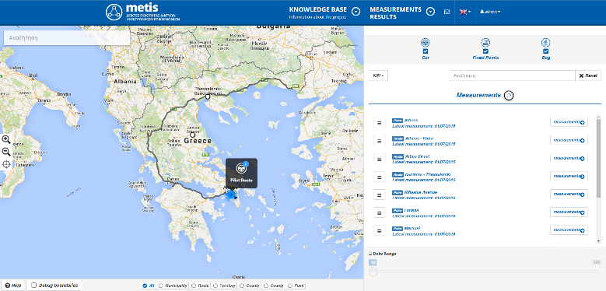
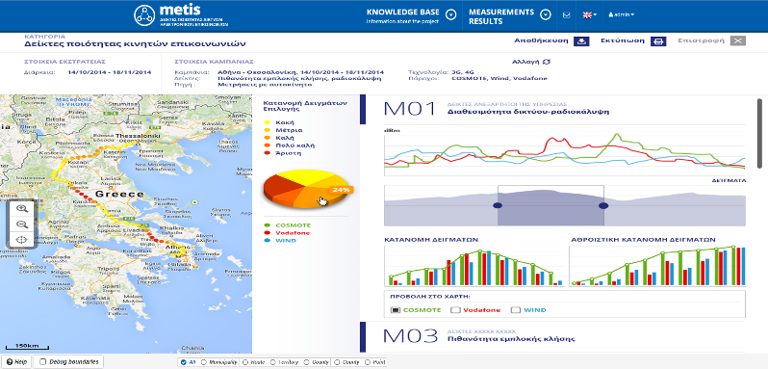
Next Steps
Current Status
Fully operational for one Regulator as a Product
Fully integrated with Anite Nemo equipment
Cloud hosting & SAAS usage
Integration of Crowd Sourcing Measurements
Improved GIS capabilities
Improved Time / Animation Visualizations

Slide 8
Thank you
Artemis ITS SA

