Slide 1
Monitoring QoS & QoE System of Mobile & Fixed Networks
Case study of Greece
Dr. Stavroula Bouzouki
Head of Regional Office of Hellenic Telecommunication & Post Commission

Slide 2
Outline
QoS & QoE concept for NRA
Motivation
Solution (post-process and visualization)
Monitoring System benefits
Future work

Slide 3
NRA and QoS & QoE
Recognizing the importance of this information to users and the telecommunications market in accordance with International Standards and Recommendations of International Organizations, a National Regulatory Authority (NRA) has a duty to take steps to ensure:
The provision of objective information to all entrepreneurship in telecommunications
The healthy competition between providers
NRA
The development of reliable electronic communications networks
The protection of end users

Slide 4
Motivation
The main motives of EETT for the development of a Monitoring QoS & QoE System are the following:
1. The ability to inform the end users objectively regarding the quality of different mobile services of all mobile providers in specific geographical locations
2. To protect the end users through the control of the service provider with whom they are affiliated
3. To strengthen the competition between providers of telecommunications services aimed at improving the provided service quality, availability and geographical coverage of their networks
4. To increase available information and enhance the auditing role of EETT

Slide 5
QoS & QoE measurement methodologies
The QoS & QoE measurement methodologies fall in the following two categories:
Category 1: measurement methodologies with controlled measuring devices for simultaneous measurement of all providers (benchmarking measurements).
Category 2: measurement methodologies from each user terminal device, capable of measuring only the operator of the specific user (crowd sourcing measurements).
The differences between the categories make impossible the comparison of the respective results

Slide 6
Basic features of EETT’s Monitoring System
The implementation covers:
QoS & QoE measurement methodology of category 1
Provision of the move measurements of mobile service quality indicators simultaneously for all mobile providers
Measuring Network of broadband quality indicators at fixed points for all mobile providers, via a dynamic procedure covering all the country
Information for measurements’ control and presentation system
Comparison results
GIS search results
The measurements are performed according ETSI standards and ITU recommendations

Slide 7
Overview of the Project
Project: System for Measurement and Presentation of Quality Indicators for Communication Networks
Budget: € 910.000,00
Duration: 11 months
Consortium: ΑΡΤΕΜΙΣ ITS & VECTOR
  Subcontractors: Anite Finland ltd (Nemo) & University of Piraeus Research Center
  Urbanit

Slide 8
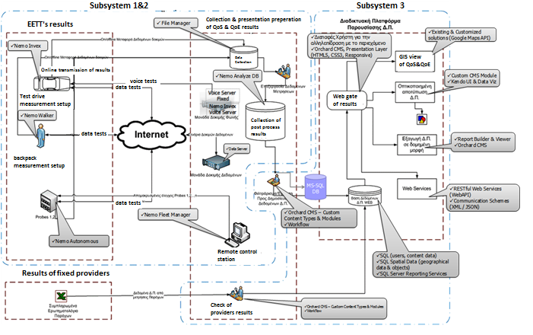
Architecture of Monitoring System (1/2)
High Level Architecture of the Approach
  Sub-System 1: Mobile Measurements Stations
  Sub-System 2: Fixed Measurements Stations
  Sub-System 3: System for the Presentation of Quality Indicators

Slide 9
Architecture of Monitoring System (2/2)
The high level architecture consists of two parts:
A) Measurements Equipment for performing campaigns by EETT (Sub-System 1&2)
B) System for the Presentation of Quality Indicators (Sub-System 3)
Sub-System 1 & 2 carries out quality indicators measurements with the use of mobile and fixed units. Sub-System 3 undertakes the visualization of the results through a Content Management System (CMS). Moreover Sub-System 3 receives and visualizes fixed line measurements from the operators.
Sub-System 1 includes :
  One mobile measurement station (modified vehicle for long distance coverage measurements)
  One mobile measurement station (modified backpack)
Sub-System 2 includes :
  Twenty (20) probes
Sub-System 3 includes:
  Visualization of the Quality Indicators
  Operators' Measurements Results

Slide 10
Technological Solutions for mobile networks
  Nemo Invex - Nemo Walker
  Nemo Invex Outdoor
  Nemo Autonomous / Nemo Fleet Manager
  Nemo Analyze Server / Voice Server / Data Server
  Orchard CMS
  Visualization tools
    Google Maps API
    Orchard CMS custom module for the visualization
    of the quality Indicators
Sub-System 1 & 2
Sub-System 3

Slide 11
Technical Characteristics for mobile networks
Supported Technologies
LTE/LTE-A (FDD/TDD, carrier aggregation)
VoLTE
HSPA+ Dual Cell /HSPA+
GSM, cdmaOne, AMPS
TETRA, iDEN
HSCSD, GPRS, EDGE
WCDMA
CDMA2000 1xRTT, CDMA2000 1xEVDO (Rel. 0, Rev. A, Rev. B)
HSDPA, HSUPA, TD-SCDMA
WiMAX (802.16e)
Measurement Options
CS and PS data measurements
Voice, voice quality PESQ and POLQA (ITU-T P.862.1, WB-AMR, P862.2, ITU-T P.863)
VoLTE voice call support (Qualcomm IMS, Samsung IMS client)
Video call, video call quality, video streaming, PVI video quality streaming, YouTube video streaming, and video streaming analysis measurements (PEVQ-S)
Multi measurements
Indoor measurements
Frequency scanning, pilot scanning, CW scanning and spectrum analyzer measurements
SMS, MMS, and USSD measurements
FTP testing for file transfers (multi-threaded)
SFTP testing for file transfers (download and upload)
HTTP/S testing for file transfers (download and upload)
HTTP/S testing for web browsing
SMTP/POP3/IMAP for email testing
WAP testing
Iperf for UDP/TCP testing
SIP-based VoIP call, voice quality testing
PTT call testing (QChat and Kodiak InstaPoC™)
Facebook, Twitter, Instagram testing
IP packet capturing and playback
Missing neighbor detection for GSM, WCDMA, and CDMA
CDMA, EVDO, and WCDMA pilot pollution analysis
GSM interference analysis
LTE ANR CGI reports
Diagnostics data logging (Qualcomm)
Carrier aggregation testing
Emergency call testing
Remote controlled measurements with Nemo Commander

Slide 12
Quality Indicators categories of Monitoring System
The quality indicators are divided into three main categories:
Category 1: Quality indicators of fixed communications systems services
Category 2: Quality indicators of mobile communications systems services
Category 3: Consumer Services and directory inquiry services quality indicators

Slide 13
Quality indicators of fixed communications systems services
Service parameters for Fixed Telephony services:
Unsuccessful call percentage (ETSI EG 202 057-2 v1.3.1)
Proportion of card and coin operated public pay-telephones in working order (only for providers with Universal Service Obligation) (ETSI ETR 138)
Speech connection quality (ITU-T G.107 , G.108, G.109, G.177, Y.1541, ETSI EG 202 057-2 v1.3.1, ETSI TS 101 329-5 V1.1.2)
Supply time for initial connection (ETSI EG 202 057-1 v1.3.1, ETSI EG 201 769 v1.1.2)
Faults rate per access line (ETSI EG 202 057-1 v1.3.1, ETSI EG 201 769 v1.1.2)
Fault repair time (ETSI EG 202 057-1 v1.3.1, ETSI EG 201 769 v1.1.2)
Service parameters for Fixed Broadband services:
Data transmission speed achieved (ETSI EG 202 057-4 v1.2.1)
Interconnection capacity (N/A)
VoIP unsuccessful call percentage (ETSI EG 202 057-2 v1.3.1)
VoIP connection quality (ITU-T G.107 , G.108, G.109, G.177, Y.1541, ETSI EG 202 057-2 v1.3.1, ETSI TS 101 329-5 V1.1.2)
Supply time for initial connection (ETSI EG 202 057-1 v1.3.1, ETSI EG 201 769 v1.1.2)
Faults rate per connection (ETSI EG 202 057-1 v1.3.1, ETSI EG 201 769 v1.1.2)
Fault repair time (ETSI EG 202 057-1 v1.3.1, ETSI EG 201 769 v1.1.2)
Limitations in use and provision of QoS guarantees/SLAs

Slide 14
Quality indicators of mobile communications systems services
Radio Network availability
Voice quality
Call block rate
Call drop rate
Voice quality
Call Setup time
FTP Uplink
Mean Data Rate UL
FTP Upload IP Service Setup Time
FTP Upload Data Transfer
FTP server connection success rate
FTP Downlink
Mean Data Rate DL
FTP Download IP Service Setup Time
FTP Upload Data Transfer Cut-Off Ratio
FTP server connection success rate
HTTP Downlink
HTTP Data Transfer Non-Stability
HTTP Mean Data Rate
IP Service setup Time
HTTP transfer duration
HTTP Web Browsing
HTTP Browsing attempt
HTTP Browsing failure
HTTP Browsing Success Ratio
HTTP Session Time
HTTP browsing transfer duration
IP Service setup Time
Video Streaming
Streaming Service Non-Accessibility
Streaming Reproduction Cut-Off Ratio
Streaming service access time
Streaming Rebuffering Rate
E-mail Send
E-mail IP service access time
E-mail Upload Service Non-Accessibility
E-mail Upload Session Time
E-mail Upload Session Failure Ratio

Slide 15
Consumer Services and directory inquiry services quality indicators
Service parameters for Helpdesk services
Availability and call charges of customer services (N/A)
Unanswered calls percentage per customer service line (ETSI EG 202 057-1 v1.3.1)
Mean response time per customer service line (ETSI EG 202 057-1 v1.3.1)
Customer complaints’ resolution percentage (ETSI EG 202 057-1 v1.3.1)
Bill correctness complaints (ETSI EG 202 057-1 v1.3.1)
Directory services
Response time for directory enquiry services (ETSI EG 202 009-2 v1.2.1)
Service parameters for Fixed Telephony services:
Supply time for initial connection (ETSI EG 202 057-1 v1.3.1, ETSI EG 201 769 v1.1.2)
Faults rate per access line (ETSI EG 202 057-1 v1.3.1, ETSI EG 201 769 v1.1.2)
Fault repair time (ETSI EG 202 057-1 v1.3.1, ETSI EG 201 769 v1.1.2)
Service parameters for Fixed Broadband services:
Supply time for initial connection (ETSI EG 202 057-1 v1.3.1, ETSI EG 201 769 v1.1.2)
Faults rate per connection (ETSI EG 202 057-1 v1.3.1, ETSI EG 201 769 v1.1.2)
Fault repair time (ETSI EG 202 057-1 v1.3.1, ETSI EG 201 769 v1.1.2)
Limitations in use and provision of QoS guarantees/SLAs

Slide 16
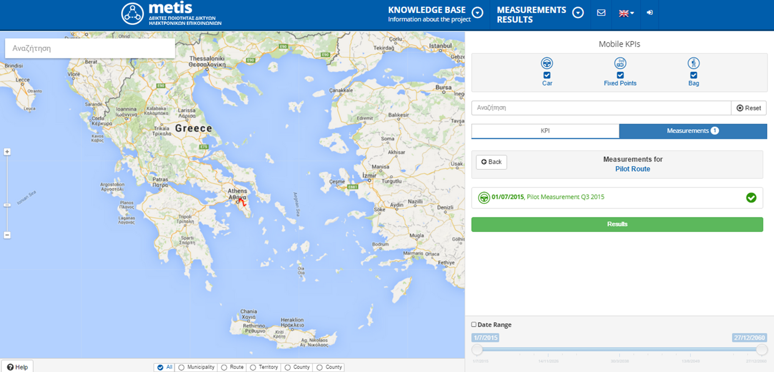
Monitoring System: Metis Portal

Slide 17

Monitoring System benefits (1/4)
QoS & QoE monitoring system
Investors

Slide 18
Monitoring System benefits (2/4)
The benefits for the consumers are:
Objective information on the quality of in-use electronic services offered by their providers
Possibility of objective comparison between service providers
Possibility of combining the aforementioned points with geographical criteria
Objective information on the quality of customer service of all service providers regardless of technology

Slide 19
Monitoring System benefits (3/4)
The benefits for investors are:
An objective point of view about the size, extent and potential of electronic communications networks per provider and technology
Information on the level of quality of electronic services in the whole Greek Territory
Information about the dynamic of the market of electronic communications as a sector of economic development

Slide 20
Monitoring System benefits (4/4)
The benefits for EETT are:
Transparency in the providers control data in accordance with the terms of licenses per technology
Encouraging competition and broadband promotion due to the publication of quality indicators
Additional control mechanism

Slide 21
Future work (1/4)
The future work of EETT as an NRA concerns:
The legislative framework
Technical issues of QoS & QoE parameters of mobile networks
Technical issues of QoS & QoE parameters of fixed networks

Slide 22
Future work (2/4)
Legislative framework
The objectives to be fulfilled by the new legislative framework are the following:
1. Fast adaptation of the KPI’s of new technological developments which introduce new communication services
2. An accurate and quick response to new needs in measuring equipment (hardware & software)
3. Easy adjustment to the information needs of end users

Slide 23
Future work (3/4)
Technical issues of QoS & QoE parameters of mobile networks
Include crowd sourcing measurements
Different end users profile

Slide 24
Future work (4/4)
Technical issues of QoS & QoE parameters of fixed networks
Include crowd sourcing measurements
Measurement probes in end user site

