Slide 1

Quality of Service (QoS), Quality of Experience (QoE) and Performance
ITU Workshop on
“Performance, Quality of Service and Quality of Experience of
Emerging Networks and Services”
(Athens, Greece 7-8 September 2015)
Joachim Pomy
Consultant@joachimpomy.de
OPTICOM, Germany
Notes:
1

Slide 2
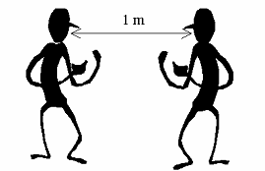
Where it All Begins:
Real Communication Situation

Slide 3
... and where End-to-End Quality comes to Play:
Employing a Telecommunication System
... I want to speak now !
... can you hear me ?

Slide 4
Definitions start here: ITU-T Rec. E.800
Network Performance (NP)
  Pre-requisite to Quality of Service (QoS)
  Not directly visible to the user
Quality of Service (QoS)
  Performance of the Service offered to the User
  Some QoS Aspects directly perceivable, some indirectly
Network Performance
Charging Performance
Provisioning Performance
Administration Performance
Availability Performance
Transmission Performance
Quality of Service
Service Support Performance
Service Operability Performance
Serveability
Service Security Performance

Slide 5
Four Viewpoints of QoS
Consistent Approach to QoS
  Well-defined and Relevant (e.g. Customer-affecting)
  Used to Plan and Deploy Networks
  Includes Monitoring Service Quality
ITU-T Rec. G.1000 defines four Viewpoints of QoS
  Customer's QoS Rrequirements
  Service provider's offerings of QoS (or targeted QoS)
  QoS achieved or delivered
  Customer survey ratings of QoS
Ideally there would be 1:1 Correspondence between Delivered QoS and Perceived QoS

Slide 6
4 Viewpoints of QoS

Slide 7
ITU-T Rec. G.101
The Transmission Plan
  Fundamental principles of transmission planning
  A good transmission plan is set up in order to deliver to users signals that are at a desirable level and free from objectionable amounts of delay, echo and distortion
  Has to take into account transmission parameters and impairments, different network configurations and elements
  Specific transmission plans have to be set up in order to take care of specific transmission impairments and conditions for
    traditional narrow-band telephone networks
    mobile networks
    packet switched networks
    multimedia applications

Slide 8
Traditional Transmission Planning

Slide 9
Transmission Planning Today
ITU-T Rec. G.108: Transmission Planning with the E-Model
Traditional transmission planning methodologies no longer flexible enough to account for new factors

Slide 10
Transmission Planning Challenges - 1
  Multinational networks require planning which takes into account regional differences in loss plan requirements and inter-network transmission plans
  Due to liberalization of the telecommunication markets (e.g. in Europe) there are no longer laid down ranges of values for transmission parameters by regulation
  The changing scenario in the public network operator domain is impacting transmission performance

Slide 11
Transmission Planning Challenges - 2
  G.108 is applicable to the use of new technology within the networks, including wireless (cordless or mobile), IP transmission etc.
  G.108 provides planning methods and contains necessary information and tools which will enable the planner to design the network transmission plan
  Guidelines and planning examples are based on the use of the E-Model

Slide 12
E-Model - ITU-T Rec. G.107
Computational model for use in transmission planning
Assessing the combined effects of variations in several transmission parameters that affect conversational quality of 3.1 kHz handset telephony
Covers also packet loss
For many combinations of high importance to transmission planners, the E-model can be used with confidence
Caution must be exercised when using the E-model for some conditions

Slide 13
Reference connection of the E-model

Slide 14
Effects of Talker Echo in the Presence of Delay
100
90
80
no Talker Echo
TELR=65 dB
E-Model Rating R
TELR=55 dB
TELR=45 dB
70
TELR=35 dB
TELR=25 dB
60
50
0
50
100
150
200
250
300
350
400
450
500
Mouth-to-Ear-Delay / ms

Slide 15
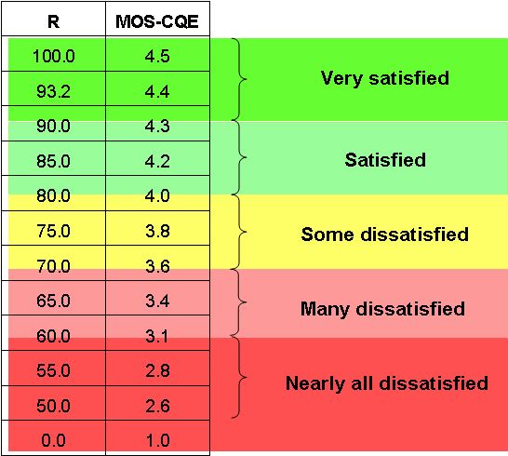
Categories of Communication Quality in Terms of Users' Satisfaction Classes
Voice Quality Continuum

Slide 16
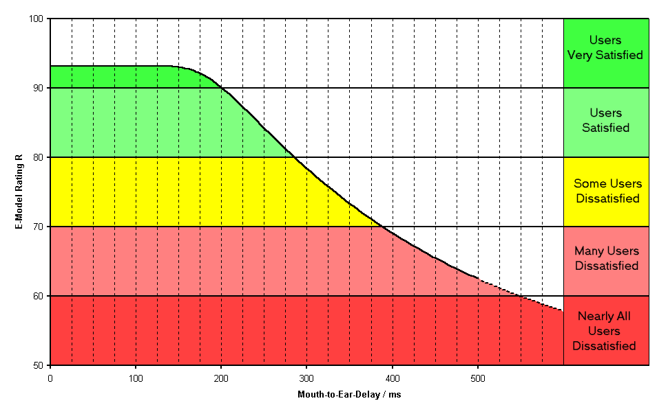
Example with Delay as Impairment

Slide 17
QoE Definition
ITU-T Rec. G.100 / P.10 defines
  Quality of Experience (QoE): The overall acceptability of an application or service, as perceived subjectively by the end-user.
  NOTE 1 – Quality of experience includes the complete end-to-end system effects (client, terminal, network, services infrastructure, etc.).
  NOTE 2 – Overall acceptability may be influenced by user expectations and context.
under review !

Slide 18
QoE Implications
QoE includes „everything“
  Many aspects out of control of Operators
  Includes Terminal Aspects
  Conext and Environment of the User
Proper QoS and NP
  Technical pre-requisites
  For achieving desired QoE

Slide 19
Users‘ Perception of Speech Quality
Sound Quality &
Naturalness
Intellegibility
Speech
Individual
Charakteristic
Perception
Speech
(Transmission) Quality
Listening & Talking
Efforts
Conversational
Efforts
Environmental
Network
Conditions
Doubletalk
Capability
Expectation
Conditions
...
Backgroundnoise
Transmission
...

Slide 20
Motivation for Multimedia Quality - 1
Quality as perceived by the User
  A Promotional Factor for the Market
User compares Quality of New Telecommunication Services
  With Quality experienced in the Past
  With other Telecommunication Service offers
  With Quality experienced for Entertainment Services

Slide 21
Motivation for Multimedia Quality
Individual Quality Threshold
  Users try new Service only few times ( ~ 3x … 5x )
  If Quality below Indivdual Threshold Users give up
  e.g. Download of a Website takes too long
    User remembers this experience
    Will try a few times and conclude this as Static Effect:
    "This website is not useable - let's try the Offer of the Competitor…"

Slide 22
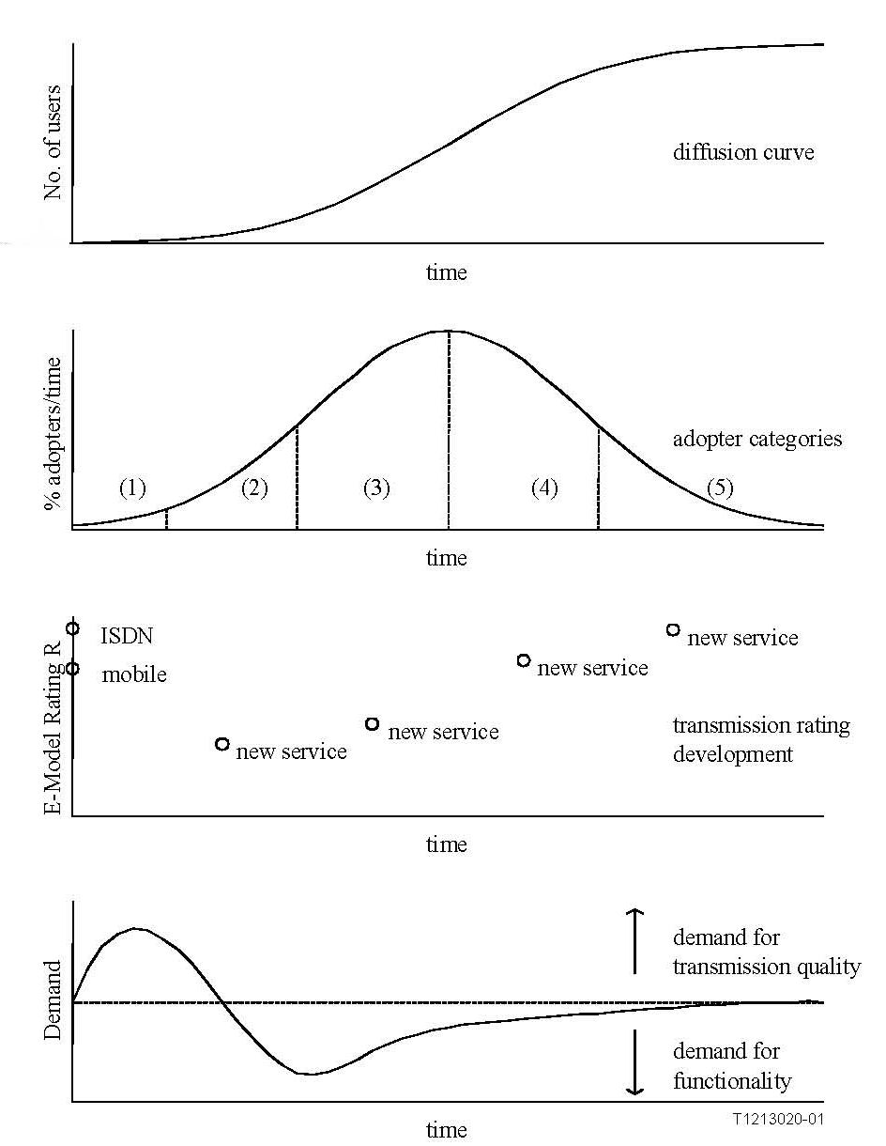
Diffusion, Transmission Quality and Expectation for an Innovation
Diffusion Theory generally accepted for describing Consumer Behaviour on the Introduction of an Innovation or New Service
Number of Users develops in S‑shaped Curve
5 Classes of Users:
  (1) Innovators
  (2) Early Adaptors
  (3) Early Majority
  (4) Late Majority
  (5) Laggards
Trade-off between Transmission Quality and New Functionality

Slide 23
Changes in Users' Behaviour - 1
Users tend to be much more reluctant to accept lower quality
  This is quoted frequently
    True for some sorts of social calls
    Definitively NOT true for sensible business calls
  Does it help network operators when defining QoS for their network ?
    High quality has to be provided when demanded by business customers or other sensible clients
    But the distribution of quality acceptance over time and areas cannot be matched with the occurrence of impairments in the network
  Not really useful for designing networks
23
Notes:
23

Slide 24
Changes in Users' Behaviour - 2
Users switch between different communication devices
  Wireline, wireless, PC, PDA etc
  Depending on place, task, purpose
    And depending on QUALITY
24
Notes:
24

Slide 25
Key Parameters affecting MM Quality
Media Distortion
End-to-End Delay
Echo Effects
Information Loss
Background Noise Distortion
Loss of Synchronization between Media Streams

Slide 26
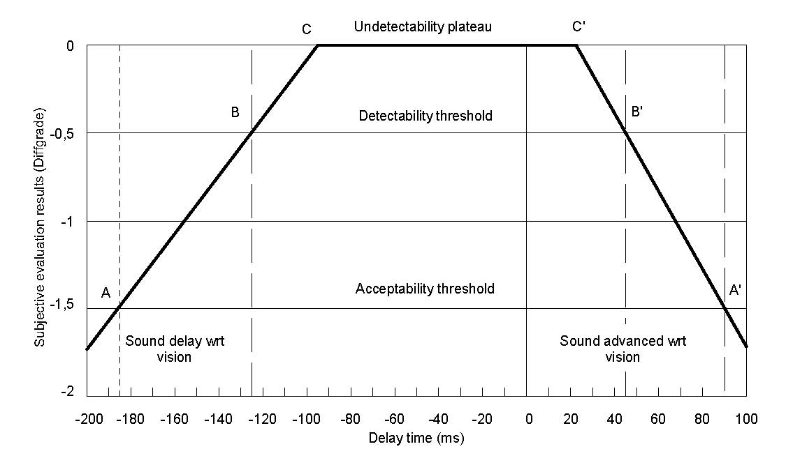
Example: Lip Sync

Slide 27
Impairments in packet networks
Distinction between Effects
  that occur in the Network and
  Mechanisms in the Terminals that are affected
Terminals can be used to correct for the Effects in the Network
Remaining Issues are:
  End-to-End Delay is increased when compensating for other Effects
  Loss of Information can be Concealed but Not Recovered

Slide 28
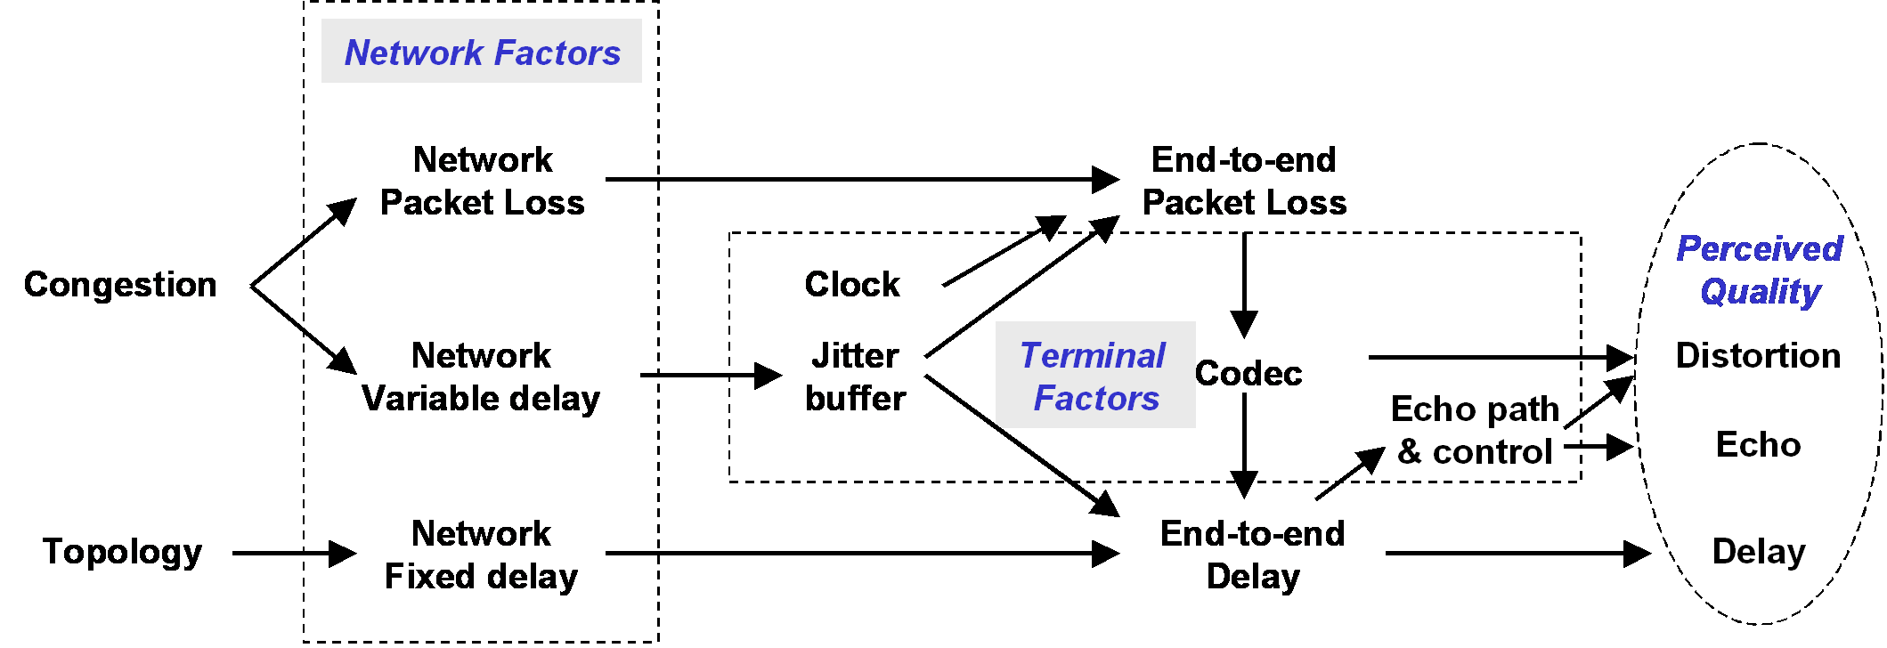
Impairments in packet networks

Slide 29
QoS Layers in Mobile
QoS model for mobile has four layers.
First layer is the Network Availability
  defines QoS rather from the viewpoint of the service provider than the service user
Second layer is the Network Access
  from user's point of view basic requirement for all the other QoS aspects and parameters
Third layer contains other QoS aspects
  Service Access, Service Integrity & Service Retainability
Different services are located in the fourth layer
  Their outcome are the QoS parameters as perceived by the user

Slide 30
QoS aspects of Mobile

Slide 31
POLQA™ - Rec. P.863
The limitations of existing standards that are now addressed by POLQA
  CDMA
  Chinese 3G TD-SCDMA
POLQA offers immediate, strong support for testing of new wideband 4G/LTE networks delivering HD-quality voice services
Tests carried out during the POLQA evaluation included future technologies such as
  Unified Communications
  Next Gen Networks
  4G/LTE
  HD Voice, i.e. "wide-band" and "super-wide-band"
See POLQA: The Next Generation in Voice Quality Testing http://www.polqa.info

Slide 32
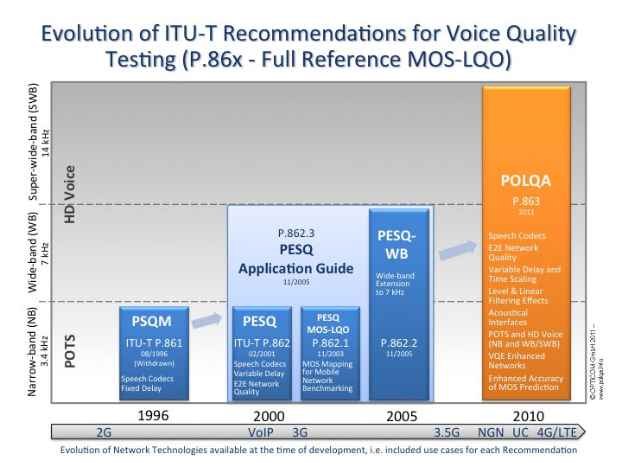
Notes:
32

Slide 33
Performance Validation
The ITU has validated POLQA on:
Languages included in the POLQA validation:
  47000 file pairs across
  64 subjective experiments
  American English and British English
  Chinese (Mandarin),
  Czech,
  Dutch,
  French,
  German
  Swiss German
  Italian,
  Japanese,
  Swedish
POLQA Introduction - (c) OPTICOM GmbH 2010
33
Notes:
TNO Meeting, Delft, 01.09.2005
(c) OPTICOM 2005 - C O N F I D E N T I A L
33

Slide 34
Confidence Intervalls for Different Sample Sizes (1)
Effect of different sample sizes in a measurement campaign
  based on the Pearson-Clopper formulas for calculation of confidence intervals
  valid in a generic way and even for small sample sizes
  for higher sample numbers, the calculation of confidence intervals based on the approximation of a normal distribution can be applied
  Three different graphs are depicted: Sample sizes in the range:
    between 100 and 1 100 samples;
    between 1 100 and 2 100 samples; and
    between 1 000 and 11 000 samples.

Slide 35
Confidence Intervalls for Different Sample Sizes (2)

Slide 36
Confidence Intervalls for Different Sample Sizes (3)

Slide 37
Confidence Intervalls for Different Sample Sizes (4)

Slide 38
KPIs based on Network Counters
Vendor specific = network internal KPIs
  different strategies
    how to count network events
    which events are included in which counter(s)
Requires knowledge of specific system
  specialists with detailed system knowledge
  testing the counters
    documentation may be faulty
    approach to counter change with system update
Mobile operators struggling with this
  most operator live in a multi vendor environment
  counters from different vendors cannot be directly compared
  requires continous attention and a strategy

Slide 39
KPIs from Users' Perspective = KQIs
Key Quality Indicators (KQIs) = external indicators
  can be assessed in the Field
For Monitoring, Regulation etc.
  a subset can be selected
    applicable across all vendors & operators
    not limited to mobile, but also good for broadband

Slide 40
KPIs versus KQIs
Sometimes confused
  KPIs = internal indicators
    part of network performance
    based on network counters
    essential for operation, maintenance, business model
    could be reported, audited etc.
    however, meaningless when out of context
  KQIs = external indicators
    basis for QoS assessment as perceived by the user
    vendor independant
    operator independant
    ideal to compare different operators on a statistical basis
    cannot be reported from the system itself
    requires some kind of field testing, drive, walk etc.

Slide 41
Any questions ?
Contact:
Consultant@joachimpomy.de

