Slide 1
ITU Workshop on “Quality of Service and
Quality of Experience of Multimedia Services in Emerging Networks”
(Istanbul, Turkey, 9-11 February 2015)
QUALITY PARAMETERS of FIXED TELEPHONE SERVICES in TURKEY and BENCHMARK STUDIES
Mustafa ALANOĞLU,
Senior Expert, Türk Telekom
mustafa.alanoglu@turktelekom.com.tr

Slide 2
QUALITY PARAMETERS OF FIXED TELEPHONE SERVICES
Service Quality Criterion | Related Measure | Measured Value | Target Value
Supply Time for the initial connection | The times by which the fastest 95% requests are completed | Day/s | ≤ 6
Faults Rate Per Access Line | Ratio of valid fault reports over total number of subscriber lines | % | ≤ 2,2
Faults Repair Time | The time by which the fastest 95% of valid faults on access lines are repaired | Hour/s | ≤ 90
Faults Repair Time for persons with disabilities | The time by which the fastest 95% of valid faults on access lines are repaired | Hour/s | ≤ 48
Unsuccessful Call Ratio | Unsuccessful call ratio in national calls | % | ≤ 1,5
 | Unsuccessful call ratio in international calls | % | ≤ 2,5
Call Set Up Time | The mean value in seconds for national call | Sec/s | ≤ 3
 | The mean value in seconds for international calls | Sec/s | ≤ 7
Proportion of Available Public Pay phones | Proportion of available public pay phones to all public pay phones | % | ≥ 95
Bill Complaints Ratio | Ratio of the bill complaints over the total number of bills | % | ≤ 1

Slide 3


SUPPLY TIME FOR THE INITIAL CONNECTION ≤ 6 Days
(Included)
(Excluded)
A new access line
Taken over by another customer
An additional access line
The renewal of the technology
Cancelled requests
The number of transfer requests
Agreement for some time in the future
Inadequate infrastructure
Transfer of subscription requests
The instant of a valid service order being received by a service provider
The instant a working service is made available to use
Includes official holidays
Starts with beginning of sign of a contract
Each requested service separately

Slide 4







Supply Time for the initial connection – Benchmark of Target Values*
5 Days, %95
14 Days, %95
32 Days, %99
21 Days, %95
43 Days, %99
1 week, %80
4 weeks, %95
12 weeks, %99
30 Days, %95
70 Days, %99
60 Days, %99
6 Days, %95
* Study of ETNO NANI (Naming, Addressing and Numbering Issues) Working Group, 2013 May

Slide 5
FAULTS RATE PER ACCESS LINE ≤ %2,2
Calculated faults must be in the responsibility of the operator
Reported Valid Faults
Faults due to customer responsibilities are excluded
Received Fault reports should be counted rather than the number of lines affected
Total number of subscriber lines
Total used subscriber lines at the end of the measuring period

Slide 6
Faults Rate Per Access Line– Benchmark of Target Values*
% 7,5
% 12,9
% 10
% 13,5
% 20
% 4
% 2,2
* Study of ETNO NANI Working Group, 2013 May

Slide 7



FAULTS REPAIR TIME ≤ 90 Hours
(Excluded)
The cases that have an appointment in a future date
When the subscriber is absent in the agreed time
Special agreement including a specific fault repair time
Faults in responsibility of subscribers
The instant when a fault has been notified by the customer
The instant when the service has been restored and is ready to use

Slide 8
Faults Repair Time – Benchmark of Target Values*
35 hours, %80
40 hours, %95
60 hours, %99
47 hours, %80
125 hours, %95
Acc. Net.
72 h, %80
165 h,%95
Others
47 h, %99
108 h, %95
36 hours, %70
72 hours, %85
144 hours, %95
Acc. Net.
30 h, %80
96 h,%95
Others
24 h, %99
36 h, %95
48 hours, %95
90 hours, %95
* Study of ETNO NANI Working Group, 2013 May

Slide 9
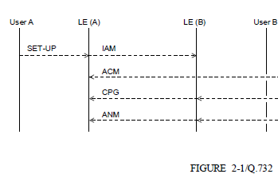

UNSUCCESSFUL CALL RATIO ≤ %1,5 / %2,5
Unsuccessful calls
Total number of call attempts
Is a call attempt to a valid number, which calling party can’t take
Neither busy tone
Nor ringing tone
Nor answer signal
within 30 seconds
The scarcity of resources of radio link, transmission, switching etc.
Unsuccessful Call

Slide 10
Unsuccessful Call Ratio – Benchmark of Target Values*
N/A
N/A
N/A
N/A
Int’l; %6
Nat’l ; %4
Int’l; %2
Nat’l ; %1
Int’l; %2,5
Nat’l ; %1,5
* Study of ETNO NANI Working Group, 2013 May

Slide 11


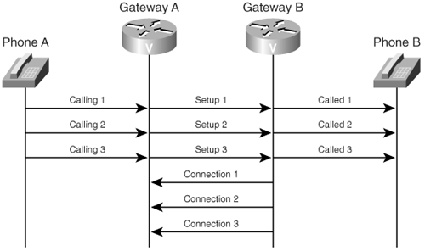
CALL SET UP TIME ≤ 3 / 7 Second
Starts when the address information required for setting up a call is received by calling network
Finishes when
busy tone or
ringing tone or
answer signal
is received by the calling party

Slide 12
Call Set Up Time – Benchmark of Target Values*
N/A
N/A
N/A
N/A
Int’l; 5 sec
Nat’l ; 3 sec
Int’l; 9 sec
Nat’l ; 2 sec
Int’l; 7 sec
Nat’l; 3 sec
* Study of ETNO NANI Working Group, 2013 May

Slide 13
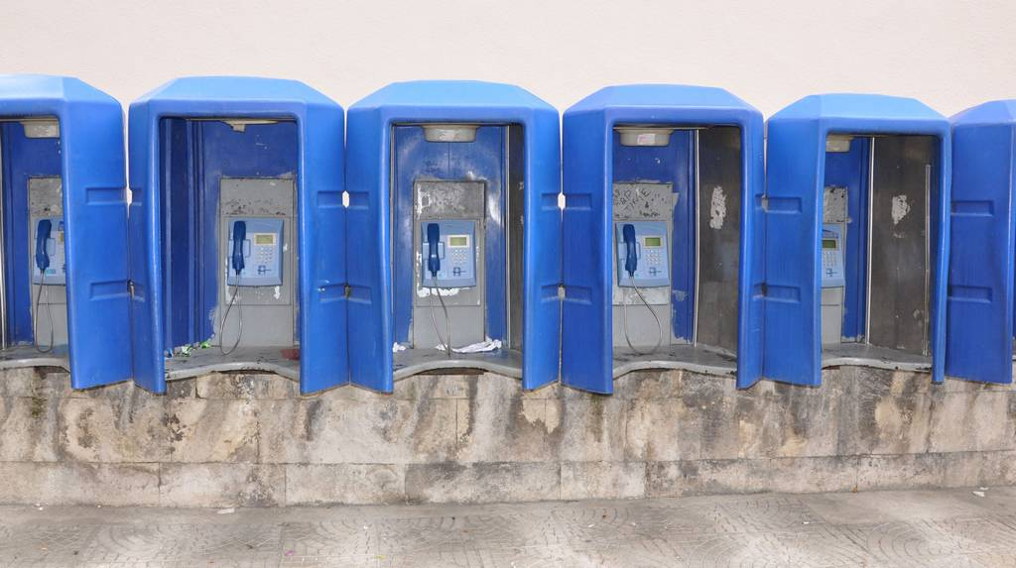
PROPORTION OF AVAILABLE PUBLIC PAY PHONES ≥ %95
Available Public Pay Phones
Total number of pay phones
Available means that;
Public pay phones can be used at any time (from 00:00 to 23:59)
Example; If a public pay phone
has a failure at 23:59
then it is repaired at 00:01 (just 2 minutes later)
this public pay phone should be accepted as not working for 2 days

Slide 14
Proportion Of Available Public Pay Phones– Benchmark of Target Values*
N/A
% 96
% 96
% 93
% 92
N/A
% 95
* Study of ETNO NANI Working Group, 2013 May

Slide 15

BILL COMPLAINTS RATIO ≤ %1
Regardless of the validity of the complaint (all billing complaints )
Regardless of the dates of calls or any other occurrences
Bill inquiries and failure notifications are excluded
All bill complaints
Total number bills

Slide 16
Bill Complaints Ratio– Benchmark of Target Values*
% 1
Disputable bills; %2,7
Billing Faults, %0,5
For just billing mistakes,
% 0,04
% 0,2
% 1
% 0,5
% 1
* Study of ETNO NANI Working Group, 2013 May

Slide 17
DO WE NEED ANY ADDITIONAL PARAMETER?
Around 15 per cent of the world's population, or estimated 1 billion people, live with disabilities.
They are the world's largest minority
Is it enough to only discount the prices of tariffs for persons with disabilities (pwd)?
What about Quality of Service?
*http://whqlibdoc.who.int/publications/2011/9789240685215_eng.pdf?ua=1

Slide 18


FAULT REPAIR TIME FOR PERSONS WITH DISABILITES
Target value of Fault repair time for other people ≤90 hours
BUT
48 hours for the persons with disabilities.
Telecommunication services are much more important for the people with disabilities since it may be the only way of communication for them
Thus, we may accept that solving
the problems of the persons with disabilities = emergency calls
The persons with disabilities at least the ratio of %40 (it is needed to be certified)
THAT MUST BE A RECOMMENDATION / STANDARD, OR NOT ?

Slide 19

Thanks
COMMENTS & Questions?

