Slide 1
ITU Workshop on “Quality of Service and
Quality of Experience of Multimedia Services in Emerging Networks”
(Istanbul, Turkey, 9-11 February 2015)
QoS FRAMEWORKS AND MODELS FOR NOWADAYS NETWORKS AND SERVICES
Eva Ibarrola
Associate Professor, UPV-EHU
eva.ibarrola@ehu.es

Slide 2
Outline
Introduction
Background
QoS and Standards
ITU-T G.1000 QoS Framework
Challenges
Conclusions

Slide 3

Introduction
Quality
Telecom sector
New applications and services
Deregulation of the market
Complex and competitive scenario
Evolution to NGN
QoS major role
Novel QoS frameworks required!

Slide 4
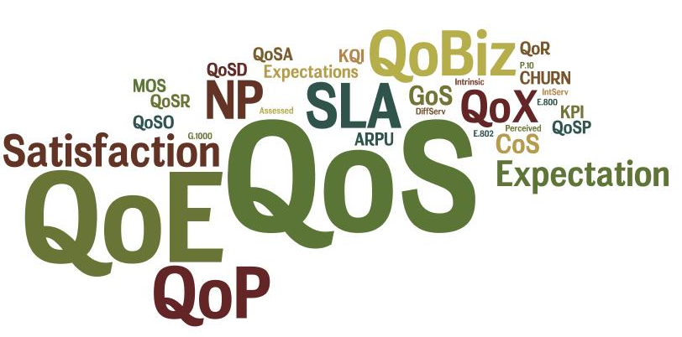








Background
QoS concept evolution
User’s point of view integration
More complex analysis needed!

Slide 5




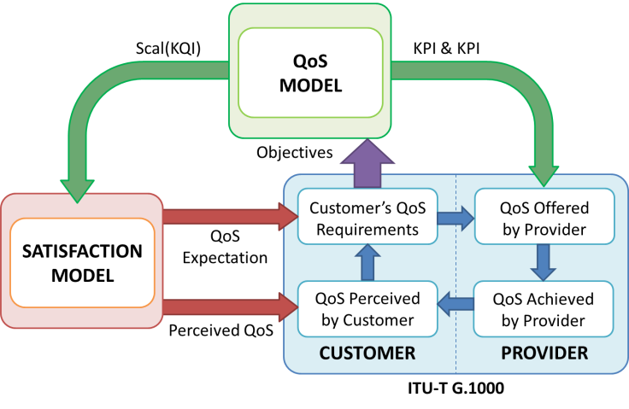

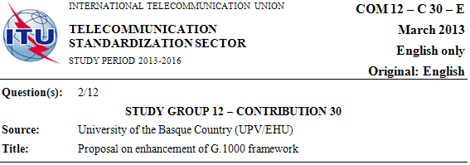

QoS and Standards
Standardization bodies are aware of the new QoS dimension
QoS standards updated

Slide 6
ITU-T G.1000 QoS Framework
Four points of view
Meaningful to everyone
Regulator’s approach
Internet QoS regulation:
  A key issue
Difficult to deploy
  Methodology needed!
USER
PROVIDER
Customer´s
QoS
Requirements
QoS Offered
by Provider
QoS Perceived
by Customer
QoS Delivered
by Provider

Slide 7
G.1000 & Internet QoS Regulation
Different approaches for each NRA
USER
PROVIDER
Customer´s
QoS
Requirements
Customer´s
QoS
Requirements
QoS offered
by provider
QoS Offered
by Provider
Effective Regulation
of QoS
Spain
U.K.
Portugal
India
QoS perceived by customer
QoS achieved
by provider
Colombia
QoS Perceived
by Customer
QoS Delivered
by Provider
ITU-T QoS FRAMEWORK

Slide 8
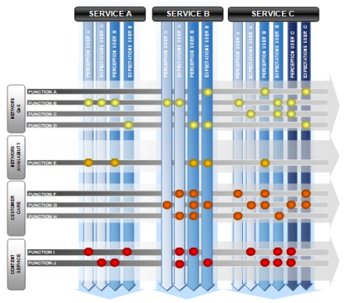
G.1000 model proposal
Satisfaction Model
Framework
CUSTOMER
SERVICE
PROVIDER
Expectation
Customer's Expectation
Customer's QoS
Requirements
QoR
QoS Offered
by Provider
QoO
Expectation
Update
Customer's
Satisfaction
Disconformation
QoS Perceived
by Customer
QoP
QoS Delivered
by Provider
QoS
Customer's Perception
ITU-T G.1000
Methodology
Scal (KQI)
Four Market Model
Performance Model
Universal Model
ACF Model
CSAT Model
QoS Model
E.802 E.803

Slide 9
Challenges
More complex analysis (new QoS dimension)
Novel or updated QoS Multilayer Framework meaningful for users, regulators & providers
New QoS models and methodologies needed to deploy QoS frameworks in real scenarios

Slide 10








Challenge 1:
QoS, QoE, QoX???
A new concept that will embrace the different QoS-related aspects (QoX??)

Slide 11

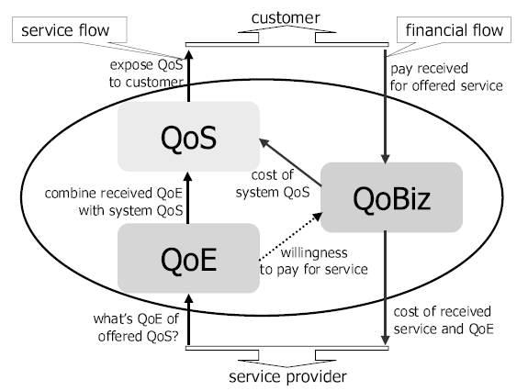


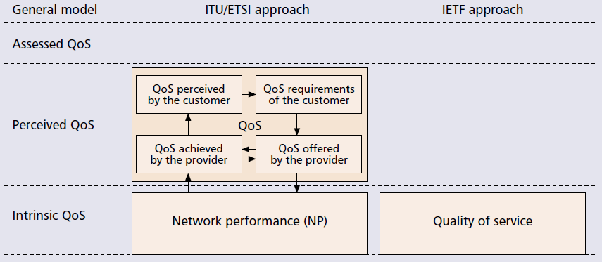
Challenge 2:
Novel Multilayer QoS framework
Stratification of the different aspects of QoS

Slide 12
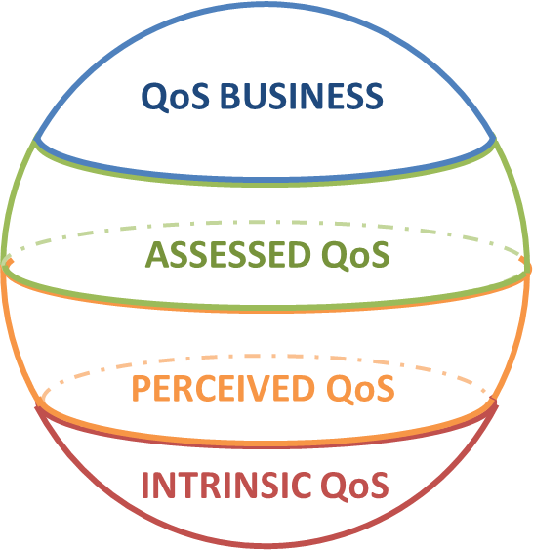


Challenge 3:
New QoS models and methodologies
Interrelations and intra-relations between different layers
  Example:

Slide 13
Intrinsic QoS
Analysis of the objective QoS
  Grade of Service (GoS)
  Class of Service (CoS)
  Network Performance (NP)
G.1010
Y.1540
Y.1541
Y.1542
NP
CoS
INTRINSIC QoS
GoS

Slide 14
Perceived QoS
Based on G.1000 QoS framework
  QoSR, QoSO, QoSD, QoP
Scal (KQI)
QoS Model
KQI & KPI
Objetives
QoP
QoSR
QoS
Required
QoRS
QoS Offered
QoSO
Assessed QoS
QoSR
QoSD
QoSO
ITU-T G.1000
QoP
QoS Perceived
QoP
QoS Delivered
QoSD
PERCEIVED QoS
User
Provider

Slide 15
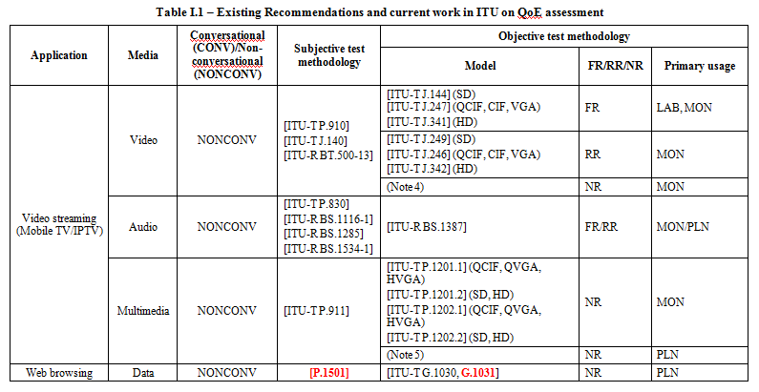
Assessed QoS
G.1011 (2013)

Slide 16
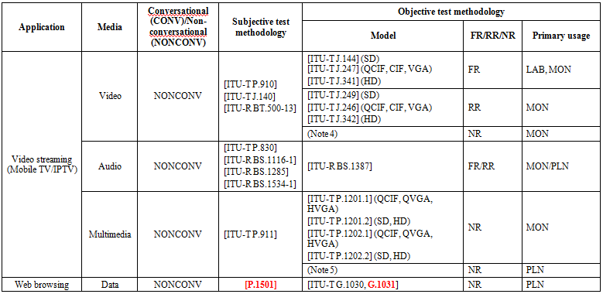
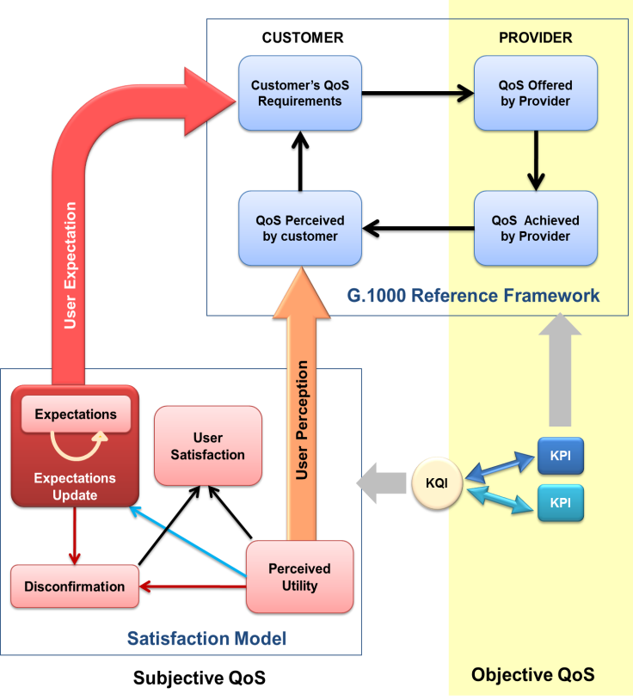
Assessed QoS (II)
Effect on user satisfaction
  QoS Experienced (QoE)
  User’s Satisfaction (SAT)
  User Provider Selection (UPS)
  User’s Expectation (EXP)
SAT
UPS
ASSESSED QoS
QoE
EXP

Slide 17
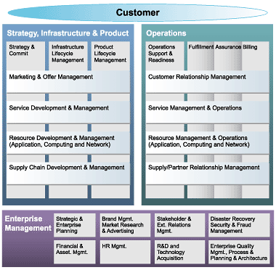
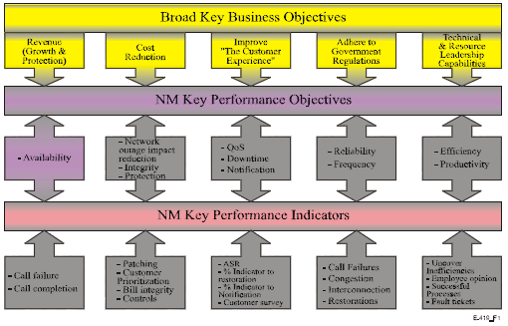
Business QoS
M.3050 & E.419
Analysis of provider’s profitability
  QoS Experienced (QoE)
  User’s Satisfaction (SAT)
  Churn & ARPU
  User’s Expectation (EXP)
ARPU
QoBIZ
CHURN
QoBiz

Slide 18
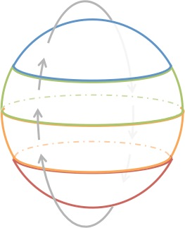
QoS Multilayer Dynamic Behavior
CUSTOMER
FIDELITY
ARPU
ARPU
CHURN
CHURN
QoBiz
QoBiz
ADV
ADV
SAT
SAT
UPS
UPS
QoE
QoE
EXP
EXP
QoP
QoP
QoSR
QoSR
QoSD
QoSD
QoSO
QoSO
GoS
GoS
NP
CoS
NP
CoS
QoR
QoR

Slide 19
Conclusions
Novel QoS multilayer framework needed
  Based on ITU-T G.1000 Framework (Internet QoS regulation)
Embracing all the aspects of QoS (NP, QoE..)
General purpose:
  User’s satisfaction
  Provider’s profitability
  Network operator’s performance

Slide 20
CfParticipation: Open Work Items
SG-12/Q.2 “Definitions, guides and frameworks related to QoS/QoE”
  Revision Rec. G.1000
    T13-SG12-C-0030
    T13-SG12-TD-0133
    T13-SG12-C-214
SG-11/Q.10 “Service and networks benchmarking measurements”
  Draft Q.QMS
    T13-SG11-C-0283
SG-11/Q.15”Testing as a service (TAAS)”
  Draft Q.Int_speed_test
  http://www.itu.int/en/ITU-T/C-I/Pages/IM/Internet-speed.aspx

Slide 21

Thank you!!
Any questions?

