Slide 1
ITU Workshop on “Quality of Service and
Quality of Experience of Multimedia Services in Emerging Networks”
(Istanbul, Turkey, 9-11 February 2015)
Overview of ITU-T Study Group 12
Recommendations on QoS and QoE
Joachim Pomy,
Senior Engineer, Opticom GmbH Germany
Consultant@joachimpomy.de
Notes:
1

Slide 2
SG 12 Recommendations
E.420-E.479, E.800-E.859
G.100-series, except G.160-, G.180- and G.190-series
G.1000-series
I.350-series (including Y.1501/G.820/I.351), I.371, I.378, I.381
P-series, except P.900-series
Y.1220-, Y.1530-, Y.1540-, Y.1560-series
http://www.itu.int/ITU-T/recommendations/index_sg.aspx?sg=12

Slide 3
Work Programme (1/8)
Coordination of QoS/performance studies
Communications Quality of Service: A framework and definitions
Vocabulary for performance and quality of service
Mean Opinion Score (MOS) terminology
Transmission characteristics for wideband digital handset and headset telephones - Inclusion of extended wideband terminals
Transmission characteristics for cordless and moblie digital terminals
Transmission characteristics for wideband digital loudspeaking and hands-free telephony terminals - Inclusion of extended wideband terminals
Technical requirements and test methods for the universal wired headset or headphone interface of digital mobile terminals
Narrowband hands-free communication in motor vehicles
Wideband hands-free communication in motor vehicles

Slide 4
P.800.1 Relation between some MOS qualifiers

Slide 5
Work Programme (2/8)
User interface requirements for automotive applications
Subsystem requirements for automotive speech services
Artificial ears
Calculation of loudness ratings for telephone sets
Use of head and torso simulator (HATS) for hands-free and handset terminal testing
Bone conduction testing setup
Multiple test positions setup
Setups and testing techniques for terminal performance measurements with background noise
Artificial voices
Speech processing devices for acoustic enhancement
Transmission characteristics and speech quality parameters of hands-free terminals

Slide 6
Typical development cycle for a car speakerphone hands-free system and applicability of clauses of Rec. P.1100

Slide 7
Work Programme (3/8)
Test signals for use in telephonometry
Objective test methods for speech communication systems using complex test signals
Methods for determining the ‘Objective Quality Number’ as overall quality value for terminals
Applicability of psycho-acoustic models to HATS based setups for the benefit of terminal testing
Setup signals for terminal with background noise
Subjective quality evaluation of telephone services based on spoken dialogue systems
Subjective performance of active signal processing devices
Cultural/language/nationality dependence of subjective quality
Subjective evaluation of generic sound activity detectors
Multidimensional scaling quality assessment
Subjective assessment methods for music quality of narrowband and wideband telephony

Slide 8
Rating scales used in ITU-T P.806 subjective testing methodology

Slide 9
Work Programme (4/8)
Test methodology for web browsing and browser based applications
Subjective usability evaluation of speech-based or multimodal interactive services
Q.7/12 defines test plans for tests of speech coders, and reports the test results and analysis
E-model extension for non-handset user interfaces
E-model extension for speech processing devices
E-model update for conversational quality features
Mixed-band and beyond-wideband E-model
E-model for monitoring
Operational quality estimator
Perceptual approaches for multi-dimensional analysis
Perceptual objective noise reduction

Slide 10
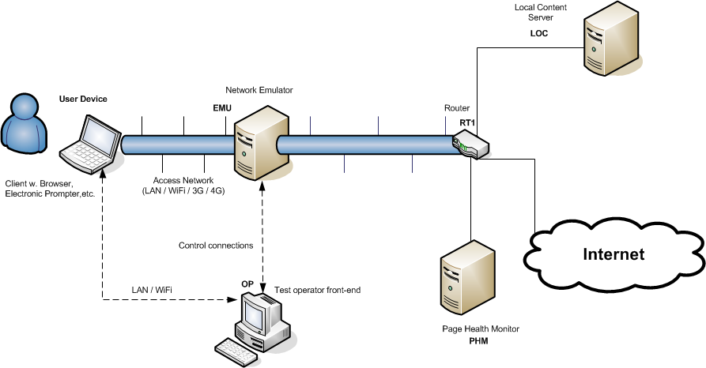
Test setup for Rec. P.1501 Quality of web browsing

Slide 11
Work Programme (5/8)
Perceptual Objective Prediction of Speech Intelligibility
No-reference models for quality prediction
Subjective method for simulated conversation tests addressing audio and audiovisual call quality
Effect of delays on the telemeeting quality
Use of auditory and visual cues for high-quality telemeetings
Overall telemeeting quality value (long term goal)
Quality implications and requirements for telemeeting and conferencing services
Spatial audio meetings quality evaluation
Frequent updates of Appendices
Quality of Experience aspects of Multi Connection
End-to-end QoE aspects of tandemmed speech processing devices

Slide 12
Rec. P.1301 Decision tree for Subjective quality evaluation of audio and audiovisual multiparty telemeetings

Slide 13
Work Programme (6/8)
End-to-end performance for managed voice over LTE networks This Recommendation describes the key aspects impacting end-to-end performance of managed voice applications over LTE networks.
Definitions and associated measurement methods for user-centric parameters for call handling in cellular mobile voice service
Mobile QoS
Supplement XX to ITU-T E.800-series Recommendations (Guidelines on Regulatory Aspects of QoS)
End-user multimedia QoS categories
Network model for evaluating multimedia transmission performance over Internet Protocol
Opinion model for video and audio streaming applications
QoE of Web-browsing
QoE requirements for multicast video streaming services
QoE requirements for telepresence services
Guidance for the use of P.1201 and P.1202 in operational contexts

Slide 14
Rec. G.1010 – Model for user-centric QoS categories

Slide 15
Work Programme (7/8)
QoE-diagnostic information from P.120X.Y type models on technical causes of QoE impairments
Integral index of quality for general service monitoring (per user-session); KQI definitions
Media-session QoE model (temporal pooling, long sequences; UDP- and TCP-based streaming)
Parametric non-intrusive assessment of audiovisual progressive download, considering stalling/re-buffering & quality integration
Parametric non-intrusive assessment of TCP-based multimedia streaming quality, considering adaptive streaming
In-service non-intrusive measurement device – Voice service measurements
Analysis and interpretation of INMD voice-service measurements
Conformance testing for voice over IP transmission quality assessment models
Conversational model
Framework for invoking diagnostic functions
Voice Service Diagnosis Framework

Slide 16
Rec. G.1029 - Voice Service Diagnosis Framework

Slide 17
Work Programme (8/8)
Technical cause analysis
Buffer models for development of client performance metrics
Hand-over performance among multiple access networks
Internet protocol data communication service – IP packet transfer and availability performance parameters
Network performance objectives for IP-based services
Measurements in IP networks for inter-domain performance assessment
Ethernet frame transfer and availability performance
Ethernet service activation test methodology
Home network performance parameters
Proposed Appendices for Y.1566 : QoS mapping and interworking between Ethernet, IP and MPLS

Slide 18
Cannot find your Topic ?
Work in ITU-T is contribution driven !
It is up to Y O U !!!!!
Next Meeting of Study Group 12
  5 – 14 May 2015 in
  Geneva (Switzerland)
  Deadline for Contributions
    22 April 2015
  http://www.itu.int/net/ITU-T/ddp/Default.aspx?groupid=T13-SG12

Slide 19

Any questions ?
Joachim Pomy
consultant@joachimpomy.de

